Slide 1
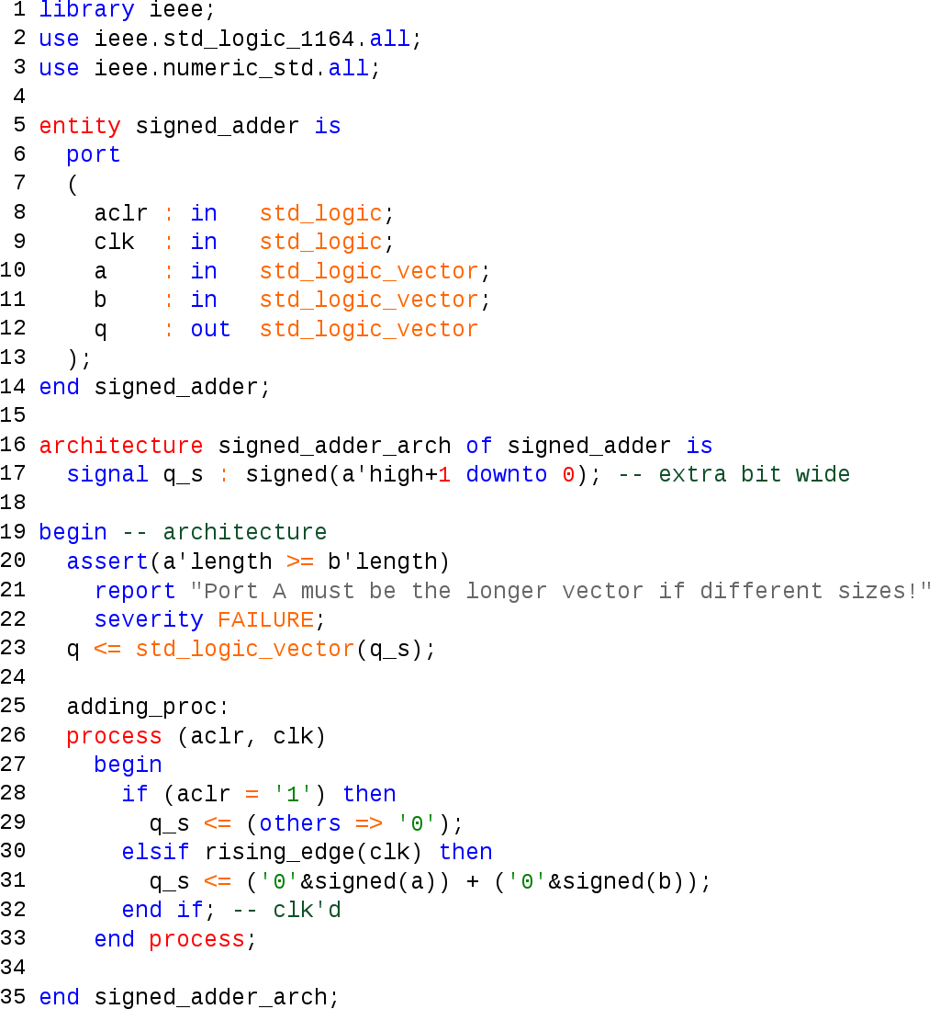
About Hardware Description Languages

Slide 2
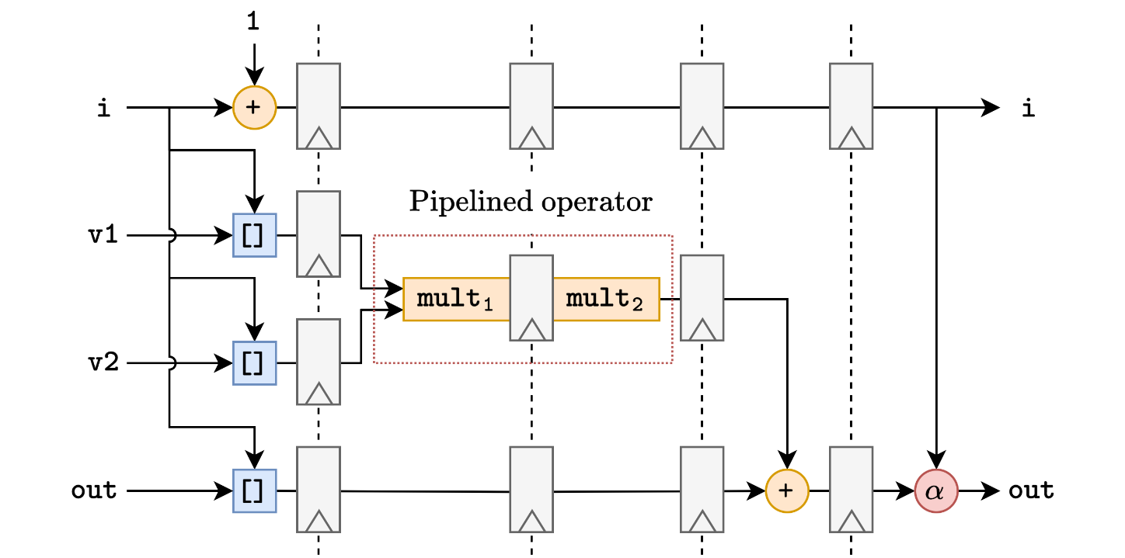
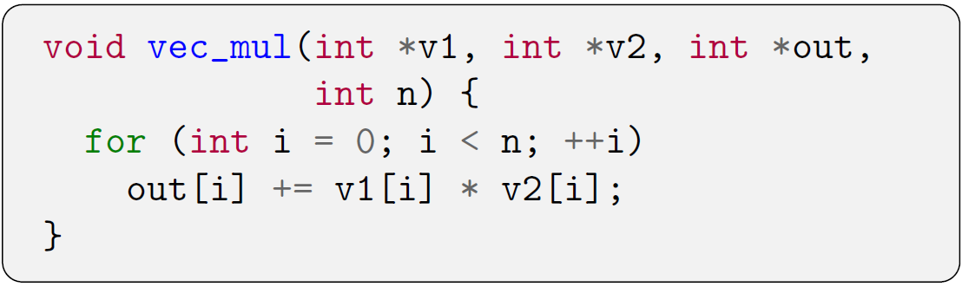
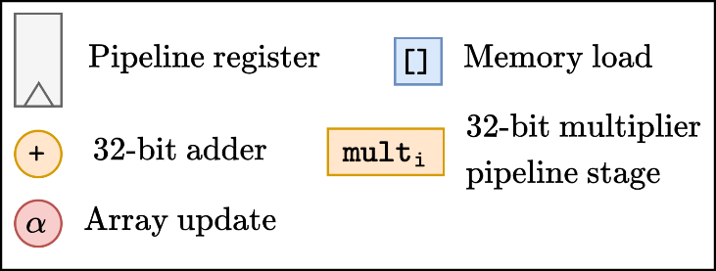
What is High-Level Synthesis (HLS)?
A simple example
HLS tool
The key step for HLS is operation scheduling

Slide 3
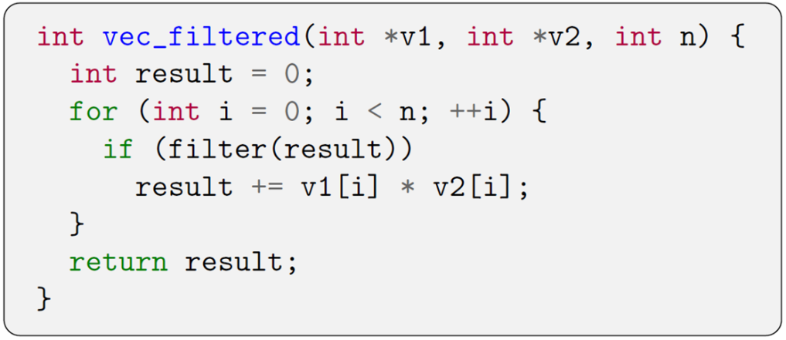
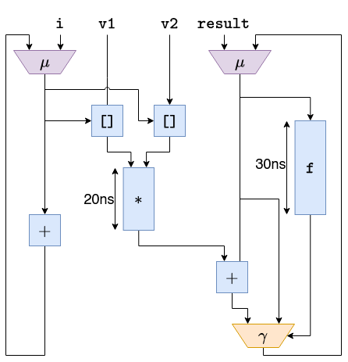
An overview of scheduling techniques
Tclk=10 ns

Slide 4
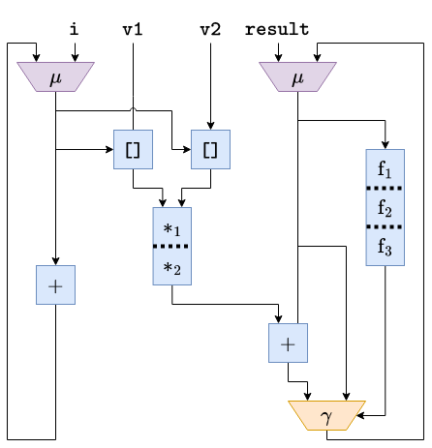
An overview of scheduling techniques

Slide 5
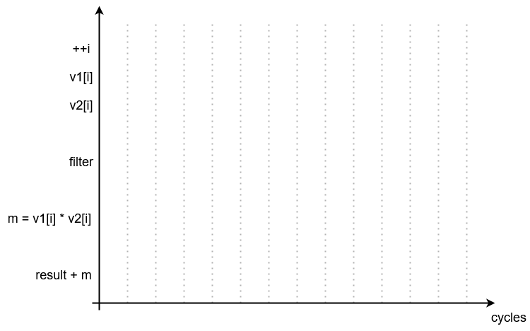
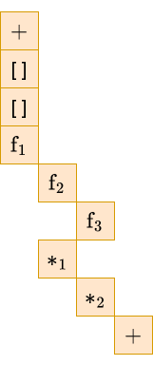
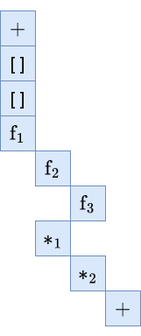
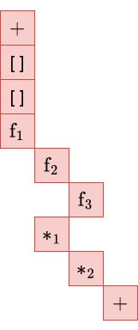
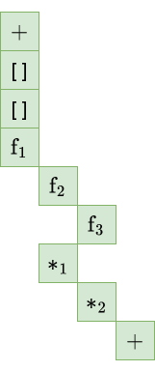
An overview of scheduling techniques
II=4 (Initiation Interval)
Static scheduling

Slide 6
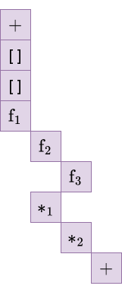
An overview of scheduling techniques
II=3
II=4
Dynamic scheduling

Slide 7



An overview of scheduling techniques
II=1
II=4
Speculative scheduling

Slide 8
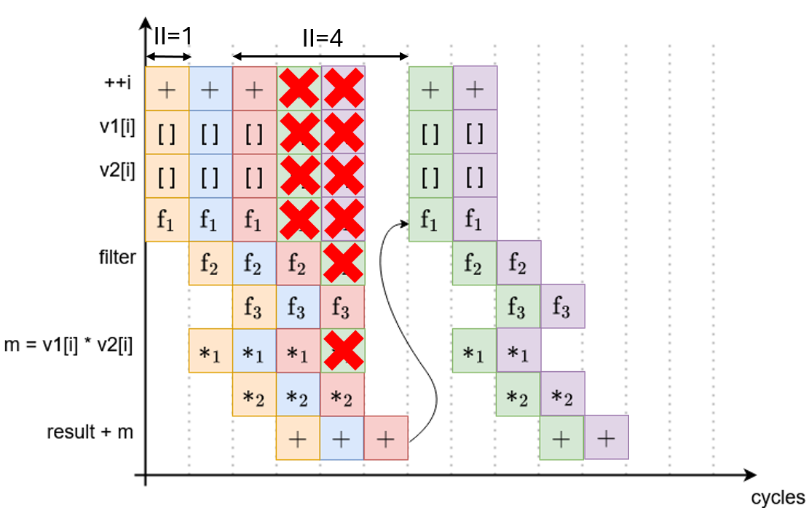
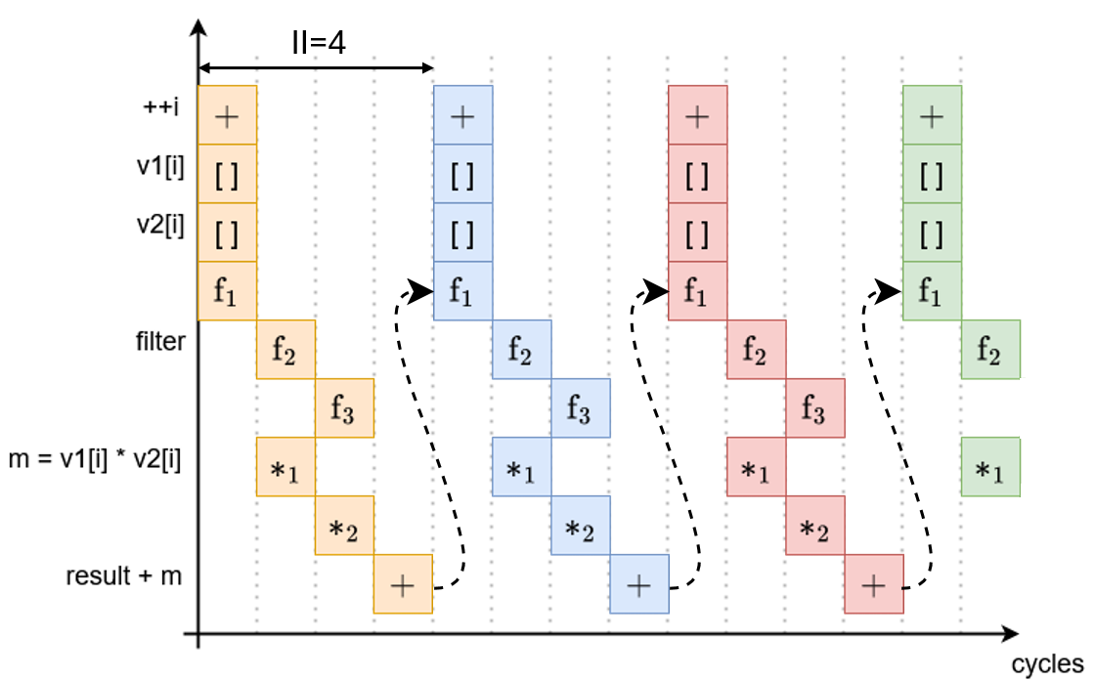
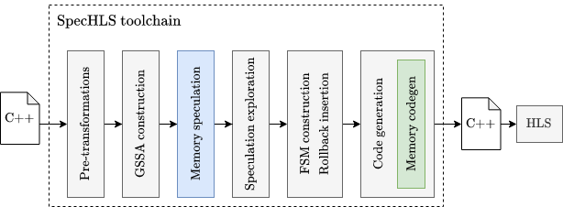
The SpecHLS compilation flow

Slide 9

What is UCLID?
Finite-state machine prover
not a Proof assistant
var i: integer;
init {
i = 0;
}
next {
i = i + 1;
}
invariant inv1: i >= 0;
invariant inv2: i == old(i) + 1;
Theorem plus_n_0 : forall n:nat, n+0 = n.
Proof.
intros n.
induction n as [|n' IH].
- (* 0 + 0 = 0 *)
reflexivity.
- (* S n' + 0 = S n' *)
simpl.
rewrite -> IH.
reflexivity.
Qed.

Slide 10
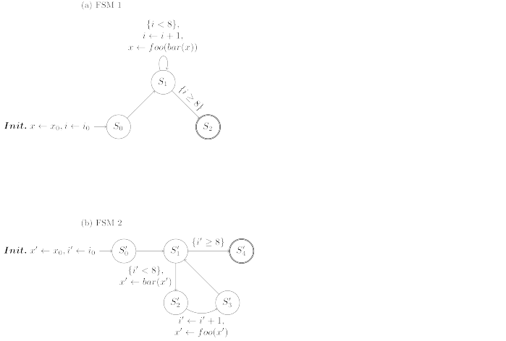
Static scheduling toy example (FSM 1)
Execution example, given:
@S0 -- i = 0, x = 5
@S1 -- i = 0, x = 5
@S1 -- i = 1, x = 8
@S1 -- i = 2, x = 14
@S1 -- i = 3, x = 26
@S1 -- i = 4, x = 50
@S1 -- i = 5, x = 98
@S1 -- i = 6, x = 194
@S1 -- i = 7, x = 386
@S1 -- i = 8, x = 770
@S2 -- i = 8, x = 770

Slide 11
Static scheduling toy example (FSM 2)
Execution example, given:
@S’0 -- i = 0, x = 5
@S’1 -- i = 0, x = 5
@S’2 -- i = 0, x = 4
@S’3 -- i = 1, x = 8
@S’1 -- i = 1, x = 8
@S’2 -- i = 1, x = 7
@S’3 -- i = 2, x = 14
@S’1 -- i = 2, x = 14
@S’2 -- i = 2, x = 13
@S’3 -- i = 3, x = 26
@S’1 -- i = 3, x = 26
@S’2 -- i = 3, x = 25
@S’3 -- i = 4, x = 50
@S’1 -- i = 4, x = 50
@S’2 -- i = 4, x = 49
@S’3 -- i = 5, x = 98
@S’1 -- i = 5, x = 98
@S’2 -- i = 5, x = 97
@S’3 -- i = 6, x = 194
@S’1 -- i = 6, x = 194
@S’2 -- i = 6, x = 193
@S’3 -- i = 7, x = 386
@S’1 -- i = 7, x = 386
@S’2 -- i = 7, x = 385
@S’3 -- i = 8, x = 770
@S’1 -- i = 8, x = 770
@S’4 -- i = 8, x = 770

Slide 12

Static scheduling toy example (Alg.)
x ← x0
i ← i0
While i < 8 do
i ← i + 1
x ← foo(bar(x))

Slide 13
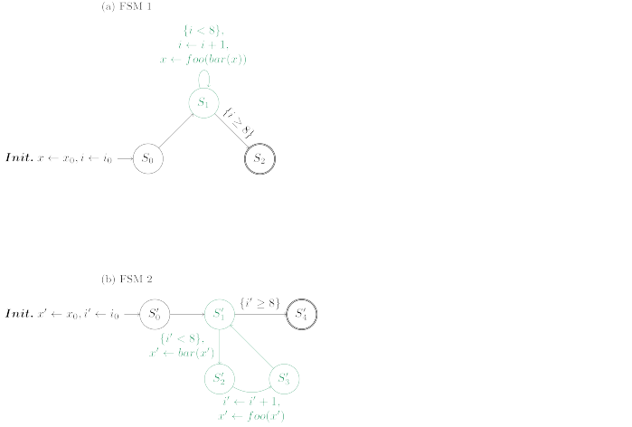
Static scheduling toy example (Proof)
Proof goal
(+6 invariants for proof completion)

Slide 14
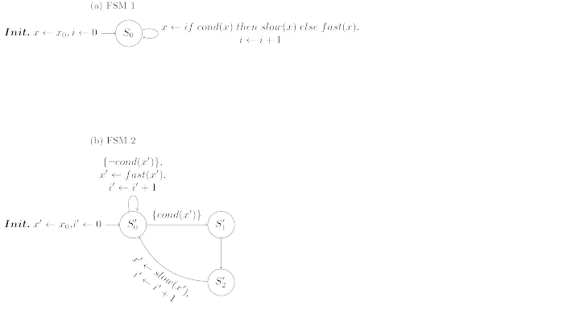
Dynamic scheduling toy example (FSM 1)
where:
x ← x0
i ← 0
While True do
If cond(x)
x ← slow(x)
Else
x ← fast(x)
i ← i + 1

Slide 15
Dynamic scheduling toy example (FSM 2)
where:
x ← x0
i ← 0
While True do
If cond(x)
x ← slow(x)
Else
x ← fast(x)
i ← i + 1

Slide 16
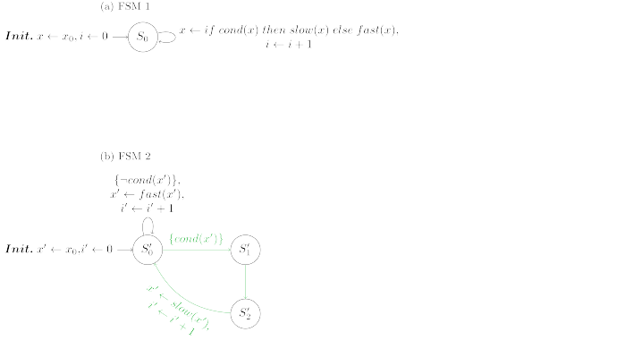
Dynamic scheduling toy example (FSM 2)
where:
x ← x0
i ← 0
While True do
If cond(x)
x ← slow(x)
Else
x ← fast(x)
i ← i + 1

Slide 17
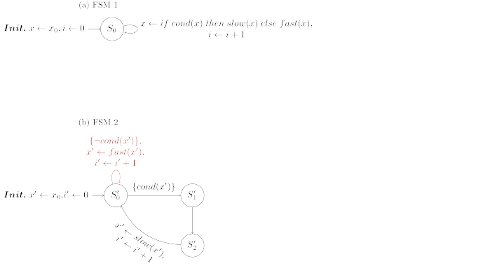
Dynamic scheduling toy example (FSM 2)
where:
x ← x0
i ← 0
While True do
If cond(x)
x ← slow(x)
Else
x ← fast(x)
i ← i + 1

Slide 18
Dynamic scheduling toy example (FSM 2)
where:
x ← x0
i ← 0
While True do
If cond(x)
x ← slow(x)
Else
x ← fast(x)
i ← i + 1

Slide 19
Dynamic scheduling toy example (Proof)
where:
Proof goal
(+1 invariant for proof completion)

Slide 20
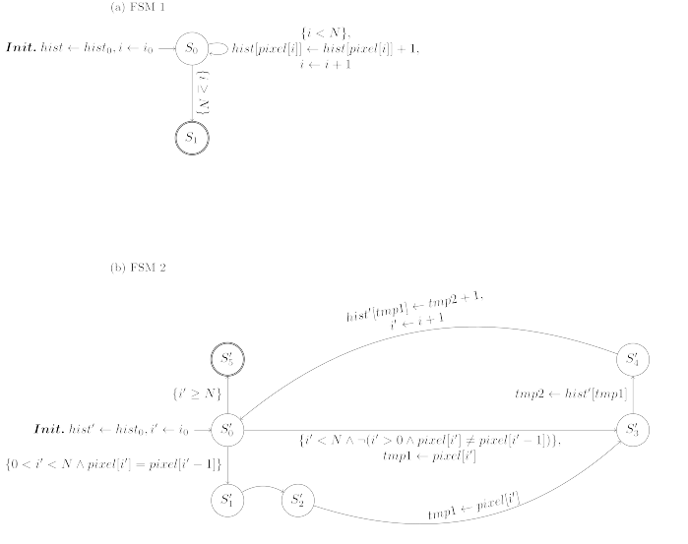
Dynamic schedule toy example 2 (FSM 1)
int hist[];
int pixel[];
int N;
int i = i0;
while (i < N) {
hist[pixel[i]]++;
i++;
}

Slide 21
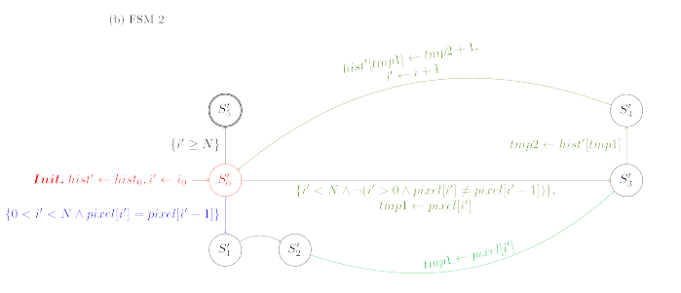
Dynamic schedule toy example 2 (FSM 2)
int hist[];
int pixel[];
int N;
bool stall = false;
int counter = 0;
int i = i0;
while (i < N) {
if (stall && !counter) {
stall = false;
hist[pixel[i++]]++;
}
else if (stall)
counter--;
else if (
i > i0 &&
pixel[i] == pixel[i – 1]
)
stall = true, counter = 1;
else
hist[pixel[i++]]++;
}

Slide 22
Dynamic schedule toy example 2 (Proof)
Proof goal
(+7 invariants for proof completion)

Slide 23
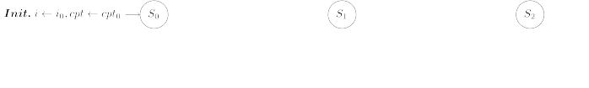
Synthesis toy example

Slide 24
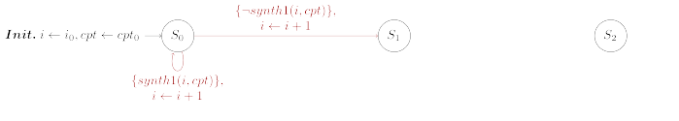
Synthesis toy example

Slide 25
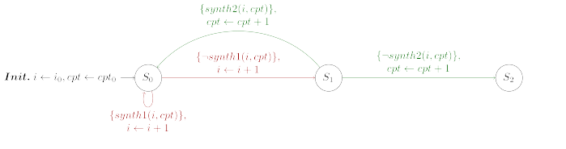
Synthesis toy example

Slide 26
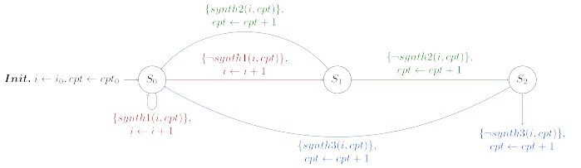
Synthesis toy example
Goal
Find
such that
is always upheld.
→ UCLID manages to suggest

Slide 27
Pipelining problem (Spec.)
int in[];
int A[];
int B[];
int out[];
int i = 0;
while (i < N) {
A[i] = foo(in[i]);
B[i] = bar(A[i]);
out[i] = baz(B[i]);
i++;
}
Specification

Slide 28
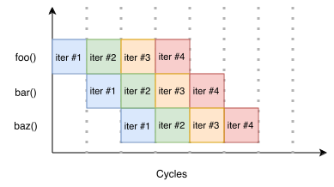
Pipelining problem (Pipelined)
int in[];
int A’[];
int B’[];
int out’[];
bool stage1 = false;
bool stage2 = false;
bool stage3 = false;
int i’ = 0;
while (i’ < N + 2) {
stage1 = 0 <= i’ < N;
stage2 = 1 <= i’ < N + 1;
stage3 = 2 <= i’ < N + 2;
if (stage1)
A’[i’] = foo(in[i’]);
if (stage2)
B’[i’ - 1] = bar(A’[i’ – 1]);
if (stage3)
out’[i’ – 2] = baz(B’[i’ – 2]);
i’++;
}
Pipelined equivalent

Slide 29
Pipelining problem
int in[];
int A[];
int B[];
int out[];
int i = 0;
while (i < N) {
A[i] = foo(in[i]);
B[i] = bar(A[i]);
out[i] = baz(B[i]);
i++;
}
int in[];
int A’[];
int B’[];
int out’[];
bool stage1 = false;
bool stage2 = false;
bool stage3 = false;
int i’ = 0;
while (i’ < N + 2) {
stage1 = 0 <= i’ < N;
stage2 = 1 <= i’ < N + 1;
stage3 = 2 <= i’ < N + 2;
if (stage1)
A’[i’] = foo(in[i’]);
if (stage2)
B’[i’ - 1] = bar(A’[i’ – 1]);
if (stage3)
out’[i’ – 2] = baz(B’[i’ – 2]);
i’++;
}
Proof goal
Specification
(+2 invariants for proof completion)
Pipelined equivalent

