Slide 1
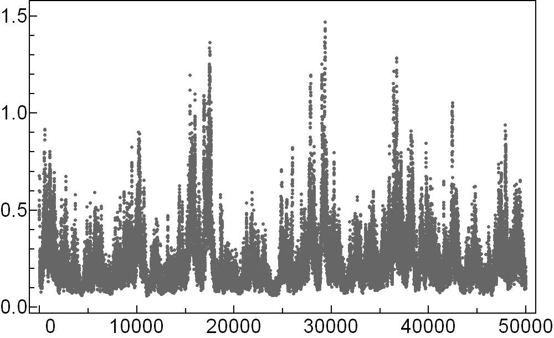
Simulation Time [Arb. U.]

