Slide 1
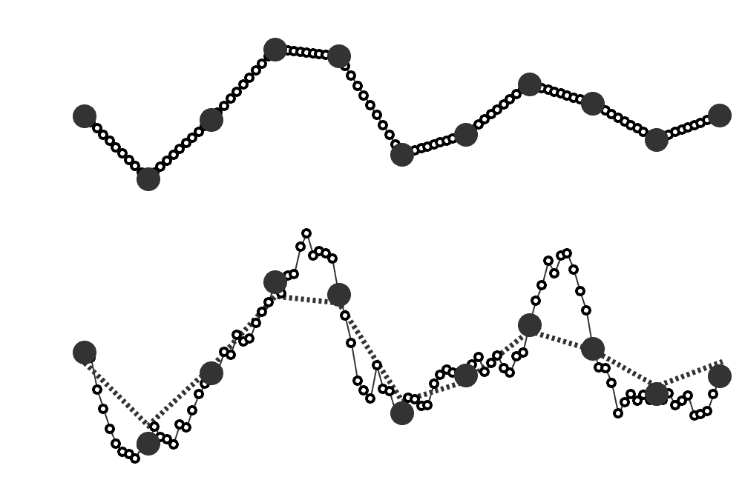
Physical Time
Simulation Time

