Slide 1
Time Series Forecasting US Home Sales
Presented by Ubaldo Martinez III

Slide 2
Agenda
Problem Statement & Hypothesis
Data Analysis Process
Summary of Findings
Limitations of Tools & Techniques
Recommended Actions
Expected Benefits

Slide 3
Problem Statement & Hypothesis
Research Question
Can home sales in the United States be effectively forecasted based solely on research data?
Null & Alternative Hypothesis
H0: An effective predictive time series forecasting model with a mean absolute percentage error of <20% can't be generated from the dataset
Ha: An effective predictive times series forecasting model with a mean absolute percentage error of <20% can be generated from the dataset.

Slide 4
Data Analysis Process
Clean Data
Prepare Data
Explore & Visualize
Build Model

Slide 5
Data
Type of Homes
Condominium
Co-Operative
Single-Family Residentials
Geographic Area
Top 94 Metropolitan Statistical Areas of US
Time Period
2008 – 2022

Slide 6
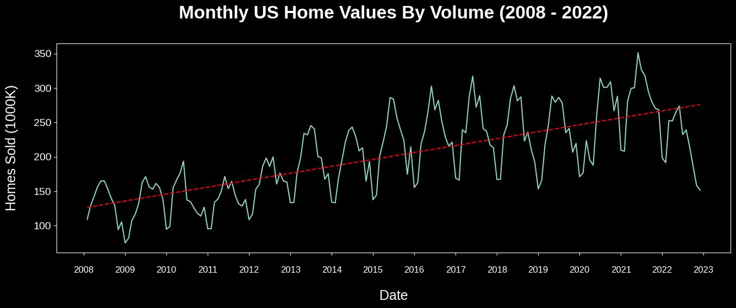
Summary of Findings
Season Uptrend: Summer 2021
Decline In Home Sales: 2022

Slide 7
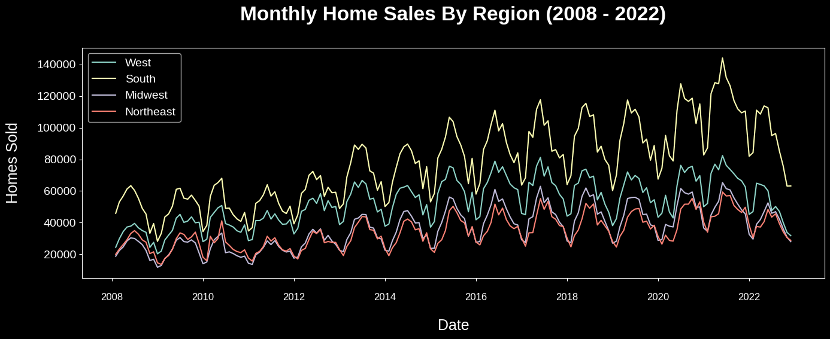
Summary of Findings
West: CA, OR, WA, ID, MT, WY, NV, UT, CO, AZ, NM
South: TX, OK, AR, LA, MS, AL, GA, GA, FL, SC, TN, KY, WV, VA, NC, MD, DE
Midwest: ND, SD, NE, KS, MO, IA, MN, WI, MI, IL, IN, OH
Northeast: PA, NJ, NY, CT, MA, VT, NH, ME

Slide 8
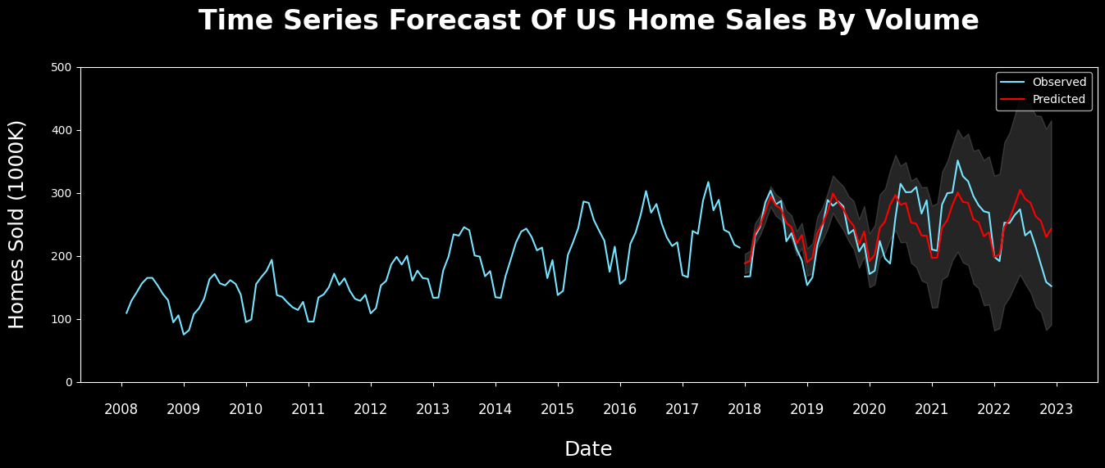
Summary of Findings
Final Model of Time Series Forecast: 12.7% Mean Absolute Percentage Error

Slide 9
Summary of Findings
Alternative Hypothesis
Threshold of 20% or less for a mean absolute percentage error, thus affirming the model's effectiveness and warranting the rejection of the null hypothesis.
Mean Absolute Percentage Error (MAPE)
a metric that defines the accuracy of a forecasting method.
average of the absolute percentage errors of each entry in a dataset to calculate how accurate the forecasted quantities were in comparison with the actual quantities
Model | AIC | RMSE | MAPE
ARIMA | 1050.57 | 36.97 | -
SARIMA | 840.49 | 56.44 | -
Prophet | - | 35.65 | 12.7%

Slide 10
Limitations of Tools & Techniques
CSV File Format
Learning Structure of Data
Best Methods of Transformation
Quality of Data
Mixed Data For Types of Homes
Quantity of Data
Limited To 2008 - 2022 Records

Slide 11
Recommended Actions
Historical Data Predating 2008
In-Depth Analysis of Buyer Data
Evaluation of Mortgage Loans & Interest Rates

Slide 12
Expected Benefits
Homebuyers
Investors
Lenders & Financial Institutions
Homebuilders
Government Agencies & Policy Makers

Slide 13
Sources
Housing data - Zillow Research. (2023, April 25). Zillow. https://www.zillow.com/research/data/
Ma, B. (2021c, December 13). Time Series Modeling with ARIMA to Predict Future House Price. Medium. https://towardsdatascience.com/time-series-modeling-with-arima- to-predict-future-house-price-9b180c3bbd2f
Cphalpert. (n.d.). census-regions/us census bureau regions and divisions.csv at master · cphalpert/census-regions. GitHub. https://github.com/cphalpert/census- regions/blob/master/us%20census%20bureau%20regions%20and%20divisions.csv
Maverickss. (2023). Time Series Forecasting using ARIMA/SARIMA/SARIMAX. Kaggle. https://www.kaggle.com/code/maverickss26/time-series-forecasting-using-arima-sarima-sarimax
Li, S. (2018, November 30). An End-to-End Project on Time Series Analysis and Forecasting with Python. Medium. https://towardsdatascience.com/an-end-to-end-project-on-time- series-analysis-and-forecasting-with-python-4835e6bf050b

