Slide 1
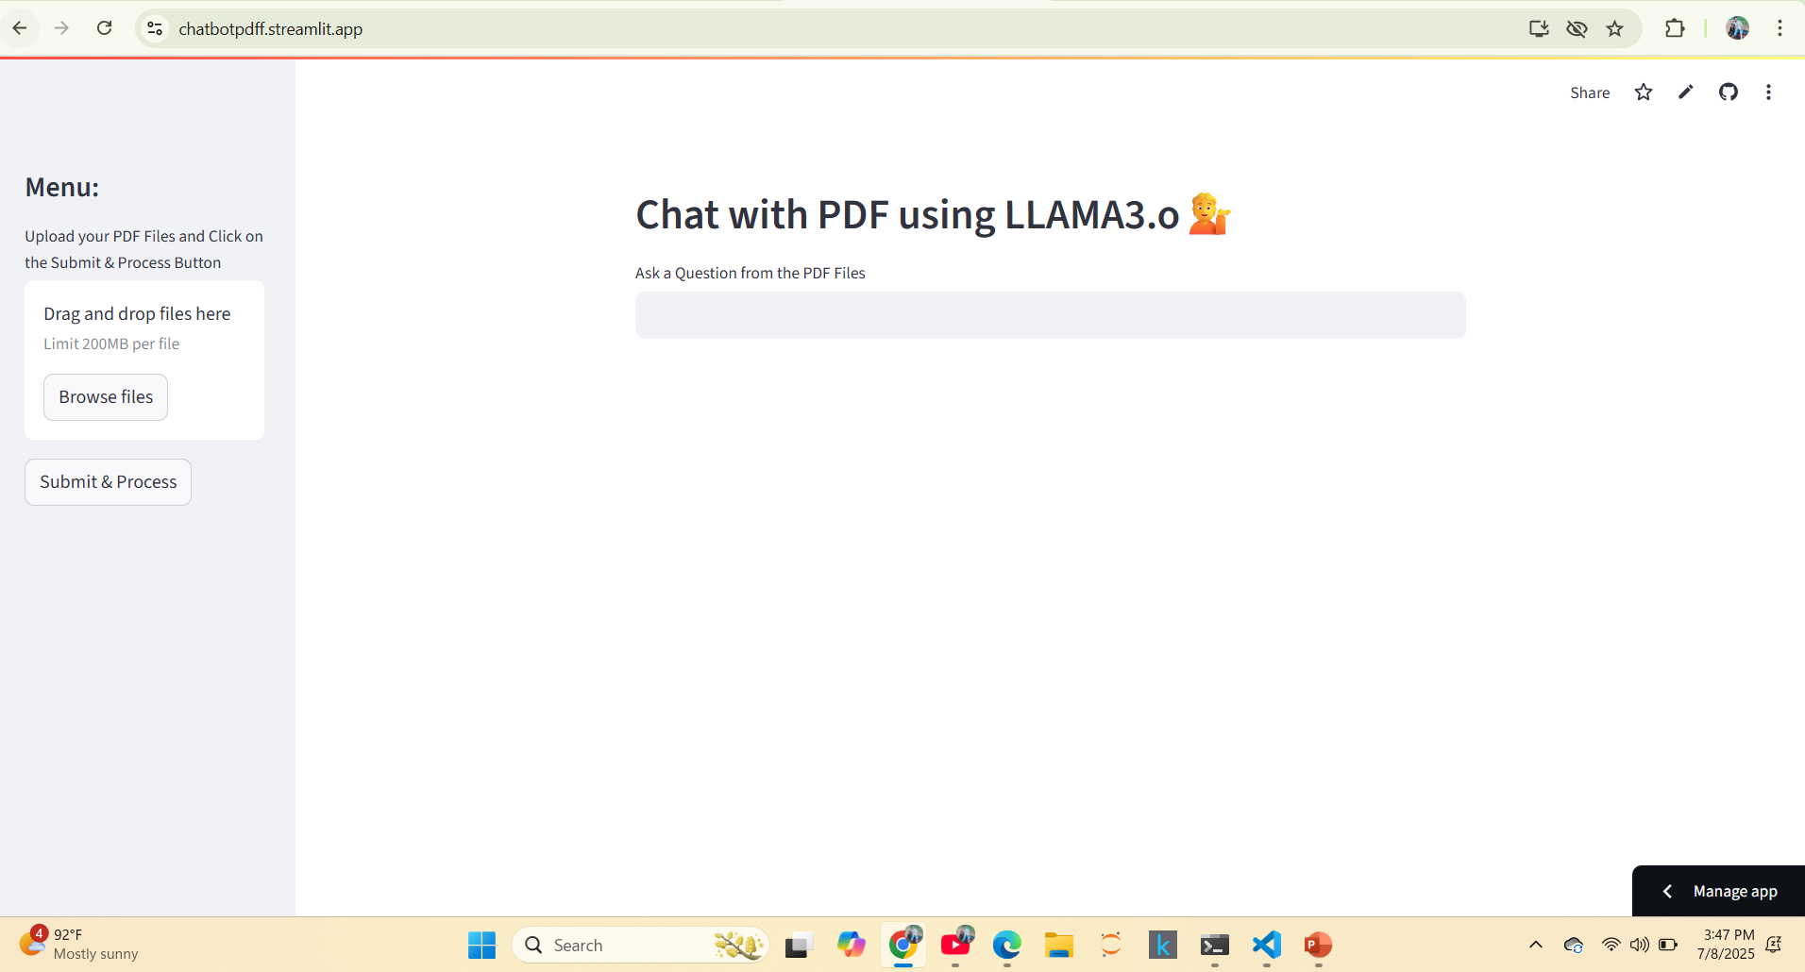

Slide 2

Submit your file by clicking on Browse Files

Slide 3
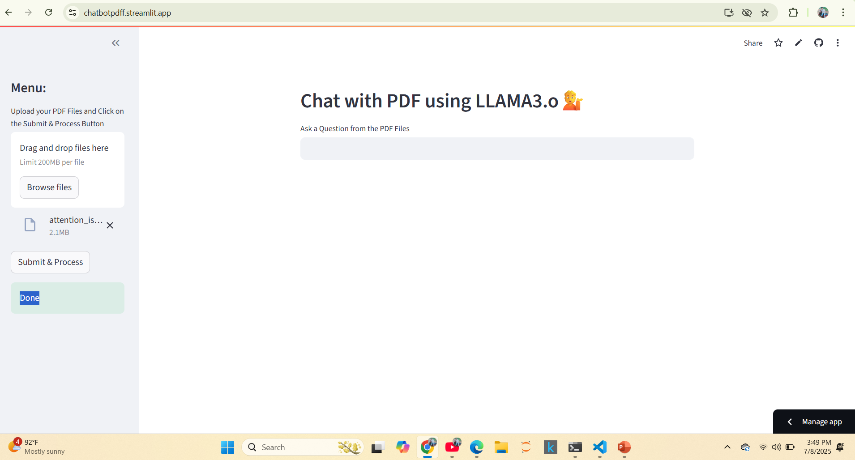
Click on Submit & Process

Slide 4
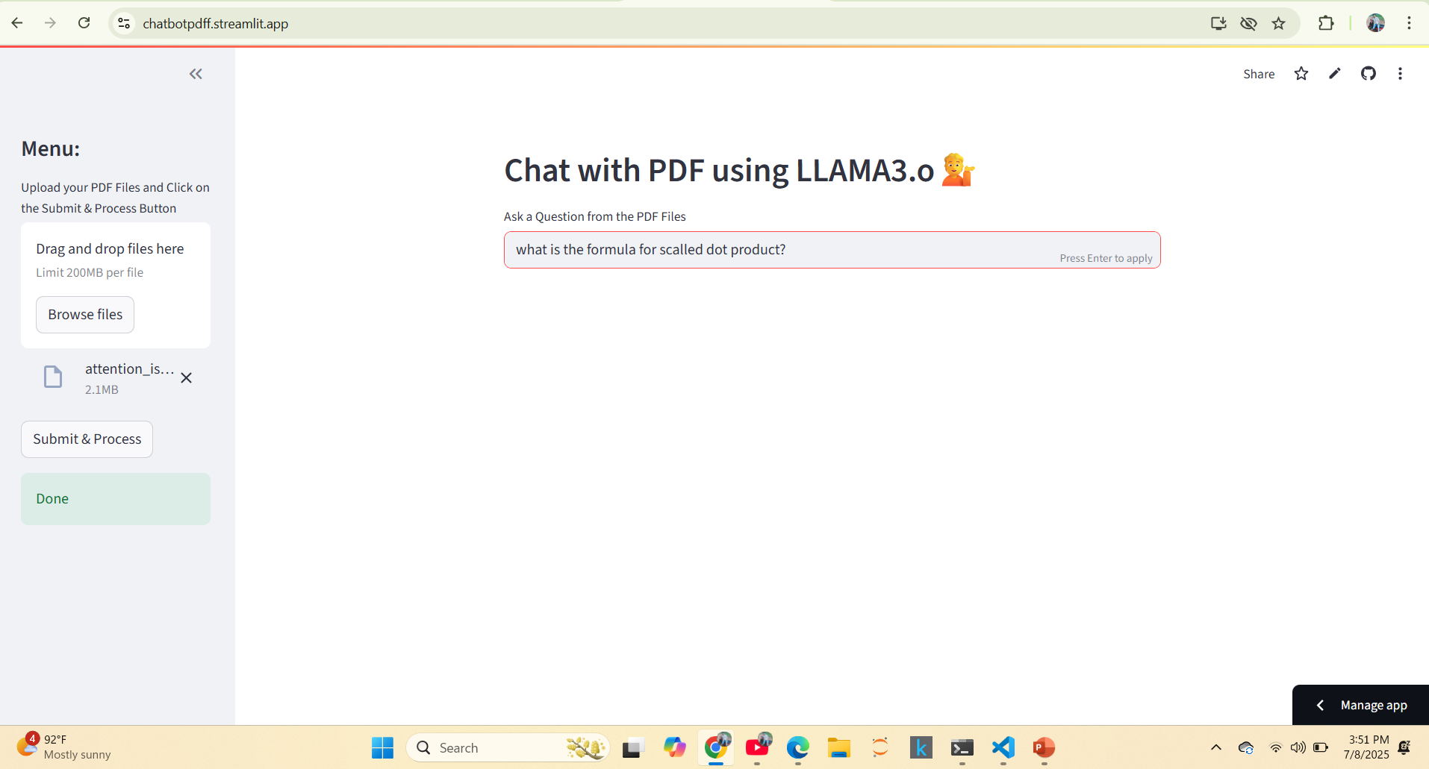
Ask Question to know from PDF

Slide 5
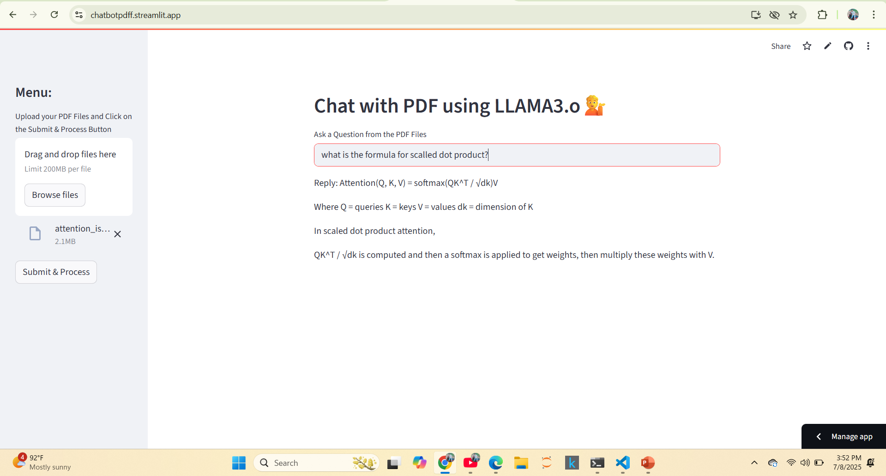
Response Generated

Slide 6
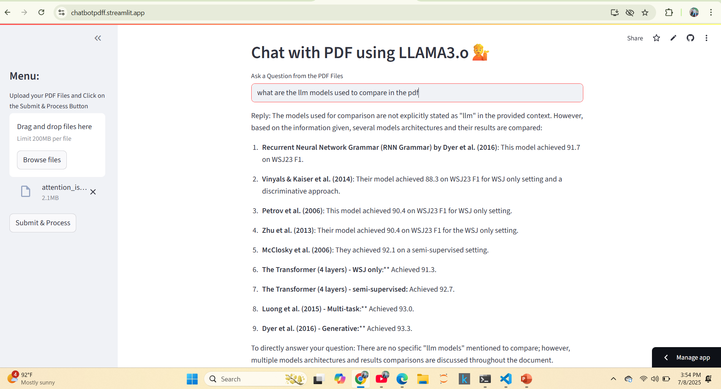
Sample Question 2

