Slide 1
Image processing approach using Deep Learning

Slide 2
ECG-ID Dataset
The database contains 310 ECG recordings, obtained from 90 persons. Each recording contains:
ECG lead I, recorded for 20 seconds, digitized at 500 Hz with 12-bit resolution over a nominal ±10 mV range; 10 annotated beats (unaudited R- and T-wave peaks annotations from an automated detector); information (in the .hea file for the record) containing age, gender and recording date. The records were obtained from volunteers (44 men and 46 women aged from 13 to 75 years who were students, colleagues, and friends of the author). The number of records for each person varies from 2 (collected during one day) to 20 (collected periodically over 6 months).
The raw ECG signals are rather noisy and contain both high and low frequency noise components. Each record includes both raw and filtered signals: Signal 0: ECG I (raw signal) Signal 1: ECG I filtered (filtered signal)
Data is in the form of waveforms.
Source Link :​ https://www.physionet.org/content/ecgiddb/1.0.0/

Slide 3
Block diagram
ECG_ID
Database
(.atr,.dat,
.hea)
WFDB library
Feature
Extraction
(10 Features)
Christov
Segmentebr
(Algorithm to calculate QRS complex)
Difference of each R peak Signal
.atr files
ECG-1 Filter
Sampling rate
QRS Complex
RR interval
Authentication
Training
Siamese/CNN
Matplotlib
Similarity
Plot graphs
(Images)

Slide 4
Methodology explanation
We have provided the .atr files from the dataset as the input to waveform database to extract the features.
Waveform-database(wfdb) is a python library which is used for reading signals and it returns the samples as decimal numbers on the output.
Wfdb.rdsamp function converts the signal to array and extracts the features from the ecg signals.
We got the below features after extracting the ECG signals

Slide 5
Features
Feature Name | Type
Signal name | ECG_1, ECG_1 filtered
Age | Decimal
Gender | Male or Female
Signal length | Length of the signal(10000)
Units | mV(millivolts)
Fractional Sharpening(Fs) | Decimal
Person_id | Decimal(Id of the person)
ECG Date | Date of recording

Slide 6
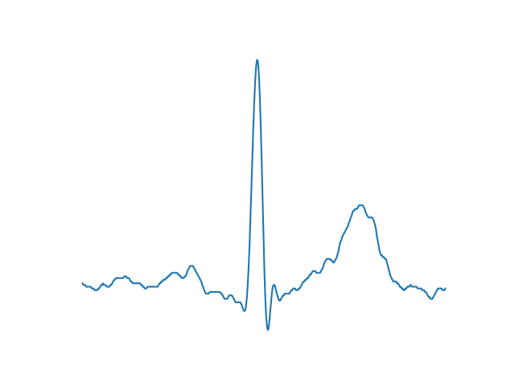
Once the features are extracted, we provide ecg 1 filtered and sampling rate features as input to the christov segmenter algorithm which is a R peak segmentation algorithm.
Christov segmenter algorithm provides the output of R peaks(QRS complex) of the record.
Once we get the R peak of each record, we will calculate the difference between each R peak.
After calculating difference of each R peak, We will use matplotlib to plot the images of each record of the person.

Slide 7
Siamese Network
Once the Images are plotted, the images are given as input to the Siamese network for training.
Siamese network takes two images as input and compares the similarity between the images and provides the percentage of similarity between the images.
Each image in Siamese network goes through different convolution layers and then compares the similarity between the images and provides the percentage of similarity as output.

Slide 8
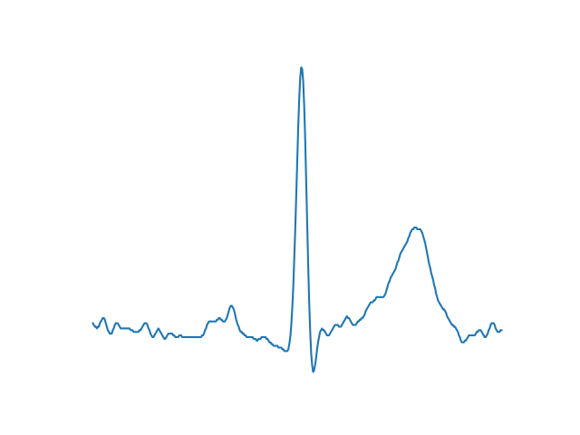
Architecture of Siamese Network
Person 1 , rec 1
E
N
C
O
D
I
N
G
CNN
Differencing layer d(r1,r2)
OUTPUT
Person 1, rec 2
E
N
C
O
D
I
N
G
CNN

Slide 9
Architecture of CNN
Input Image
Convolution + RELU
Pooling
Convolution + RELU
Pooling
Feature Learning
FLATTEN
FULLY CONNECTED

Slide 10
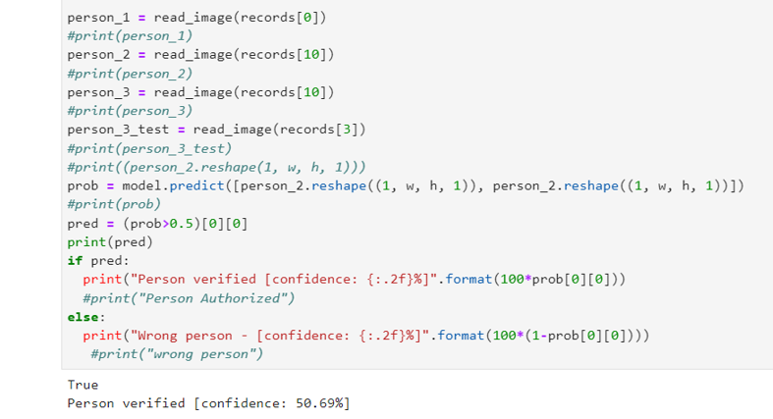
Validation
The model is Authenticating the user as true or false, but the confidence of the model is just 50%.
We are working on improvising the confidence of the model. Below is the screenshot of validation of the model.

