Slide 1
Two Factor Authentication
TEAM MEMBERS:
Jahnavi Dammannagari
Sailaxman Janumula
Nikitha Srivyshnavi Kankanalapalli
Sai Tejaswee Vissapragada
Archana Lingampally
Abdul Rehman Sayeed Mohammed
Shahid Mohammed
Shiva Krishna Myakala
Dheemanth Reddy Sanku
Manikanta Vasana

Slide 2
Outline
Introduction
Existing System
Proposed System
Why QR Code and Heartwave
Methodology-I
Methodology-II
Task Accomplished
Future Accomplishments

Slide 3
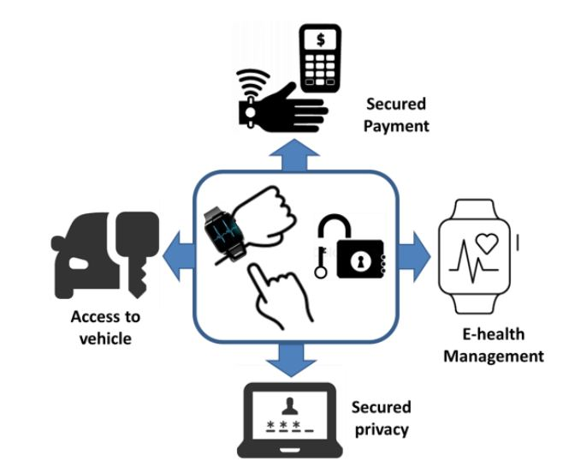
Introduction
It is remarkable how, by and large, users are still burdened by numerous passwords, which have been used for access control since the earliest days of computing.
There has been a recent shift of interest towards the field of biometric authentication, which proves the identity of the user using their biological characteristics.
Past research has shown that ECG is unique to each individual and thus could potentially be used for authentication.

Slide 4
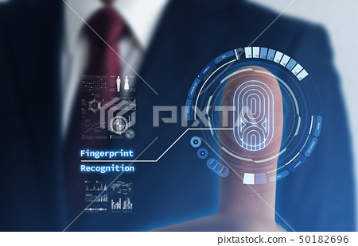
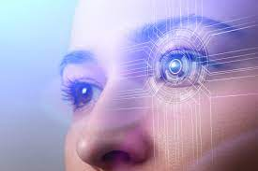
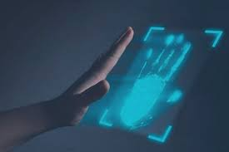
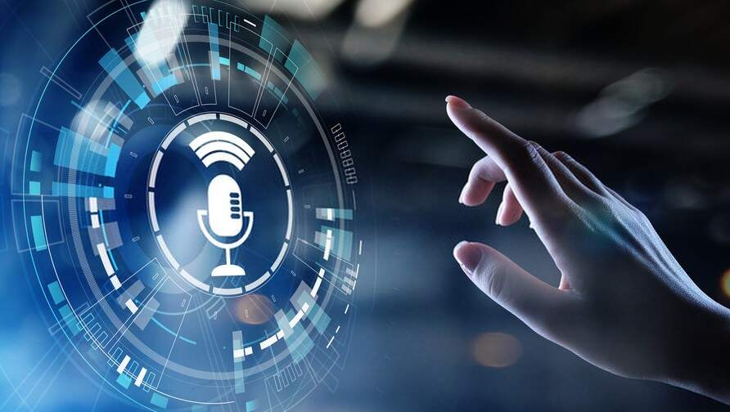
Existing Systems
Fingerprint Authentication
Iris Authentication
Palm Authentication
Voice Authentication

Slide 5
Why QR Code Authentication?
Super fast reading capabilities
No dedicated third-party hardware needed
Simple use makes it ideal for younger users
Easily combined with other authentication factors for increased verification.
Badge printing can be delegated to business managers or teachers

Slide 6
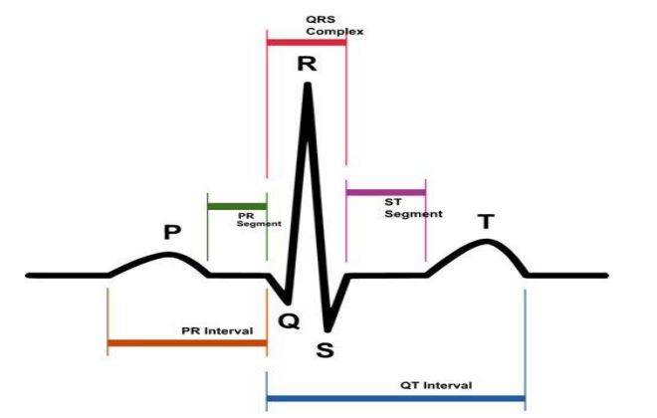
Why Heart Wave Authentication ?
Non-transferrable – Everyone has a unique set of biometrics
High security and assurance – Biometric identification provides the answers to “something a person has and is” and helps verify identity
Spoof-proof – Biometrics are hard to fake or steal.
User Experience – Convenient and fast.
QRS Wave

Slide 7
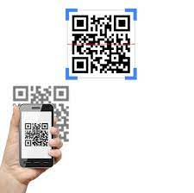
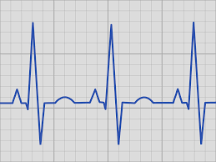

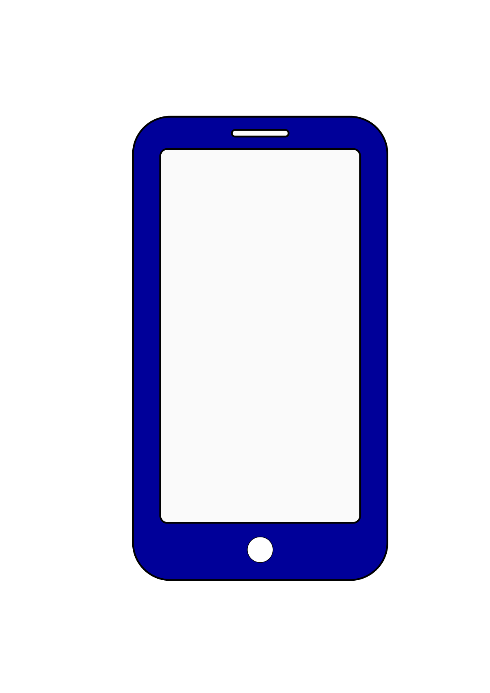
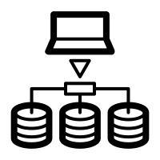
Proposed System
Access Granted
QR Code is Scanned
ECG wave is detected
User
Access Granted
Heart wave Authentication
Services

Slide 8
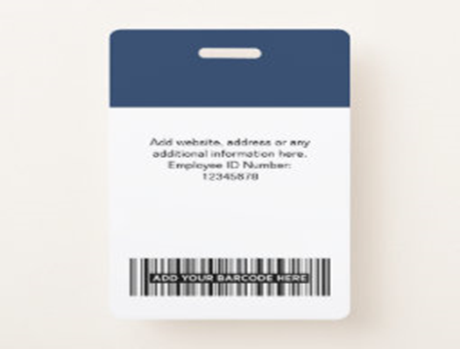
QR Code Authentication
When an employee registers with an organization, the profile data, including the date of birth, gender, and email address, will be gathered.
A Unique id will be given to the user with the QR code on it.
The QR code is scanned at the first stage of authentication.
The scanned QR code will be de-coded and user verification is done.

Slide 9
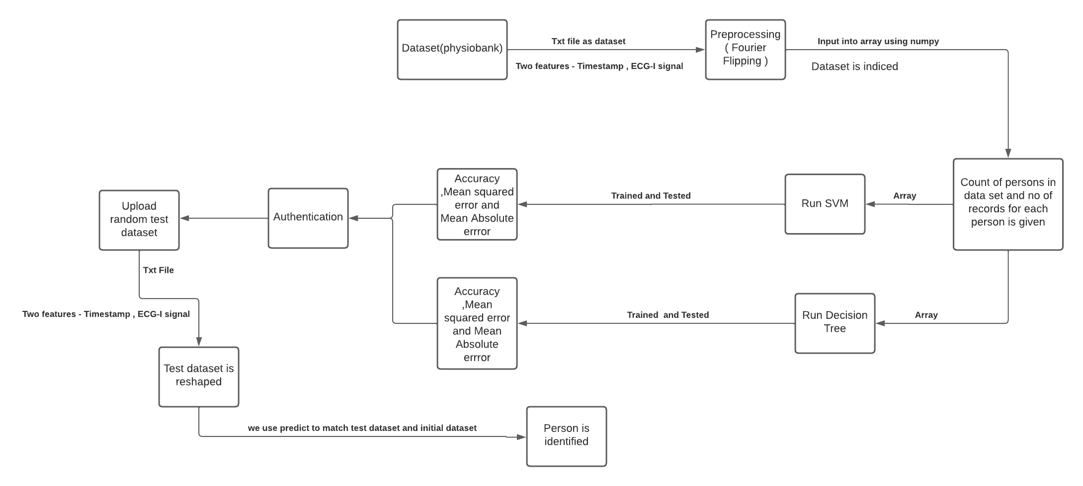
Heartwave Authentication using ML

Slide 10
Methodology-1
The name of dataset is ECG-ID Database(ecgiddb)
The input dataset is in form of .txt files
The .txt files have 2 extracted features, they are time lapse and ecg-1 filtered
There are 20 ECG recordings obtained from 20 persons for 10 secs
Source Link for methodology-1:
https://archive.physionet.org/cgi-bin/atm/ATM

Slide 11
Fourier Flipping Transformation
The data given as input is .txt files
In this module we will pre-process dataset to remove missing values
And then apply flipping and Fourier transform algorithm to select important attributes from dataset
Function to calculate FFT on recordings:
np.fft.fft(data)/len(data)

Slide 12
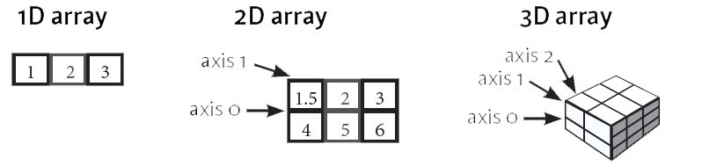
Support Vector Machine & Decision Tree
Explanation of how both will algorithm work:
We will be reshaping the array(input) using numpy.reshape.
We will then use test-train and split to split our data into two parts which will be used for training and testing. The features are scaled.
3. The training model is generated by fitting the classified data into training set.
4. The MSE, MAE and Accuracy is determined for the provided data using in-built functions.

Slide 13
Accuracy Results
SVM Test data size(%) | SVM Accuracy | DT Test data size (%) | DT Accuracy
50 | 0.5 | 50 | 0.6
60 | 0.583 | 60 | 0.666
70 | 0.64 | 70 | 0.71
80 | 0.6875 | 80 | 0.75
90 | 0.722 | 90 | 0.777
95 | 0.736 | 95 | 0.789
100 | ERROR | 100 | ERROR
The accuracy of both algorithms increases with increase in size of test data, and we get error when we take 100% of data for testing.

Slide 14
Reasons for not going with Methodology-1
The dataset has only two features and which is very less when we want to train and get proper results for matching.
We tried adding more features to datasets, but we could not find ideal data to add them to the data we have.
The result of prediction of which person the data belongs to at the end is only done by matching numbers in the data which can give fault predictions easily if we change the testing data a little bit.

Slide 15
Methodology-2
The name of dataset is ECG-ID Database
The database contains 310 ECG recordings, obtained from 90 persons. Each recording contains:
The number of records for each person varies from 2 to 20.
Here we will get raw data in form of .dat, .hea and .atr files and how the required data is extracted will be explained later
Source Link :​ https://www.physionet.org/content/ecgiddb/1.0.0/

Slide 16
Block diagram
ECG_ID
Database
(waveform)
Feature Extraction
QRS Complex
RR interval
wfdb.rdsamp
Christov segmenter
Difference of each R peak Signal
Waveform Database
Matplotlib
Authentication
Siamese/CNN
Plot graphs
(Images)
Similarity
Training

Slide 17
Methodology explanation
We have provided the .atr files from the dataset as the input to waveform database to extract the features.
Waveform-database(wfdb) is a python library which is used for reading signals and it returns the samples as decimal numbers on the output.
Wfdb.rdsamp function converts the signal to array and extracts the features from the ecg signals.
We got the below features after extracting the ECG signals

Slide 18
Features
Feature Name | Type
Signal name | ECG_1, ECG_1 filtered
Age | Decimal
Gender | Male or Female
Signal length | Length of the signal(10000)
Units | mV(millivolts)
Fractional Sharpening(Fs) | Decimal
Person_id | Decimal(Id of the person)
ECG Date | Date of recording

Slide 19
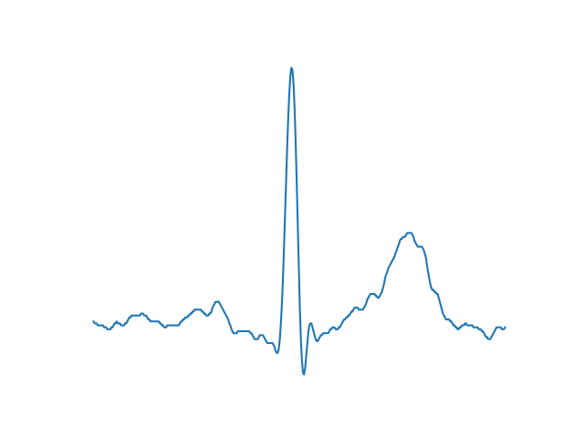
Once the features are extracted, we provide ecg 1 filtered and sampling rate features as input to the christov segmenter algorithm which is a R peak segmentation algorithm.
Christov segmenter algorithm provides the output of R peaks(QRS complex) of the record.
Once we get the R peak of each record, we will calculate the difference between each R peak.
After calculating difference of each R peak, We will use matplotlib to plot the images of each record of the person.

Slide 20
Siamese Network
Once the Images are plotted, the images are given as input to the Siamese network for training.
Siamese network takes two images as input and compares the similarity between the images and provides the percentage of similarity between the images.
Each image in Siamese network goes through different convolution layers and then compares the similarity between the images and provides the percentage of similarity as output.

Slide 21
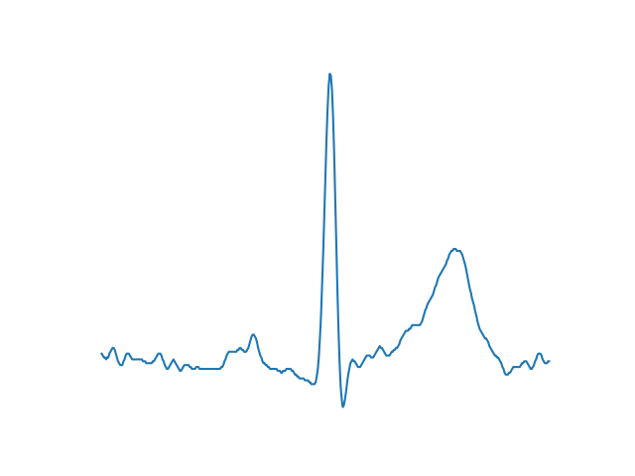
Architecture of Siamese Network
Person 1 , rec 1
E
N
C
O
D
I
N
G
CNN
Differencing layer d(r1,r2)
OUTPUT
Person 1, rec 2
E
N
C
O
D
I
N
G
CNN

Slide 22
Future Tasks to be accomplished
We need to optimize Siamese Neural Network.
Train model with different Deep Learning Techniques.
We need to create User Interface and integrate QR code with Heart wave authentication.

Slide 23
DEMO

Slide 24

THANK YOU

