Slide 1
What is CNN?
Convolutional Neural Network is one of the main categories to do image classification and image recognition in neural networks. Scene labeling, objects detections, and face recognition, etc., are some of the areas where convolutional neural networks are widely used.
CNN takes an image as input, which is classified and process under a certain category such as dog, cat etc.
The computer sees an image as an array of pixels and depends on the resolution of the image. Based on image resolution, it will see as h * w * d, where h= height w= width and d= dimension.

Slide 2
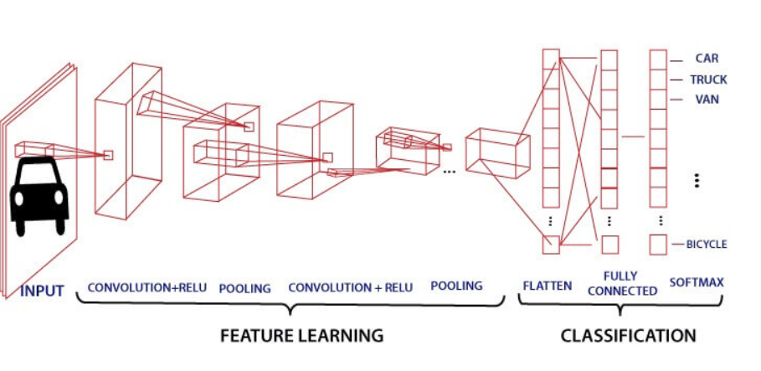
Block Diagram

Slide 3
How Image Processing Occurs in CNN?
In CNN, each input image will pass through a sequence of convolution layers along with pooling, fully connected layers, filters (Also known as kernels). After that, we will apply the Soft-max function to classify an object with probabilistic values 0 and 1.
Convolution layer is the first layer to extract features from an input image.
By learning image features using a small square of input data, the convolutional layer preserves the relationship between pixels. It is a mathematical operation which takes two inputs such as image matrix and a kernel or filter.

Slide 4
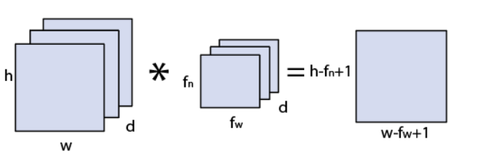
Image Processing contd:
The dimension of the image matrix is h×w×d
The dimension of the filter is f_{h}×f_{w}×d
The dimension of the output is (h-f_{h}+1)×(w-f_{w}+1)×1.

Slide 5
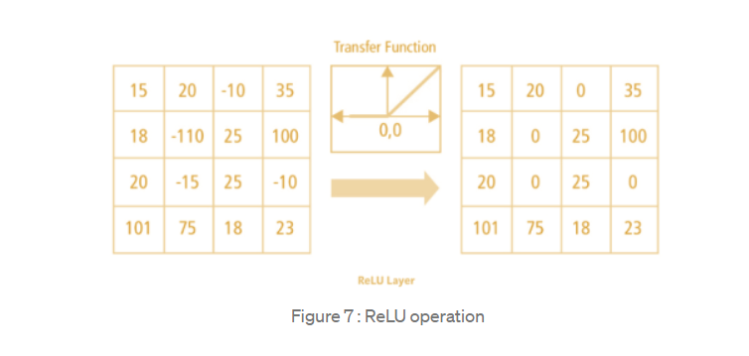
Non Linearity (ReLU)
ReLU stands for Rectified Linear Unit for a non-linear operation. The output is ƒ(x) = max(0,x).
Why ReLU is important : ReLU’s purpose is to introduce non-linearity in our ConvNet. Since, the real world data would want our ConvNet to learn would be non-negative linear values.

Slide 6
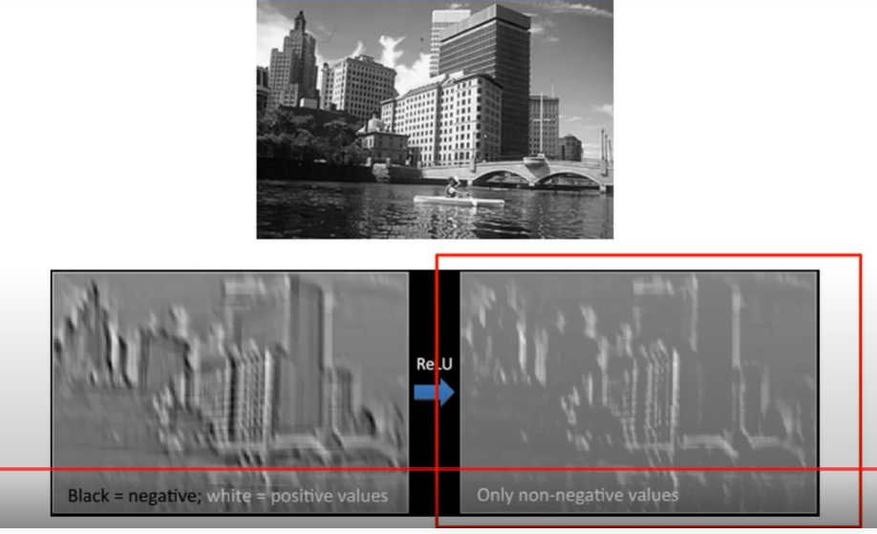
ReLU Explanation with Diagram

Slide 7
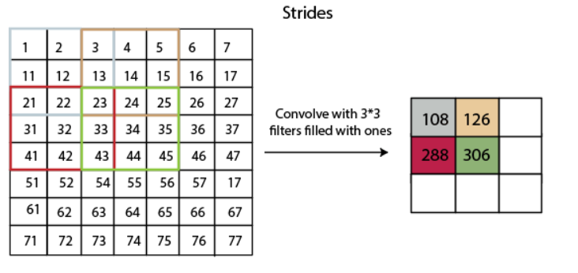
Features extraction IN CNN?
Strides: Stride is a component of convolutional neural networks, or neural networks tuned for the compression of images and video data. Stride is a parameter of the neural network's filter that modifies the amount of movement over the image. or video.

Slide 8
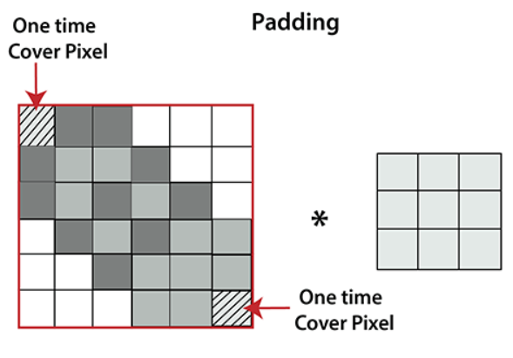
Padding
Padding plays a crucial role in building the convolutional neural network. If the image will get shrink and if we will take a neural network with 100's of layers on it, it will give us a small image after filtered in the end.
If we take a three by three filter on top of a grayscale image and do the Convolving.

Slide 9
Padding Contd:
It is clear from the above picture that the pixel in the corner will only get covers one time, but the middle pixel will get covered more than once. It means that we have more information on that middle pixel, so there are two downsides:
Shrinking outputs
Losing information on the corner of the image.
To overcome this, we have introduced padding to an image. "Padding is an additional layer which can add to the border of an image."

Slide 10
Pooling Layer
Pooling layer plays an important role in pre-processing of an image.
Pooling layer reduces the number of parameters when the images are too large.
Pooling is “Downscaling" of the image obtained from the previous layers.
It can be compared to shrinking an image to reduce its pixel density.
Spatial pooling is also called Down sampling or subsampling, which reduces the dimensionality of each map but retains the important information.
Furthermore, it is useful for extracting dominant features which are rotational and positional invariant, thus maintaining the process of effectively training of the model.

Slide 11
Types of Pooling
There are two types of Pooling: Max Pooling and Average Pooling.
Max Pooling returns the maximum value from the portion of the image covered by the Kernel. Max Pooling also performs as a Noise Suppressant.
Max pooling is done by applying a max filter to non-overlapping sub-regions of the initial representation.
On the other hand, Average Pooling returns the average of all the values from the portion of the image covered by the Kernel. Average Pooling simply performs dimensionality reduction as a noise suppressing mechanism.
Hence, we can say that Max Pooling performs a lot better than Average Pooling.

Slide 12
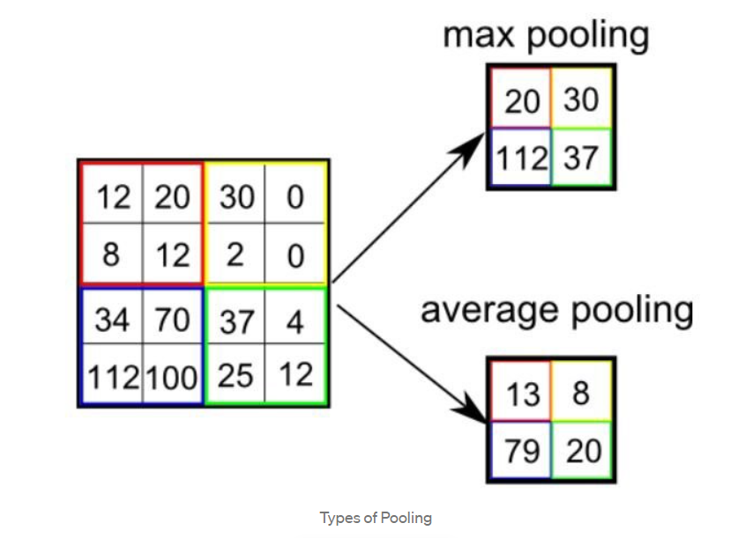
Pooling Explanation With Diagram

Slide 13
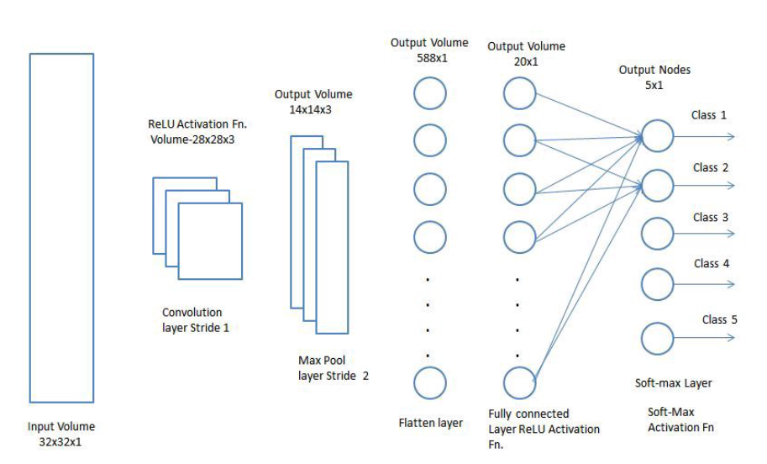
Diagram For Classification

Slide 14
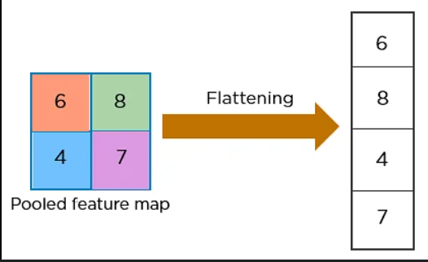
Flatten
Flattening is used to convert all the resultant 2-Dimensional arrays from pooled feature maps into a single long continuous linear vector. The flattened matrix is fed as input to the fully connected layer to classify the image.

Slide 15
Fully Connected Layer (FC Layer)
The Fully connected layer (as we have in ANN) is used for classifying the input image into a label.
This layer connects the information extracted from the previous steps (i.e Convolution layer and Pooling layers) to the output layer and eventually classifies the input into the desired label.
In the above diagram, the feature map matrix will be converted as vector (x1, x2, x3, …). With the fully connected layers, we combined these features together to create a model.

Slide 16
Softmax
The softmax activation is normally applied to the very last layer in a neural net. The reason why softmax is useful is because it converts the output of the last layer in your neural network into what is essentially a probability distribution.
In CNN, after the application of the Softmax Function, is to test the reliability of the model using as Loss Function the Cross Entropy Function.

