Slide 1

Mutual Fund Analytics Platform Bluestock Fintech Pvt. Ltd. Data Analyst Internship Capstone Project
Prepared By: Boppana Uma Maheswari

Slide 2
Problem Statement
Problem Statement
Mutual fund data is distributed across multiple sources.
Investors need insights into fund performance, risk, and returns.
Manual analysis of large financial datasets is difficult.
A centralized analytics platform is required for better decision-making.
Goal: Build a complete Mutual Fund Analytics Platform using real mutual fund datasets.

Slide 3
Project Objectives
Build an automated ETL pipeline.
Create a normalized database schema.
Perform exploratory data analysis.
Calculate fund performance metrics.
Analyze investor transaction behavior.
Develop advanced risk analytics.
Create an interactive Power BI dashboard.
Generate actionable business insights.

Slide 4
Data Sources
Datasets Used
Fund Master Data
NAV History Data
AUM by Fund House
Monthly SIP Inflows
Category Inflows
Industry Folio Count
Scheme Performance Data
Investor Transactions
Portfolio Holdings
Benchmark Indices
Sources: AMFI India, mfapi.in, Public Market Data

Slide 5
ETL Architecture
ETL Workflow
Extract
↓
Transform
↓
Load
↓
Analytics
↓
Dashboard

Slide 6
Exploratory Data Analysis (EDA)
EDA Highlights
Industry AUM growth analysis.
SIP inflow trend analysis.
Category-wise fund inflows.
Folio growth trends.
Fund house comparison.
Risk vs Return analysis.
Key Finding
Industry AUM and SIP inflows showed strong growth between 2022 and 2025.

Slide 7
Investor Analytics
Investor Behavior Analysis
State-wise transaction distribution.
Age-group investment patterns.
SIP vs Lumpsum contribution.
Monthly transaction trends.
Investor demographics.
Key Finding
Investor participation increased significantly across multiple states and age groups.

Slide 8
Performance Analytics
Metrics Calculated
Daily Returns
CAGR (1Y, 3Y, 5Y)
Sharpe Ratio
Sortino Ratio
Alpha
Beta
Maximum Drawdown
Tracking Error
Key Finding
Moderate-risk funds delivered strong risk-adjusted returns.

Slide 9
Advanced Analytics
Advanced Risk Metrics
Historical VaR (95%)
Conditional VaR (CVaR)
Rolling 90-Day Sharpe Ratio
Investor Cohort Analysis
SIP Continuity Analysis
Sector HHI Concentration
Fund Recommender
Top 3 funds recommended based on risk appetite and Sharpe Ratio.

Slide 10
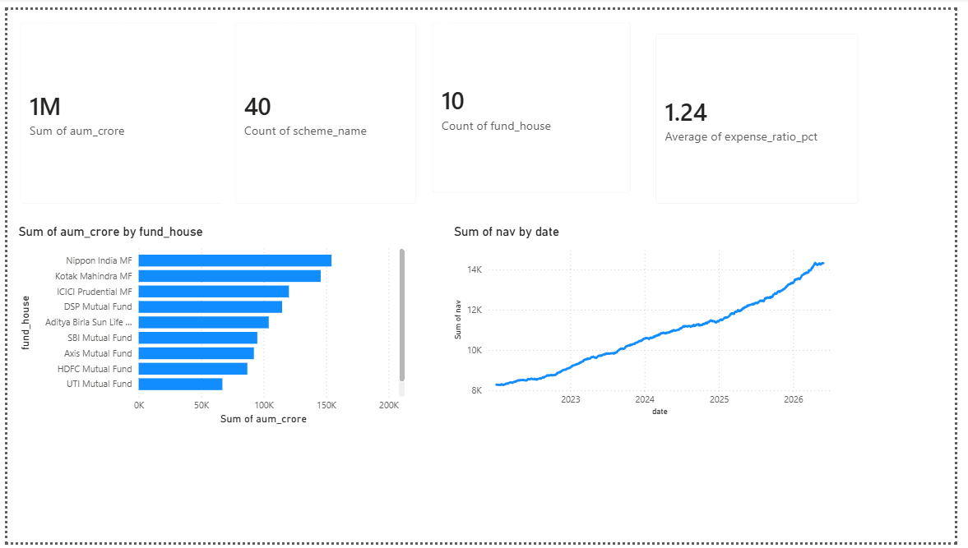
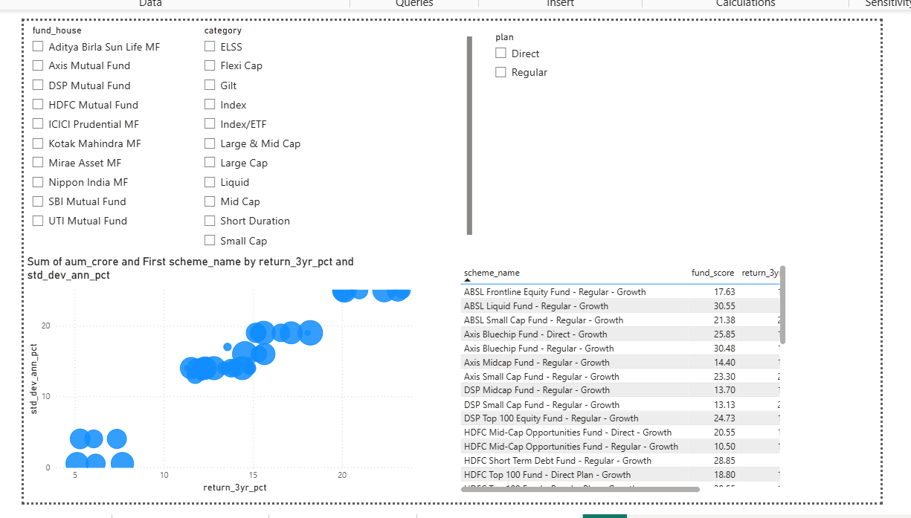
Dashboard Overview
Page 1
Page 2

Slide 11
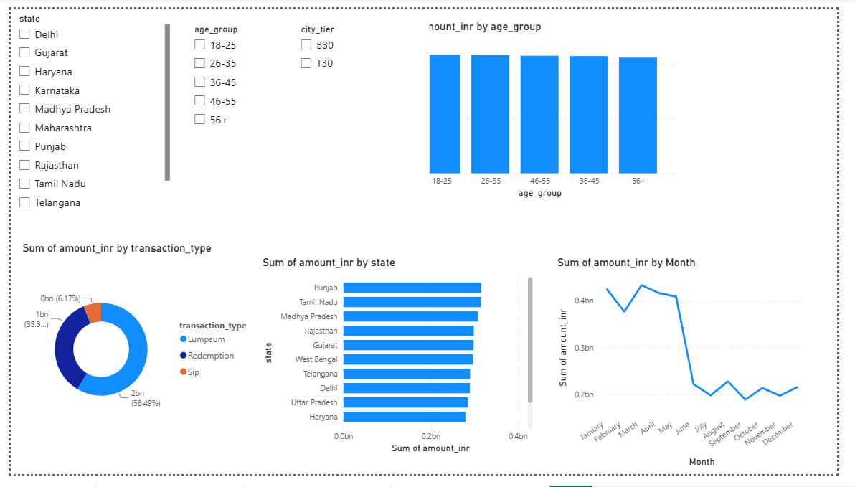
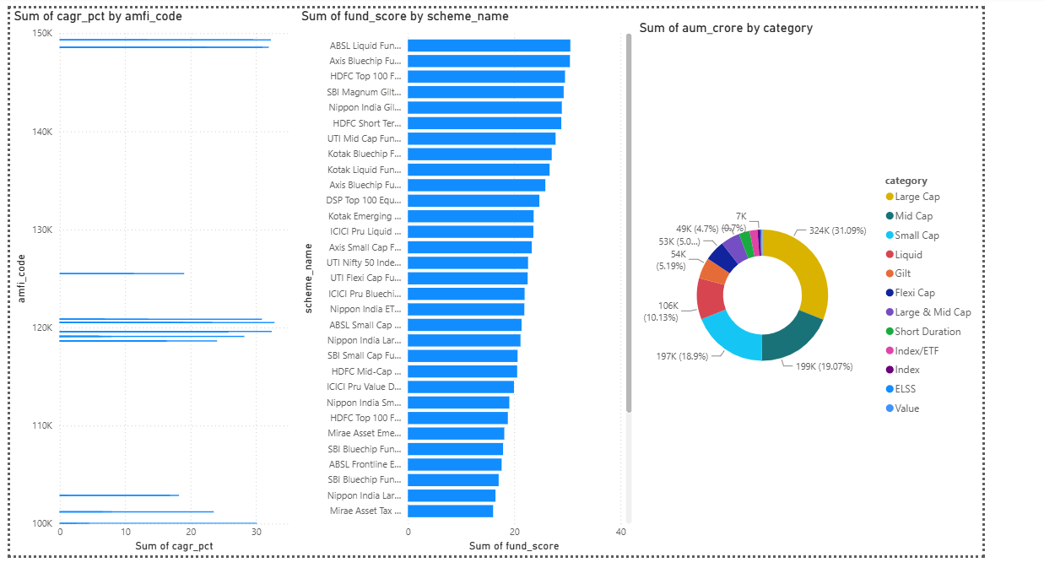
Page 3
Page 4

Slide 12
Conclusion
The Mutual Fund Analytics Platform successfully combined data engineering, financial analytics, and dashboard reporting to analyze mutual fund performance and investor behavior. The project provided meaningful insights through ETL processing, risk analysis, advanced analytics, and interactive Power BI dashboards, supporting informed investment decision-making.

