Slide 1
Introduction
Definition: Alzheimer’s Disease (AD) is a progressive neurodegenerative disorder leading to memory loss and cognitive decline.
Global Impact: Over 55 million cases worldwide, projected to rise to 139 million by 2050.
Importance of Early Detection: Early diagnosis is critical for effective management but remains challenging due to subtle initial symptoms.

Slide 2
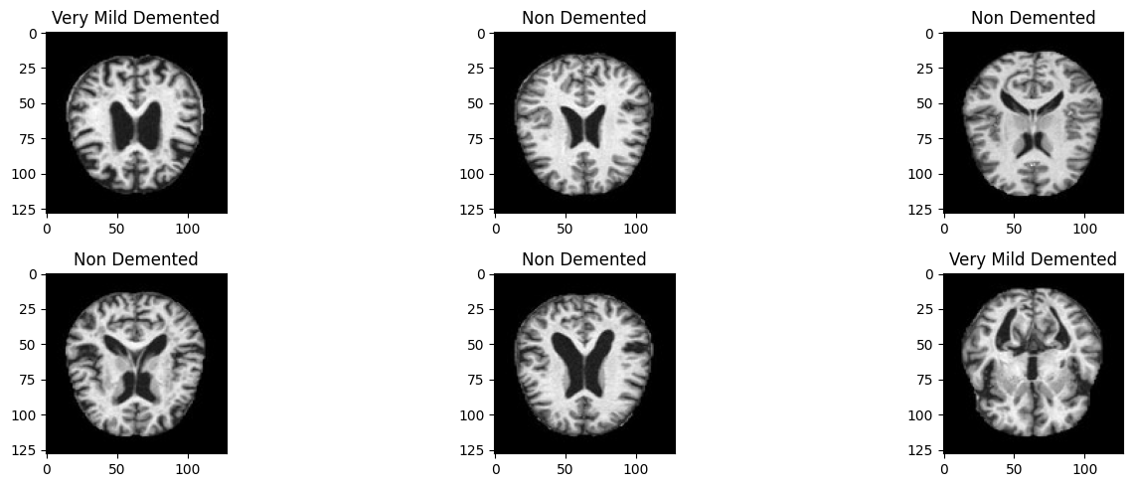
Role of MRI in Diagnosis
Advantages of MRI:
High-resolution, non-invasive imaging.
Identifies biomarkers like cortical thinning, hippocampal atrophy, and ventricular enlargement.
Challenges in Manual Interpretation:
Time-consuming and subjective.
Inconsistent results across clinicians.

Slide 3
AI and Deep Learning in AD Diagnosis
Why Deep Learning?
Automatically detects patterns in complex MRI data.
Provides consistent and scalable solutions.
Key Techniques:
Convolutional Neural Networks (CNNs).
Data augmentation and preprocessing.
Transfer learning to address data limitations.

Slide 4
Research Objectives
Develop a CNN-based model for AD classification.
Enhance generalization across diverse MRI data.
Focus on early detection, particularly Mild Cognitive Impairment (MCI).

Slide 5
Methodology
Dataset Sources: Public repositories like HuggingFace.
Preprocessing Techniques:
Skull stripping, normalization, augmentation.
Model Architecture:
Evaluation of CNN architectures
Evaluation Metrics:
Accuracy, precision

Slide 6
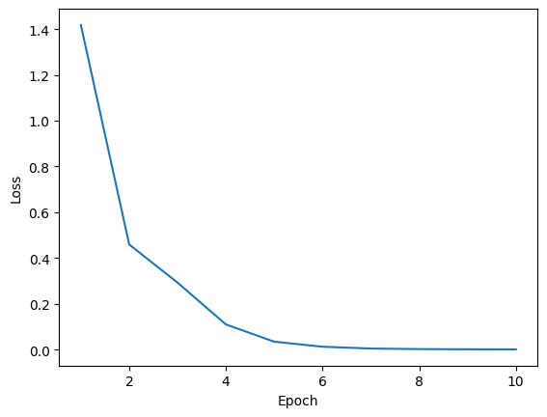
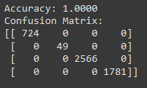
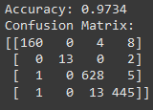
Results
Baseline Model Performance:
Accuracy > 80% with minimal overfitting.
Confusion matrix tor training
Confusion matrix tor testing

Slide 7
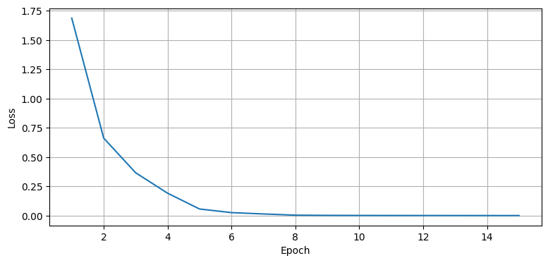
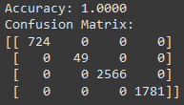
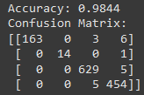
Augmented Model : Improved generalization and accuracy.
Confusion matrix tor training
Confusion matrix tor testing

