Slide 1
Java

Slide 2
Software List
Open JDK 8
Notepad++
IntelliJ Community .zip version (not .exe)
Maven bin .zip version

Slide 3
Recommended Books
Head First Java By Oreilly (Kathy Sierra)
Java For Dummies By Doug Lowe
Effecting Java By Joshua Bloch
Java Concurrency In Practice By Brian Goetz
Generics & Collections By Oreilly (Maurice Naftalin)

Slide 4
Recommended Links
https://docs.oracle.com/javase/tutorial/
https://docs.oracle.com/javase/8/docs/api/

Slide 5
Running Java
SOURCE CODE (Test.java)
PLATFORM INDEPENDENT (MAC, WINDOWS)
BYTE CODE (Test.class)
JVM Software

Slide 6
Commands
javac Test.java (compiles the source code into bytecode)
java Test (delegates the bytecode to jvm)

Slide 7
Open JDK8 ZIP
https://developers.redhat.com/products/openjdk/download

Slide 8
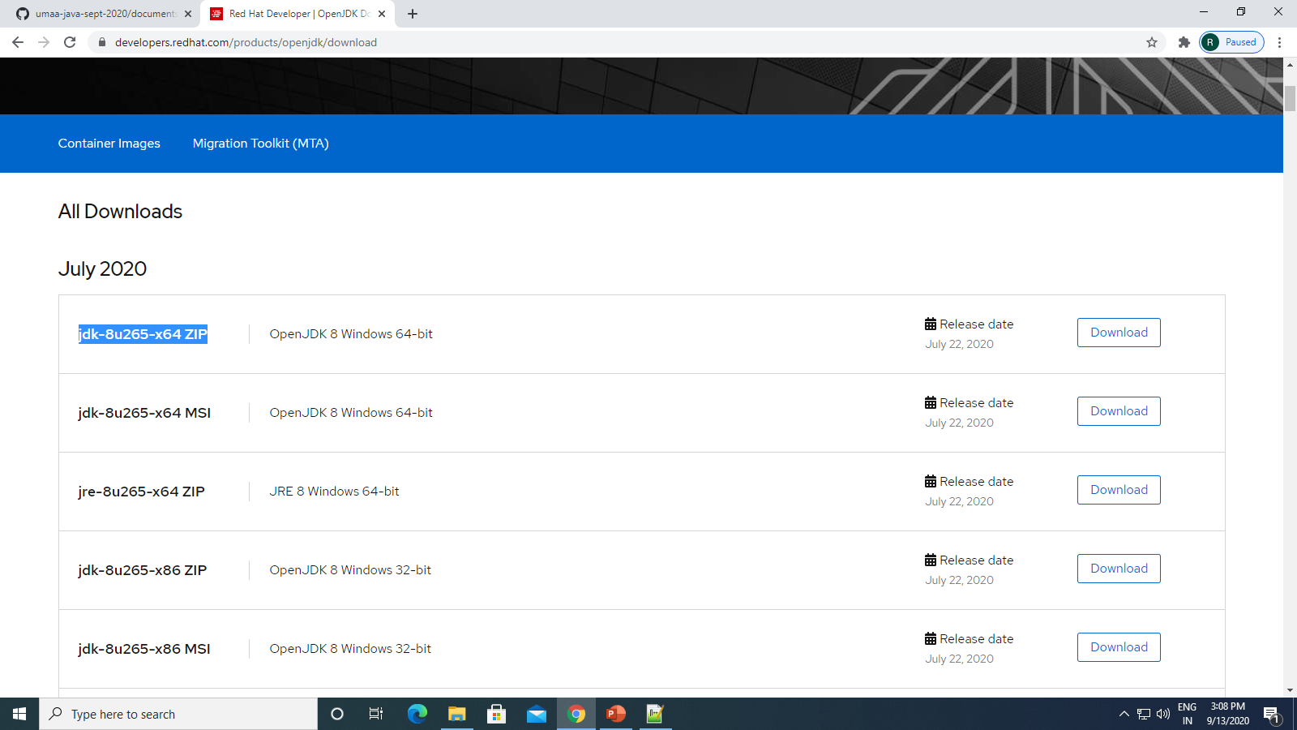

Slide 9
Maven Binary ZIP
https://maven.apache.org/download.cgi

Slide 10
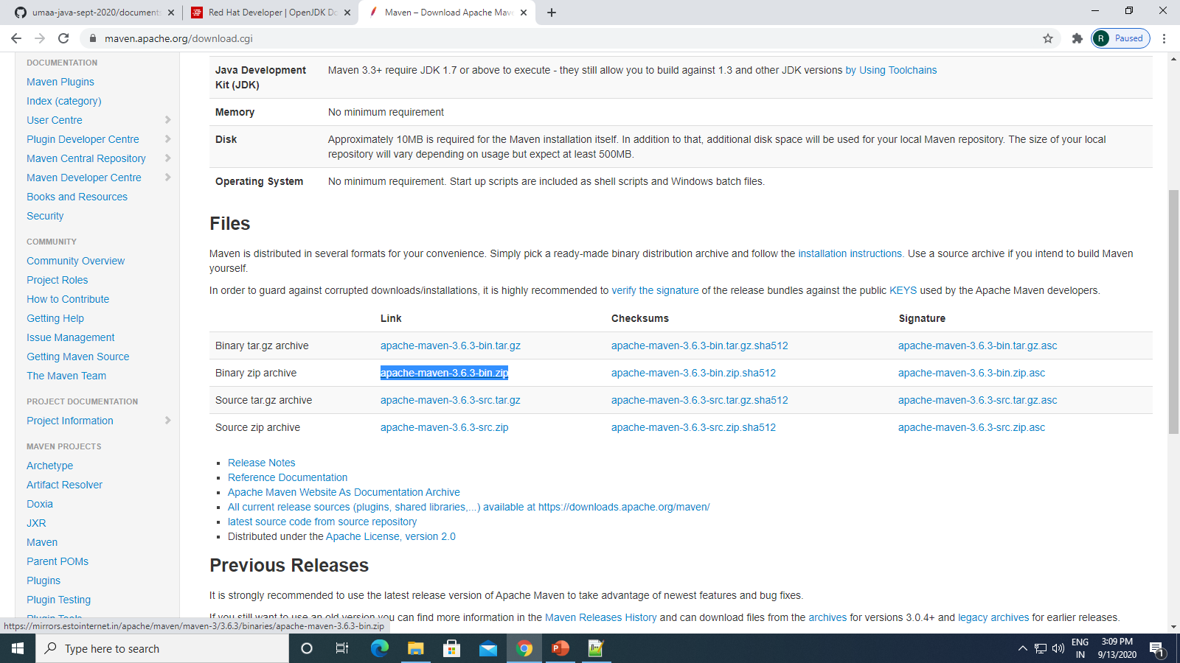

Slide 11
Notepad++ Download Installer .exe
https://notepad-plus-plus.org/downloads/v7.8.9/

Slide 12
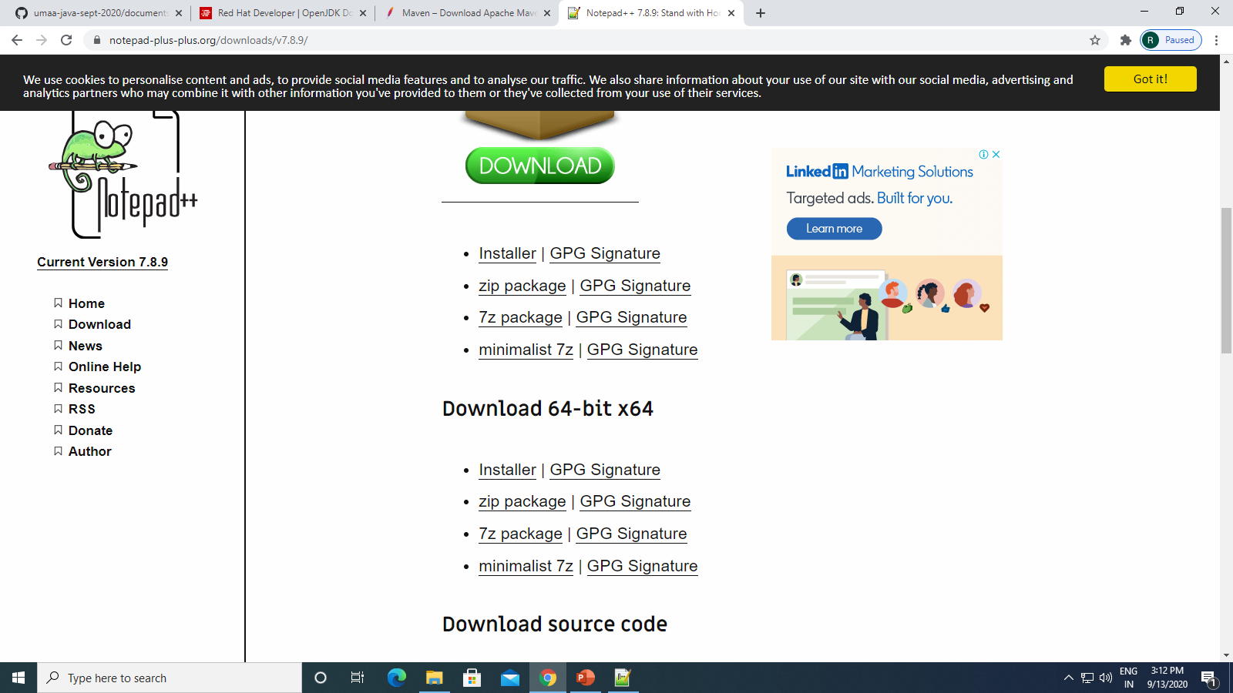

Slide 13
IntelliJ Ide Community Edition .Zip
https://www.jetbrains.com/idea/download/

Slide 14
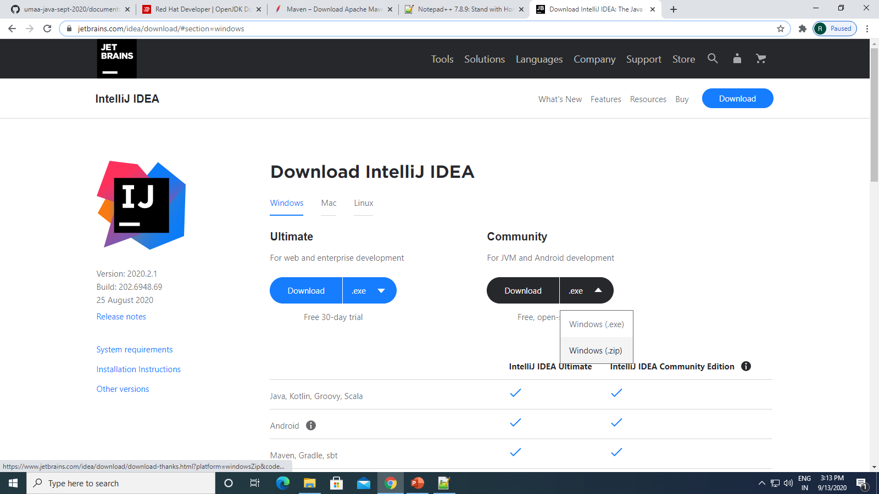

Slide 15
Topic to cover
Core Java
Jdbc
Servlets

Slide 16
Quiz
Why Java.
Founder Of Java.
In Which Year Java Founded.
Relation of java with sun micro systems.
What is the current version of java.
Relation of java with oracle.
Why openjdk.
List down some java frameworks.

