Slide 1

MINI PROJECT

Slide 2
Math Quiz Game Project By Umamani,Anjali,Deepak (B.Tech 2nd year CSE)
Here is where our presentation begins

Slide 3
01
02
03
Introduction
Objective
Key Features of the Project
04
05
06
Technologies Used
Project Architecture
Code snippets
About ourself, interest in Python & game development
Interactive quiz game with multiple difficulty levels.
Multiple levels, sound feedback, dynamic questions, real-time updates.
Python, Turtle Module, Winsound Module.
Screen setup, UI components, sound integration, game logic.
Generating questions and validating user answers.

Slide 4
07
08
Interface Screenshots
Challenges Faced
09
10
Conclusion
Q&A Session
Intro, game interface, and updated score displays.
Sound integration, dynamic question generation, interface responsiveness.
Gained skills in Python, game development, and problem-solving.
Q&A

Slide 5
Introduction
We are 2nd-year B.Tech Computer Science students passionate about Python, game development, and experimenting with coding project
We created this interactive math quiz game to improve my problem-solving skills, learn Python’s Turtle and Winsound modules, and gain practical experience in game development

Slide 6
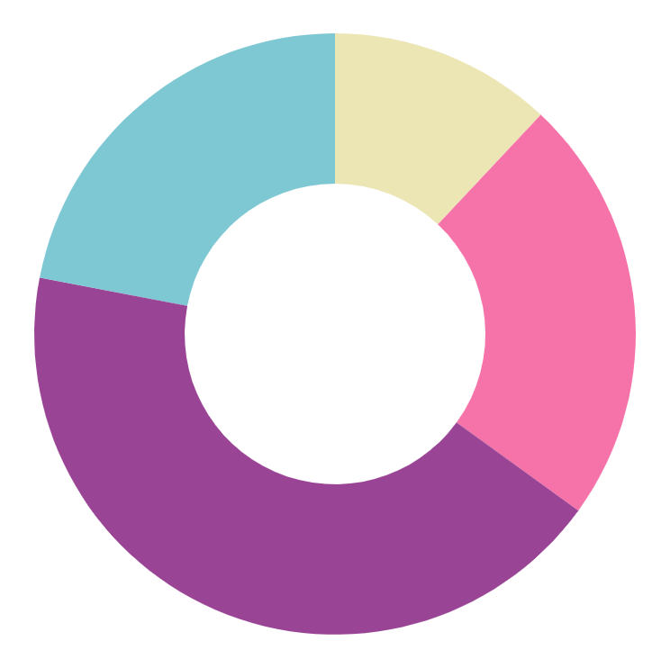
Objective
Create an interactive quiz game with three difficulty levels: Easy, Medium, and Hard.
Provide instant feedback with correct and wrong answer messages and appropriate sounds.
Display and track user progress, scores, and difficulty levels in real-time.
Enhance problem-solving, logical thinking, and Python programming skills.

Slide 7
Key Features of the Project
Multiple Difficulty Levels:
Sound Feedback Integration:
Dynamic Question Generation:
User Interface Updates:
Level 1: Easy (Addition, Subtraction),
Level 2: Medium (Multiplication),
Level 3: Hard (Division, Mixed Operations)
Correct: Beep sound, Wrong: Different beep sound
Questions adjust automatically based on difficulty.
Real-time Level and Score updates with a clean, user-friendly interface

Slide 8
Technologies Used
Python Programming Language:
Turtle Module:
Winsound Module:
Game Logic and Algorithms:
Used for logic implementation, game mechanics, and interface design.
Used for creating graphics, UI elements, and interface components.
Integrated to provide sound feedback for correct and incorrect answers.
Dynamic quiz generation, answer checking, and score management

Slide 9
Project Architecture
Screen Setup
UI Components
Sound Integration
Game Logic
Initial setup of the game window using the Turtle module
Level and Score Displays show game progress, while the Pen displays questions and feedback
Correct and incorrect answers trigger distinct beep sounds using the Win sound module
Dynamically generates quiz questions, checks answers, and handles scoring and level

Slide 10

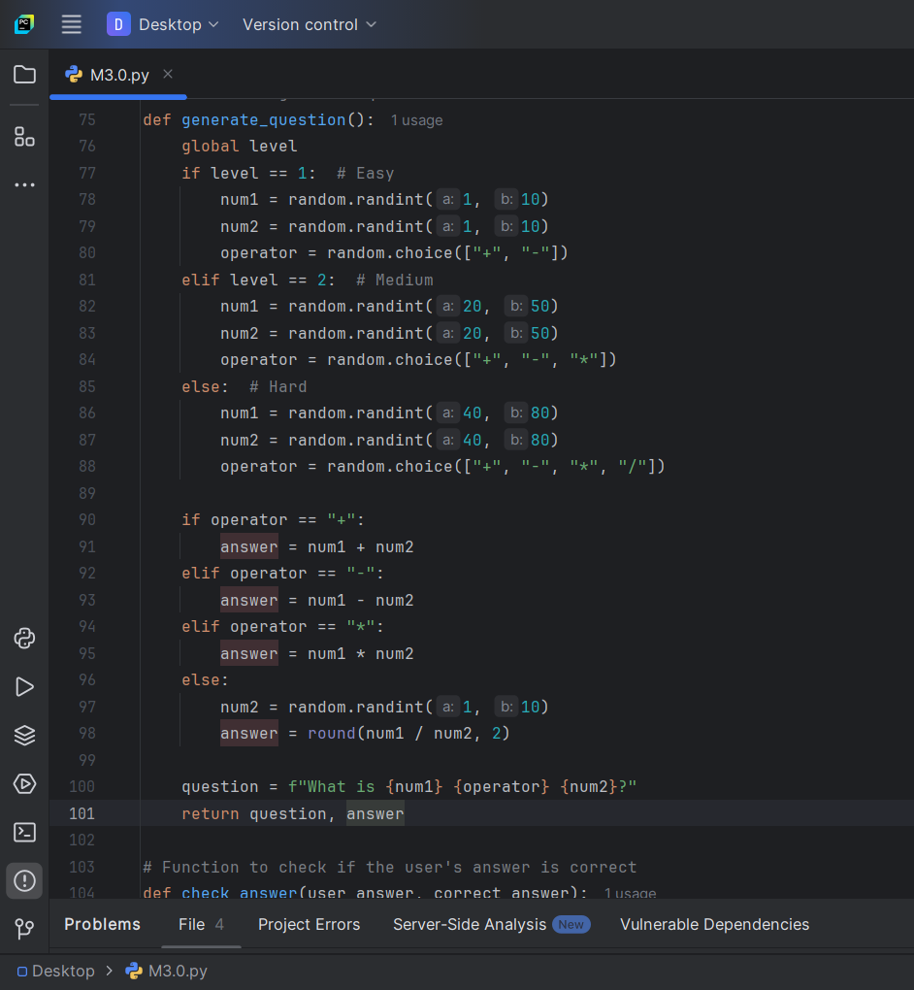
Code Snippets
Dynamically generates arithmetic questions tailored to the current difficulty level: Easy, Medium, or Hard.

Slide 11
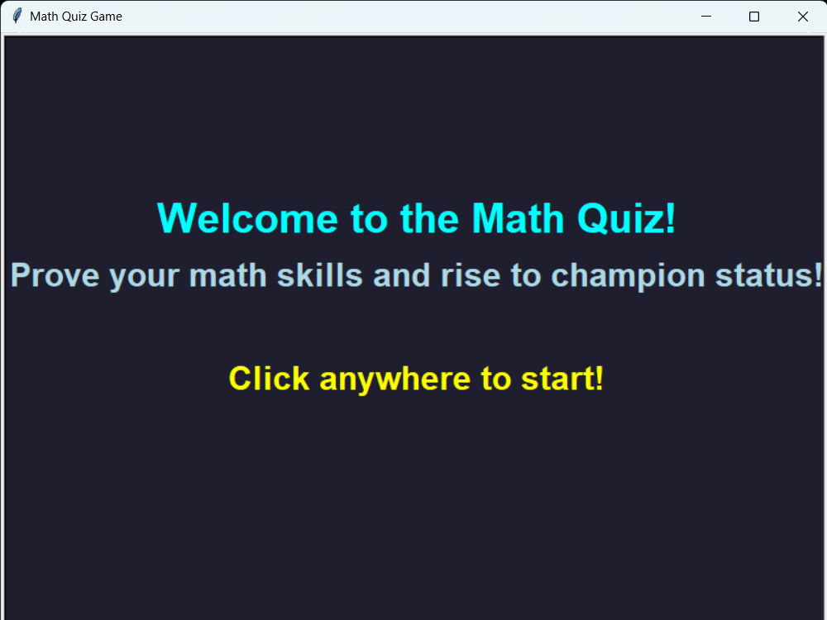
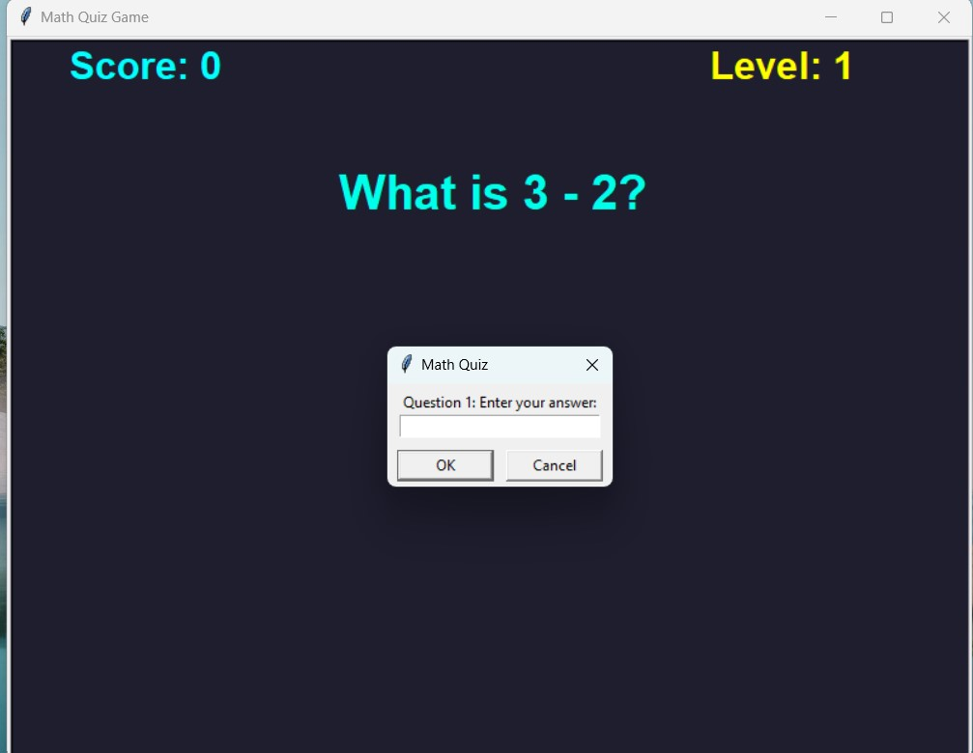

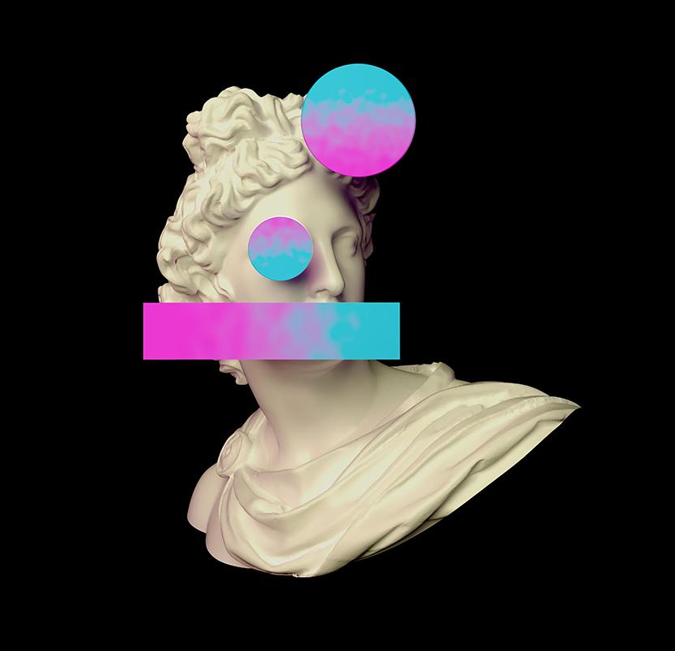
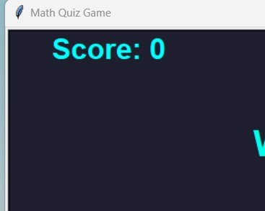
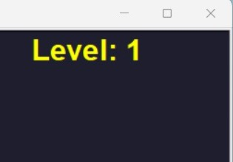
Interface Screenshots
Intro Screen
Game Interface:
Level and Score Display:
Welcome screen with 'Welcome to the Math Quiz' and instructions: 'Click anywhere to start
Displays current questions with a user interaction window for input answers.
Displays score and level, updating in real-time during the quiz

Slide 12
Challenges Faced
Dynamic Question Generation
Sound Integration
Interface Design
Creating a logic to adjust questions according to difficulty levels.
Difficulty in integrating the Winsound module for instant feedback
Maintaining a clean and responsive interface while ensuring quick response times.

Slide 13
Conclusion
We gained expertise in Python programming and game development, while also learning about dynamic question generation and user interface integration.
Improved problem-solving skills, logical thinking, and algorithmic knowledge.

Slide 14
Future aspects of the project
The future of our Python math quiz is
full of cool features, like making it look nicer, smarter, more fun,
and useful for everyone. It could become a tool that not only helps
users practice math but also keeps them motivated to learn more.

Slide 15
THANKS

