Slide 1
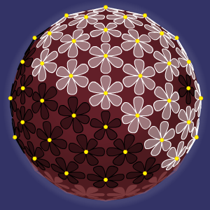
Daisyworld
-
Modelling a Sustainable Planet

Slide 2
The Classic Daisyworld Model
Concept: A planet where life itself regulates the global temperature.
The Rules:
Black Daisies: Absorb sunlight, warming the planet. They prefer cooler temperatures.
White Daisies: Reflect sunlight, cooling the planet. They prefer warmer temperatures.
The Feedback Loop:
Planet gets hot -> White daisies spread -> Planet cools down.
Planet gets cold -> Black daisies spread -> Planet warms up.
Result: A stable, self-regulating system.

Slide 3
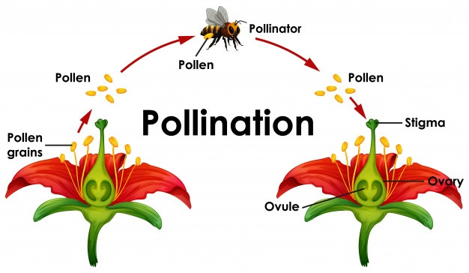
New Factor: The "Pollen Effect"
The Question: What if daisies didn't just compete for empty land, but competed directly with each other?
New Rule: Daisies can convert their neighbours.
A small probability (5%) for any daisy to "pollinate" its neighbours.
If a black daisy's pollen hits a white daisy, it can flip it to black.
If a white daisy's pollen hits a black daisy, it can flip it to white.
The Key: This new rule is independent of temperature. It is a direct "war" for territory.

Slide 4
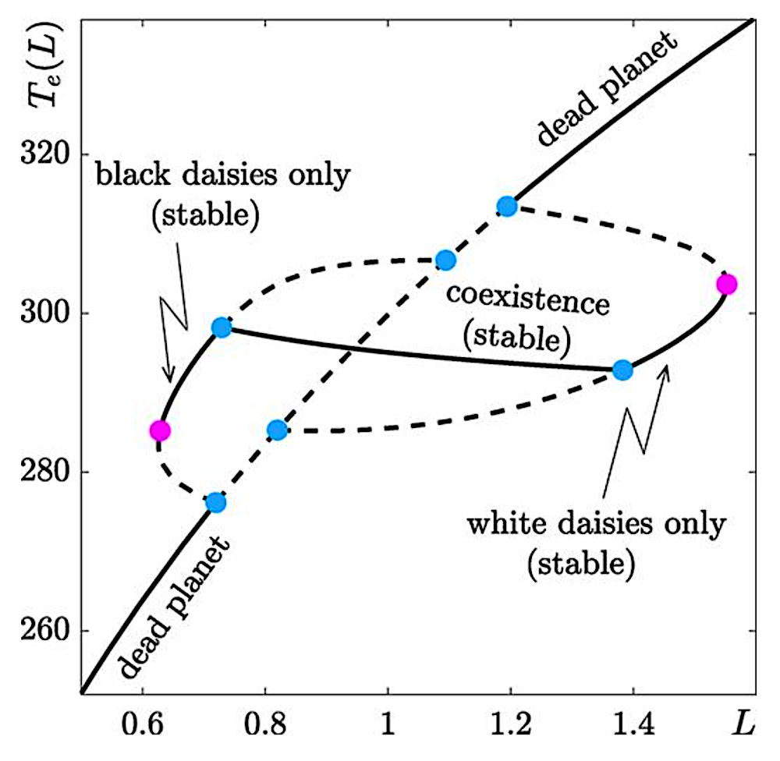
Hypothesis: The Tipping Point
Two competing feedback loops:
Environmental Loop: Daisies vs. Temperature (Balance)
Conflict Loop: Black Daisies vs. White Daisies (Dominance)
Hypothesis: We predicted the Conflict Loop would be stronger.
We expected a "Tipping Point" where one species would gain a small advantage, trigger a "runaway" effect, and wipe the other species out, leading to a total ecosystem collapse.

Slide 5
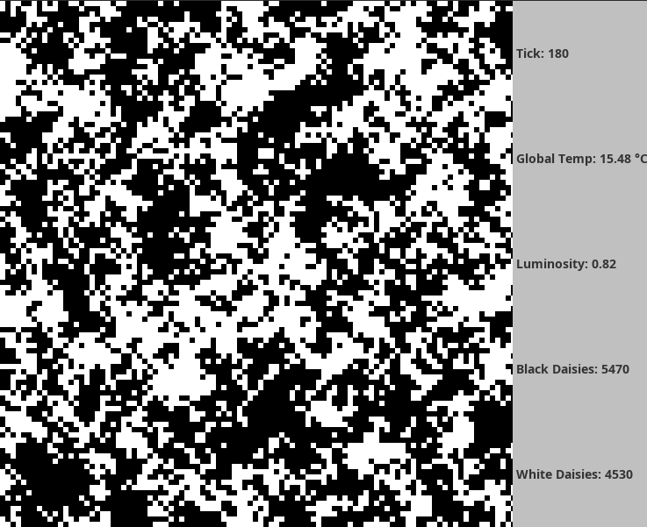
The Simulation Architecture
Our simulation runs in discrete steps called "ticks".
Logic per Tick:
Update Sun: Solar luminosity (heat) slowly increases.
Calculate Temp: Global temperature is calculated based on the planet's average colour (albedo).
Run "Pollen War" (New Step): Every daisy attempts to convert its neighbours (5% chance).
Run Reproduction (Classic Step): Daisies grow on empty land based on the local temperature.
Record Data: Log the populations and temperature for this tick.

Slide 6
The Visual Results
Classic Daisyworld: A random mix of daisies.
Our "Pollen Effect" Model:
The simulation shows large, continental-sized clusters of a single colour.
The borders between these clusters become active "battlegrounds" where conversion is constantly happening.
This confirms our "internal conflict" rule is working visually.

Slide 7
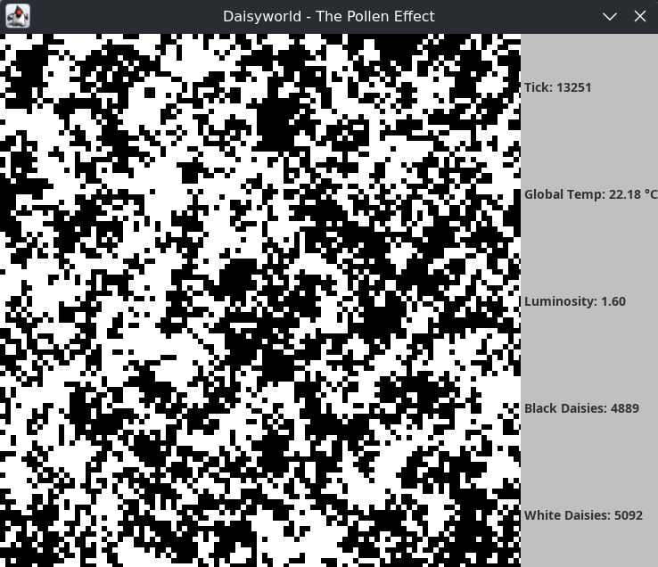
An Unexpected Stability!
Our hypothesis was wrong... in a fascinating way.
The Data (after 13,000 ticks):
Luminosity: 1.60 (Maximum level - extreme pressure)
Global Temp: 22.1 °C (A perfect, stable temperature!)
Populations:
Black Daisies: ~4800
White Daisies: ~5100
Analysis: The system did not collapse. The "Pollen War" did not create a winner; it created a perfect stalemate.

Slide 8
Analysis & What We Learned
Why did it stabilize? The two competing loops created a new, dynamic balance.
The "Pollen War" prevents either species from getting too dominant.
The "Temperature" loop prevents the planet from dying.
The internal conflict itself became a regulating mechanism, forcing the populations into a ratio that perfectly balanced the extreme heat from the sun.
We modelled a complex system where two competing feedback loops created an emergent, stable state.
Our key lesson: Sustainability is not the absence of conflict; it is the management of it. A system can be incredibly resilient, not despite its internal conflicts, but because of them.

Slide 9
Thank You

