Slide 1

TRAVEL GUIDE ANALYSIS
Analyzing the price of travel destination including all features
By
KOMATI UMA BHARATHI
PAVULURI ASHWITHA

Slide 2
Agenda:
Introduction
Data Collection
Data Cleaning
Data analysis and Data Visualization
Conclusion

Slide 3
Introduction
Objective of Analysis:
To retrieve all the potential insights from the extracted travel data.
To identify which features have the most significant impact on the trip destination.
To help tourists to find best places to visit according to their budget.
Overview of the Dataset:
The dataset includes information of Travel destination city, Price, Discount, number of days in Vacation.
The data has been sourced from Travel Triangle.
Scope of Analysis:
Exploring the relationship between city and price variants.
Performing analysis on different columns which are related to each other.
Identifying trends and patterns in the data.
Building predictive models to estimate travel budget based on their destination.

Slide 4






Required libraries:
Requests
BeautifulSoup
Re
Numpy
Pandas
Matplotlib
Seaborn
Python

Slide 5
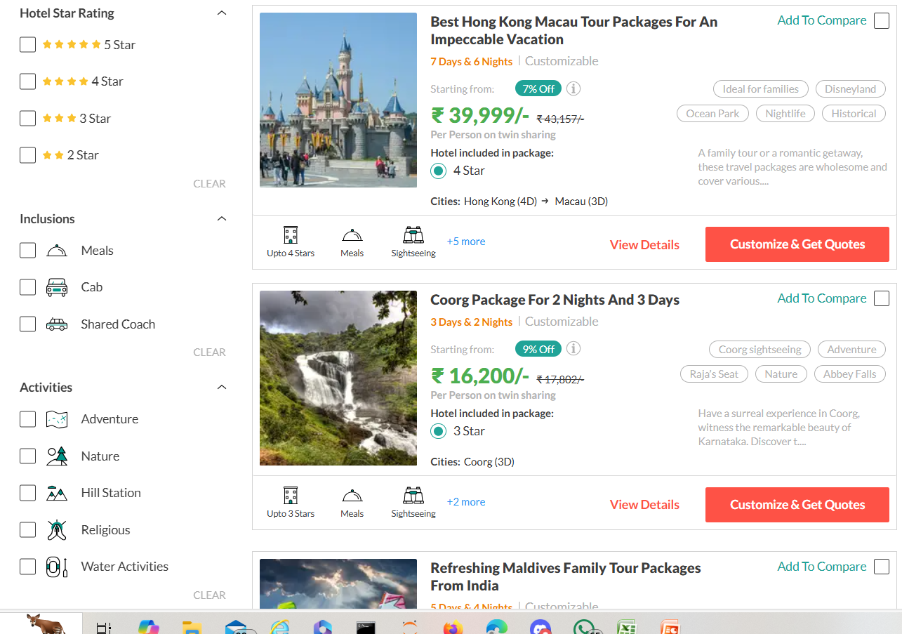
Website:
Website used to scrape the data:
URL: Family Packages - Book Tour Packages for Family at TravelTriangle

Slide 6
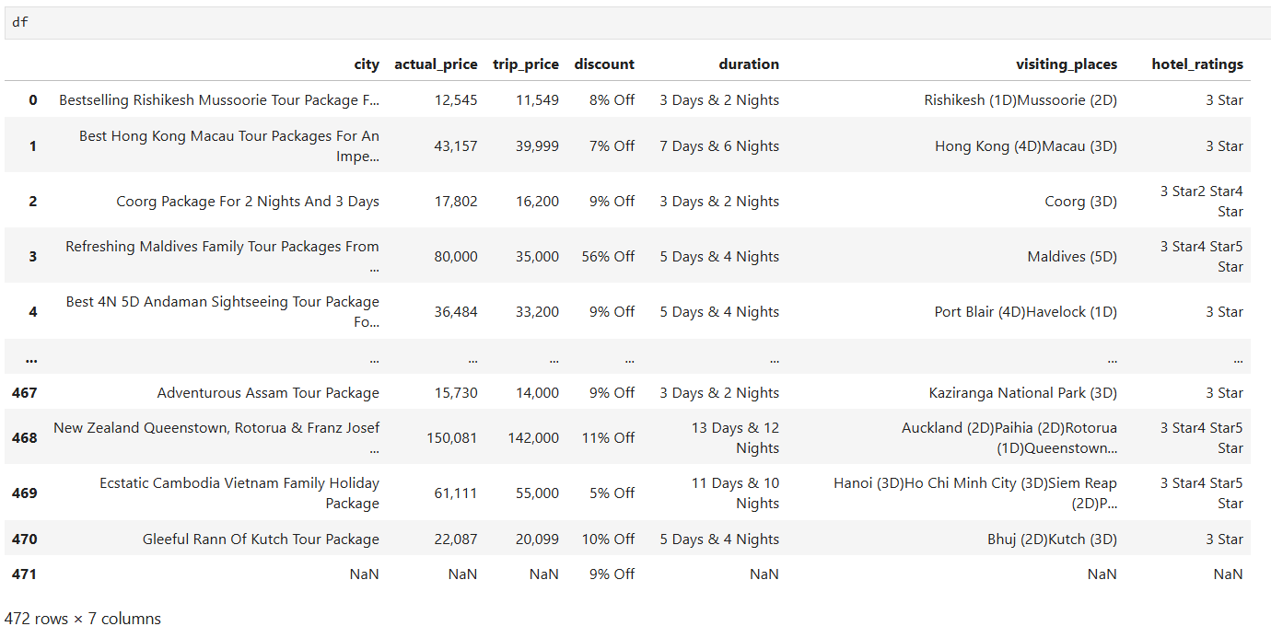
Summary of data
Data obtained after scrapping:
Travel data in Data frame:

Slide 7
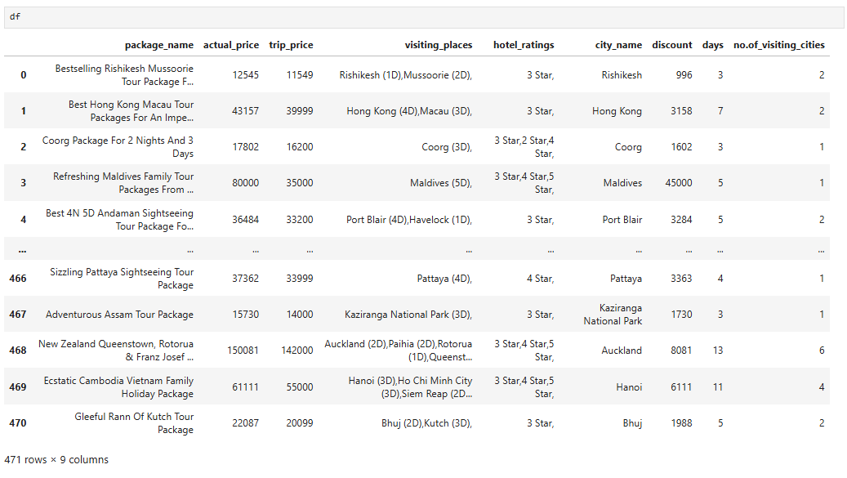
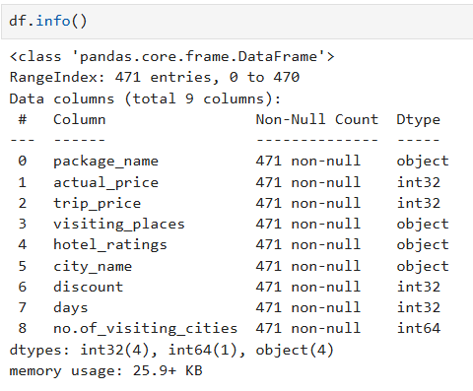
Data Cleaning:
Data cleaning is the process of fixing or removing incorrect, corrupted, incorrectly formatted, duplicate, or incomplete data within a dataset.
Removing unnamed column & duplicaties and converting datatypes (after cleaning) :

Slide 8

DATA ANALYSIS AND VISUALIZATION

Slide 9
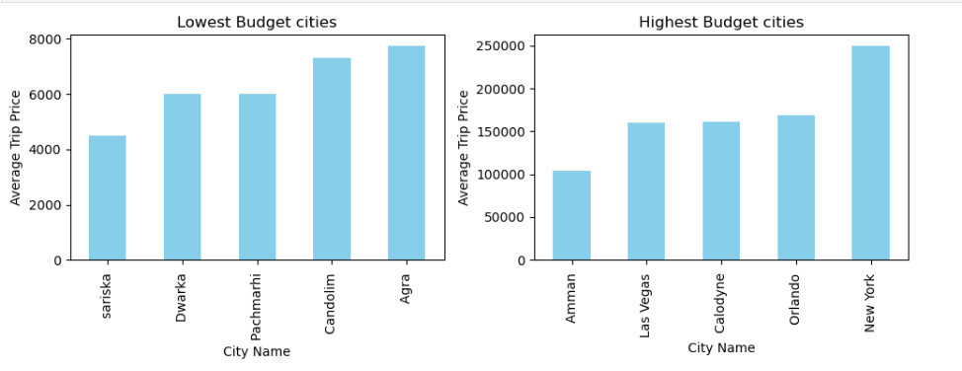
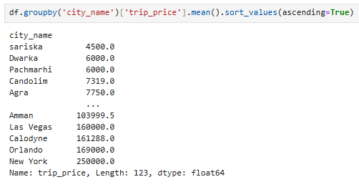
Trip Price according to the budget and cities

Slide 10
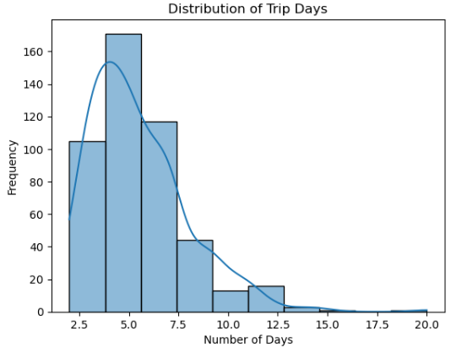
FREQUENCY OF NUMBER OF DAYS IN TRIP
Most trips are lasting for 5 to 6 days
Range of the trips are 3 to 10 days

Slide 11
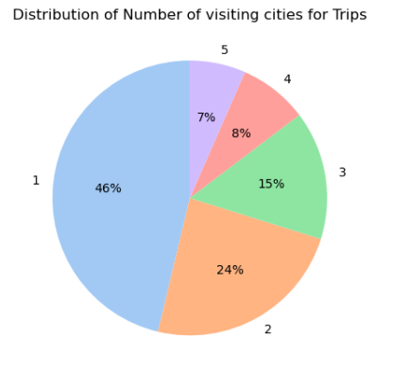
FREQUENCY OF NUMBER OF VISITING CITIES
In 46% of trips tourist visit only 1 place.
We rarely observe people travelling more than 5 cities

Slide 12
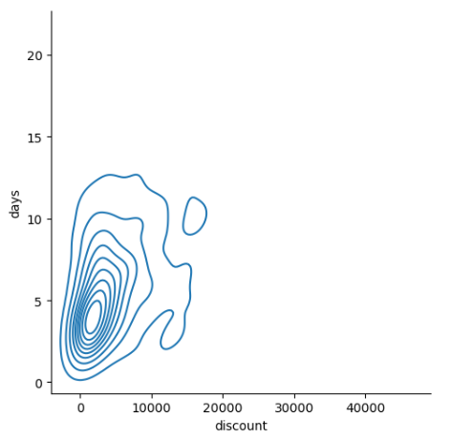
DISCOUNT ACCORDING TO THE NUMBER OF DAYS IN VACATION
As we have seen frequency of number of days and visiting cities.
This is the discount variation according to the number of days in vacation.
When the number of days of vacation is less then discount is less.

Slide 13
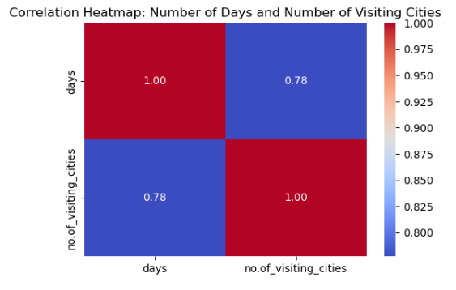
CORRELATION BETWEEN NUMBER OF DAYS AND NUMBER OF VISITING CITIES
We can find there is a strong correlation between number of visiting cities and number of days in vacation

Slide 14
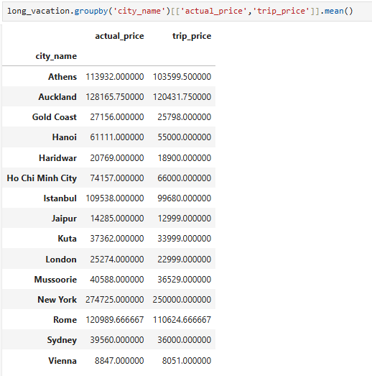
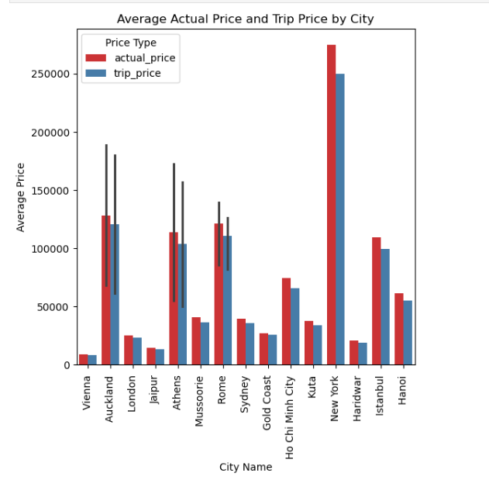
PRICE DIFFERENCE FOR LONG VACATION ON AVERAGE

Slide 15
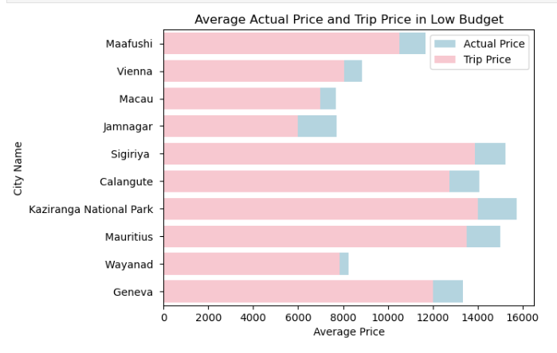
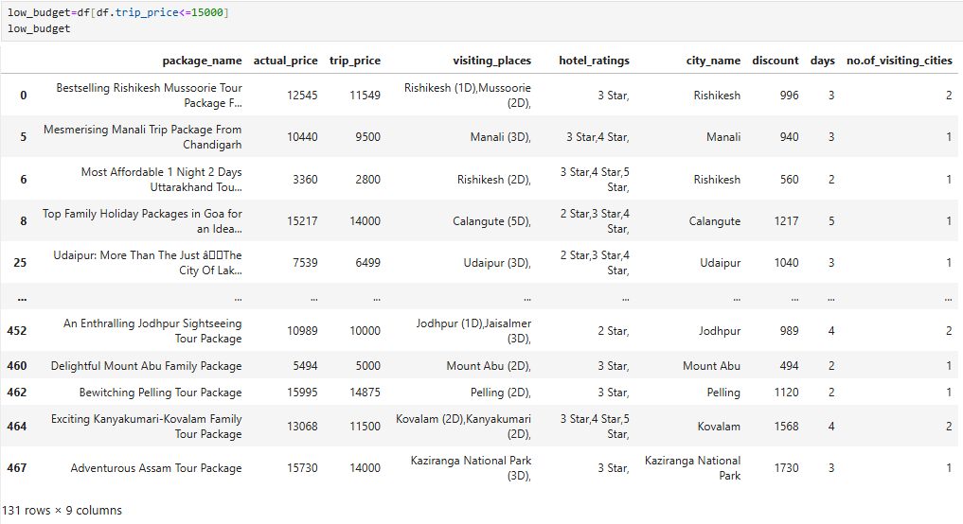
LOW BUDGET CITIES ACCORDING TO PRICE

Slide 16
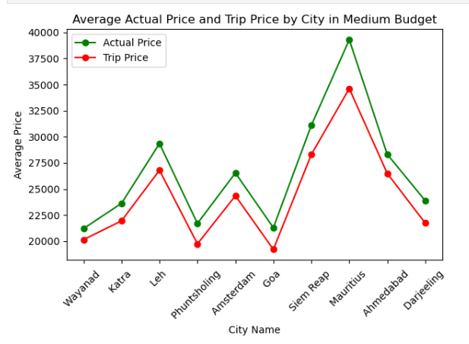
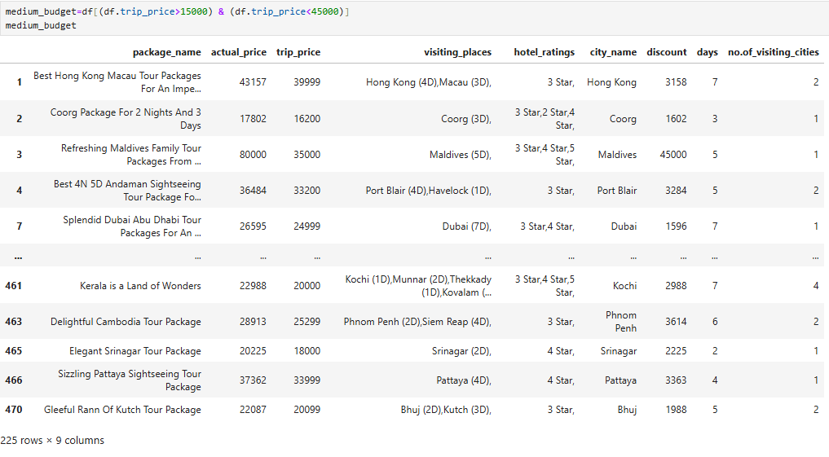
MEDIUM BUDGET CITIES ACCORDING TO PRICE

Slide 17
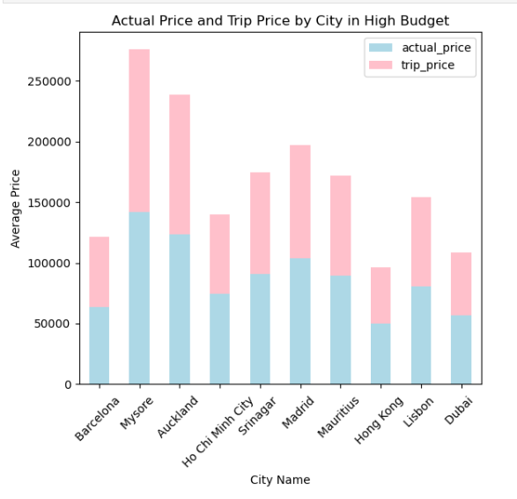
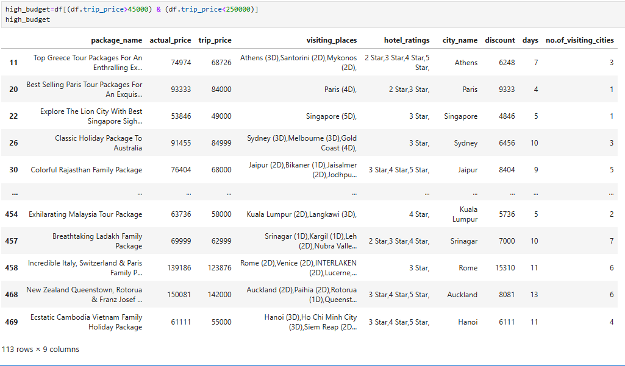
HIGH BUDGET CITIES ACCORDING TO PRICE

Slide 18
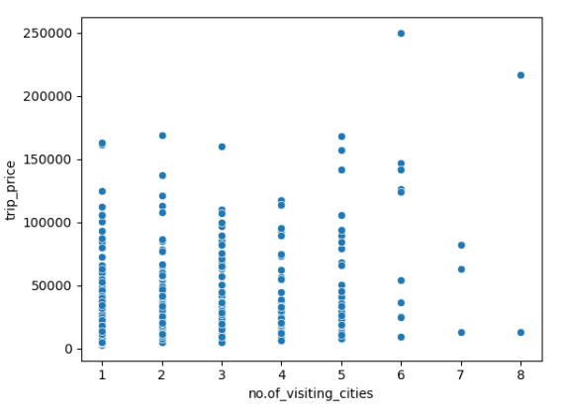
TRIP PRICE ACCORING TO NUMBER OF VISITING CITIES
Number of visiting cities does not affect the trip price.
The price of trip is based on the location and popularity of the place.

Slide 19
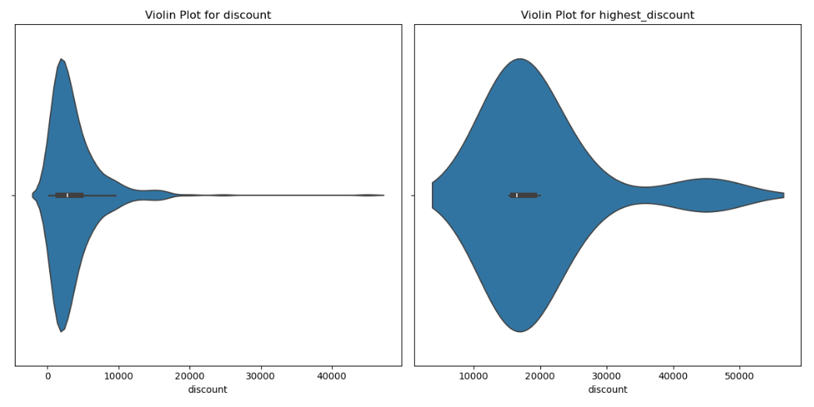
DISCOUNT DISPERSION BETWEEN OVERALL DISCOUNT AND HIGHEST DISCOUNTS

Slide 20
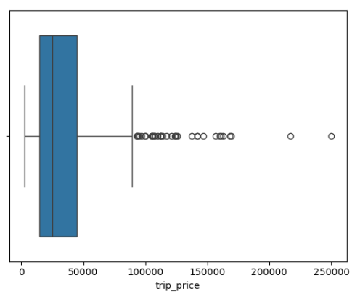
BOX PLOT ON TRIP PRICE
Most of the trips are ranging between 20,000 to 80,000.
There are outliers and cannot treat them because it is based on the trip location.
Some people are likely to travel to those cities.
So we need to perform analysis on outliers also.

Slide 21
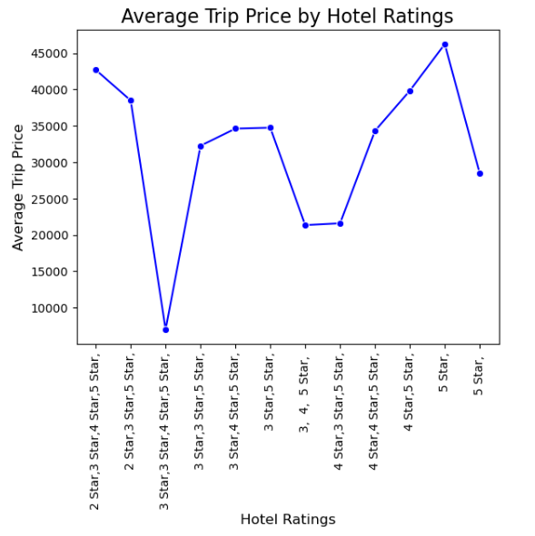
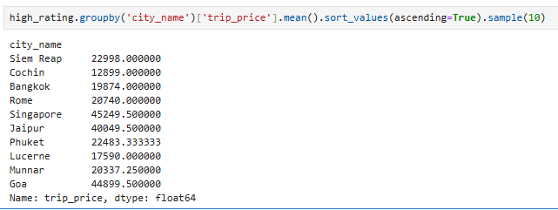
CITIES WITH HIGH RATINGS AND AVERAGE TRIP PRICE ACCORDING TO RATINGS

Slide 22
Conclusion
Discount and price factors are affecting the number of vacation days and visiting cities.
There is a strong correlation between number of days and visiting cities.
Price varies according to the number of days of trip.
Classified cities according to the budget where every parameter changes when price is varying.
Most of the trips last for 5 to 6 days.
In every trip mostly tourists visit 1 city.
There are highest discounts for some trips.
Hotel ratings are also affecting the price.
For some trips cost is too high and some are low cost can be travelled according to the budget.

Slide 23

THANK YOU

