Slide 1

Preparation Hub
A Cloud-Based Student Preparation Platform
Presented by:
1. Bapatla Kavya Sri
2. Bhimireddy Vaishnavi Reddy
3. Bitra Sri Lakshmi Nivas
4. Uma Chandra Chakravaram
5. Kumara Vishnu Chattu

Slide 2
Agenda
Problem Statement
Solution Overview
Key Features
AWS Services Used
Architecture
Future Enhancements
Conclusion

Slide 3

Problem Statement
Students juggle multiple websites and platforms for placement and exam preparation.
Resources are scattered across sources and hard to organise.
No centralised system exists to track progress and bookmarks.
Manual management of study materials is inefficient and time-consuming.
Secure, personalised access to preparation resources is limited.

Slide 4

Solution Overview
Preparation Hub centralises learning resources for placement and competitive exam preparation. Students sign in securely with Amazon Cognito, browse categorised study materials, bookmark key items, and monitor progress via a personalised dashboard.
Hosting
Backend
Static frontend hosted on Amazon S3 for fast, secure delivery.
Serverless business logic with AWS Lambda; API Gateway manages requests.
Data
User profiles, bookmarks, and progress stored safely in Amazon DynamoDB.

Slide 5




Key Features
Secure Authentication
Personalised Dashboard
Bookmark Management
Serverless & Scalable
Single sign-on and robust identity management via Amazon Cognito.
Track learning milestones, recent activity and personalised goals.
Save and categorise resources for quick revisit and revision planning.
Backend implemented with AWS Lambda and API Gateway for elastic scaling.

Slide 6
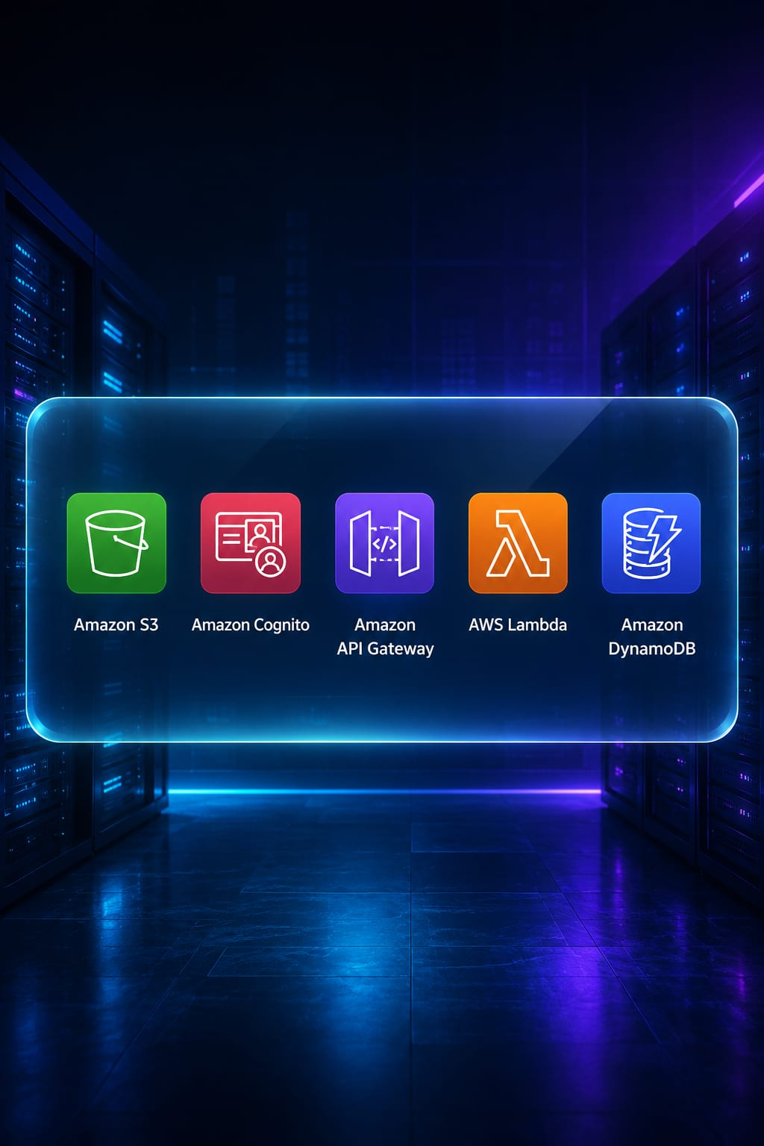
AWS Services Used
1. Amazon S3
Hosts the static website and assets.
2. Amazon Cognito
Secure authentication and user management.
3. AWS Lambda
Serverless backend for business logic.
4. Amazon DynamoDB
Stores profiles, bookmarks, progress.
5. Amazon API Gateway
Frontend-to-backend integration and routing.

Slide 7
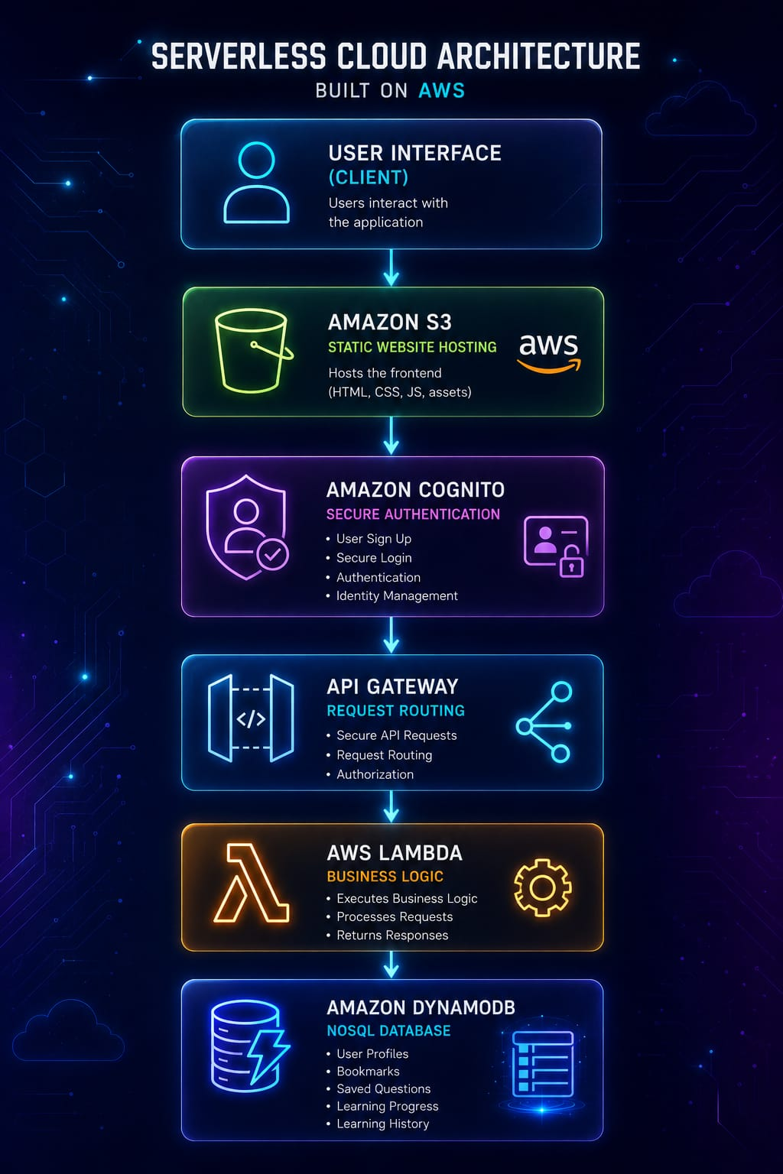

Architecture
User
Cognito
Lambda
Frontend
API Gateway
A serverless, event-driven architecture: static frontend on S3, secure authentication via Cognito, API Gateway routing to Lambda, and DynamoDB for low-latency storage. This delivers scalable, cost-efficient operations with minimal management overhead.

Slide 8
Future Enhancements
AI-powered Study Assistant
Personalised Recommendations
Context-aware tutoring, question summarisation and clarifications.
Adaptive content suggestions based on performance and goals.
Mobile Application
Resume Analyzer
Native iOS/Android apps for on-the-go learning and push notifications.
Automated CV checks with role-matching suggestions.
Analytics Dashboard
Institution-level metrics and student engagement insights.

Slide 9

Conclusion
Centralised platform simplifies student preparation and resource discovery.
Bookmarks and progress tracking improve study efficiency and retention.
Secure authentication through Amazon Cognito protects user data.
Serverless AWS architecture offers scalability, reliability and low operational overhead.
Platform design supports future AI-driven personalisation and mobile reach.

Slide 10

THANK YOU
Questions?

