Slide 1

Depression Detection Analysis
Authors: Joe Patton, Zachary Wenz, Jesse Kowalcic, Ahmed Abouhashem
https://github.com/umadjoe440/Data_Final

Slide 2
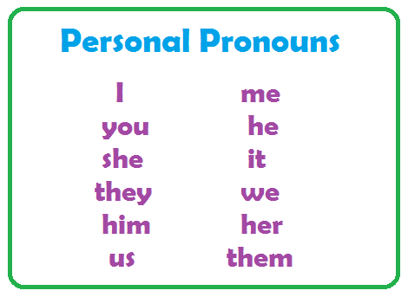
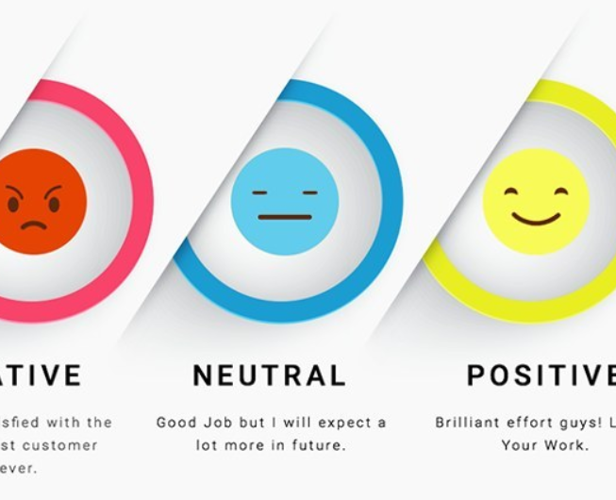
Pre-Research
Multiple studies identified predictors of depression in text:
Personal pronouns use
Negative sentiment
Absolutist language

Slide 3

Can we use ML Models to detect warning signs of depression in subreddit posts?

Slide 4

Our Methods

Slide 5


Sub-reddits used

Slide 6
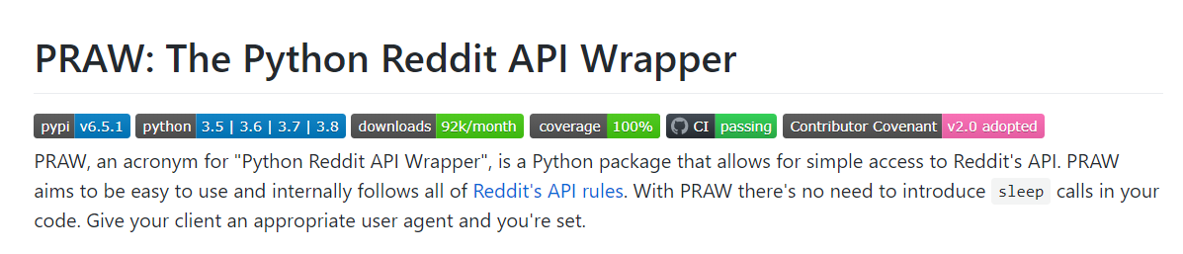
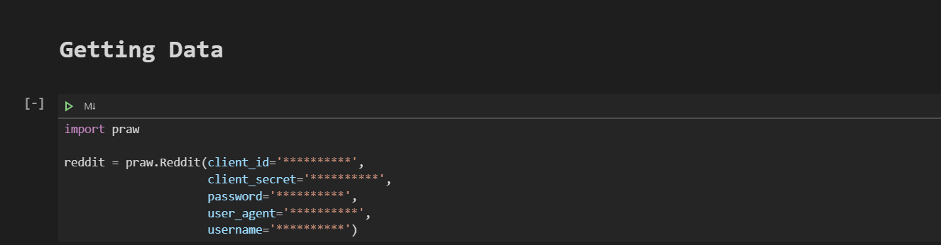
Data Collection

Slide 7
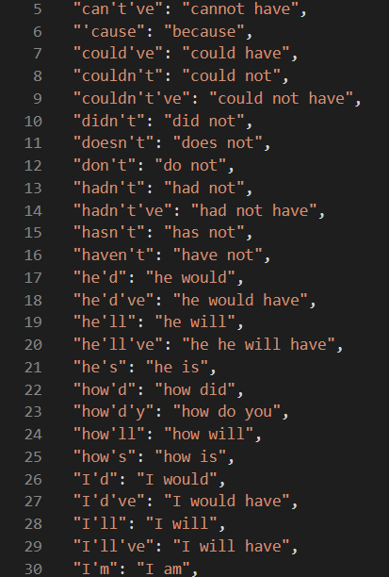
Contraction removal

Slide 8
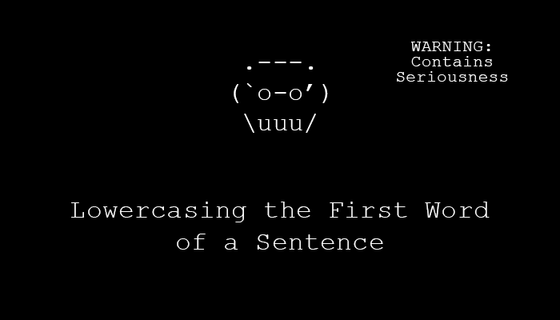
Lower casing

Slide 9
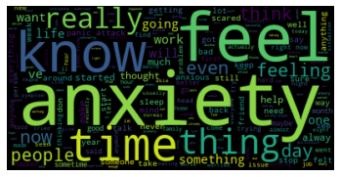
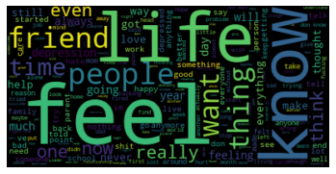
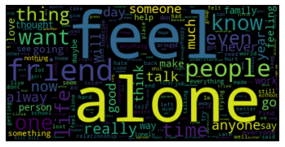
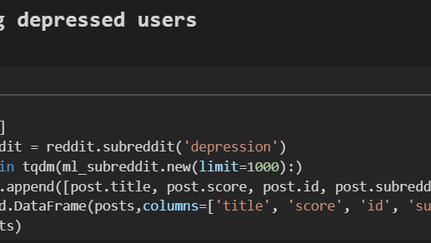
The Depression Subreddit
https://www.reddit.com/r/depression/

Slide 10
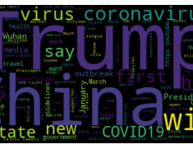
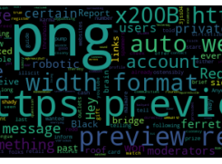
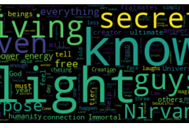
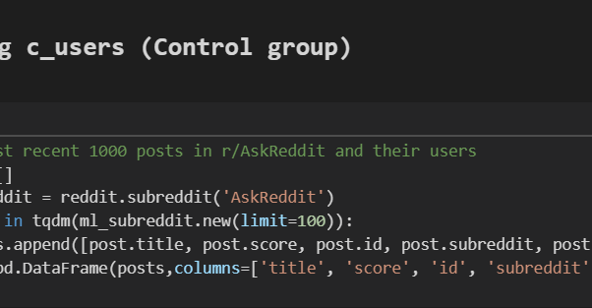
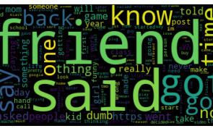
The AskReddit subreddit
The control group
https://www.reddit.com/r/AskReddit/

Slide 11
Model Types
Type | Features
Logistic | Sentiment, First person pronouns, absolutist language index | 63%
 | Vector Counts | 94%
 | Words | 83%
 | Ngrams | 87%
 | Characters | 83%
Naïve Bayes | Vector Counts | 84%
 | Words | 75%
 | Ngrams | 80%
 | Characters | 62%
SVM | Ngram vectors | 63%
Random Forest | Vector Counts | 91%
 | Words | 92%
Gradient Boosting | Vector Counts | 94%
 | Words | 95%
 | Characters | 96%
5 different types of classifiers
Various feature types
Gradient boosting showed best results
Potential opportunity for stacking

Slide 12
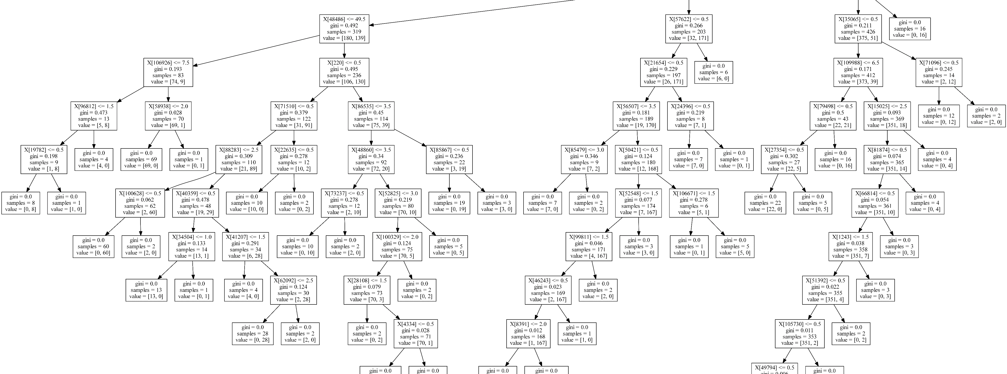
Model Visuals
Feature overview
Visualization of best models

Slide 13
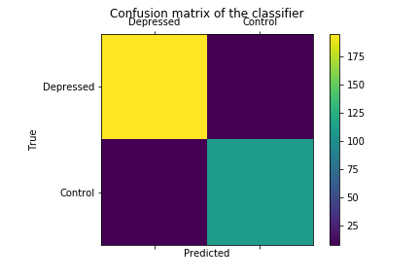
Best Model – Gradient boosting with characters as features

Slide 14
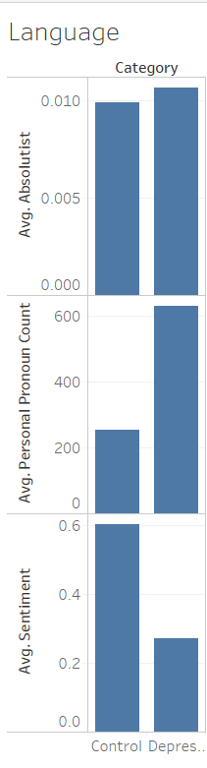
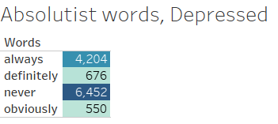
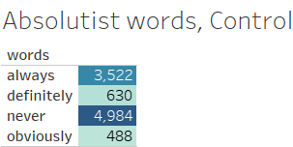
Feature analysis

Slide 15
Where we are trying to go from here
Predictor app
Improve classifier
Add different kinds of text to the data

