Slide 1


Study Literature Review and Scientific Writing
Oleh:
Dr. Wasilah, S.Kom,M.T.
18/8/2010
Revisi 01 Audit Sistem Informasi

Slide 2
TEKNIK PERKULIAHAN
Orasi
Interaktif
Review artikel
Tugas Mandiri / Terstruktur
Diskusi
Presentasi
LMS/ online
18/8/2010
Revisi 04 Pemodelan Proses Bisnis

Slide 3
TEKNIK PENILAIAN
Presensi Kehadiran
Tugas Mandiri
Ujian Tengah Semester
Ujian Akhir Semester
Attitude
18/8/2010
Revisi 04 Pemodelan Proses Bisnis

Slide 4
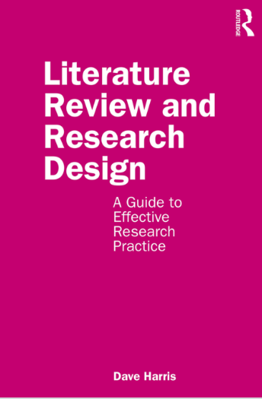
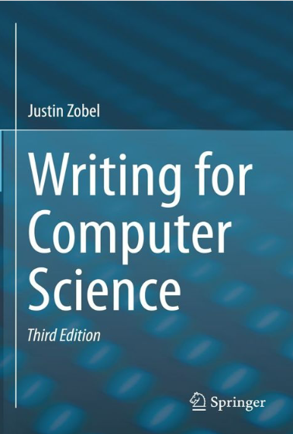
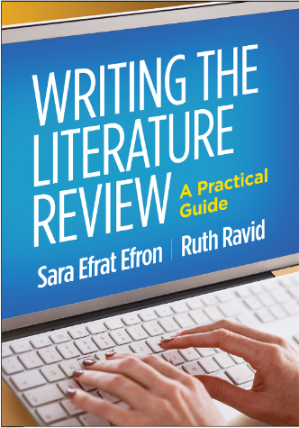
Refference
18/8/2010
Revisi 01 Audit Sistem Informasi

Slide 5
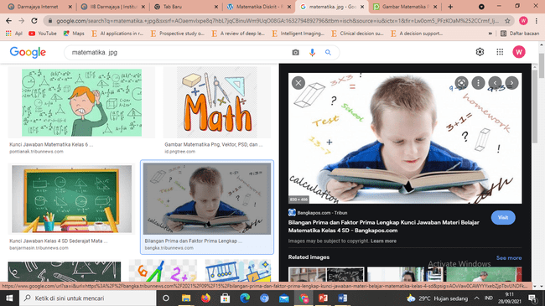
Refference
Writing for Computer Science, 2014, Justin Zobel
2. Writing The Literature Review A Practical Guide, 2019, Sara Efrat Efron Ruth Ravid
3. Literature Review and Research Design A Guide to Effective Research Practice ,2020, Dave Harris
5/4/2010

Slide 6
Silabus
Philosophy of scientific writing
Research Planning
How to get published in a reputable international journal with high impact factor
Finding Research Papers
Reading Literature
Developing a Literature Review
Evaluation of Papers
Content of Reviews
Drafting a Review
Checking Your Review
Writing a paper
14/3/2011
Revisi 01 Audit Sistem Informasi

Slide 7
Scientific research
Research is a considered activity, which aims
to make an original contribution to knowledge
5/4/2010
Revisi 01 Bahasa Indonesia

Slide 8
Research is about describing and explaining the real world: what is it and how does it work? It wants to tell a coherent story about the world, but not just any story; one that is, in basic terms, fact, not fiction.
5/4/2010
Revisi 01 Bahasa Indonesia

Slide 9
Research wants to explain the world, and so it tells stories about how the world works and stories about how research works. A research project will develop when a researcher is trying to tell a story and comes up against a question that wants an answer.
5/4/2010
Revisi 01 Bahasa Indonesia

Slide 10
Make original contribuon means:
Developing a novel approach to solve
a problem or
Using appropriate approach to solve
new problem
5/4/2010
Revisi 01 Bahasa Indonesia

Slide 11
Scientific results can be presented: a book, a thesis, a journal article, a paper or extended abstract in a conference or workshop proceedings, or a manuscript.
Kinds of Publication
5/4/2010
Revisi 01 Bahasa Indonesia

Slide 12
Each kind of publication has its own characteristics
5/4/2010
Revisi 01 Bahasa Indonesia

Slide 13
Thus “style” is not just about how to write, but is also about what to say.
5/4/2010
Revisi 01 Bahasa Indonesia

Slide 14
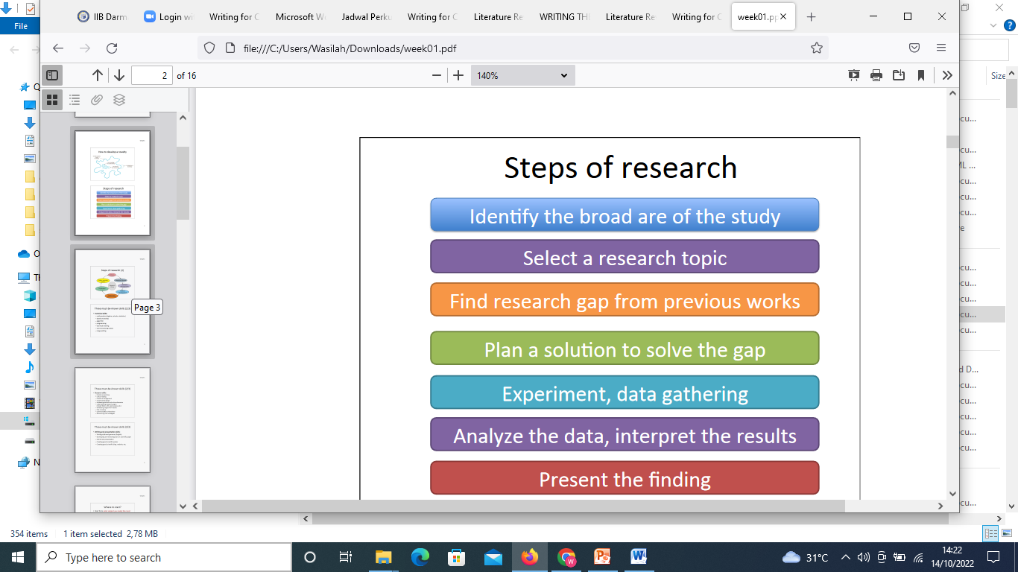
5/4/2010
Revisi 01 Bahasa Indonesia

Slide 15
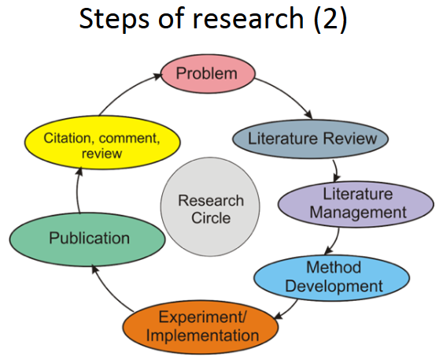

Slide 16
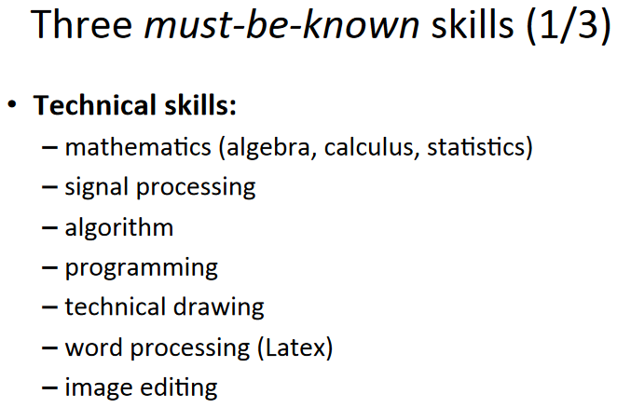

Slide 17
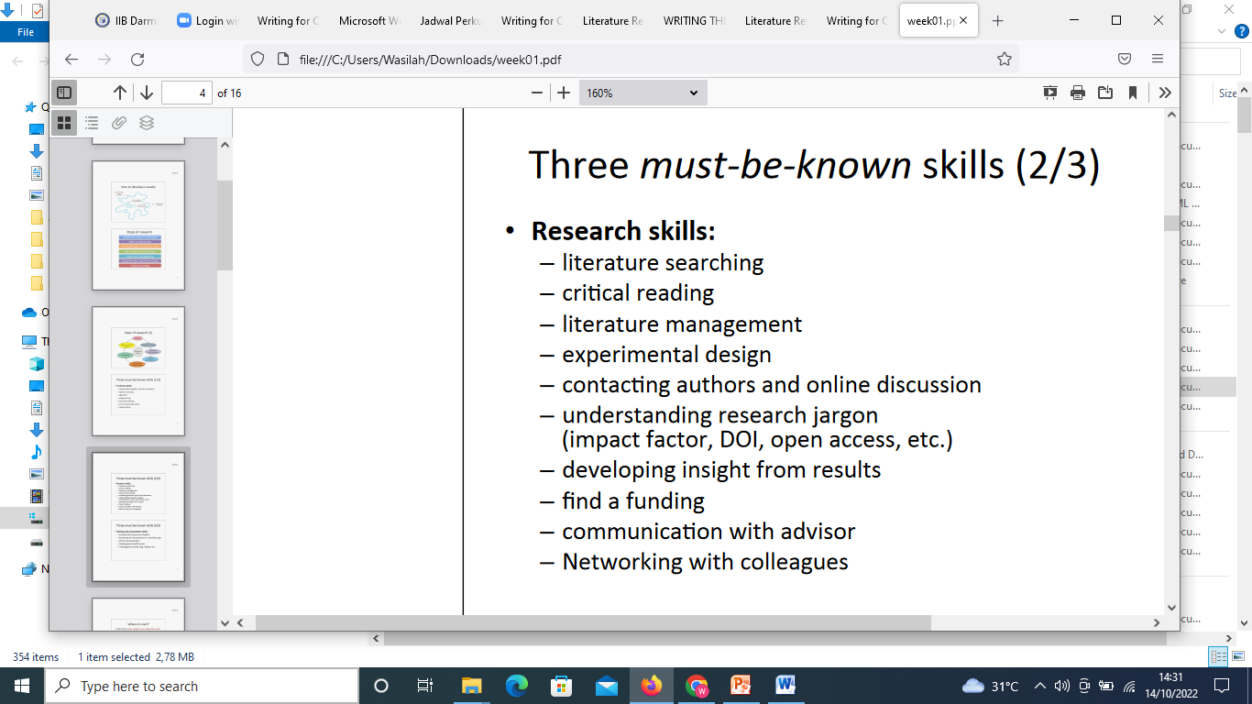

Slide 18
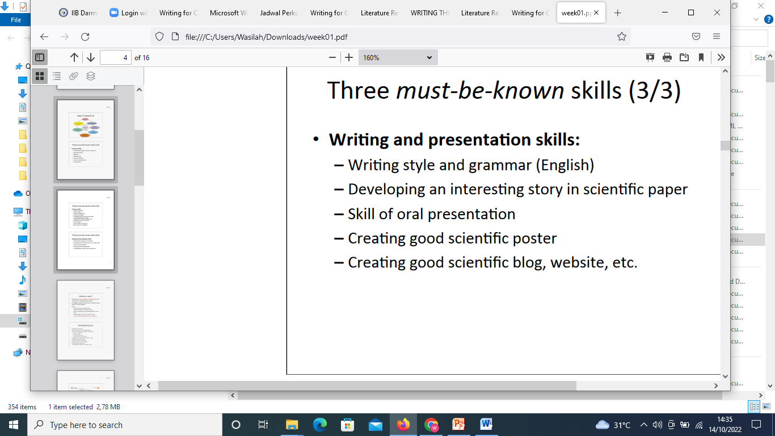

Slide 19
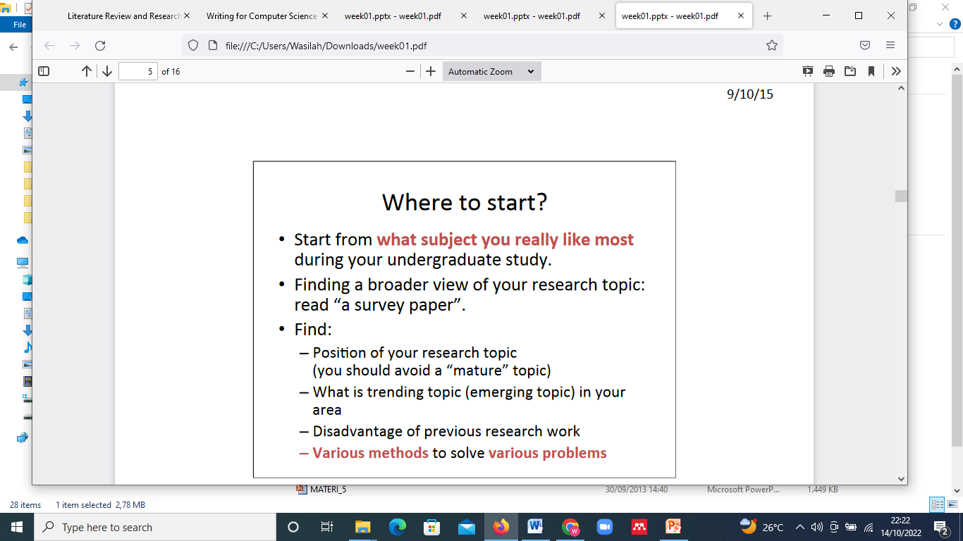

Slide 20
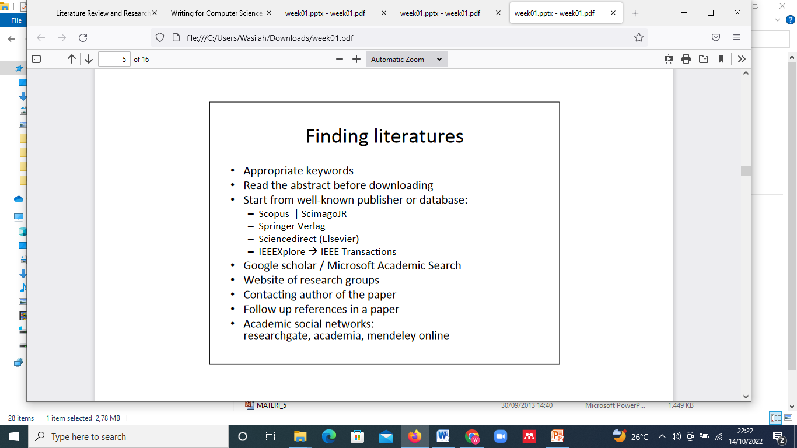

Slide 21
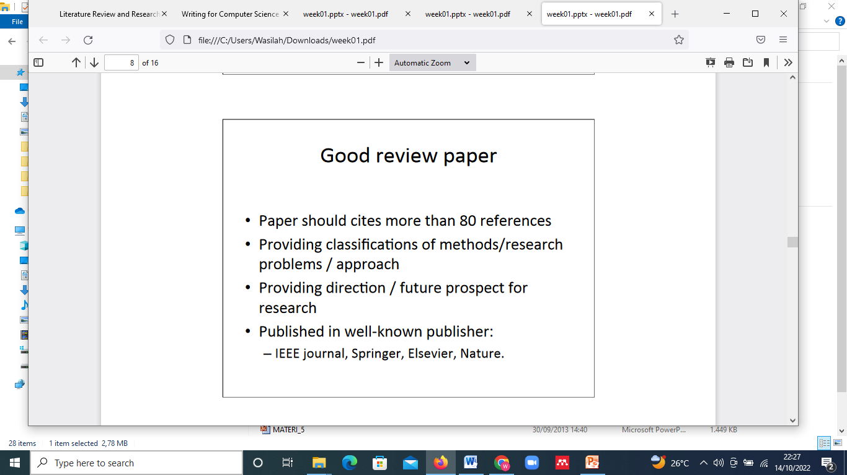

Slide 22
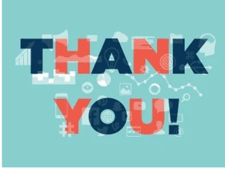
14/3/2011
Revisi 01 Audit Sistem Informasi

