Slide 1
TestNG

Slide 2
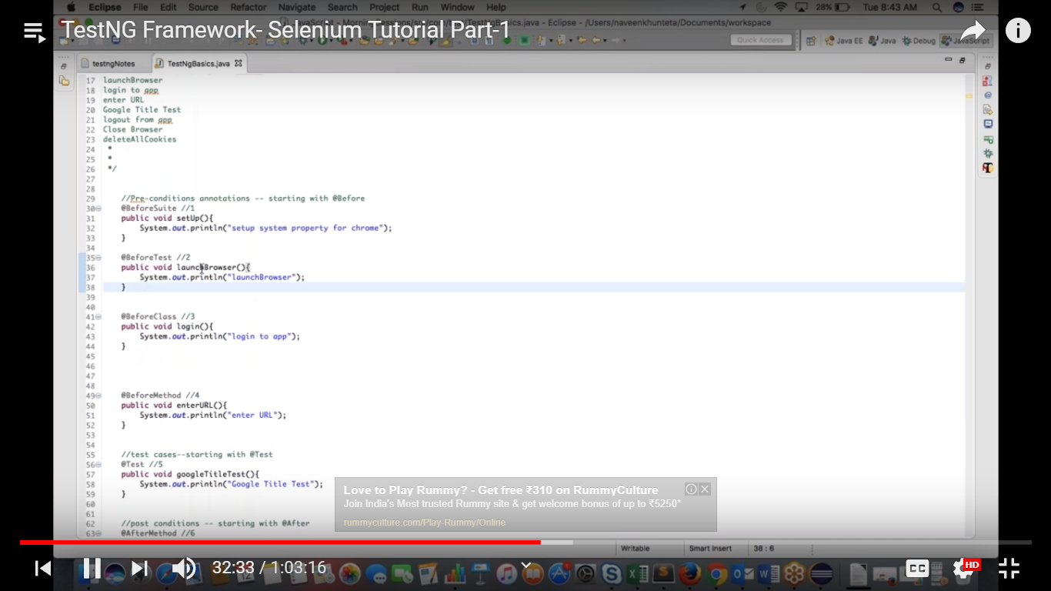

Slide 3
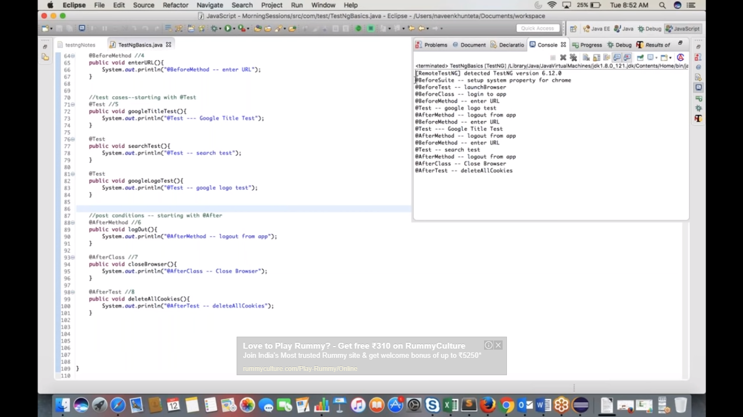
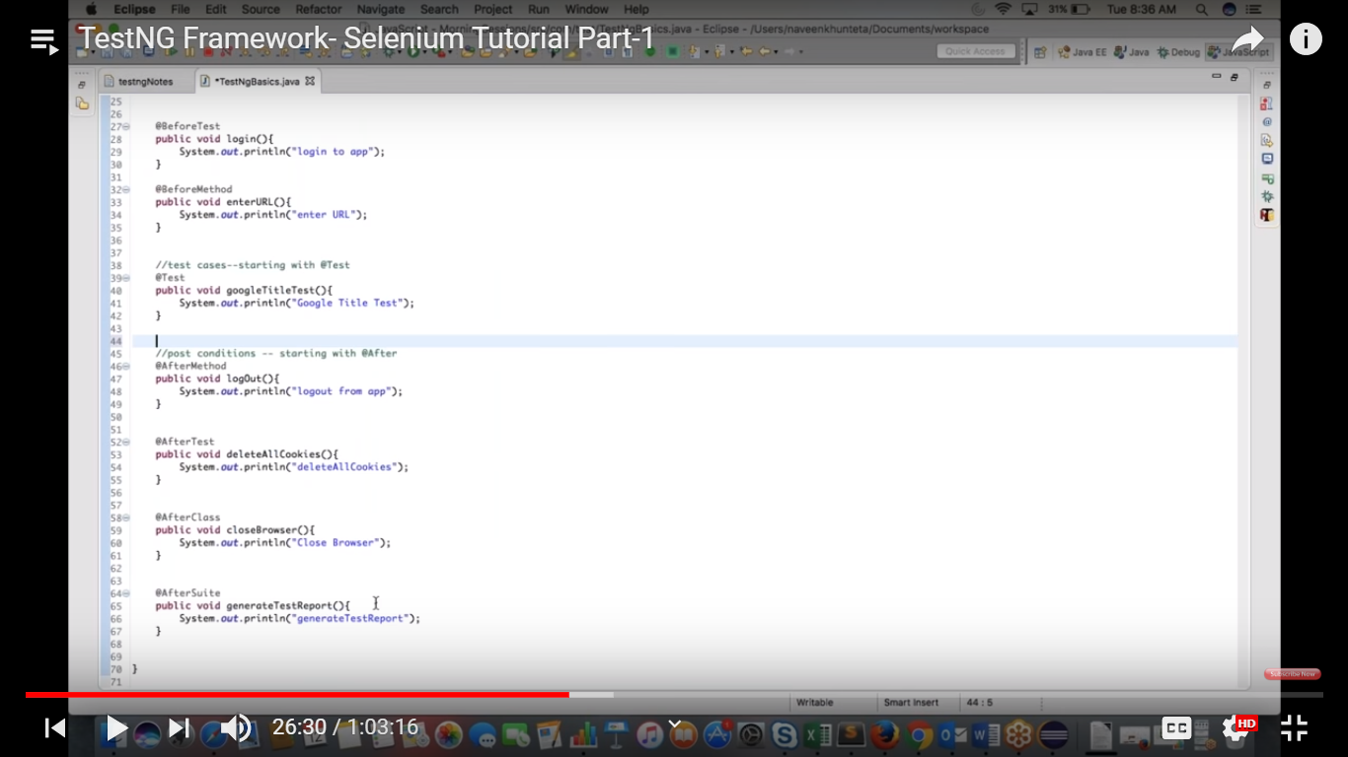

Slide 4
@Beforesuite
@BeforeTest
@BeforeClass
@BeforeMethod
@Test
@AfterMethod
@AfterClass
@AfterTest
@AfterSuite

Slide 5
Set priority to the test :
To mention the order of test cases
@Test(priority=1)
Public static login(){
}
@Test(priority=2)
Public static logout(){
}
Right click Run→TestNg
RightClick Project->Refresh->goto “Test-Output” folder->right click index.html file

Slide 6
Copy the location of index.html file and paste it in the chrome browser to get the reports

