Slide 1
SAP Overview

Slide 2
SAP?
Company
ERP Software package
  R/2
  R/3

Slide 3
Why ERP
Integration
Best business practices
Standardization

Slide 4
Why not ERP?
Complexity
Cost
Inflexibility

Slide 5
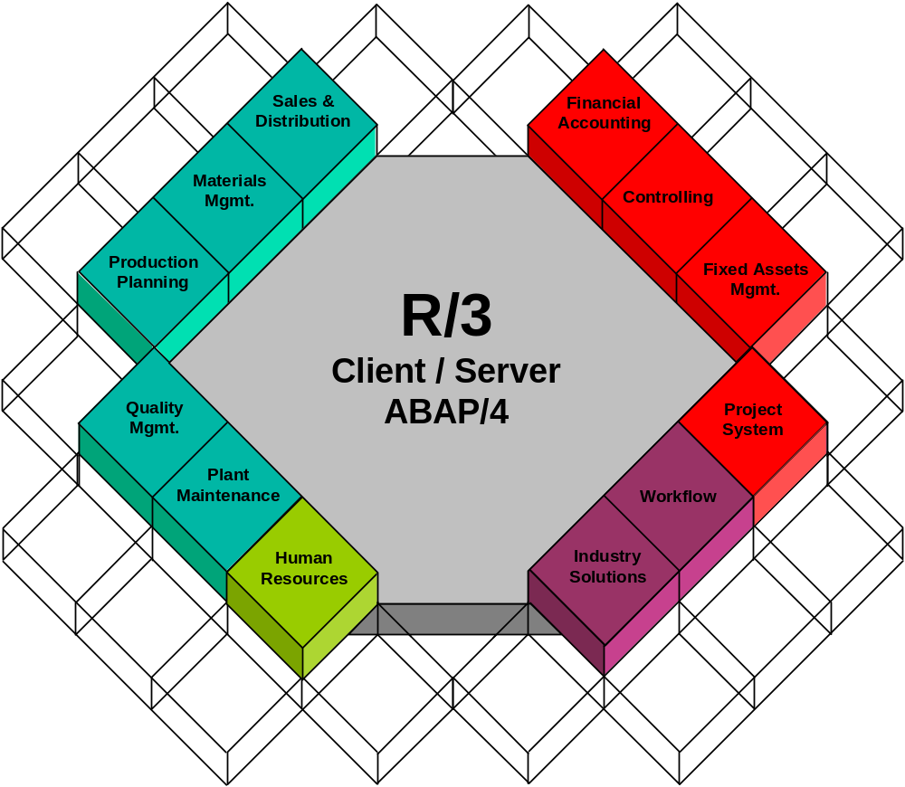
SAP R/3 System Business Modules
Logistical
Financial

Slide 6
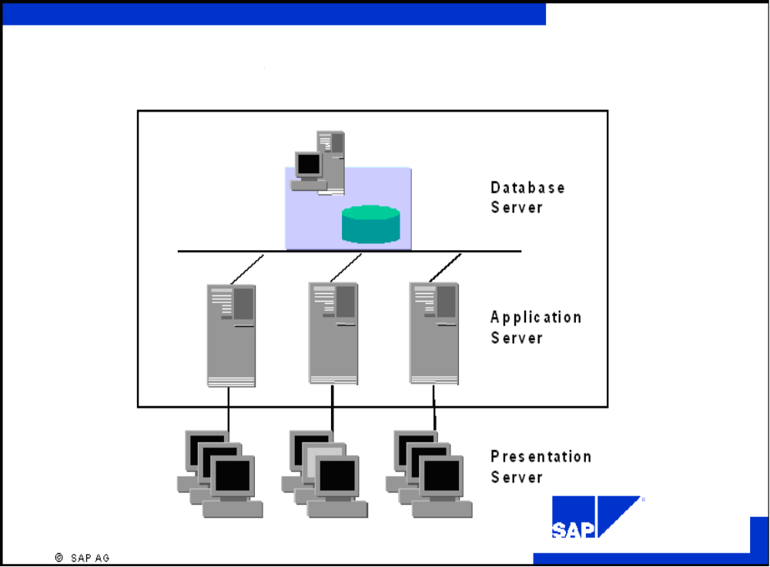
R/3 System: Hardware/Software Views

Slide 7
Typical Client Server Architectures
Presentation
Application
Database
Central System
Two - tier
Distributed System
Two - tier
Client/Server
Three - tier
Client/Server
Multi-layer
Cooperative
Client/Server

Slide 8
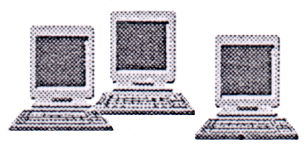


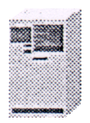
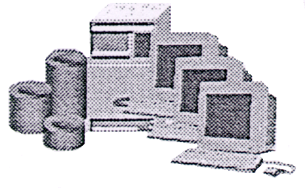
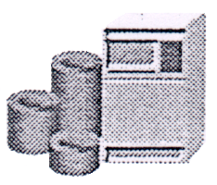
R/3 System Configurations
SAP
Central System
2-Tier Configuration
3-Tier Configuration
Web-enabled
Presentation
Presentation
Internet Transaction Service/Web Service
Application
Database,
Application,
Presentation
Database and Application
Database
In a central R/3 System configuration, one host is responsible for all processing tasks.

Slide 9
R/3 System Configurations
SAP
Central Systems
2-Tier Configuration
3-Tier Configuration
Web-enabled
Presentation
Presentation
Internet Transaction Service/Web Service
Application
Database,
Application,
Presentation
Database and Application
Database
Two‑tier R/3 System configurations are usually implemented using special presentation servers that are responsible solely for formatting the graphical interface. Many R/3 System users use PCs with Microsoft Windows ‑installed, for example, as presentation servers.

Slide 10
R/3 System Configurations
SAP
Central Systems
2-Tier Configuration
3-Tier Configuration
Web-enabled
Presentation
Presentation
Internet Transaction Service/Web Service
Application
Database,
Application,
Presentation
Database and Application
Database
An alternative two‑tier configuration is to install powerful desktop systems and to use these for presentation and applications (two‑tier client/server). This type of configuration is particularly useful for expensive applications (such as simulations) or for software developers.

Slide 11
R/3 System Configurations
SAP
Central Systems
2-Tier Configuration
3-Tier Configuration
Web-enabled
Presentation
Presentation
Internet Transaction Service/Web Service
Application
Database,
Application,
Presentation
Database and Application
Database
In a three‑tier configuration, you use your own host for the three tiers. Using data from the database server, several different application servers can operate at the same time. To ensure that the load on individual servers is as even as possible and to achieve optimal performance, you can use special application servers for individual application areas such as sales planning, distribution or financial accounting.

Slide 12
R/3 System Configurations
SAP
Central Systems
2-Tier Configuration
3-Tier Configuration
Web-enabled
Presentation
Presentation
Internet Transaction Service/Web Service
Application
Database,
Application,
Presentation
Database and Application
Database
To web‑enable the SAP Applications, a Web Server and an ITS (Internet Transaction Server) are needed. The web‑service and the services for the ITS can run on one server or on two dedicated servers. The presentation in this configuration is provided by an Internet Browser. The new SAP Web platform is NetWeaver.

Slide 13
Basis System: Three-Tier Computer Hierarchy
Central Database
(Storage of all data)
Access to Dataase:
(Read / Write data)
Database
Input / Output
of data to users
Application
Processing of data
using application logic
Presentation of the
processed data to
the user
Presentation

Slide 14
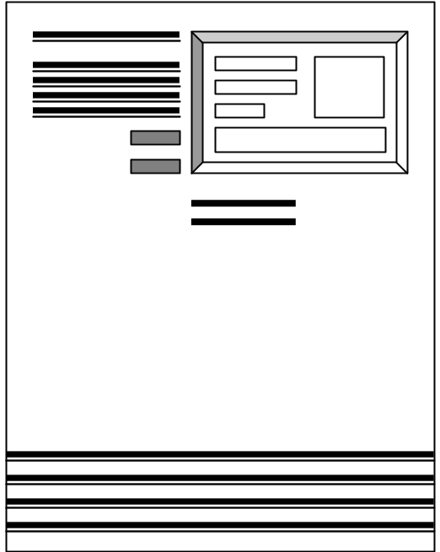

Client/Server Overview
Server
LAN/WAN
TCP / IP
Client

Slide 15
Client/Server Overview (Logical Structure)
Server
Data Storage
Application
Logic
Client
Presentation

Slide 16
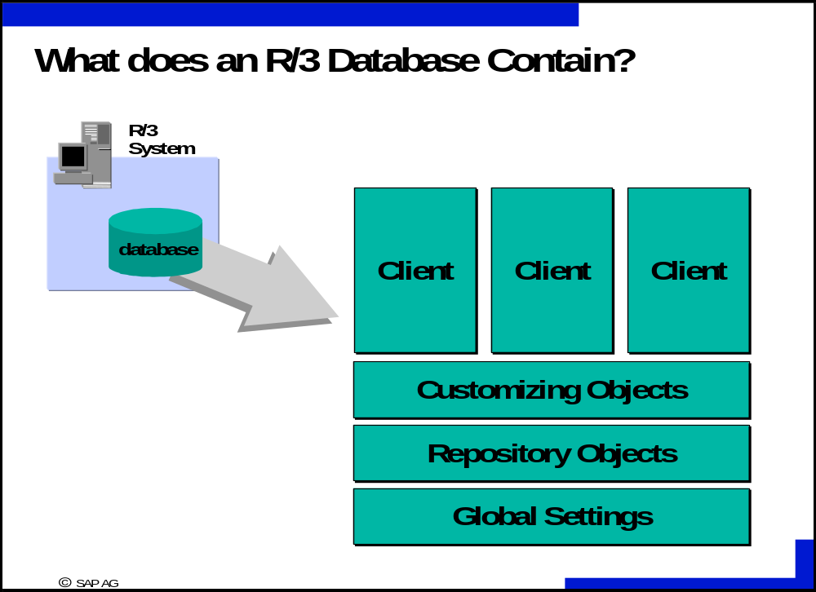

Slide 17
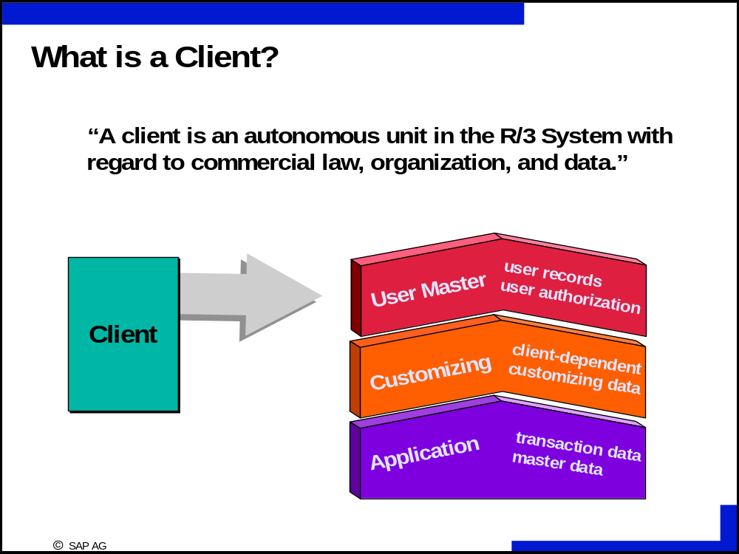

Slide 18
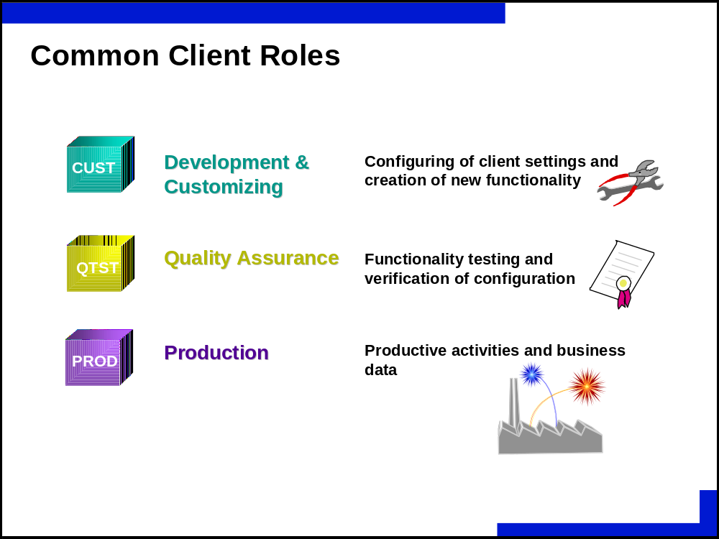

Slide 19
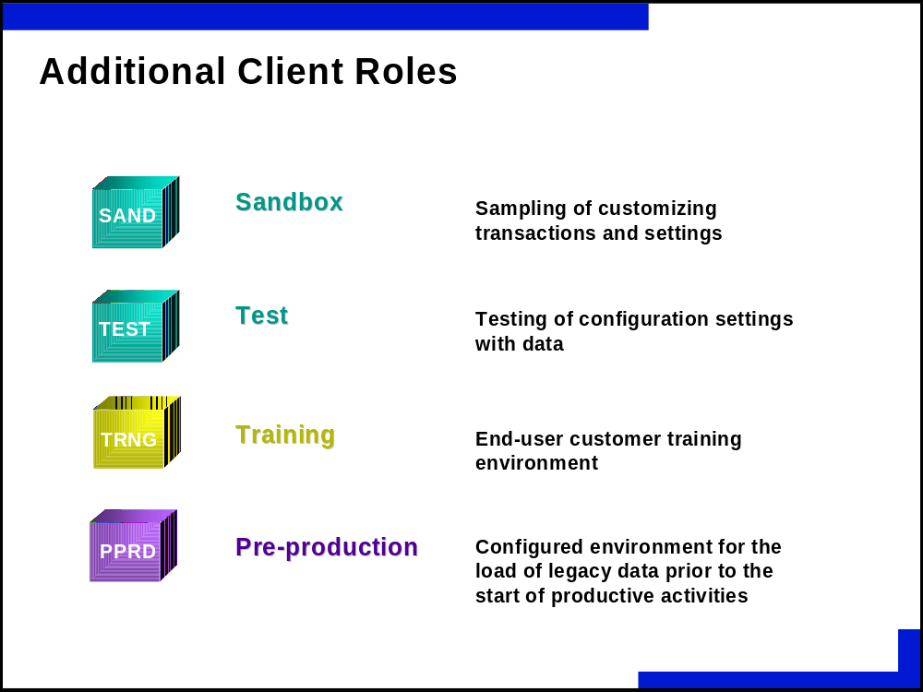

Slide 20



Sample SAP System Landscape
Development
Testing
Production
Database
Servers
Application
Servers
Presentation
Servers
Notes:
SAP R/3 Technical Configuration
An SAP R/3 System can consist of one or more instances (e.g. a central instance or a distributed SAP R/3 System).
Multiple instances are represented by the configuration of a database server and one or more application servers.
Only one database and dictionary will exist for an SAP R/3 System.
Note: with R/4, you can have multiple database instances.
To isolate each distinct phase of an implementation, a typical or recommended configuration for an SAP R/3 System implementation will consist of three separate systems:
Development: for configuration of SAP applications with user specific data and user development.
Quality Assurance Testing: to isolate development from final testing and user training for production.
Production: of live business transactions and company data.

Slide 21
Object Migration
Corrections and Transport
Development
QA Testing
Production
Program A
Program A
Program A
Table A
Table A
Table A
Screen A
Screen A
Screen A
Export
Import
Export
Import

Slide 22
Object Migration
Corrections
and
Transport
Development
QA Testing
Program A
Version 1
Program A
Version 1
?
Program A
Version 2
Program A
Version 2
?
Program A
Version 3
Program A
Version 3
Originals

Slide 23
Geography-based Clients
America Client 010
Europe Client 020
Japan Client 030
R/3
Europe
R/3
America
R/3
Japan

Slide 24
Client Copies
Configuration
Development
Quality Assurance
Interface Testing
User Training

Slide 25
ERP: Integration
Integrate people, data and business processes within and between organizations.
Collaboration, non-redundancy, consistency and internal process optimization.

Slide 26








Procurement Process
Outline
Agreement
Purchase
Requisition
Scheduling
Agreement
Vendor
Demand
Accounts
Payable
Purchase
Order
Invoice
Verification
Goods Receipt
& Inventory Mgmt.

Slide 27





Production Process
Schedule/Release
Goods Issue
Shop Floor
Order Settlement
Goods Receipt

Slide 28



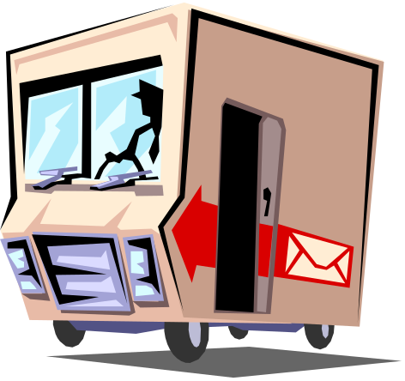
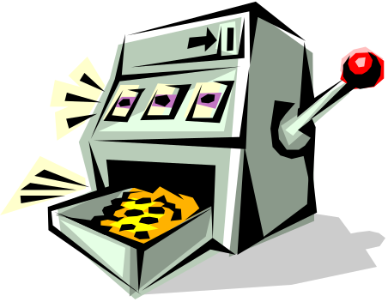

Sales Process — Trading Goods
Customer Order
Picking
Packing
Accounts Receivable
Billing
Goods Issue

Slide 29




Sales Process Finished Goods
Availability
Check
Goods Issue
Customer Order
Final Payment
Partial Payment
Billing

Slide 30



Sales Process Finished Goods
Availability Check
- Insufficient -
Independent
Demand
Customer Order
Dependent
Demand
MRP Run
Production
Scheduling
Purchasing

Slide 31


Process Flow
Goods Issue
to Shop Floor
Goods
Receipt
Production
Accounts Receivable
Billing
Goods Issue

Slide 32
Logging In
Basics

Slide 33
Client
This is a numeric field.
This number defines a whole business entity.

Slide 34
User
Every SAP user has a user name.
Users of SAP system are client-specific, which means that having a user identification on one client will only allow access to that particular client.

Slide 35
Password Rules
Letters
Numbers
Easy to remember
3-8 Characters long
No 3 Characters can be the same
Do not start with a ? or an !
Do not use previous 5 passwords

Slide 36
Language
SAP supports multi-national character sets and languages on the same system, at the same time.
Default languages are English and German.

Slide 37
Field Types
There are three types of Entry Fields
  Required
  Default entry
  Optional entry field

Slide 38
Sessions
An SAP session is a window in which the user may perform a particular task.
A User may have up to nine sessions open at one time.

Slide 39





SAP R/3 Resource Management: The Dispatcher
Presentation
SAP GUI
Application
Communications
Dispatcher
Work
Process
Work
Process
Work
Process
Buffers
Data base

Slide 40

SAP R/3 Resource Management: Data Flow
Presentation
SAP GUI
Terminal
Process
1
7
Application
Dispatcher
2
Request queues
3
SAP Memory Buffer
6
Work
Process
Roll
Page
4
5
Data base
Relational database system

Slide 41

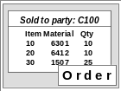

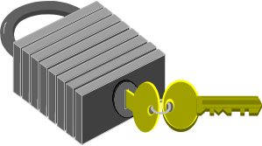
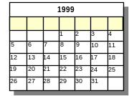

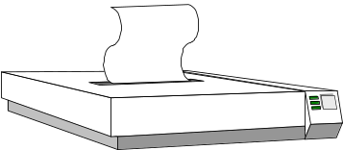
SAP R/3 Resource Management: Work Processes
A
B
Dialog
Update
Message
M
SAP Dispatcher
Background Jobs
Enqueue
C
Gateway
Spool
R/3
R/2
G

Slide 42
SAP R/3 Resource Management:
Lock Management by the Enqueue Work Process
Instance A
Dispatcher
Message
Server
Work
Process
Update
Work
Process
Enqueue
Instance B
Dispatcher
Lock table in
Work
Process
Update
Work
Process
Enqueue
main storage

Slide 43
SAP R/3 Resource Management: R/3 Instance
Database
Instance
Instance Profiles
(parameters)
Message
Server
SAP
Gateway
Dispatcher
Dialog
. . . .
Update
Spool
Back-
ground
Enqueue
SAP Buffers
Instance
Start
or
Stop
Central

Slide 44
SAP R/3 Resource Management: Distributed SAP R/3 Processing
Instance 03
Instance 02
Dispatcher
Dispatcher
Dialog
Back-
ground
Enqueue
Enqueue
Dialog
. . .
Instance 01
Dispatcher
Mess-
age
Gate-
way
Dialog
Update
Enqueue
Spool

Slide 45
Reporting
Three basic steps to running a report
  Access the report
  Enter selection criteria
  Execute the report

Slide 46

System Messages
E - Error
  An invalid entry has been made.
  The cursor moves to the field where the error has occurred.
W - Warning
  A possible error has been made.
  The user can continue without changing.
I – Information
  Feedback from the system.

Slide 47
Customizing - Modeling the Business
  Organizational Structures in each module
  Master Data - Customers, Materials, …
  Rules - required entries, tolerances, …

Slide 48
Mapping
  Assignment of organizational structures to reflect the enterprise model
  Establishes integration among modules

