Slide 1
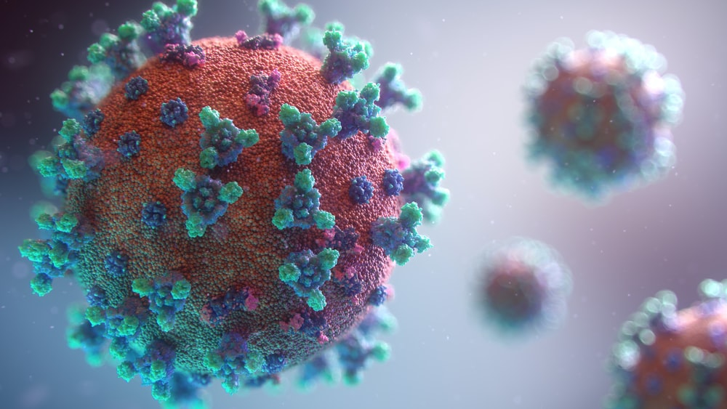
A Novel Approach to Apply Different Algorithms to Predict COVID-19 Disease
BY
MAHESH UTLAPALLI - 170031326
SYAM JASON BONELA – 170030161
NITHYA TANVI NISHITHA SANKA - 170031524
SUPERVISOR
JONNALAGADDA SURYA KIRAN
ASST. PROFESSOR
CSE DEPT.,KLEF

Slide 2
Contents
Table of Contents :
Abstract
Introduction
Literature Survey
Problem Statement
Disadvantages of Existing System
Proposed System
Block Diagram
Technologies Used
Output Screenshots
References
Conclusion
Future Scope
Plan of Action

Slide 3

Abstract
The Covid-19 outbreak occurred in Wuhan in December 2019 and spread everywhere in the world. The Covid-19 communicable disease have a vaccine and drug for its treatment. The foremost important factors in reducing the spread of the virus are washing hands, employing a mask, and reducing social distance. Today additionally to clinical studies, computer-aided studies also are widely administered for the Covid-19 outbreak. AI methods are successfully applied during this study. In this study, we used different algorithms for the prediction and analysis of Covid-19 daily cases. As a result of the study, the number of daily cases was successfully estimated with these different types of algorithms.
10%

Slide 4
Introduction
The primary case was identified in Wuhan, China, in December 2019, passing from bats to humans. The virus spread all over the world in a very short period and turned into a deadly disease and collapsed the health systems of many countries in this world. Covid-19 is a severe acute respiratory syndrome and disease progression can have fatal consequences. The most obvious symptoms of the disease; It is known as fever, dry cough, sore throat, headache, weakness, muscle pain, diarrhea, and shortness of breath. In more advanced cases, it causes severe pneumonia, causing inflammation in the lungs due to oxygen difference and multiple organ failure. Especially this disease has much more dangerous effects for those with chronic diseases, weak resistance or immune system, smokers, and the elderly. Artificial intelligence methods are used successfully in the solution of many problems. In the COVID-19 epidemic, many studies have been carried out using artificial intelligence methods. Some of those are; diagnosis using radiology images, tracking disease, estimating the patient's health outcome, early detection, and diagnosis of infection, drug discovery, monitoring treatment.

Slide 5
Literature Survey
Title | Year Of Publish
Fuzzy Rule-Based System for Predicting Daily Case in COVID-19 Outbreak | 2020
A Novel Deep Learning Approach for Classification of COVID-19 Images | 2020
Regression Analysis of COVID-19 using Machine Learning Algorithms | 2020
COVID-19 Pandemic Prediction using Time Series Forecasting Models | 2020
A comparative study of Machine Learning Models for COVID-19 prediction in India | 2020
Covid Symptom Severity Using Decision Tree | 2020
COVIDGR Dataset and COVID-SDNet Methodology for Predicting COVID-19 Based on Chest X-Ray Images | 2020
A Novel Parametric Model for the Prediction and Analysis of the COVID-19 Casualties | 2020
Prediction of Covid-19 pandemic based on Regression | 2020
Covid-19 Disease Simulation using GAMA platform | 2020

Slide 6
Problem Statement
Coronavirus disease (COVID-19) is an inflammation disease from the latest virus. This particular infection causes respiratory ailment (like influenza) with manifestations, for example, cold, cough, and fever, and in progressively serious cases, The problem in breathing. COVID-2019 has been perceived as a worldwide pandemic and a couple of examinations are being led utilizing different numerical models to anticipate the likely advancement of this pestilence. These numerical models hooked into various factors and investigations are dependent upon potential inclination. Here, we presented a model that could be useful to predict the Covid-19 daily cases by using different algorithms.
20%

Slide 7
Disadvantages of Existing System
Dataset is having only small number of attributes for prediction
These simulations don’t work on all systems.
Forecasting is being done on some factors only.
These datasets having a smaller number of images, which may affect the proposed network accuracy for a large dataset.
Different datasets are using in the regression analysis.
It is difficult to model physical systems precisely with a mathematical formula or equation.
60%

Slide 8
Proposed System
In the proposed system we are analysing and predicting the Covid-19 daily cases based upon the different factors. Here we are using different types of algorithms for the analysis of the Covid-19 increasing cases and predicting the spreading rate of Covid-19 cases based on the previous diseases history of the person with the help of training data and the testing data. By using those different types of algorithms we can achieve the highest accuracy rate when compared with other algorithms.
40%

Slide 9
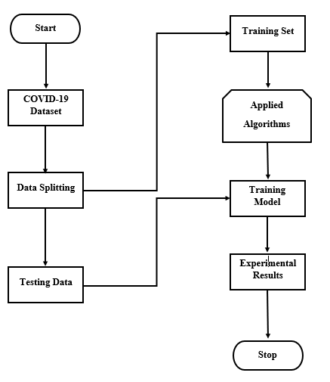
Block Diagram

Slide 10
Technologies Used
Python: Tools, Libraries, Usage
The Jupyter Notebook is an open-source web application that permits you to make and share documents that contain live code, equations, visualizations, and narrative text. Uses include data cleaning and transformation, numerical simulation, statistical modeling, data visualization, machine learning, and far more.
Python 3 version is used for our work and have used the many libraries for different algorithms.
50%

Slide 11
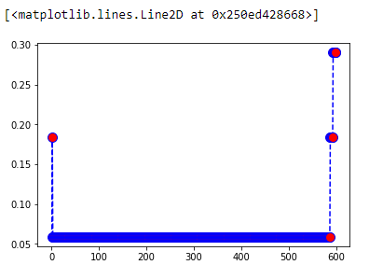

Output Screenshots
Fig 4: The above figure represents the Accuracy Rate of the KNN algorithm
Fig 3: The above figure represents the Error Rate vs K value of the KNN algorithm
60%

Slide 12
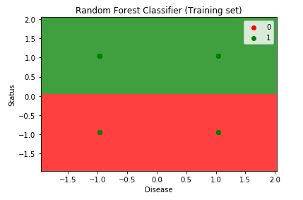
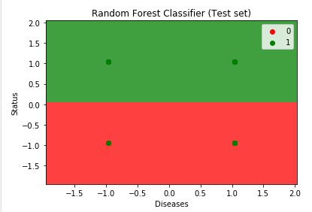
Continued…
Fig 5: The above figure Vvisualizes the Training set results of the Random Forest algorithm.
Fig 6: The above figure Vvisualizes the Testing set results of the Random Forest algorithm.

Slide 13
Continued…
ALGORITHMS | ACCURACY | ERROR RATE
Decision Tree | 96% | 7.40%
K Nearest Neighbors | 94% | 8.01%
SVM | 93% | 7.57%
Naïve Bayes | 92% | 7.45%
Random Forest | 92% | 8.51%

Slide 14
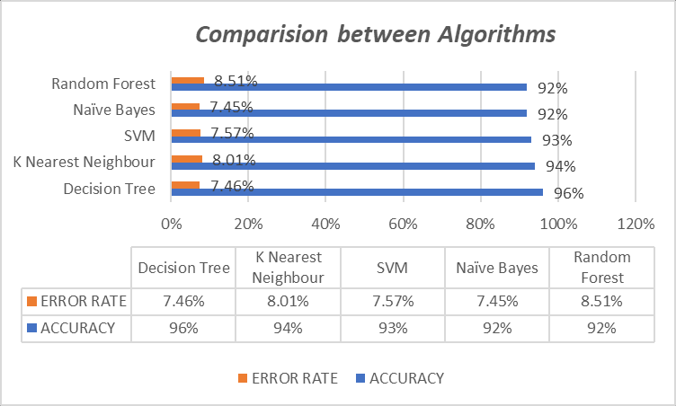
Continued…
Fig 7: The above figure illustrates the comparison between algorithms with the help of accuracy and error rate used for the Covid-19 prediction during experimentation.

Slide 15
Conclusion
In this paper, we predicted the COVID-19 cases by taking the data records of 3617 and by using the Decision Tree, SVM, Naïve Bayes, Random Forest, and KNN algorithms out of all the algorithms Decision Tree algorithm got the highest accuracy rate when compared with other algorithms.

Slide 16
Future Scope
Currently, we predicted whether the person is cured or not cured due to COVID in future we can create models in such a way to predict the possible affected regions Based on the speed of increase of cases and the places that the affected people have visited and their geolocation we can be able to track what may be the affected areas in the future. And we can also use Hadoop and the concept of HDFs in such a way that we can be able to process huge datasets.
80%

Slide 17
References
Fuzzy rule-based system for predicting daily case in COVID-19 outbreak. (2020). 2020 4th international symposium on multidisciplinary studies and innovative technologies (ISMSIT). Https://doi.Org/10.1109/ismsit50672.2020.9254714
Nath, M. K., Kanhe, A., & Mishra, M. (2020). A novel deep learning approach for classification of COVID-19 images. 2020 IEEE 5th international conference on computing communication and automation (ICCCA). Https://doi.Org/10.1109/iccca49541.2020.9250907
Gambhir, E., Jain, R., Gupta, A., & Tomer, U. (2020). Regression analysis of COVID-19 using machine learning algorithms. 2020 international conference on smart electronics and communication (ICOSEC). Https://doi.Org/10.1109/icosec49089.2020.9215356
Kumar, N., & Susan, S. (2020). COVID-19 pandemic prediction using time series forecasting models. 2020 11th international conference on computing, communication and networking technologies (ICCCNT). Https://doi.Org/10.1109/icccnt49239.2020.9225319
Bhadana, V., Jalal, A. S., & Pathak, P. (2020). A comparative study of machine learning models for COVID-19 prediction in india. 2020 IEEE 4th conference on information & communication technology (CICT). Https://doi.Org/10.1109/cict51604.2020.9312112

Slide 18
Continued…
Vi. Chaurasia, V., & Pal, S. (2020). COVID-19 pandemic: ARIMA and regression model based worldwide death cases predictions. https://doi.org/10.21203/rs.3.rs-49697/v1
Vii. Tabik, S., Gomez-Rios, A., Martin-Rodriguez, J. L., Sevillano-Garcia, I., Rey-Area, M., Charte, D., Guirado, E., Suarez, J. L., Luengo, J., Valero-Gonzalez, M. A., Garcia-Villanova, P., Olmedo-Sanchez, E., & Herrera, F. (2020). Covidgr dataset and COVID-sdnet methodology for predicting COVID-19 based on chest X-ray images. IEEE Journal of Biomedical and Health Informatics, 24(12), 3595-3605. https://doi.org/10.1109/jbhi.2020.3037127
viii. Rochmawati, N., Hidayati, H. B., Yamasari, Y., Yustanti, W., Rakhmawati, L., Tjahyaningtijas, H. P., & Anistyasari, Y. (2020). Covid symptom severity using decision tree. 2020 Third International Conference on Vocational Education and Electrical Engineering (ICVEE). https://doi.org/10.1109/icvee50212.2020.9243246
ix. Mandayam, A. U., A.C, R., Siddesha, S., & Niranjan, S. K. (2020). Prediction of COVID-19 pandemic based on regression. 2020 Fifth International Conference on Research in Computational Intelligence and Communication Networks (ICRCICN). https://doi.org/10.1109/icrcicn50933.2020.9296175
x. Ban, T. Q., Duong, P. L., Son, N. H., & Dinh, T. V. (2020). COVID-19 disease simulation using GAMA platform. 2020 International Conference on Computational Intelligence (ICCI). https://doi.org/10.1109/icci51257.2020.9247632

Slide 19
Plan of Action
Sprint | Issues/User Stories | Member Assigned | Accomplishment
Sprint 1 | Topic Selection Identification of Problem Statement Literature Survey | Mahesh Syam Jason Nithya | 100%
Sprint 2 | Proposed Framework Block Diagram | Mahesh Syam Jason Nithya | 100%
Sprint 3 | Development Phase | Mahesh Syam Jason Nithya | 100%
Sprint 4 | Testing Phase Documentation Paper Execution | Mahesh Syam Jason Nithya | 100%
Sprint 5 | Final Execution Final Documentation A2-Poster | Mahesh Syam Jason Nithya | 100%
90%

Slide 20
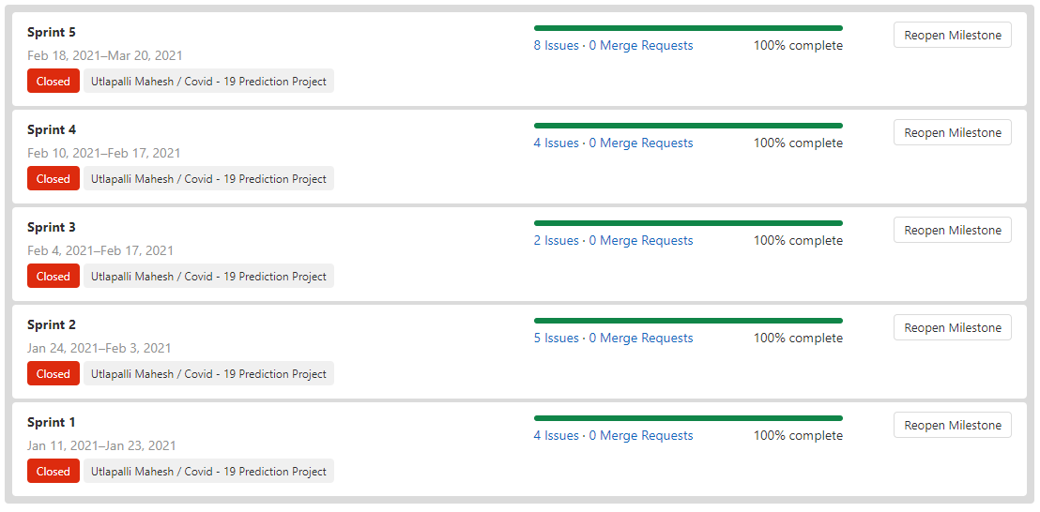
Continued…

Slide 21
Deployment
Github Link: https://projects.kluniversity.in/170031326/covid-19-prediction-project

Slide 22
Thank You
100%

