Slide 1


A NextGen Bot - A Novel Approach for Assisting Faculty in Tracking Goals
Supervisor By
J. Surya Kiran 170030161 B. Syam Jason
Asst. Professor 170030875 N. Srujan
CSE Dept. , KLEF 170031326 U. Mahesh
170031391 V. Poojitha

Slide 2
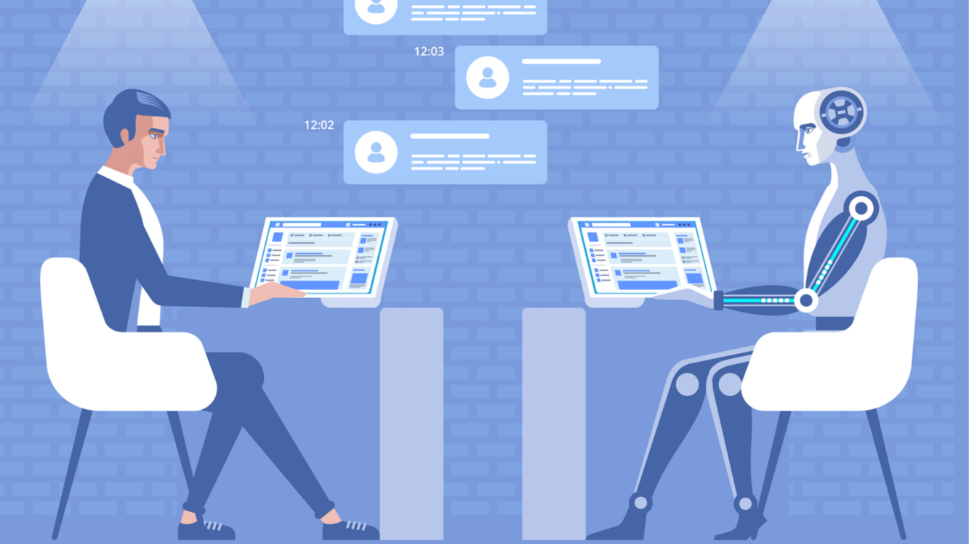
Contents
Abstract
Introduction
Literature Survey
Problem Statement
Disadvantages of Existing System
Proposed System
Advantages of Proposed system
Block diagram
Methodology
Algorithms
Technologies Used
Flow of Execution
Output Screenshots
Experimentation Results
Conclusion
References
Plan of Action

Slide 3

Abstract
In this advanced age of Artificial Intelligence, many of us are still confused about how to manage our work according to the time constraints. And still depending on the traditional reminder apps and using to-do lists which are not time effective and doesn’t work anymore in this fast-paced Digital World. Even everyone wants their queries to be resolved easily in no time. So, there is a need of a system that will help us stay up to date on our work with real time reminders and updates and which helps us to easily resolve our queries in no time. In this world of Artificial intelligence we have many such inventions that facilitate human works , one of such innovation is a Chatbot .In this Research Project we are developing a NextGen Bot which is a chatbot application that assists faculty with an effective tracking of their goals with timely updates and reminders which helps them to get an effective outcome in their works.
10%

Slide 4

Introduction
Chatbot is one of the most important game changing innovation in the field of AI and ML during the last decade. A Chatbot is a Virtual Enterprise software application with a Conversational User Interface(CUI) that provides diverse services in fields of health , education , management and Government services . It allows a kind of communication between a human and a machine, via messages or voice command. A chatbot is programmed to work independently from a human operator. It can answer questions formulated to it in natural language and respond like a real person . Chatbot innovation, hence brand communication, to an entirely new personalized level . Today's chatbots, further developed since then, are ready to answer considerably complex questions in an effective time manner and able to automate many human tasks efficiently .

Slide 5
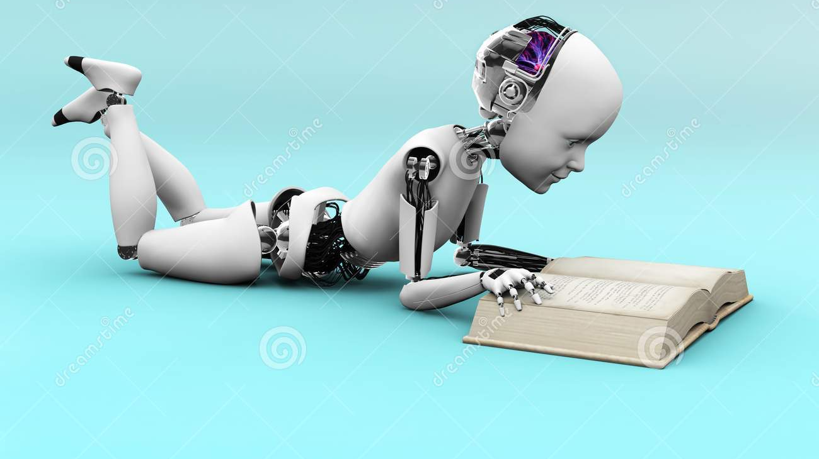
Literature Survey
1.Title : A Question Answering and Quiz Generation Chatbot for Education
Year Of Publication : 2020
Objective : This paper proposes a Question Answering and Quiz Generation Chatbot that allows a user to upload relevant documents and perform two main functions on them, namely answer extraction and question generation.
Limitation :
feedback based improvement is not present in order to generate the user level of understanding the question.
Every time user need to upload the required documents/pdf's/pics to the chatbot.
Consolidation of relevant data from all the uploaded documents/pdf's/pics may enable the system to return answers to complex Questions.

Slide 6
Continued ...
2. Title : Intelligent Chatbot for Guided Navigation of Repository Contend
Year of Publication : 2019
Objective : This paper provides an approach for Answering the user questions for a particular content. At beginning user will get registered into his account and then after login user will upload a document into chatbot database then chatbot will analyze entire document and then it starts answering the user queries using the information from this file uploaded.
Limitation :
The document type is only one specific type.
And this application can be used by only one user at a time.
20%

Slide 7
Continued ...
3. Title : Chatbots and virtual assistant in Indian bank
Year of Publication: 2020.
Objective : Indian banks are aggressively investing in chatbots and virtual assistant technology, but features are limited.
Limitations:
Most of the questions answered by chatbots/ virtual assistant are routine for which data is already available on websites of the banks.
Only 14 banks out of large number of banks have either implemented or planning to implement chatbots/ virtual assistants in India.

Slide 8
Continued ...
4. Title : Adoption of AI-Chatbots to Enhance Student Learning Experience in Higher Education in India
Year of publication: 2019
Objective : Education can benefit from Chatbot development. It can improve productivity, communication, learning, efficient teaching assistance and minimize ambiguity from interaction. A new education platform can solve next-level problems in education using this technology as the engagement tool.
Limitation :
AI-Chatbots to replace teachers means that students will interact with the Chatbots more often than with teachers.
negative effect of using technology, such as addiction.
The present study was conducted only in Indian educational institutes, so similar studies may also need to be conducted in other countries to understand the factors affecting the adoption of AI-Chatbot in individual countries.

Slide 9
Continued ...
5. Title : Chatbot and bullyfree chat
Year of Publication : 2019
Objective : chatbot and challenges we face behind the chatbot and images detection of cyberbullying
Limitation :
The drawbacks faced while doing our project is that AdaBoost M1 algorithm is used, which use the base classifier Decision Stump(AdaBoost_DS) but the simulation result shows that the proposed algorithm outperforms the existing sensing technique.
30%

Slide 10

Continued ...
6. Title : Possibilities of used intelligence-based agents in instant messaging on e-government services
Year of Publication : 2020
Objective : This paper investigates technical possibilities of delivery and deployment of Government e-services in Republic of Serbia that will enable citizens and business sector to simplify exercising right and fulfill obligations to the state authorities completely online.
Limitation :
The users need to ask questions in natural language, and retrieve the answers composed of unstructured text data.
The systems provide responses with the help of professional experts, Waiting for them to respond can take from a few hours to several days.
we can even integrate the chatbot with all the time with police.

Slide 11
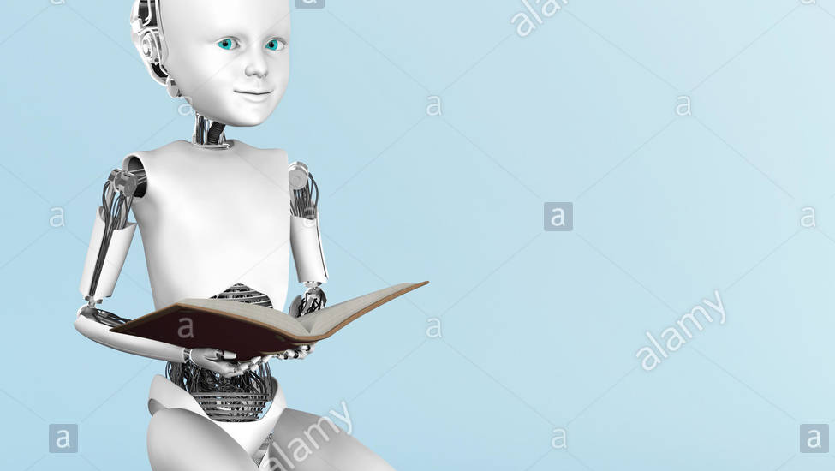
Continued ...
7. Title : Chatbot for HR Department Using AIML and LSA
Year of Publication : 2020
Objective : This paper provided an approach for Effective management Of HR Department using Artificial Intelligence Mark up language and Latent Semantic Analysis. Here they developed a chat bot that categorize whether the input given is a text or an SQL Query. If the input is a text it responds accordingly and if it is SQL Query it will perform the Query operation on that employee database and present the output as a table and graphs.
Limitation :
While Using an Intelligent Chatbot Application Providing SQL Queries instead of General text for querying the database.
For querying the database user need to have a complete knowledge on the database designed.
Employees related issues or queries are not discussed.

Slide 12
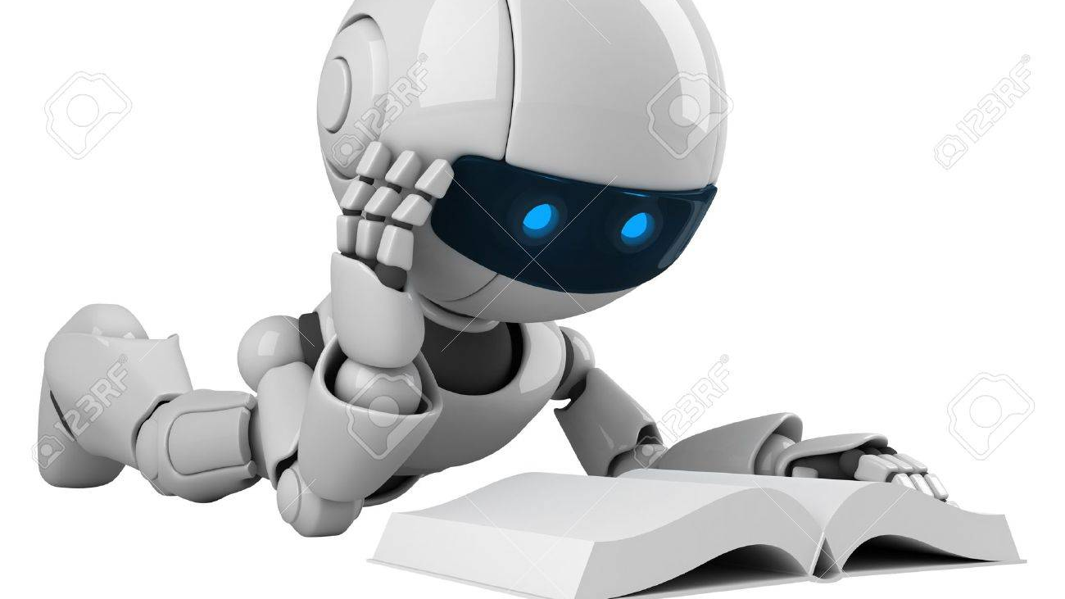
Continued ...
8.Title : A Survey on Chat-Bot system for Agriculture Domain
Year of Publication : 2019
Objective : where the farmer can query the system and the system understands the query and responds to a given query regarding the crops, raw materials used, plants grown in particular area, usage of pesticides and fertilizers etc.
Limitation :
Challenge is to give exact answer for the already built chatbot system
40%

Slide 13
Continued ...
9. Title : A Chatbot for Psychiatric Counseling in Mental Healthcare Service Based on Emotional Dialogue Analysis and Sentence Generation
Year of Publication : 2017
Objective : The methodologies enable continuous observation of emotional changes sensitively. In addition, the case-based counseling response model that combines ethical judgment model provides a suitable response to clinical psychiatric counseling.
Limitation :
In further study, we will apply the conversational service to game addiction cases of teenage and investigate clinical results and user satisfaction.

Slide 14
Continued ...
10. Title : Chat bot Using API : Human To Machine Conversation
Year of Publication : 2019
Objective : This chatbot can be integrated with various platforms such as Facebook, Google assistant, viber etc., So to conclude we can say that, using this chatbot our task of visiting multiple web pages to complete required railway requests can be saved with multiple user-friendly applications.
Limitation :
We can further develop the system to make it more accurate by adding more training phases generated by the users.
This will enable a better understanding for the users, and we will really come to know the areas where the system needs to be improved.
50%

Slide 15

Problem statement
In the current AI world we have a wide variety of chatbot applications that infiltrate every corner in educational institutions that assisting Management and students for effective interactions and querying well about institution in a real time. But there is a need of a system that guides the faculty and students in order to accomplish their goals and objectives in desired time frame. The proposed idea NextGen Bot mainly focusing on faculty which will provide a chatbot assistance that will help faculty in effective tracking and accomplishing their goals with proper remainders and updates in timely manner along with an effective management of time table.

Slide 16
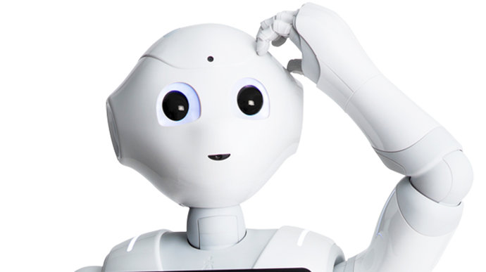
Disadvantages of Existing System
Lack of assistance : There is no existing system as assistance for faculty.
Complex Querying :User’s need to write complex queries in order to get desired result.
Time Consuming :In order to check the deadlines of objectives need to be done , User’s need to refer the web portal(ERP) every time.
Ambiguity regarding timings scheduled for classes and events

Slide 17
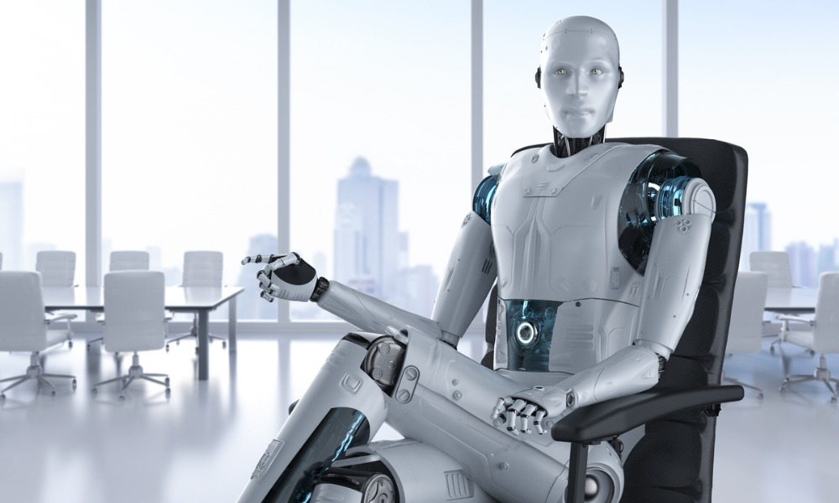
Proposed System
In the Proposed System we are developing a window based NextGen Bot as an assist that helps faculty in Goal Tracking and in managing daily tasks effectively . We are designing this Chatbot with three different modules like Profile Management which deals with academic and research Information of faculty. And Goal Tracking which is an important module that will help faculty in tracking and accomplishing their goals with timely updates and remainders. And Timetable Management module will help faculty to organize their works effectively. We are Developing a web application as an interface for admins(Management) to monitor and issue goals and this interface will be the data source for the NextGen Bot .
60%

Slide 18

Advantages of Proposed System
Tracking Assistance : we provide a chatbot assistance for faculty in tracking their goals.
Notifications: Faculty will receive timely updates and reminders as notifications.
Time Efficient: User can easily get his information about goals and tasks in no time .
No Ambiguity : Faculty can easily manage their timetable without any ambiguity in class timings.
Easy Interaction with human level Language.

Slide 19
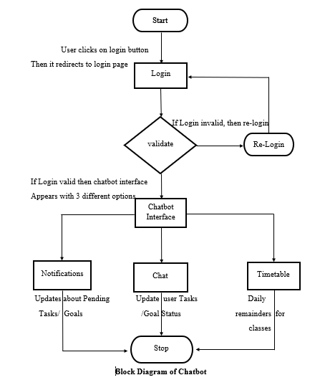
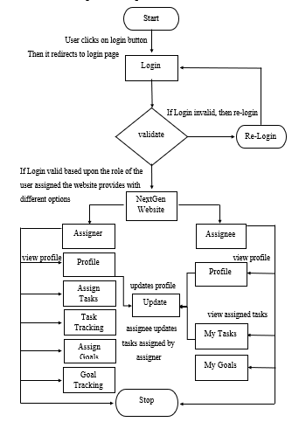
Block Diagram for Chatbot and Website
70%

Slide 20
Methodology
NextGen Framework consists of 3 Modules:
Profile Management
Academic and Research Profile
Awards/Recognitions
Skills.
Timetable Management
Scheduling and Organizing works
Timely Updates & Notifications
Goal Tracking
Accomplishment of Academic and Research goals as well as
Timely Management on Administrative tasks

Slide 21
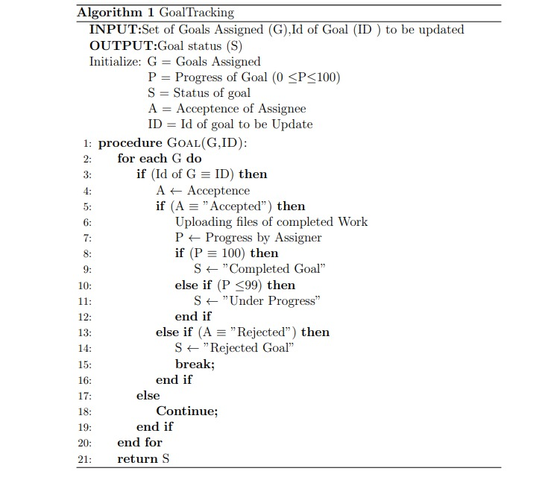
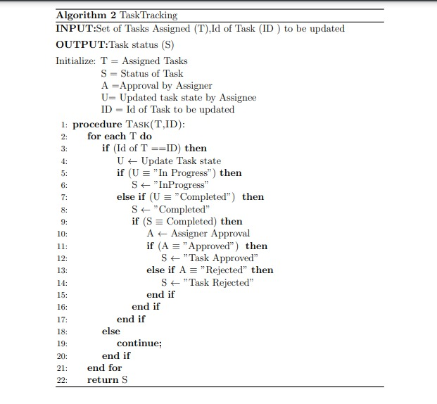
Algorithms for Goal Tracking and Task Tracking

Slide 22
Technologies Used
A. Python: Tools, Libraries, Usage
Spyder is the Scientific Development Environment for Python (v3.8), it is a free integrated development environment (IDE) which is integrated with Anaconda.
Python 3.8 version is used for our work and have used the Tkinter library. Tkinter library is built in Python and generally used for creating GUI applications which is used for creation of NextGenBot.
Cosine similarity is a metric, helpful in determining the data objects that are irrespective of their size and even we can measure the similarity between two sentences in Python using the Cosine Similarity method. In this cosine similarity, the data objects in a dataset are treated as a vector.
B. JSP & JDBC
Java Server Pages (JSP) it is a server-side technology which we used for creating web applications, and to create dynamic web content and we also used JDBC which acts as a bridge between middleware and backend databases(MySQL).
C. MySQL
MySQL is an open-source, fast reliable, and flexible relational database management system which is used for creating tables and storing data related to web application.
80%

Slide 23
Flow of Execution
Users gets the default credentials from the admin
User logs in using his credentials based upon his roles (Assignee/Assigner) the user will be redirected to a home page having a respective privileges
For Assigner login users have following privileges:
Profile Management: Here the user can check his/her profile status and also have an option to update his academic and research status.
Assigning Goals: Here in this module the assigner can assign the goals to assignee where he can mention goal priority, description of the goal along with the deadline to complete the goal.
Goal Tracking: Here in this module the assigner can track the goal that he assigned by reviewing the documents uploaded by the assignee and can increase the progress, and he can also view the deadlines to complete those goals.
Assign Tasks: Here in this module the assigner can assign the tasks to assignee where he can mention task priority, description of the task along with the deadline to complete the task.
Task Tracking: Here in this module the assigner can track the task that he assigned by reviewing the documents uploaded by the assignee and can increase the progress, and he can also view the deadlines to complete those tasks and also he can accept or reject the task based upon it’s status.
When an assigner logs into GuidoBot there he can track the task/goals by using their Id’s and there he can accept the tasks and he can even update the goal progress easily in a less time.

Slide 24
Continued …
For Assignee login users have following privileges:
Profile Management: Here the user can check his/her profile status and also have an option to update his academic and research status.
My Goals: Here in this module the assignee can check the goals that are assigned to him/her, here he can check the goal description and the deadlines and he have an option to submit the work that he progressed.
My Tasks: Here in this module the assignee can check the task that are assigned to him/her along with the description and the deadlines and he can change the status to InProgress/completed and he can also view the final acceptance of his task done.
When an assignee logs into GuidoBot at first he can get the notifications regarding his tasks/goals.
And he can also check the tasks/goals that are assigned to him and can change their status.

Slide 25

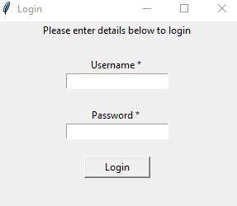
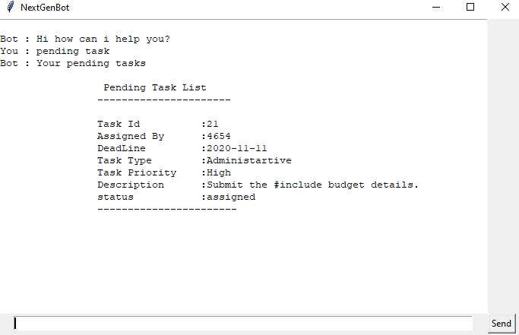
Output Screenshots
The above figure depicts that User need to enter his/her valid username and password to login to the NextGen Bot Interface.
The above figure represents that Chatbot displays the pending tasks of the user.

Slide 26
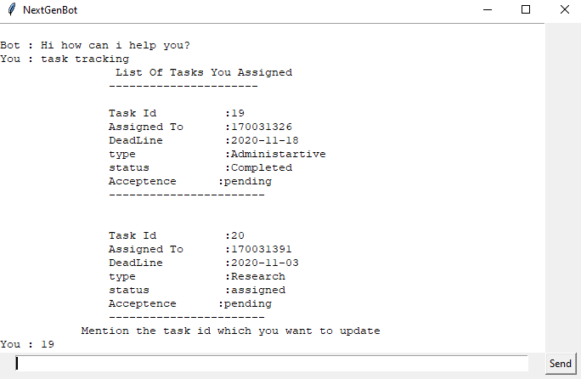
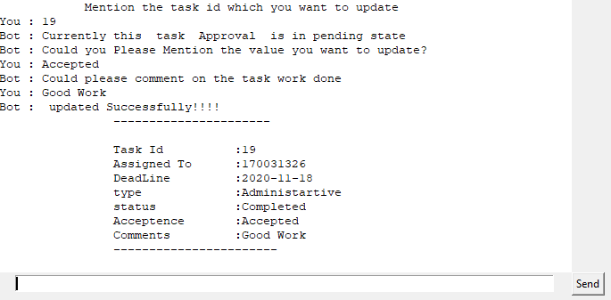
Continued …
The above figure reveals that assigner can track the task that he assigned, initially chatbot displays all the tasks that are assigned by him.
The above figure represents that the assigner can track the task by mentioning the task id and he can accept or reject the task. User can also mention his comments regarding the work.

Slide 27
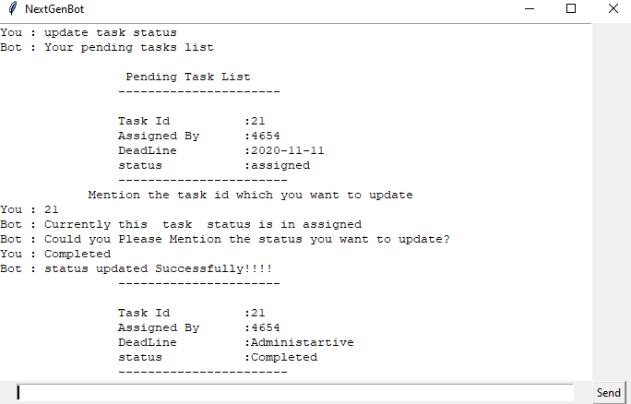
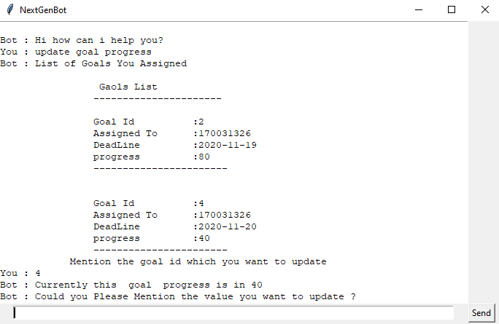
Continued …
The above figure initially displays all the tasks that are assigned to the assignee and by mentioning the task id assignee can update the status (InProgress / Completed) of his task.
The above figure represents how to interact with the chatbot to update the goal progress. Chatbot displays the list of goals assigned by the assigner. With the help of Goal id assigner can update the goal progress.

Slide 28
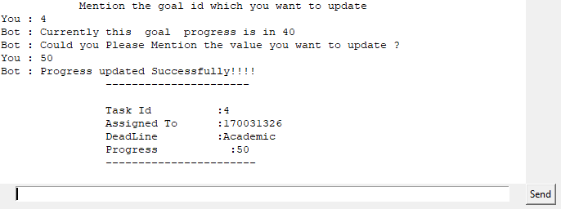
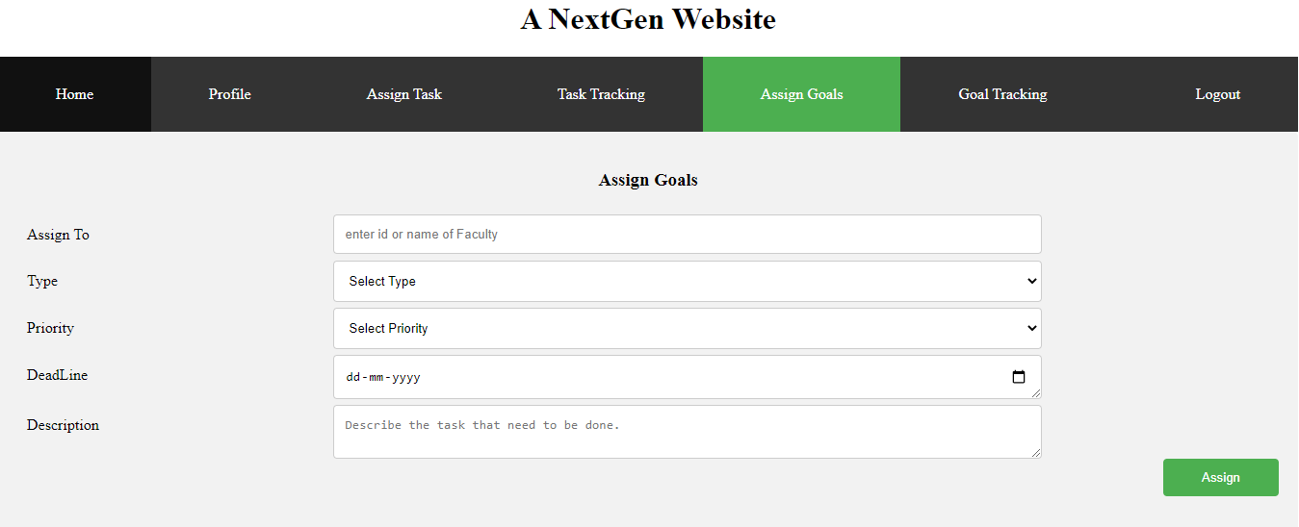
Continued …
The above figure represents the initial progress of the goal in the chatbot. Assigner can increment it with the percentage of completion as a progress.
The above figure displays a webpage where Assigner can assign goals to Assignee by stating its priority and deadline to complete it.

Slide 29
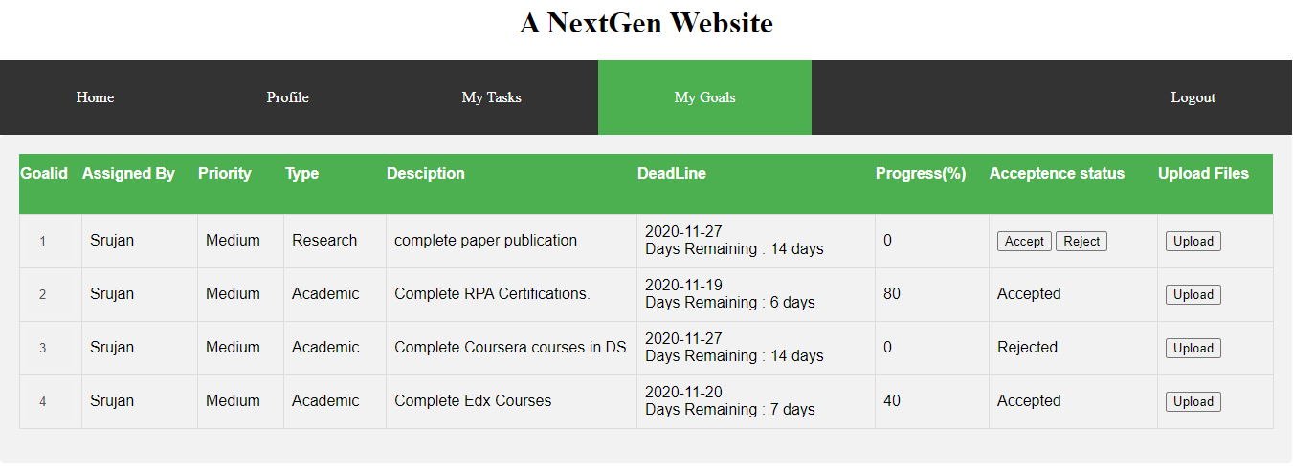
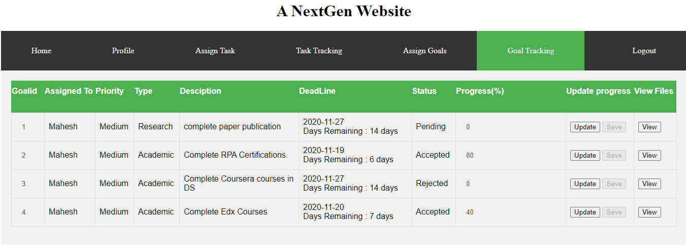
Continued …
The above picture represents My Goals tab of Assignee ,where he can view the goals that are assigned to him and he accept/reject the goal ,checks its progress and able to upload the work that he completed in order to increase the progress .
The above picture represents Goal Tracking page of Assigner, where he/she can view complete data along with deadline and status of goals that he/she assigned and he/she can able to change the progress of goals based on work done by assignee.

Slide 30
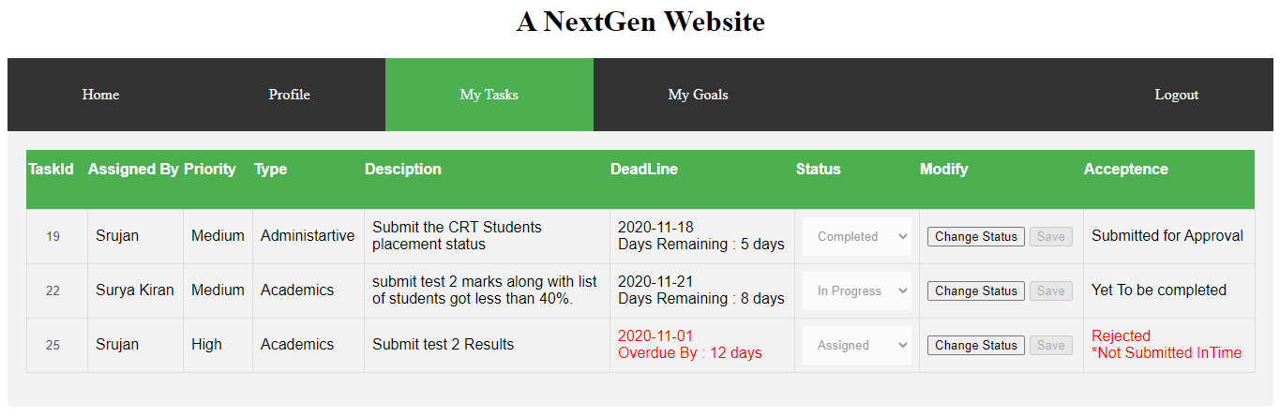
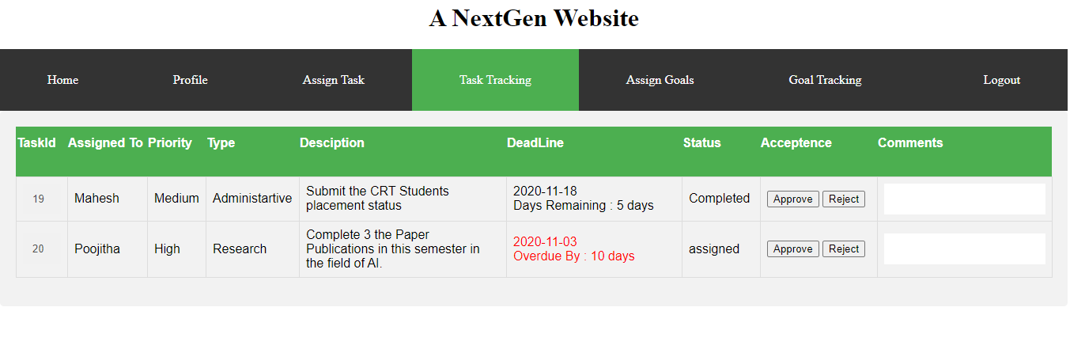
Continued …
The above figure represents the My Tasks page of Assignee, where he can view all the tasks that are assigned to him and he can able to change their status based on his work done and can view final Acceptance of his work from Assigner.
The above picture represents the Task Tracking page of Assigner where he can track all the tasks that he assigned along with their deadlines and able to check their status and Approves the tasks.

Slide 31
Conclusion
Technology as a concept is continuously working in providing new ways to save our time, and effort. NextGen bot is like having a personal assistant which exists in your phone or computer. Instead of someone else running your schedule user can do it on his own. They can utilize NextGen bot to update their profile, manage their timetable, track their goals in the best possible manner. NextGenbot provides Timely communication by operating 24/7, whatever the time as they can easily interact with the bot in human level language. It also removes the chance of human error from the equation entirely. This bot will also help lower the burden on stressed-out faculty, as they no longer have to remember all their tasks. It Serves multiple faculties simultaneously. Admin and faculty interactions are bought under one roof as admin can assign and track faculty goals and at the same time faculty can update his timely work. As they become more improvised, we need to consider humanness and proactivity, without leading to any insecurity aspects of user information.
90%

Slide 32
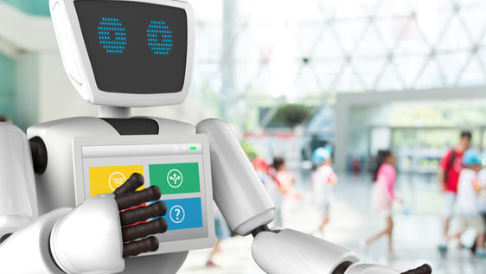
References
Sreelakshmi, A., Abhinaya, S., Nair, A., & Jaya Nirmala, S. (2019). A question answering and quiz generation chatbot for education. 2019 Grace Hopper Celebration India (GHCI). https://doi.org/10.1109/ghci47972.2019.9071832
Shinde, M. S., Nahar, M. S., & Shelke, S. (2019). Intelligent chatbot for guided navigation of repository contend. IJARCCE, 8(5), 25-28. https://doi.org/10.17148/ijarcce.2019.8506
Pal, S., & Singh, D. (2019). Chatbots and virtual assistant in Indian banks. Industrija, 47(4), 75-101. https://doi.org/10.5937/industrija47-24578
Sandu, N., & Gide, E. (2019). Adoption of AI-chatbots to enhance student learning experience in higher education in India. 2019 18th International Conference on Information Technology Based Higher Education and Training (ITHET). https://doi.org/10.1109/ithet46829.2019.8937382
Selvi, V., Saranya, S., Chidida, K., & Abarna, R. (2019). Chatbot and bullyfree chat. 2019 IEEE International Conference on System, Computation, Automation and Networking (ICSCAN). https://doi.org/10.1109/icscan.2019.8878779

Slide 33
Continued ...
Sivcevic, D., Kosanin, I., Nedeljkovic, S., Nikolic, V., Kuk, K., & Nogo, S. (2020). Possibilities of used intelligence based agents in instant messaging on e-government services. 2020 19th International Symposium INFOTEH-JAHORINA (INFOTEH). https://doi.org/10.1109/infoteh48170.2020.9066343
Ajaykumar, K ., Rishikesh, N ., & Damini, P. (2020) .Chatbot for HR Department Using AIML and LSA.IRJET,7(3),2164-2167.https://www.irjet.net/archives/V7/i3/IRJET-V7I3428.pdf
Niranjan, P. Y., Rajpurohit, V. S., & Malgi, R. (2019). A survey on chat-bot system for agriculture domain. 2019 1st International Conference on Advances in Information Technology (ICAIT). https://doi.org/10.1109/icait47043.2019.8987429
Oh, K., Lee, D., Ko, B., & Choi, H. (2017). A chatbot for psychiatric counseling in mental healthcare service based on emotional dialogue analysis and sentence generation. 2017 18th IEEE International Conference on Mobile Data Management (MDM). https://doi.org/10.1109/mdm.2017.64
Punjabi, S., Scthuram, V., Ramachandran, V., Boddu, R., & Ravi, S. (2019). Chat bot using API : Human to machine conversation. 2019 Global Conference for Advancement in Technology (GCAT). https://doi.org/10.1109/gcat47503.2019.8978336

Slide 34
Plan of Action
Sprint | Issues/User Stories | Member Assigned | Accomplishment
Sprint 1 | Topic Selection Identification of Problem Statement Literature Survey | Syam Jason Srujan Mahesh Poojitha | 100%
Sprint 2 | Proposed Framework Methodology Block Diagram | Syam Jason Srujan Mahesh Poojitha | 100%
Sprint 3 | Development Phase Testing Phase | Syam Jason Srujan Mahesh Poojitha | 100%
Sprint 4 | Documentation Paper | Syam Jason Srujan Mahesh Poojitha | 100%

Slide 35
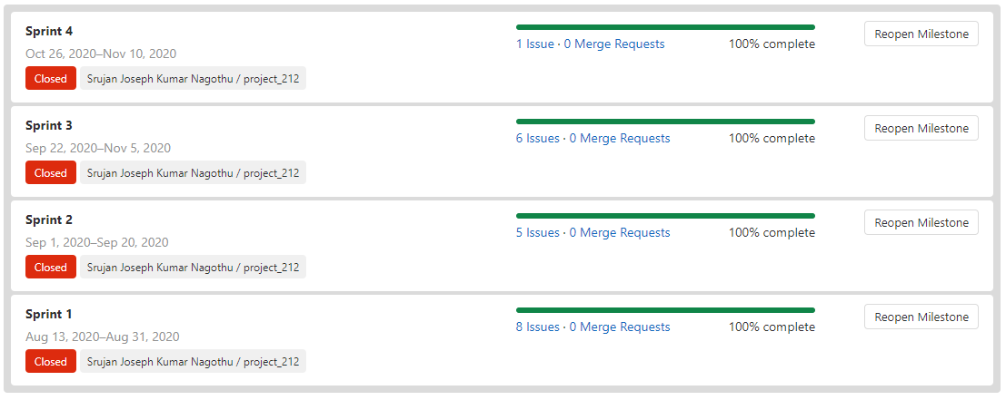
Continued …

Slide 36
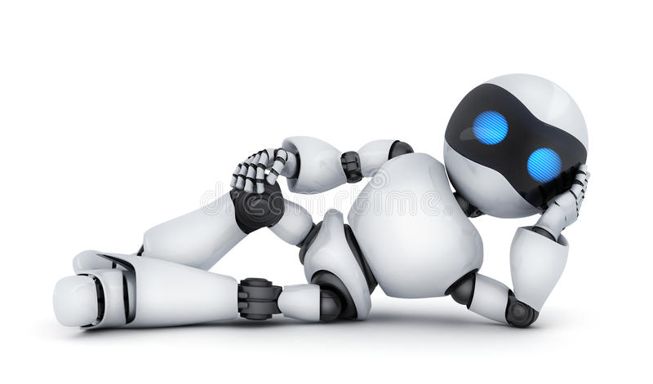
Thank You

