Slide 1
Phishing Website Detection
Cybersecurity data analysis | Logistic Regression vs Random Forest
Cybersecurity Project • 1/12

Slide 2
The security problem
Phishing sites impersonate legitimate websites to steal sensitive data.
Goal: identify risky sites while avoiding unnecessary false alarms.
Cybersecurity Project • 2/12

Slide 3
Research question
How accurately can two ML methods detect phishing websites?
Which errors matter most for security?
Cybersecurity Project • 3/12

Slide 4
Dataset
Kaggle: Phishing Dataset for Machine Learning
10,000 records • 48 predictive features • CLASS_LABEL
URL structure, hyperlinks, forms and page characteristics
Cybersecurity Project • 4/12

Slide 5
Exploratory analysis
10,000 original records; 48 predictors.
0 missing cells; 419 duplicate observations (ignoring ID).
9,581 unique records after cleaning.
Original labels: 5,000 phishing / 5,000 legitimate.
Cybersecurity Project • 5/12

Slide 6
Preprocessing
Remove ID and duplicates.
80/20 stratified train/test split.
Training-only median imputation.
Scale Logistic Regression features.
Cybersecurity Project • 6/12

Slide 7
Two machine learning methods
Logistic Regression: interpretable linear baseline.
Random Forest: ensemble of decision trees that captures nonlinear patterns.
Cybersecurity Project • 7/12

Slide 8
Model evaluation
Accuracy • Precision • Recall • F1 • ROC-AUC
Confusion matrix • False positives • False negatives
Cybersecurity Project • 8/12

Slide 9
Experimental results
Logistic Regression: 95.20% accuracy, 96.07% recall, 95.04% F1
Random Forest: 98.38% accuracy, 98.80% recall, 98.32% F1
False negatives: 36 vs 11; false positives: 56 vs 20
Cybersecurity Project • 9/12

Slide 10
Security implications
Random Forest missed 11 phishing websites vs 36 for Logistic Regression.
False negatives leave threats unflagged.
False positives incorrectly warn about legitimate sites.
The chosen alert threshold must balance both costs.
Cybersecurity Project • 10/12

Slide 11
Limitations and next steps
Static benchmark; possible data bias and related sites across splits.
Validate on newer data, monitor drift, and combine with human review.
Cybersecurity Project • 11/12

Slide 12
Conclusion and sources
Random Forest was better on this test: 98.38% accuracy, 98.80% phishing recall.
Validate on newer sites before deployment.
Dataset: https://www.kaggle.com/datasets/shashwatwork/phishing-dataset-for-machine-learning
Cybersecurity Project • 12/12

Slide 13
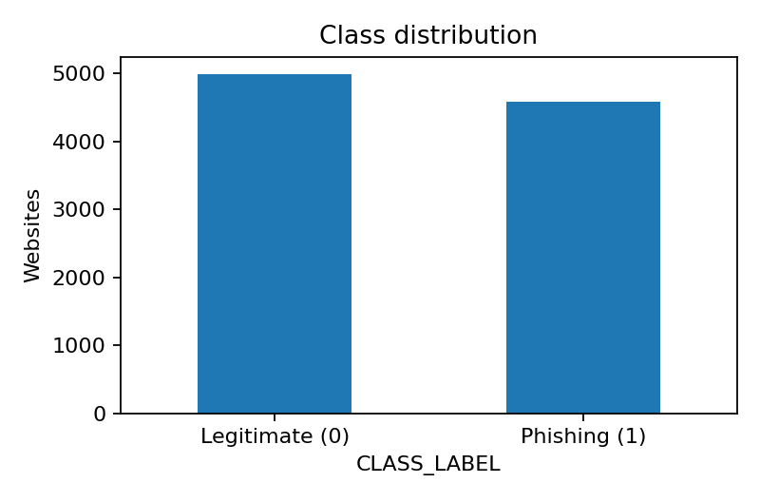
Class distribution

Slide 14
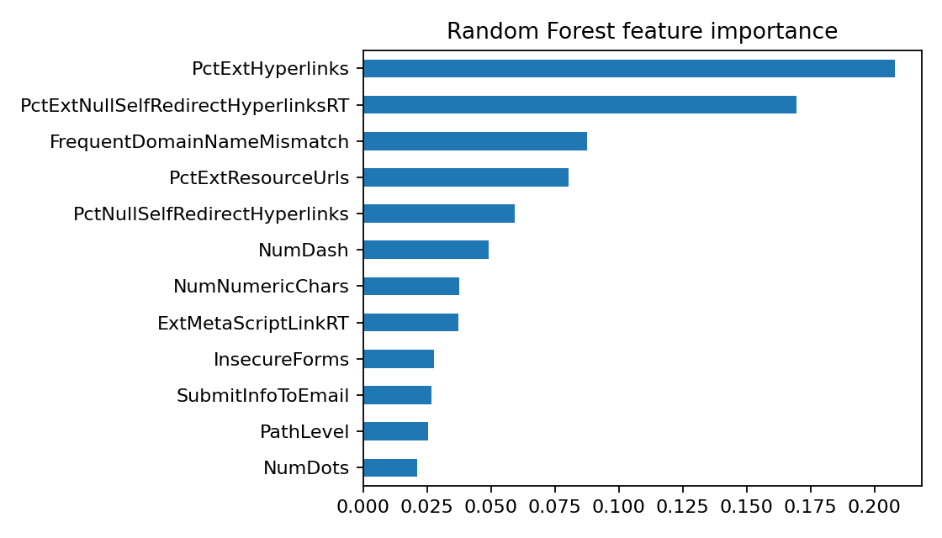
Random Forest feature importance

Slide 15
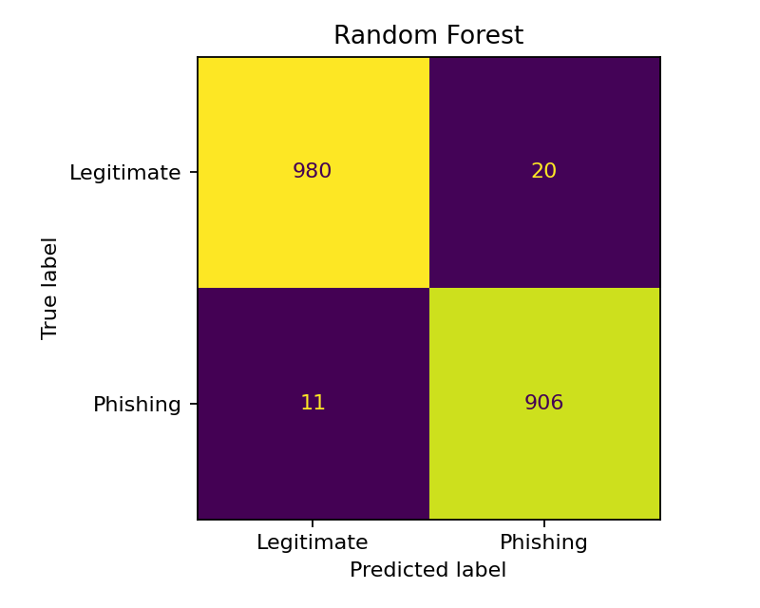
Model confusion matrices

