Slide 1
EDUCATIONAL CERTIFICATES DATA EXCHANGE STANDARD
Presented by
Umair Anwar
Presented by Umair Anwar (MSIT-6)

Slide 2
Project supervisor
DR SHARIFULLAH KHAN
Committee Members
DR SARAH S KHAN
MUHAMMAD BILAL
MR MUJTABA HAIDER
Presented by Umair Anwar (MSIT-6)

Slide 3
Agenda
Introduction
Need for this research
Literature Review
Business Process
Proposed Architecture
Proposed Data Format
Semi-Automated SDRES XML to DB Mapping Tool
Central Portal for these Web Servicess
Presented by Umair Anwar (MSIT-6)

Slide 4
Introduction
The student certificate data is currently exchanged manually between educational institutes [in Pakistan].
The thesis is an effort in suggesting a prototype infrastructure that will enable these institutes to inter-exchange student degree record digitally.
Infrastructure represents
  Data Format
  Architecture
Presented by Umair Anwar (MSIT-6)

Slide 5
Problem Statement
Suggesting a prototype data format and architecture that will enable inter-exchange of student degree record digitally between institutes.
Presented by Umair Anwar (MSIT-6)

Slide 6
Need for this research
No digital student certificate data exchange mechanism exists between universities in Pakistan.
Universities / institutes needs to validate this data
Presented by Umair Anwar (MSIT-6)

Slide 7
Literature Review
Presented by Umair Anwar (MSIT-6)

Slide 8
Existing Student Data Exchange Standards
Presented by Umair Anwar (MSIT-6)

Slide 9
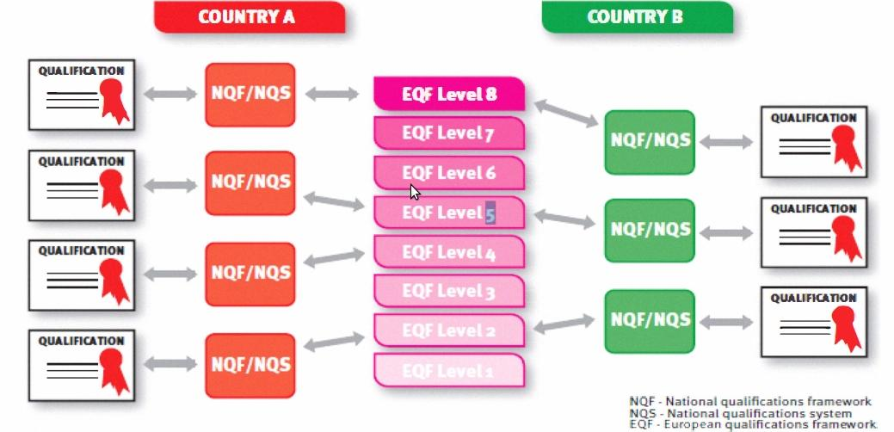
European Qualifications Framework (EQF)[1]
Common Reference Framework
Helps participating countries to compare national qualifications
From 2012, qualifications carry a reference to EQF level.
Presented by Umair Anwar (MSIT-6)

Slide 10
Europass
Collection of five documents
Curriculum Vitae, Language Passport [2], The Mobility, The Diploma Supplement, and Certificate Supplement
<DocumentInfo>
<DocumentType>ECV</DocumentType>
<CreationDate>2012-03-01</CreationDate>
<LastUpdateDate>2012-03-01</LastUpdateDate>
<XSDVersion>V3.0</XSDVersion>
<Generator>XML Editor</Generator>
<Comment>Example CV XML according to XSD v3.0</Comment>
</DocumentInfo>
Presented by Umair Anwar (MSIT-6)

Slide 11
Schema for Academia (SCHAC)
Vocabulary related to Degrees and Courses
Written in LDAP, not XML
For example;
  schacMotherTonge uses ISO-639 language codes
  schacGender uses ISO-5218 gender codes
Presented by Umair Anwar (MSIT-6)

Slide 12
European Learners Mobility
The Mobility Project [3] by Rafal Nagrodzki
Aims to exchange student data for student mobility
Proposes a data standard and architecture
XML Based standard using SOAP
Designed in context of Europe under EHEA
The REST Mobility by Karol Kanski [4]
Restful implementation of standard proposed by Rafal Nagrodzki
Presented by Umair Anwar (MSIT-6)

Slide 13
Business Process – Sequence Diagrams
Presented by Umair Anwar (MSIT-6)

Slide 14
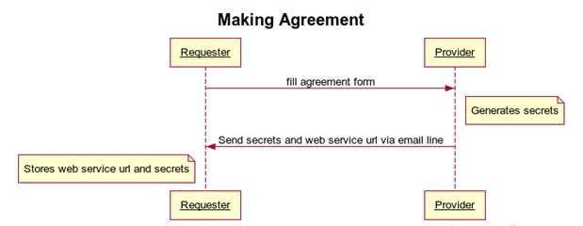
Business Process (1/4)
Presented by Umair Anwar (MSIT-6)

Slide 15
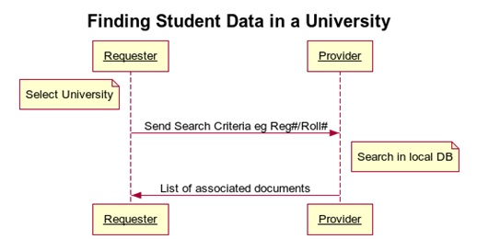
Business Process (2/4)
Presented by Umair Anwar (MSIT-6)

Slide 16
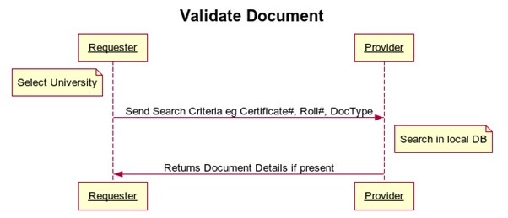
Business Process (3/4)
Presented by Umair Anwar (MSIT-6)

Slide 17
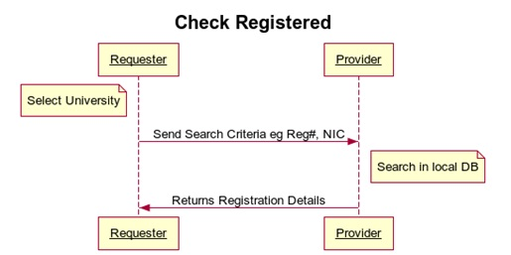
Business Process (4/4)
Presented by Umair Anwar (MSIT-6)

Slide 18
Proposed Architecture
Presented by Umair Anwar (MSIT-6)

Slide 19
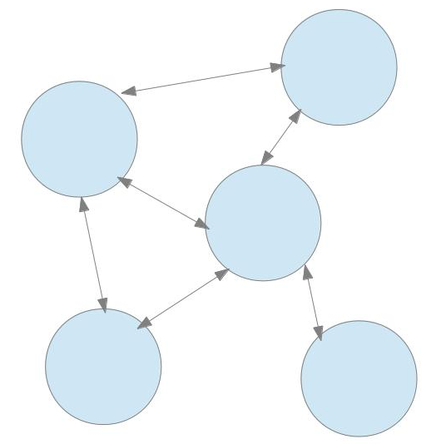
Proposed Architecture (1/2)
distributed architecture
Benefits;
  Avoidance from single point of failure
  Fewer loads
  Each node has control over its own data, thus building trust in system
Presented by Umair Anwar (MSIT-6)

Slide 20
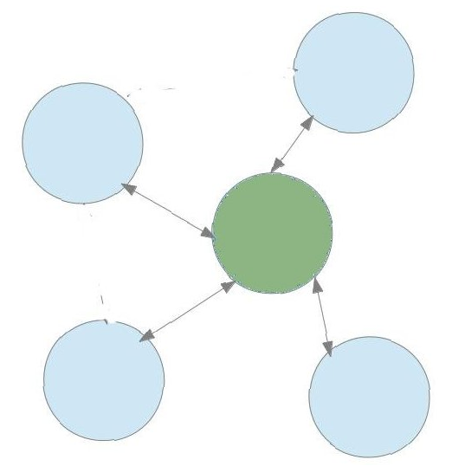
Proposed Architecture (1/2)
distributed architecture
Benefits;
  Avoidance from single point of failure
  Fewer loads
  Each node has control over its own data, thus building trust in system
Presented by Umair Anwar (MSIT-6)

Slide 21
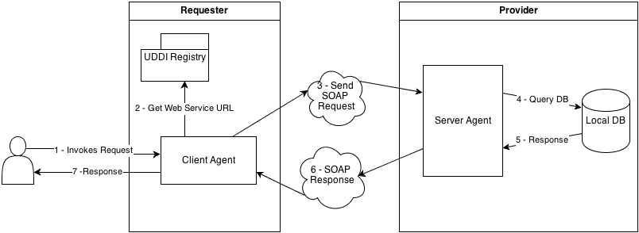
Proposed Architecture (2/2)
Presented by Umair Anwar (MSIT-6)

Slide 22
Important Considerations?
Why SOAP?
  SOAP web service uses well established standards HTTP or XML and provide abstraction from network details.
  XML-RPC lacks support for developer defined data types.
  REST is set of principles and not impose to be compliant with a clearly defined specification.
Why not global UDDI registry instance?.
  Single registry have all information at one place but single point of failure.
Presented by Umair Anwar (MSIT-6)

Slide 23
Proposed Data Format
XML based
Rafal Nagrodzki fulfills some vocabulary requirements, we will reuse these terms.
  Not have vocabulary for annual based courses
  Only have vocabulary related to semester based system
Reusing the ideas from SCHAC as it uses ISO norms where possible.
  For example, using ISO country codes
Presented by Umair Anwar (MSIT-6)

Slide 24
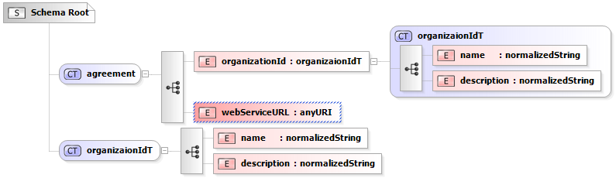
Vocabulary (1/3)
Presented by Umair Anwar (MSIT-6)

Slide 25
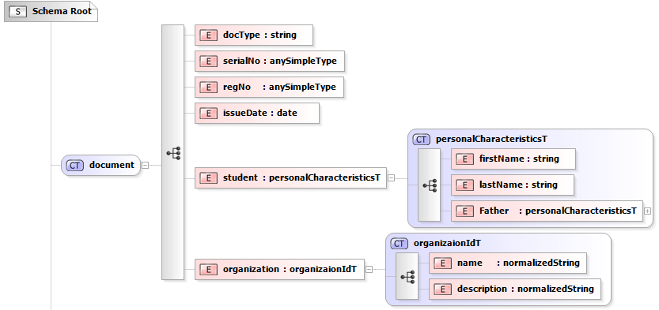
Vocabulary (2/3)
Presented by Umair Anwar (MSIT-6)

Slide 26
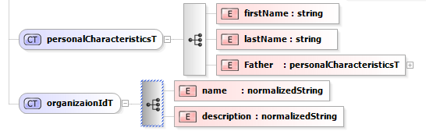
Vocabulary (3/3)
Presented by Umair Anwar (MSIT-6)

Slide 27
Mapper
Semi-Automated SDRES XML to DB Mapping Tool
Presented by Umair Anwar (MSIT-6)

Slide 28
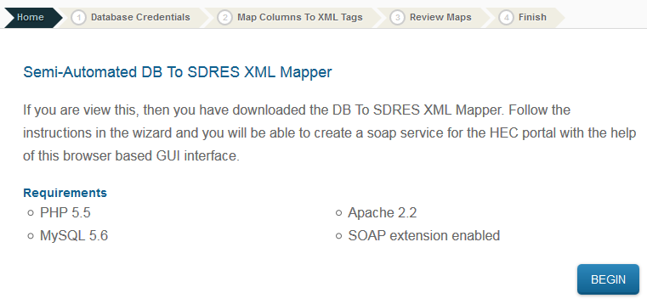
Mapper: download and unzip (1/4)
Presented by Umair Anwar (MSIT-6)

Slide 29
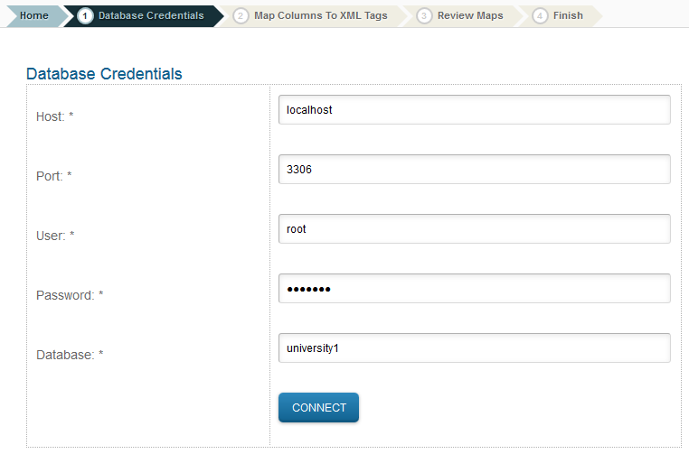
Mapper: provide db credentials (2/4)
Presented by Umair Anwar (MSIT-6)

Slide 30
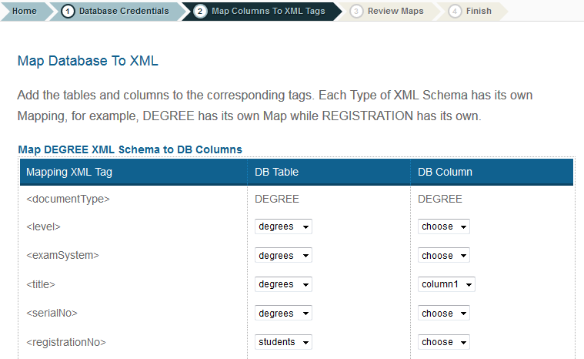
Mapper: create mappings (3/4)
Presented by Umair Anwar (MSIT-6)

Slide 31
Mapper: Web Service URL (4/4)
When mappings are successfully created a web service URL is returned.
This returned URL is sent to the Central HEC Portal Admin to be added in the Portal.
As it is added with correct credentials, it starts working with the portal since the service follows the same standard.
Presented by Umair Anwar (MSIT-6)

Slide 32
Prototype / Demo
Implementation of the Central Portal for these Web Services
Presented by Umair Anwar (MSIT-6)

Slide 33
References
Pouyioutas, P.; Gjermundrod, H.; Dionysiou, I.; Michael, M., "MAPQFTOOL: A software tool to support national qualifications frameworks," Information Society (i-Society), 2011 International Conference on , vol., no., pp.198,203, 27-29 June 2011
Karampiperis, P.; Sampson, D.; Fytros, D., "Lifelong Competence Development: Towards a Common Metadata Model for Competencies Description - The Case Study of Europass Language Passport," Advanced Learning Technologies, 2006. Sixth International Conference on , vol., no., pp.677,681, 5-7 July 2006
Rafał Nagrodzki, The Mobility Project (December 2009)
Karol Kański Integration of services in the Mobility Project (June 2011)
Presented by Umair Anwar (MSIT-6)

Slide 34

Presented by Umair Anwar (MSIT-6)

