Slide 1
Who earns what in urban Sindh?
PSLM 2019-20 | Variant 3: Sindh, urban | FA24-BEDS-075
2,644
Rs 264,000
Rs 696,000
5.80
earners aged 15-64
weighted median
90th percentile
90th / 10th ratio
Weighted by hhweight. Data: course repository, merged on hhid.
Notes:
Variant: 75 = 9 x 8 + 3, so variant 3 = Sindh urban. Sample = persons 15-64 with earn_annual > 0, merged to the household file by hhid for hhweight, prov_code, urban_rural. 2,644 earners. All statistics weighted by hhweight.

Slide 2
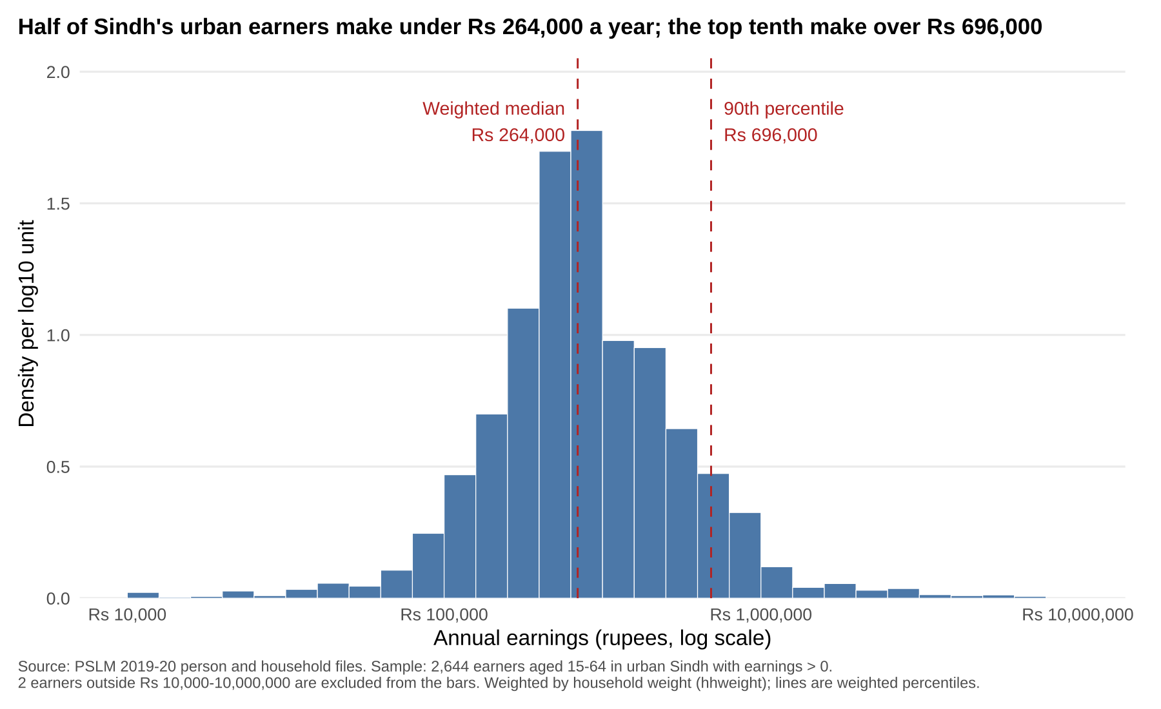
Half earn under Rs 264,000; the top tenth over Rs 696,000
Bell-shaped on a log scale, long right tail
90th is 5.8 times the 10th (Rs 696,000 vs Rs 120,000)
Weighted median Rs 264,000 vs unweighted Rs 252,000: higher earners carry larger weights
Notes:
Bins are 0.1 wide in log10 units from 4.0 to 7.0; density per log10 unit. 2 earners fall outside Rs 10,000-10,000,000 and are excluded from the bars (percentiles use all 2,644). Weighted quantile: sort, cumulative weight share, smallest x where share >= p.

Slide 3
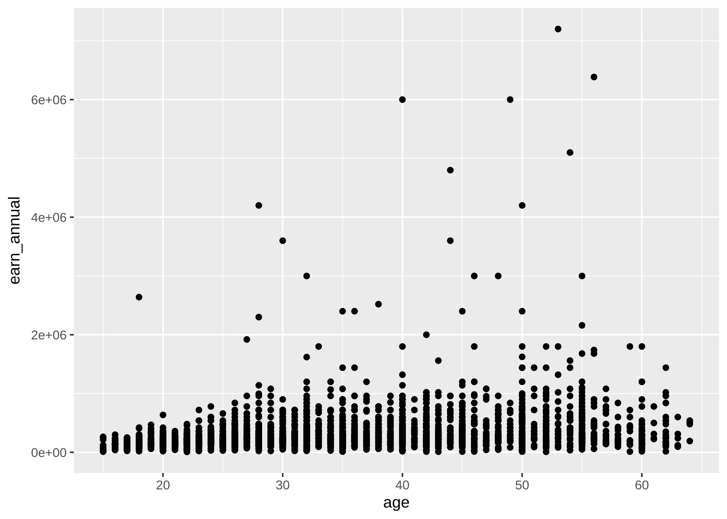
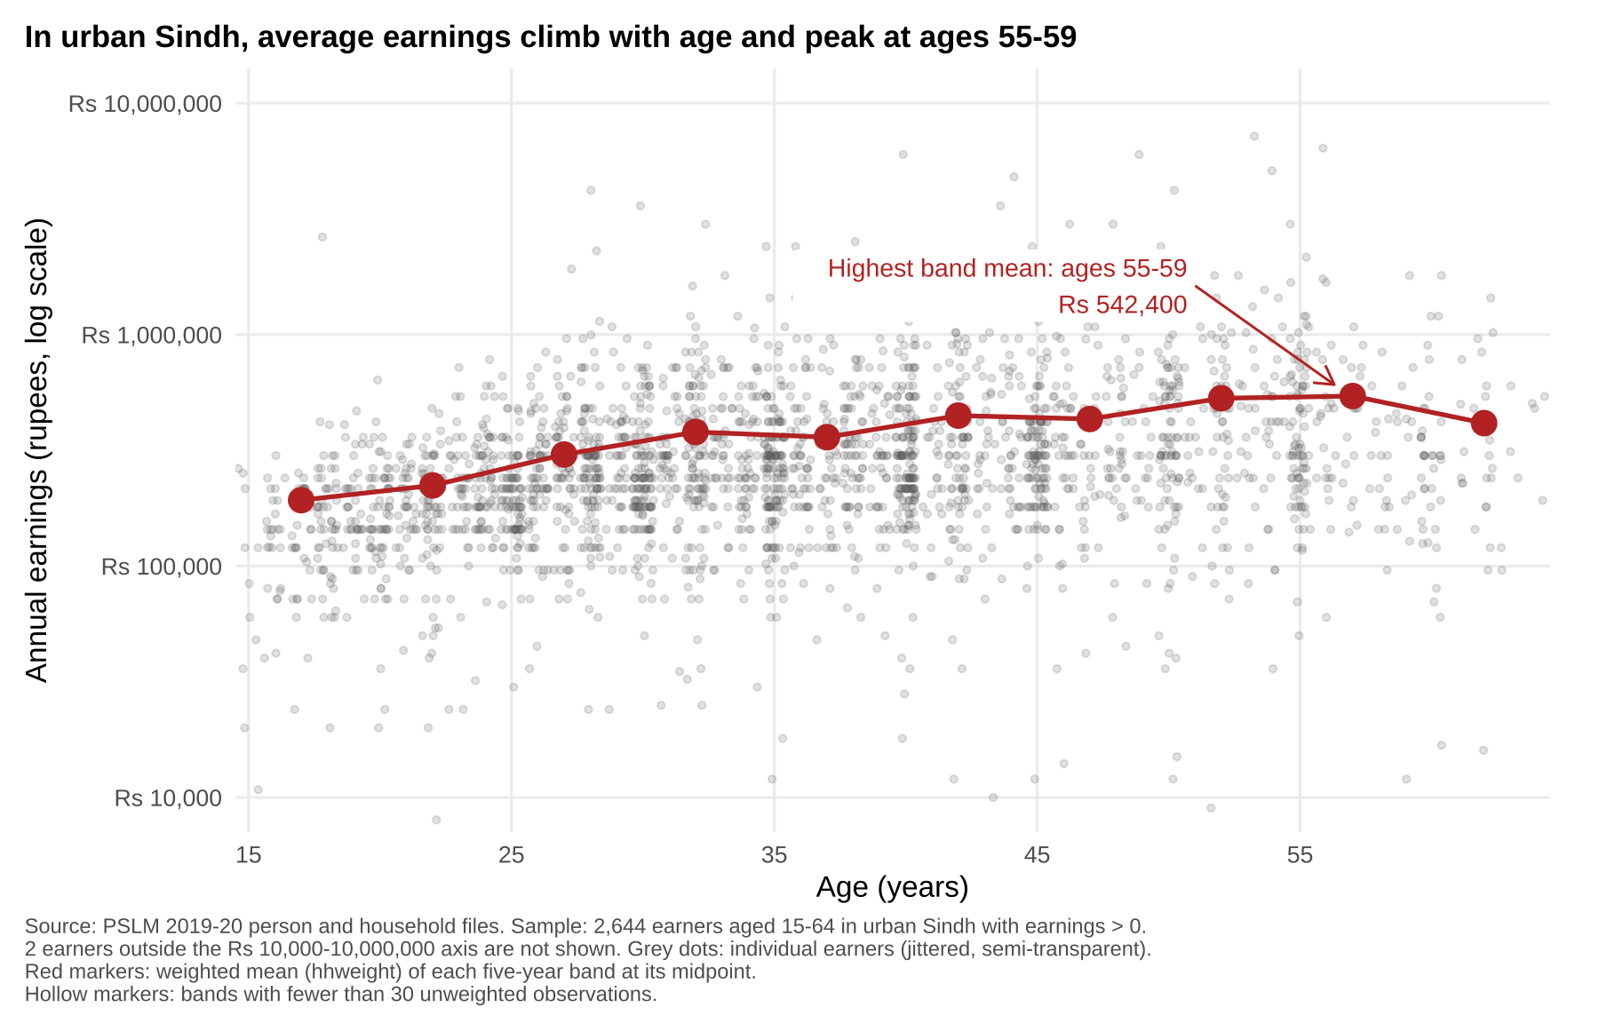
The makeover: from R's default to a readable figure
Default: geom_point() only
Redesign
Most dots are crushed into a thin strip; stripes hide the density; axis says 6e+06.
Log rupee axis, transparent jittered dots, weighted band means, and a title that states the finding.
Notes:
Principles: log scale (multiplicative gaps), overplotting (alpha + jitter because ages are integers and earnings are rounded), conditional means (band means on a common scale), data-ink (grey panel and scientific notation removed), direct labelling. What the default shows that the redesign hides: the extreme top earners (up to about Rs 7.2 million) look ordinary on a log axis, and the 2 earners below Rs 10,000 are cut off.

Slide 4
Average earnings rise 79% between the late 20s and late 50s
Rs 303,154 (25-29) to Rs 542,400 (55-59)
The oldest band (60-64) falls to Rs 414,262
Cannot tell: whether one person's pay follows this path. These are different people at one date, so age and cohort are mixed.
Notes:
Band means are weighted by hhweight and rounded to the rupee; 45-49 = Rs 431,697. All bands have at least 30 observations (smallest is 60-64 with 72), so no hollow markers. Python reproduces the table to the rupee.

