Slide 1
Aspect Based Sentiment Analysis Using Machine Learning Umair Cheema Athar Pasha

Slide 2
Overview
Project Objective
Data Preparation
Exploratory Data Analysis
Methods and Techniques
Results
Q & A

Slide 3
Project Objective
Combine Machine Learning and Natural Language Processing to conduct Aspect Based Sentiment Analysis of Customer Reviews on Restaurants.
What is Aspect Based Sentiment Analysis?
Aspect level analysis directly looks at the opinion and its target instead of just looking at document, paragraph, sentence or phrase level sentiment.

Slide 4
Aspect Level Sentiments
Example
Seafood platter was delicious but wine options were limited and ridiculously expensive.
Aspect | Polarity
Food quality | Positive
Drinks options | Negative
Drinks Price | Negative

Slide 5
Data Preparation
Downloaded SemEval 2016 XML with Review, Entity/Attribute and Sentiment Anotations
XML to Pandas (Multilabel and Multidimensional transformations)
Data Cleaning (Removal of punctuations, Case folding, Tokenization etc)

Slide 6
Data Preparation
Updated Opensource tool to prepare WordEmbeddings using Yelp data by modifying TensorFlow methods in the new version of Tensorflow
https://github.com/titipata/yelp_dataset_challenge

Slide 7
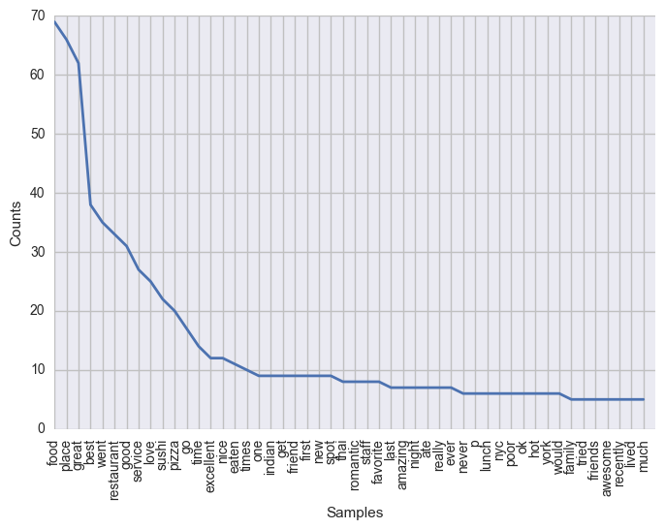
Exploratory Data Analysis
SemEval Dataset

Slide 8
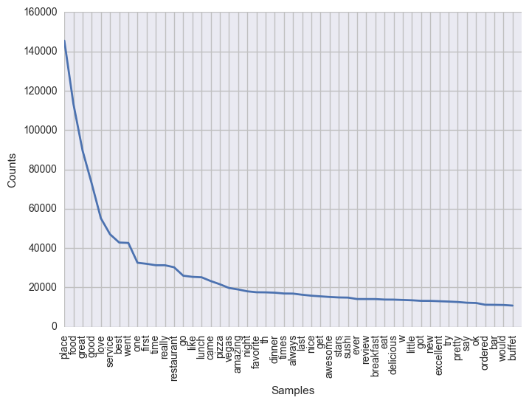
Exploratory Data Analysis
Yelp Dataset

Slide 9
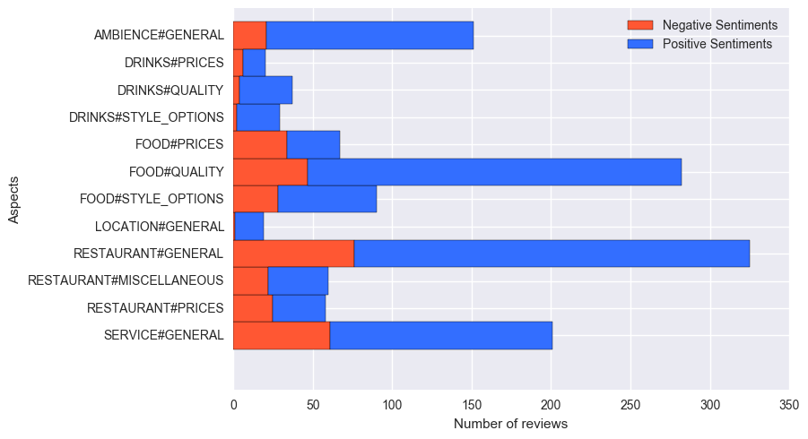
Exploratory Data Analysis
Aspect Sentiment Class Distribution

Slide 10
Challenges
Only 350 annotated samples to train models
Imbalanced Classes
No built-in scikit-learn function available for evaluating Multidimensional classification

Slide 11
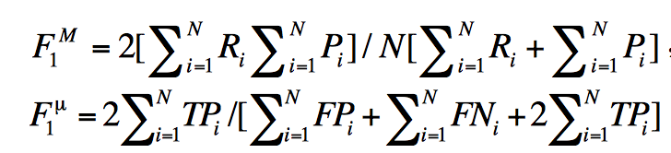
Methods and Techniques
Implemented Custom F1 micro Scoring Function described in “A MFoM Learning Approach to Robust Multiclass Multi-Label Text Categorization” by Gao et al.

Slide 12
Methods and Techniques
Prepared following features
Bag of n grams
POS Tags and Tokens
Domain Specific CBOW Word Embeddings
Domain Specific Skip gram Word Embeddings
Paragraph Vector Models and Inferred Features

Slide 13
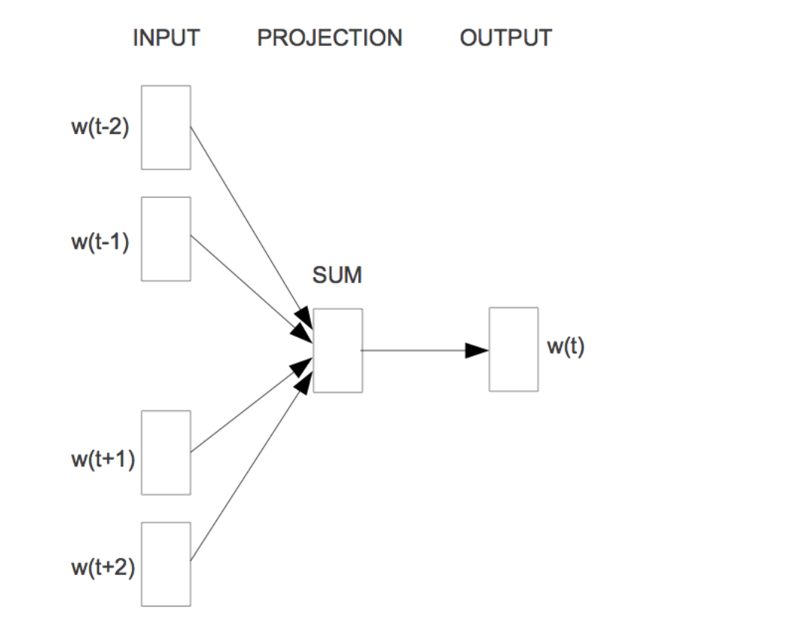
Methods and Techniques
Word Embeddings (CBOW)

Slide 14
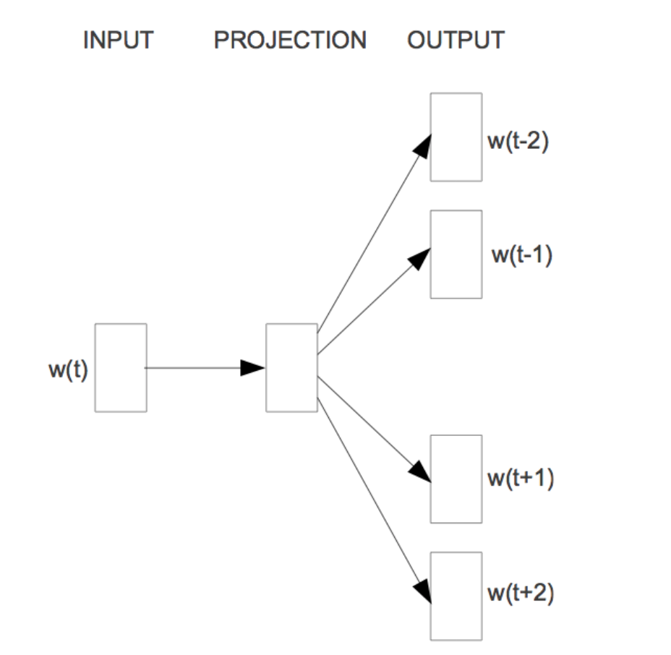

Methods and Techniques
Word Embeddings (Skip-gram)

Slide 15
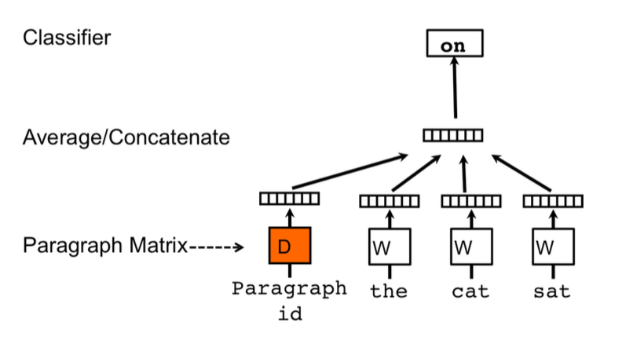
Methods and Techniques
Paragraph Vectors
(Mikolov et al ,2014)

Slide 16
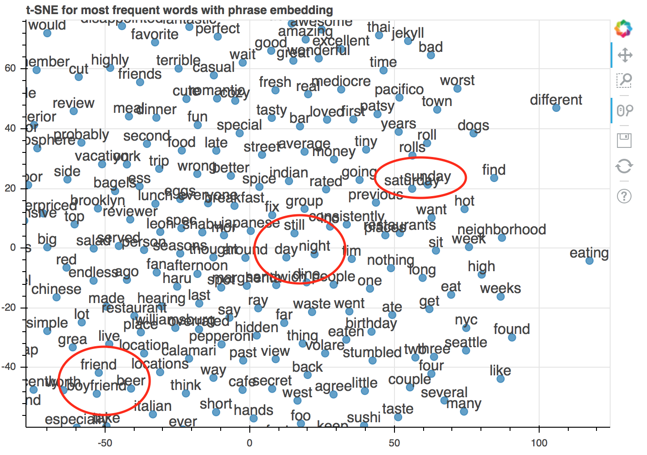
Methods and Techniques
t-distributed Stochastic Neighbor Embedding (t-SNE)

Slide 17
Methods and Techniques
Classification Algorithms
Support Vector Machines
RandomForests

Slide 18
Results
Method | F1(Aspect) | Polarity
RandomForest (Bag of Words) | 0.710 | 0.84
RandomForest (Bag of Words + POS) | 0.732 | 0.83
RandomForest (Word2Vec CBOW) | 0.715 | 0.871
SVM(Word2Vec CBOW) | 0.739 | 0.913
SVM(Word2Vec Skip gram) | 0.752 | 0.926
SVM(Word2Vec Phrase detection +CBOW) | 0.760 | 0.927
SVM (Doc2Vec) | 0.705 | 0.837

Slide 19
Conclusions
Aspect Based Sentiment Analysis is a very challenging Multilabel and Multiclass classification problem.
Domain specific Word Embeddings is an invaluable tool for converting textual features into Vector Space Model.
A Multilabel SMOTE oversampling should have been used to balance the class distribution of the labelled datasets.

Slide 20
References
Bing Liu, 2015. Sentiment Analysis: Mining Opinions, Sentiments, and Emotions. 1 Edition. Cambridge University Press.
Sebastian Ruder. 2016. On word embeddings - Part 1. [ONLINE] Available at: http://sebastianruder.com/word-embeddings-1/. [Accessed December 2016]Methods and Techniques

Slide 21
References
Quoc Le, Tomas Mikolov 2014. Distributed Representations of Sentences and Documents. Proceedings of the 31st International Conference on Machine Learning, pp. 1188-1196
Tomas Mikolov et al 2013. Efficient Estimation of word representations in vector space arXiv preprint arXiv:1301.3781

Slide 22
References
Sheng Gao et al 2004. A MFoM Learning Approach to Robust Multiclass Multi-Label Text Categorization. Proceedings of the 21st International Conference on Machine Learning, pp. 42

Slide 23
Q & A

