Slide 1
Adaptive Boosting Umair Cheema Athar Pasha
Summary of Alogrithm based on:
“AdaBoost and the Super Bowl of Classifiers. A Tutorial Introduction to Adaptive Boosting”

Slide 2
Overview
Preamble
AdaBoost
Toy Example
Summary of Ada Boost and Error
Demonstration
References
Q & A

Slide 3
Rules of Thumb: Crowd vs. Individual Decisons
Can crowds make better decisions?
Individual Decision
Perfect Info = ∞ $
Example: Accurately predict the winner of horse race based on the usual info:
Most favored odds
Fastest recorded times
Most wins…
While unable to articulate a grand rule, our gambler finds that such Rules of Thumb provide prediction that is a little better than guessing:ε ≥ ½
Boosting refers to a general and effective method of prodcuing a very accurate prediction rule by combining rough and moderately inaccurate rules of thumb

Slide 4
AdaBoost
AdaBoost is an iterative algorithm proposed in 1995 by Yoav Freund and Robert Shapire as a general method for generating a strong classifier out of a set of weak classifiers
Emphasizes incorrectly classified data for the next iteration

Slide 5

AdaBoost Roadmap: Generating strong classifiers out of weak classifiers
Use a large pool of classifiers at your disposal to submit an even better classifier
Classifiers chosen from the pool emitting an opinion k_{j}(x_{i}) for every pattern x_{j}, where k_{j} is e {-1,1}. The opinions are weighted and a final yay/nay C generated (assuming 11 experts)
Notes:
Assume you are working with 2-class patetern recognition and have a large pool of clasi

Slide 6
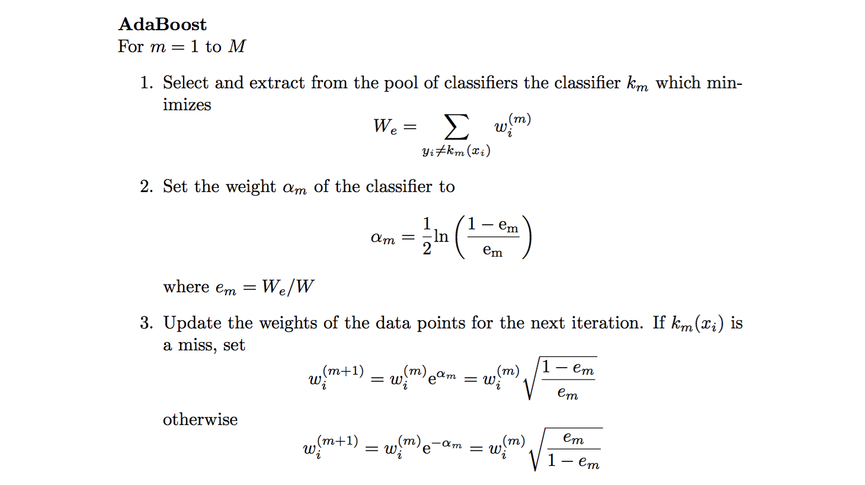
Adaboost Algorithm

Slide 7
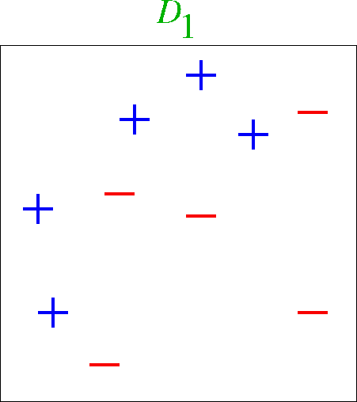
Toy Example
6
3
9
8
1
4
7
2
10
5
x | 1 | 2 | 3 | 4 | 5 | 6 | 7 | 8 | 9 | 10
w | 1/10 | 1/10 | 1/10 | 1/10 | 1/10 | 1/10 | 1/10 | 1/10 | 1/10 | 1/10

Slide 8
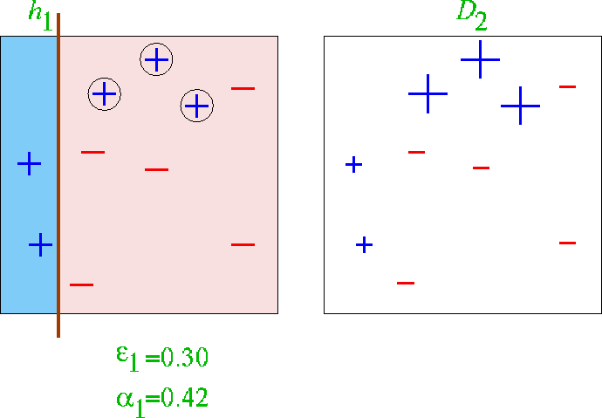

First classifier

Slide 9
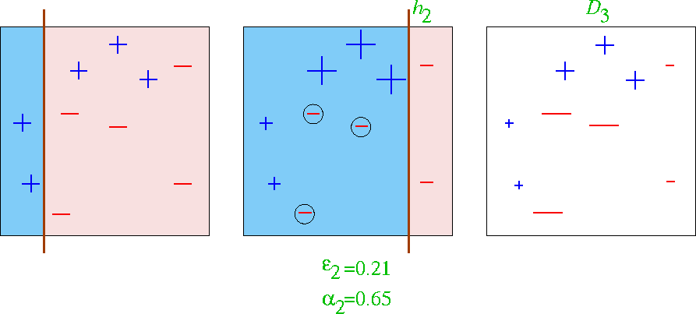

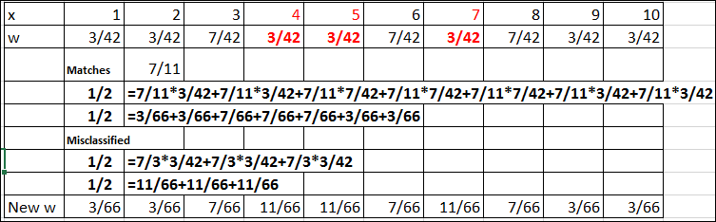
First 2 classifiers

Slide 10
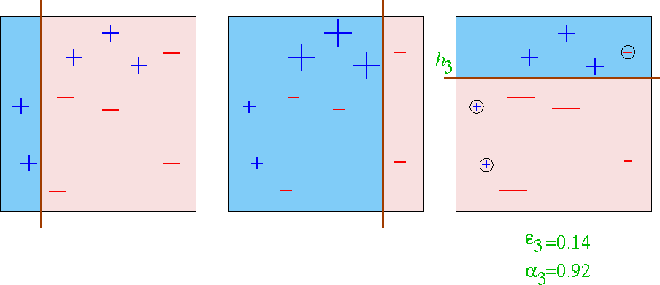

First 3 classifiers

Slide 11
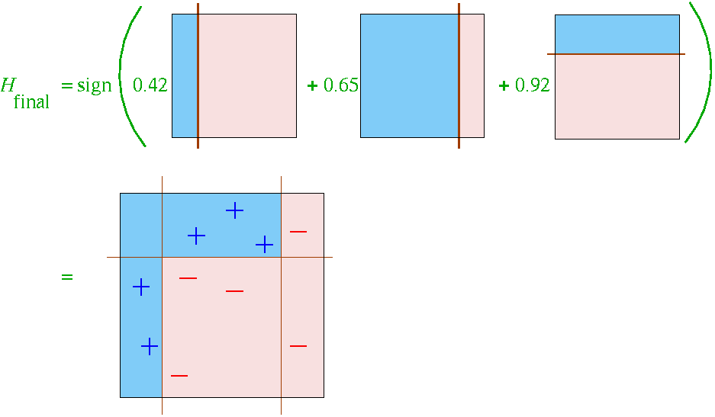
Final Classifier learned by Boosting

Slide 12
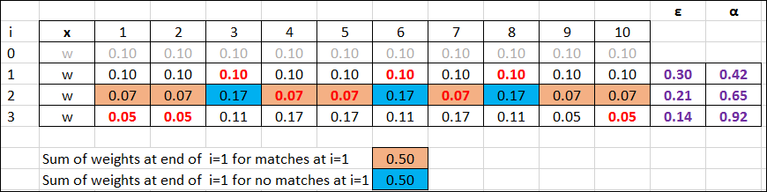
Toy Example Summary
6
3
9
8
1
4
7
2
10
5

Slide 13
Summary of AdaBoost
Boosting is an approach to machine learning based on the idea of creating a highly accurate prediction rule by combining many relatively weak and inaccurate rules (i.e Weak Classifier).
General and demonstrably effective method of producing predictions that are made by increasing weighted avearege of the weak classifiers
Fast error convergence
No “pre-processing” of prior knowledge about weak learner
Not a function of an input parameter that needs to be tweaked
Often tends not to overfit, but some issues with overfitting if classifiers are too weak

Slide 14
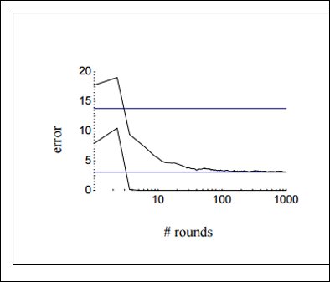
Error Curves

Slide 15
References
Yoav Freund and Robert E Schapire. 1997. A Decision-Theoretic Generalization of On-Line Learning and an Application to Boosting. J. Comput. Syst. Sci. 55, 1 (August 1997), 119-139. DOI=http://dx.doi.org/10.1006/jcss.1997.1504
Robert E Schapire, 2013. Explaining AdaBoost. Empirical Inference, pp 37-52
Raul Rojas 2009, AdaBoost and the Super Bowl of Classifiers. A Tutorial Introduction to Adaptive Boosting
MIT OpenCourseware: Artificial Intelligence, 6-034. https://ocw.mit.edu/courses/electrical-engineering-and-computer-science/6-034-artificial-intelligence-fall-2010/index.htm
http://scikit-learn.org/stable/auto_examples/ensemble/plot_adaboost_twoclass.html

Slide 16
Demonstration

Slide 17
Q&A

