Slide 1

FINAL TERM PROJECT ANALYSIS
Impact of Promotions & Economics on Retail Sales
Umair Ahmed (28118) & Aurad Asif (28770) December 31, 2025

Slide 2
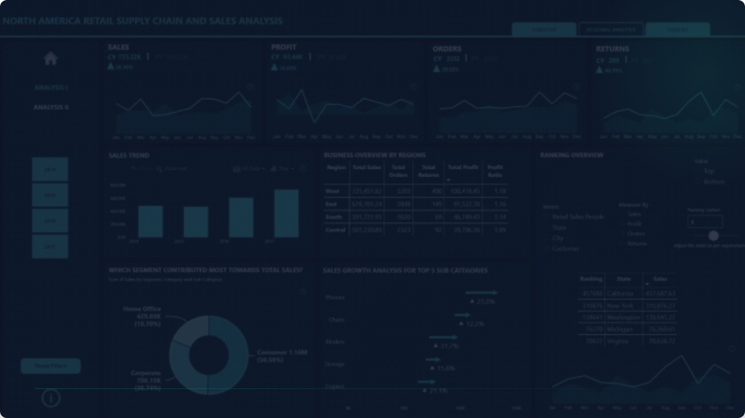
The Research Objective
Measuring the influence of promotions, macroeconomic conditions (CPI, Unemployment), and regional differences on weekly retail revenue to drive strategic forecasting.

Slide 3


Retail Data Ecosystem
Scope & Scale
Key Variables
Analyzing historical data from 45 stores across multiple departments. The study spans February 2019 to November 2021, capturing regional characteristics and temporal shifts.
•
Macro: CPI, Unemployment, Fuel Price
•
Promotional: Seasonal Markdowns
•
Store: Type (A/B/C) and Total Square Footage

Slide 4






Feature Engineering Strategy
Promo Binning
CPI Segments
Holiday Types
Categorized discounts into Low, Medium, High, and Very High based on quartiles.
Divided inflation into Low, Moderate, and High to isolate macroeconomic impact.
Specific encoding for Super Bowl, Labor Day, Thanksgiving, and Christmas.

Slide 5
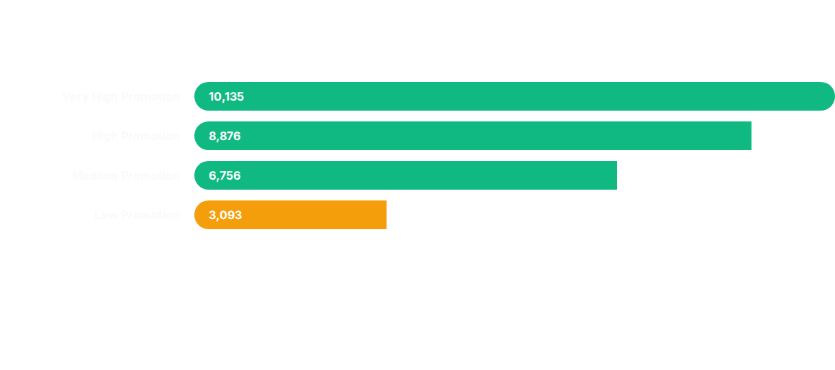
Impact of Promotional Intensity
Insights: Sales exhibit a 3.2x increase when moving from Low to Very High promotional intensity.

Slide 6
The "Large Store" Multiplier
10.6K
Store Scale Insights
Physical capacity is the strongest structural driver of revenue (0.22 correlation). Large stores generate 2.7x more sales than Small stores (3,952 median) regardless of regional conditions.
Median Weekly Sales

Slide 7

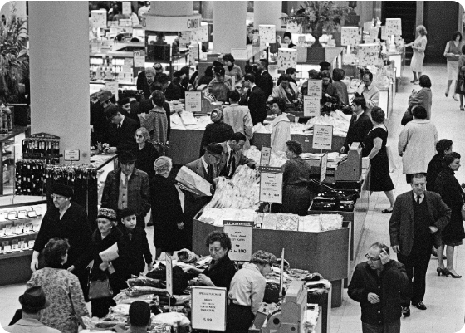
Holiday Dynamics
Thanksgiving vs. Christmas
Thanksgiving is the dominant revenue driver with a median of 7,755. Interestingly, Christmas underperforms (5,709), falling even below non-holiday baselines.
Thanksgiving creates a concentrated shopping surge.
Christmas drop likely reflects logistics or store closures.
High Promotion on Thanksgiving yields peak ROI.

Slide 8
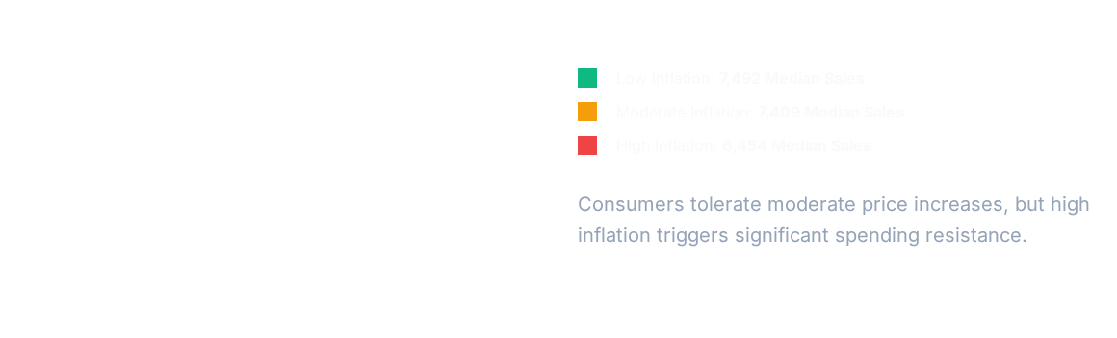
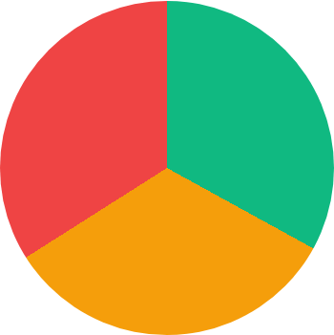

Inflation vs. Purchasing Power

Slide 9
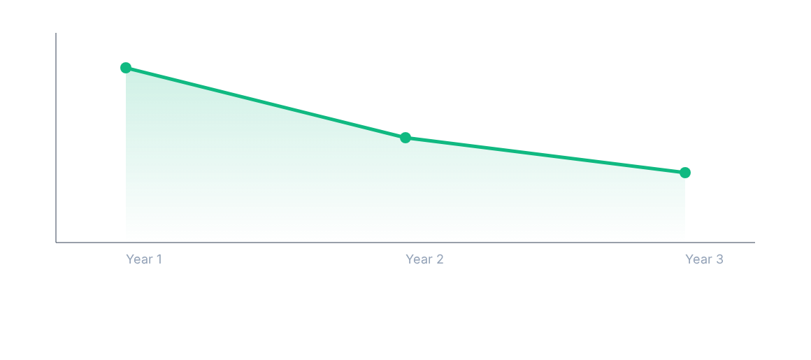
Long-term Revenue Decline
Median weekly sales dropped by 9% over three years, reflecting persistent macroeconomic headwinds.

Slide 10
Multivariate Success Factors
Promotion Bin | Holiday Type | Store Size | Median Sales
Very High | Thanksgiving | Large | 15,232 (Peak)
High | Thanksgiving | Small | 12,154
Very High | Labor Day | Large | 11,045
Low | Christmas | Small | 1,816 (Floor)

Slide 11
Strategic Recommendations
Maximize Thanksgiving ROI: Shift promotional budgets from Christmas to Thanksgiving to capitalize on the higher conversion intensity.
The High-Inflation Buffer: During high-inflation periods, shift from "High" to "Very High" promotions to maintain volume, despite margin pressure.
Store-Specific Tactics: Use aggressive discounting for Small Stores to drive traffic, while leveraging Large Stores as stable baseline earners.
August Opportunity: Implement a "Pre-Holiday" push in August to bridge the mid-year plateau before the Q4 surge.

