Slide 1
MEGA-PIK ENTERTAINMENT
Remake Greenlight Strategy
A Data-Driven Framework for Genre, Budget & Ratings Decisions
EDA of 500 Theatrical Releases, 2010–2025
Executive Strategy Briefing | August 2026

Slide 2
THE BUSINESS PROBLEM
Five of the Last Six Releases Barely Broke Even
1
2
3
4
Box-Office Slump
Capital Misallocation
No Predictive Greenlight Process
Weak Theatrical Velocity
5 of the last 6 releases barely broke even; the 6th produced a significant loss.
High budgets committed without a clear view of genre or rating risk-to-return.
IP, budget, and marketing-split decisions rely on intuition, not data.
Releases aren't generating enough preview + opening-weekend momentum to clear break-even.
Net effect: capital is being deployed at scale, but the studio has no repeatable way to know in advance which titles will recover it.
MEGA-PIK ENTERTAINMENT • REMAKE GREENLIGHT STRATEGY
2

Slide 3
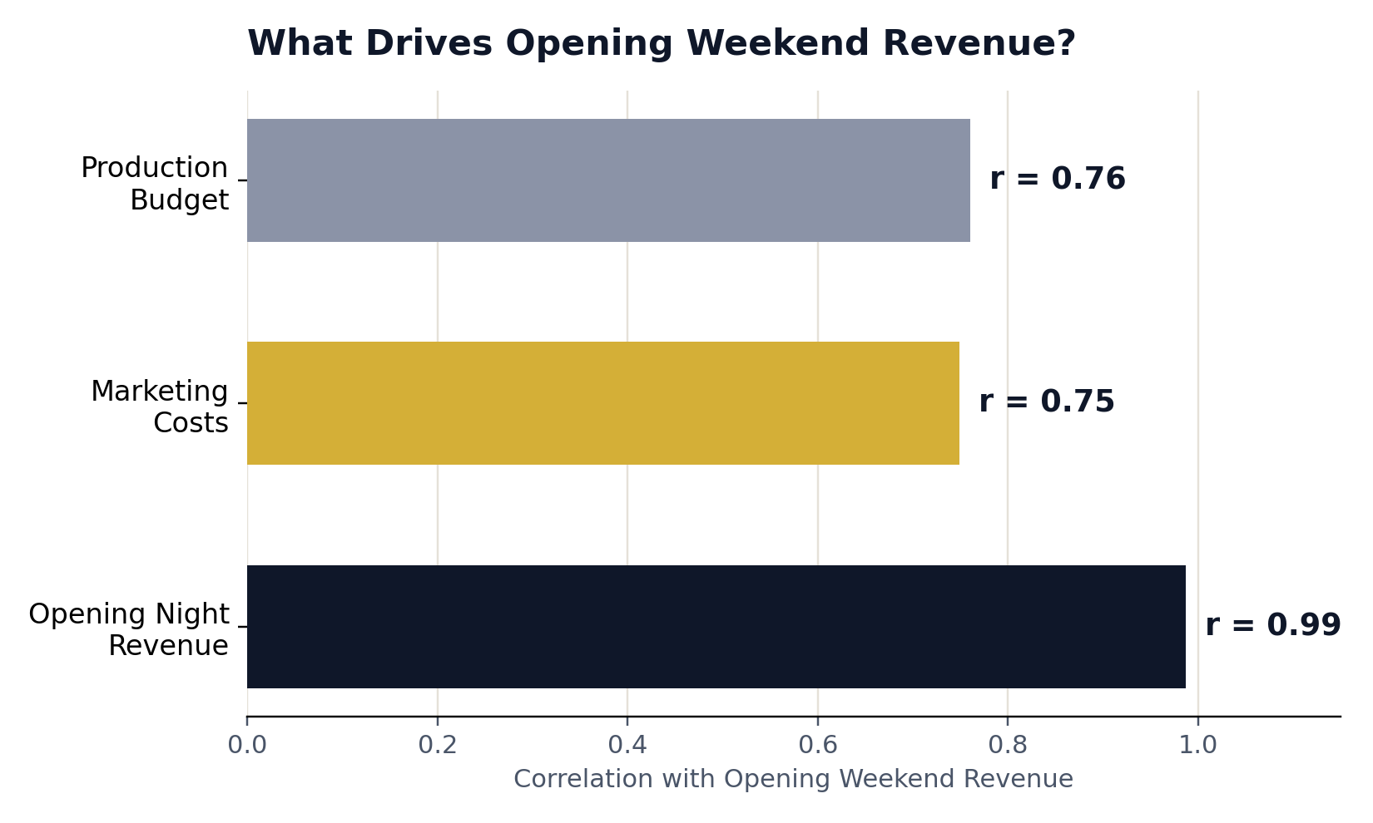
OBJECTIVE 1 — OPENING WEEKEND DRIVERS
What Actually Moves the Opening Weekend Number
0.99
Opening Night Revenue → Opening Weekend
A strong Thursday preview is an almost deterministic signal of full weekend scale.
0.75
Marketing Costs → Opening Weekend
Big openings require heavy upfront ad spend, not just a strong film.
62%
of $100M+ openers are PG-13 / PG
Broad-audience accessibility is a precondition for a nine-figure debut.
MEGA-PIK ENTERTAINMENT • REMAKE GREENLIGHT STRATEGY
3

Slide 4
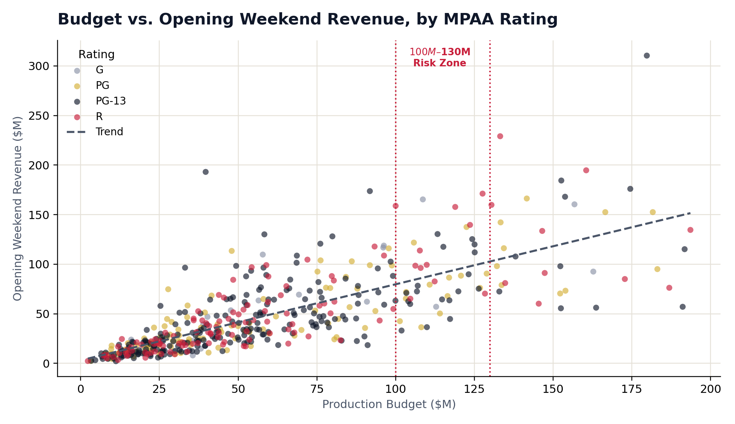
OBJECTIVE 2 — BUDGET VS. REVENUE
Bigger Budgets Grow Revenue — But Shrink Margin
Diminishing returns
Bigger budgets raise raw box office but compress percentage ROI and downside risk.
Cost recovery is a marathon
Opening weekend is only ~30.8% of lifetime revenue — recovering ≥35% of cost in 72 hrs predicts profitability 84% of the time.
$100M–$130M risk zone
Revenue growth flattens relative to spend past this range — international distribution becomes essential.
MEGA-PIK ENTERTAINMENT • REMAKE GREENLIGHT STRATEGY
4

Slide 5
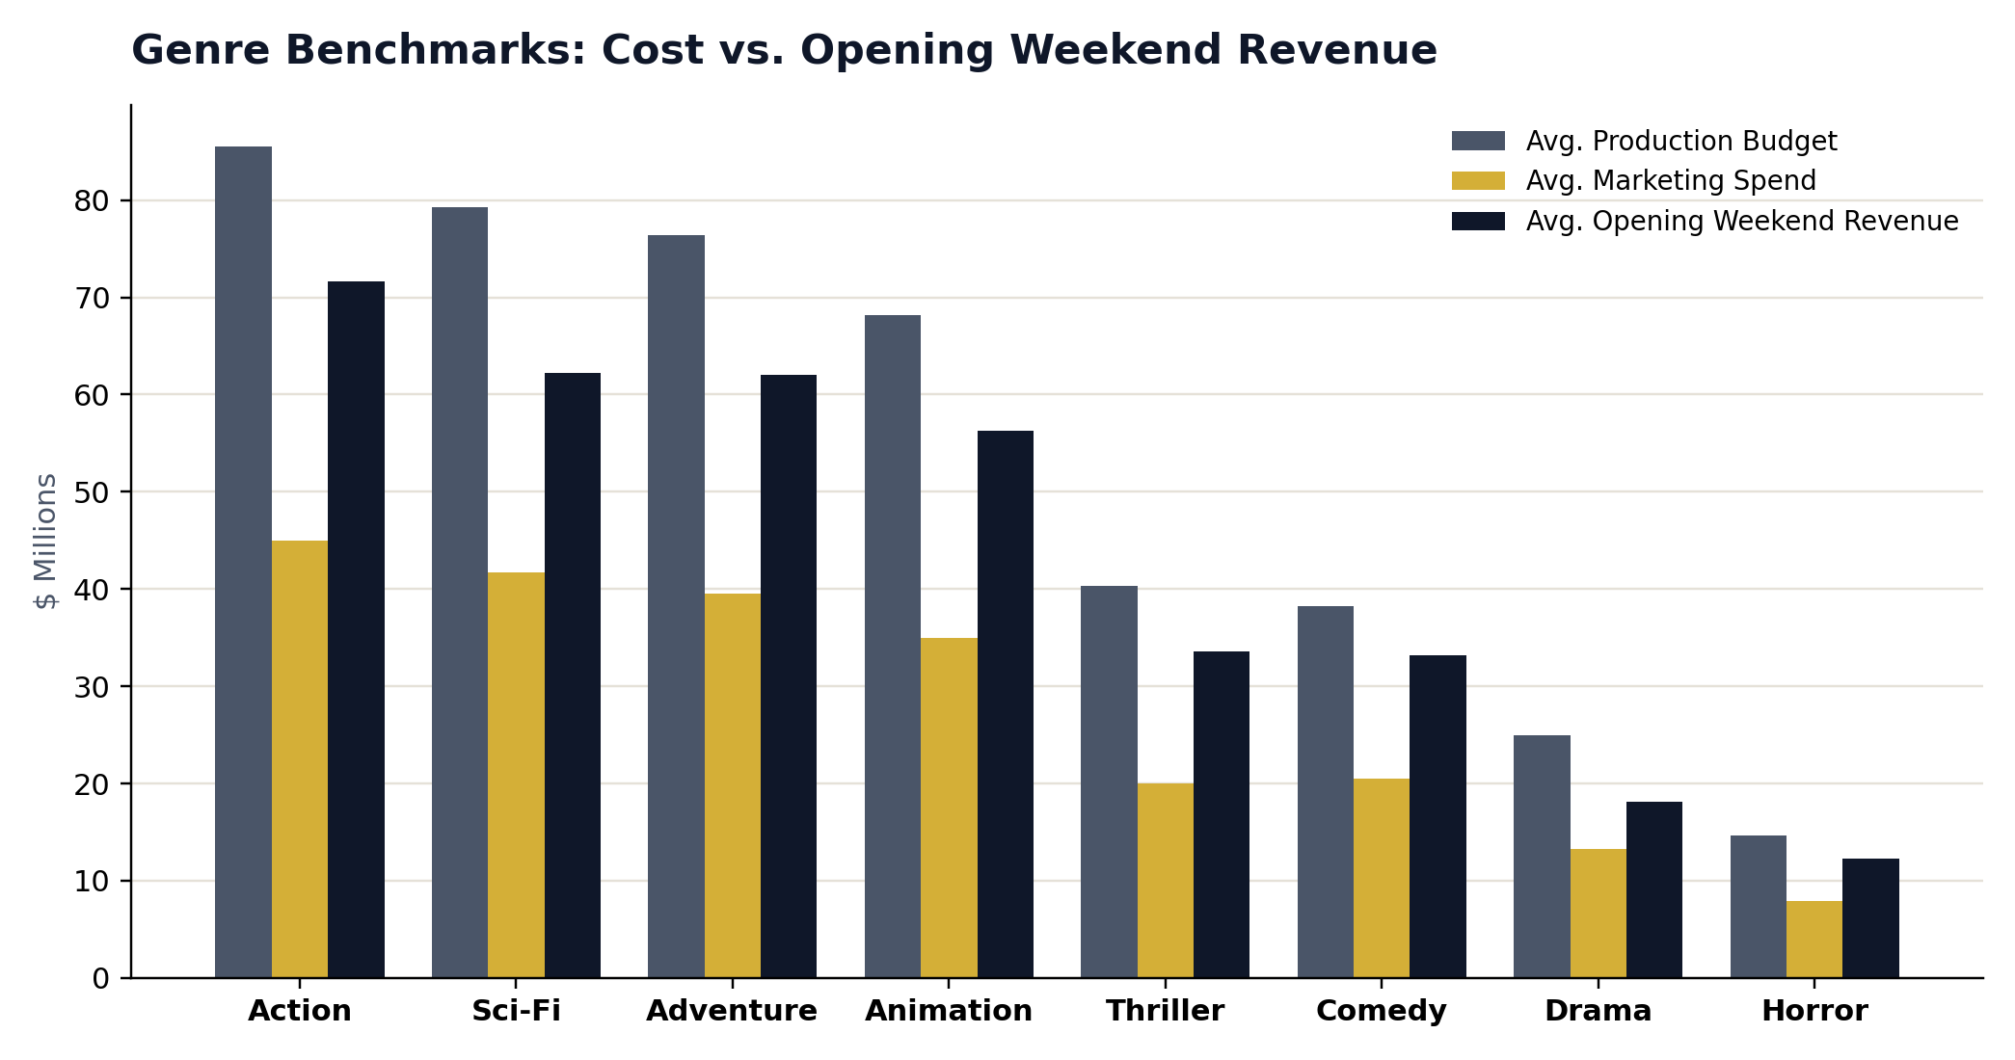
OBJECTIVE 3 — GENRE PERFORMANCE
Scale and Safety Come From Different Genres
MEGA-PIK ENTERTAINMENT • REMAKE GREENLIGHT STRATEGY
5

Slide 6
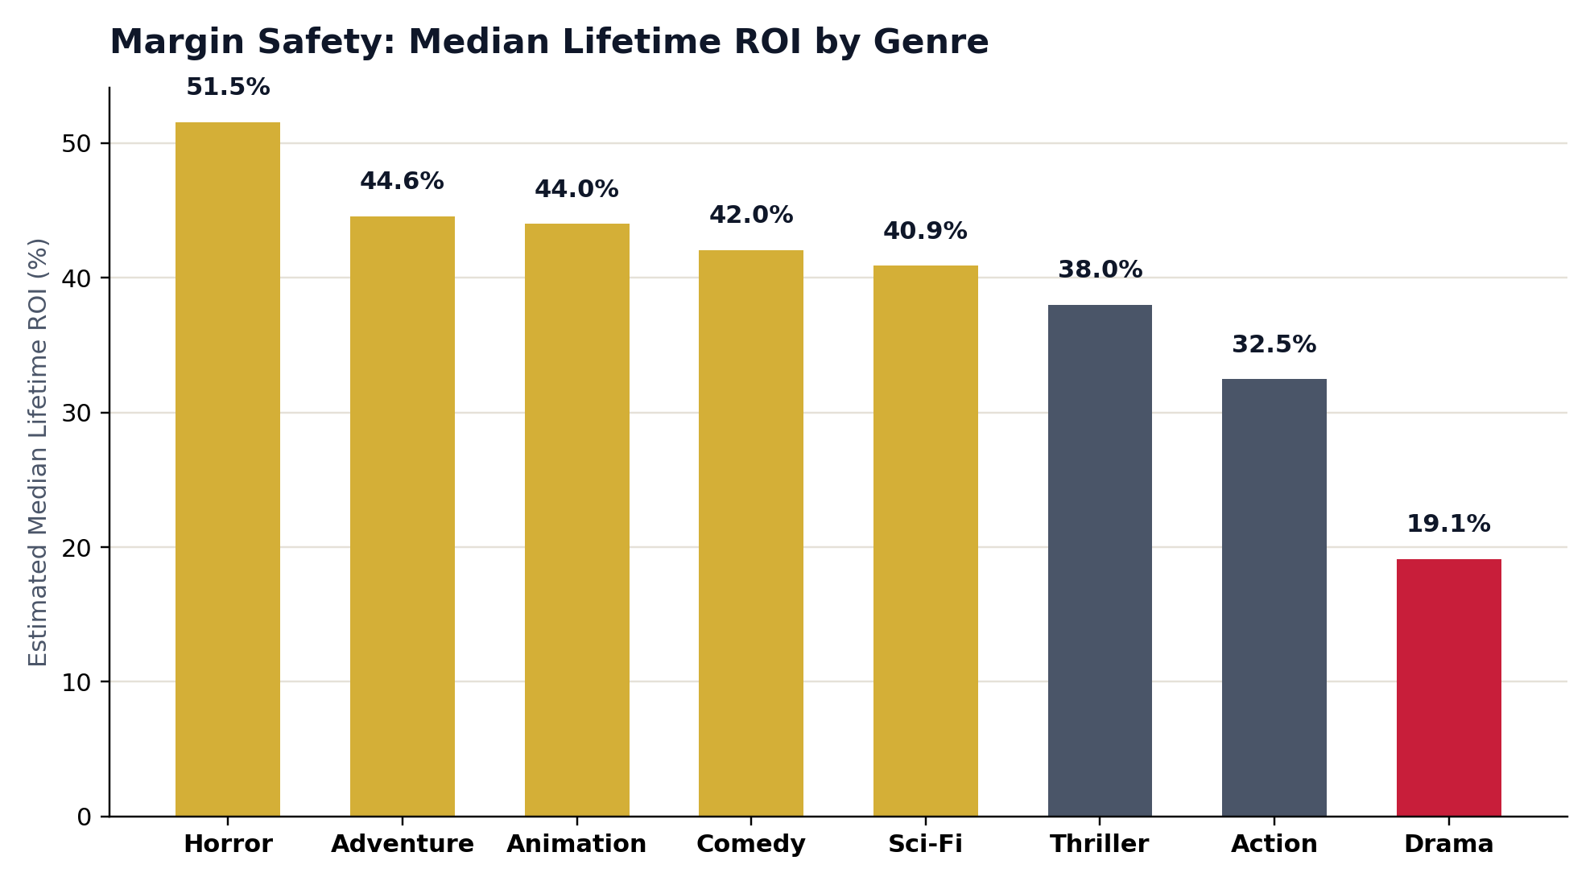
OBJECTIVE 3 — GENRE RISK PROFILE
Horror & Comedy Carry the Safest Margins
Group | Genres
Volume Leaders | Action, Sci-Fi, Adventure, Animation
Efficiency Leaders | Horror (51.6% ROI), Comedy (42.0% ROI)
Underperformer | Standalone Drama (19.1% ROI)
Horror and Comedy scale modestly but convert their low spend into the safest margins in the portfolio. Drama is dominated on both scale and safety.
MEGA-PIK ENTERTAINMENT • REMAKE GREENLIGHT STRATEGY
6

Slide 7
STRATEGIC RECOMMENDATION 1
The “2 + 4” Balanced Annual Slate
2
4
MAJOR TENTPOLE REMAKES / YEAR
MID/LOW-BUDGET GENRE REMAKES / YEAR
Legacy IP in Animation & Adventure/Action
Budget: $70M–$95M
Rating: PG / PG-13 for broad reach
Goal: anchor market share & global licensing
Horror & high-concept Comedy catalog titles
Budget: $15M–$35M
Low production floor, high margin safety
Goal: reliable cash flow that hedges tentpole risk
MEGA-PIK ENTERTAINMENT • REMAKE GREENLIGHT STRATEGY
7

Slide 8
STRATEGIC RECOMMENDATIONS 2–4
Marketing, Distribution & Greenlight Discipline
45%–55%
Shift to Streaming
$100M Cap
Marketing-to-Budget Mandate
Move Standalone Dramas Off Theatrical
Data-Driven Greenlight Gates
Hold marketing spend near half of production budget; front-load 60%+ before Thursday previews to drive opening momentum.
Lowest ROI (19.1%) and weakest opening velocity of any genre — better matched to VOD, streaming, or licensing.
Cap non-franchise standalone remakes at $100M unless paired with a PG/PG-13 rating and strong multi-quadrant brand awareness.
MEGA-PIK ENTERTAINMENT • REMAKE GREENLIGHT STRATEGY
8

Slide 9
THE BOTTOM LINE
Balance the slate. Gate the spend. Let the data pick the risk.
Two tentpoles for scale, four genre titles for safety, a fixed marketing ratio, and hard greenlight gates — replacing intuition with a repeatable framework built on 500 releases of box-office history.
51.6%
84%
0.99
19.1%
Horror ROI
Profit odds @ 35% recovery
Preview→Weekend correlation
Drama ROI (lowest)
MEGA-PIK ENTERTAINMENT • REMAKE GREENLIGHT STRATEGY
9

