Slide 1
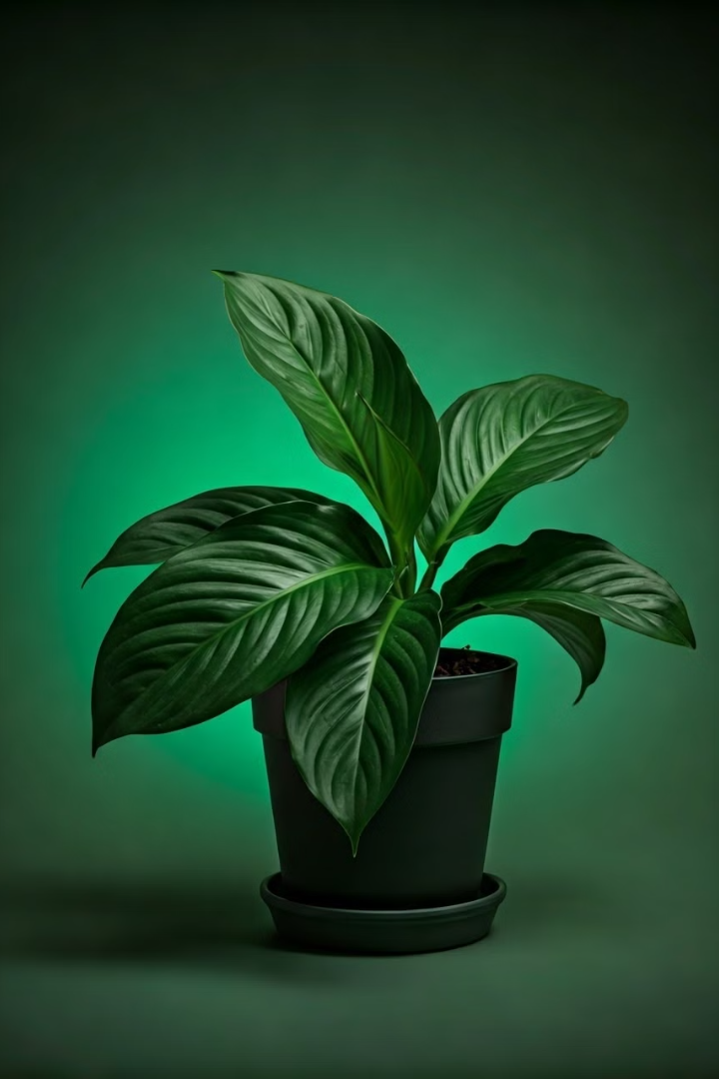
Plant Care Guide Website
Interactive guide for plant enthusiasts
Learn about plant care, solve issues, get tips
Presented By:
Umair Aslam 242791

Slide 2
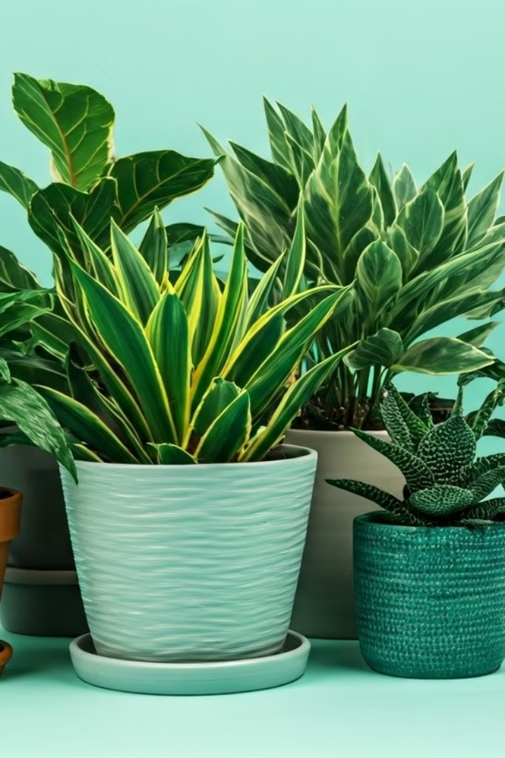
Overview
Comprehensive plant care guidance for all skill levels.
Covers watering, soil, lighting, and pest/disease management.
Interactive tools diagnose problems and provide personalized care.
Connects you with a community of plant enthusiasts.
Guidance on repotting, propagation, and troubleshooting.
Empowers you to create a thriving indoor plant collection.
Appreciate these amazing organisms.

Slide 3
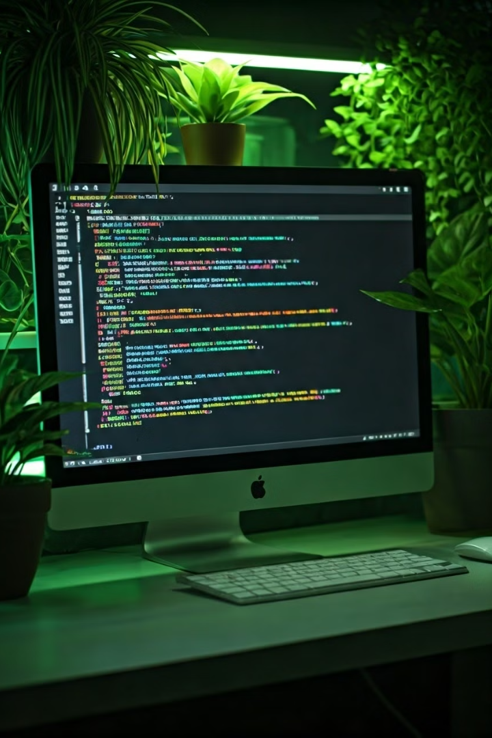




Technologies Used in Development
HTML
CSS
JavaScript
Bootstrap

Slide 4
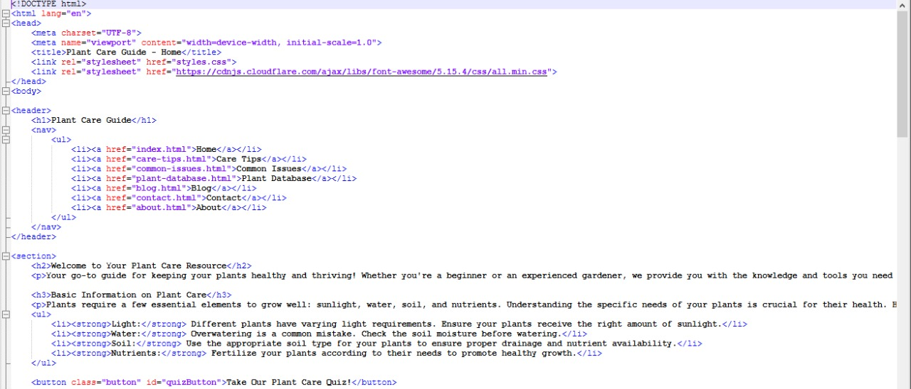
Code Snippet:

Slide 5
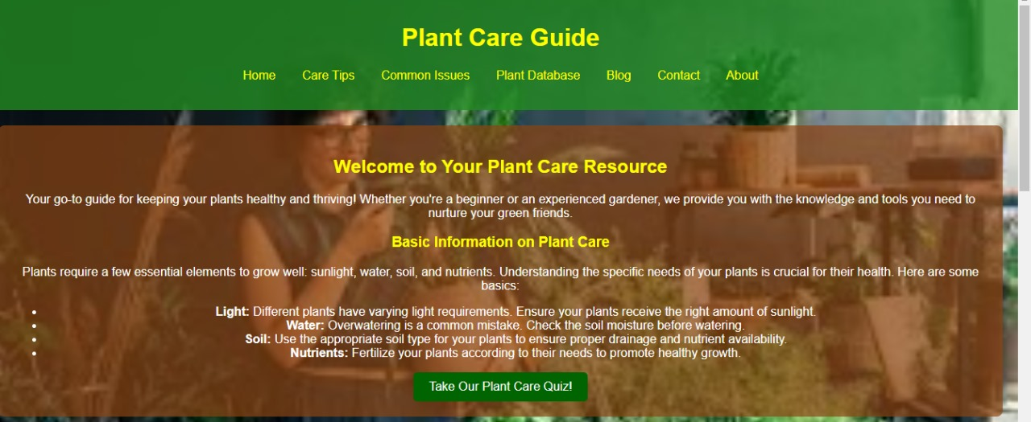
Website looks:

Slide 6
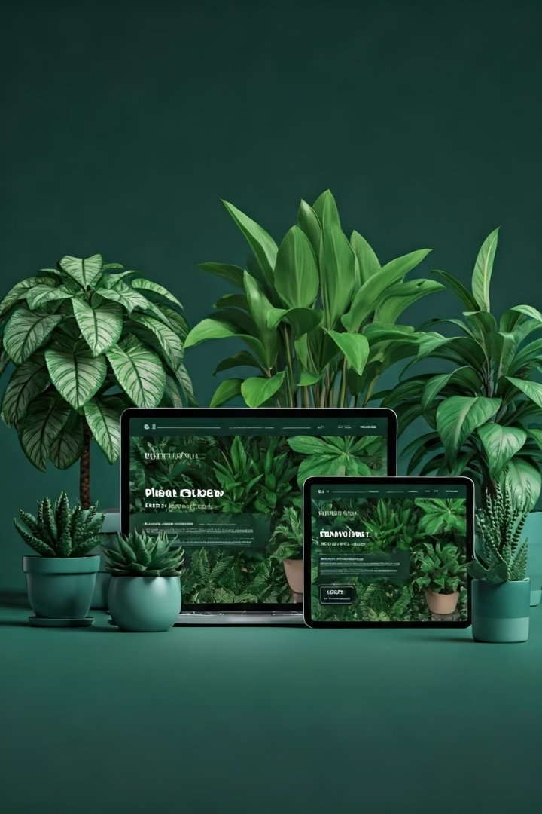



How the Website Works
Home Page
Plant quiz and enrollment session
Care Tips
Detailed care tips for various plants
Plant Issues
Common plant problems and solutions

Slide 7



Challenges Faced During Development
JavaScript Debugging
1
Complex quiz functionality
Responsive Design
2
Bootstrap layout challenges
Smooth Navigation
3
Between pages

Slide 8
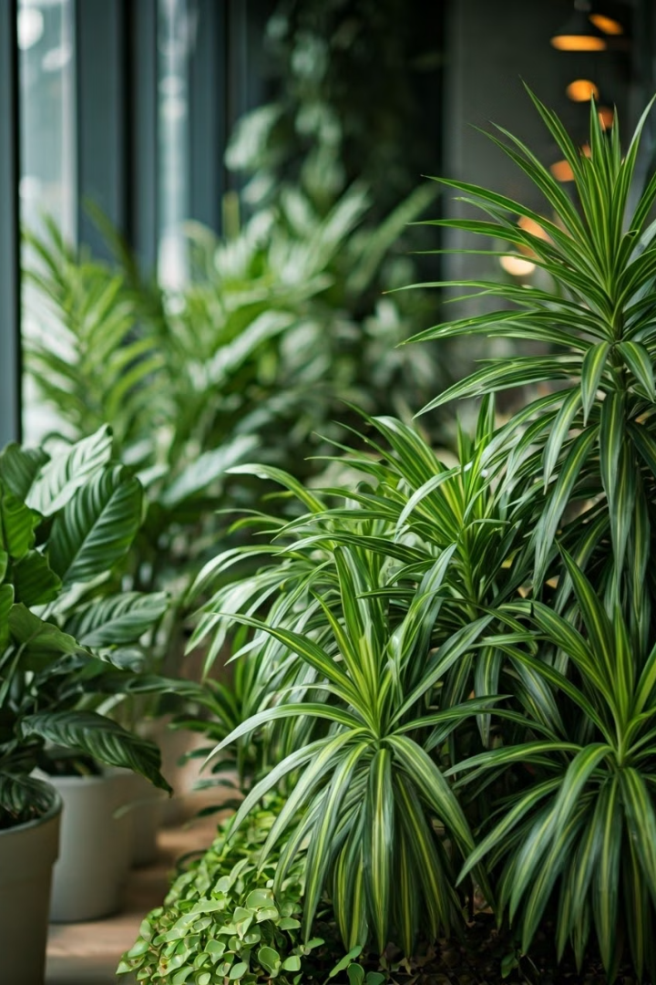
Project Summary
Skills Gained
Impact
HTML, CSS, JavaScript coding
Empowering plant enthusiasts
Call to Action
Your Plant Journey Starts Here!

Slide 9
Thank You!
Explore the Website
Connect With Us
Start your plant care journey today
Share your plant stories and experiences

