Slide 1

GITHUB REPOSITORY EXPLORER
Natural language processing

Slide 2
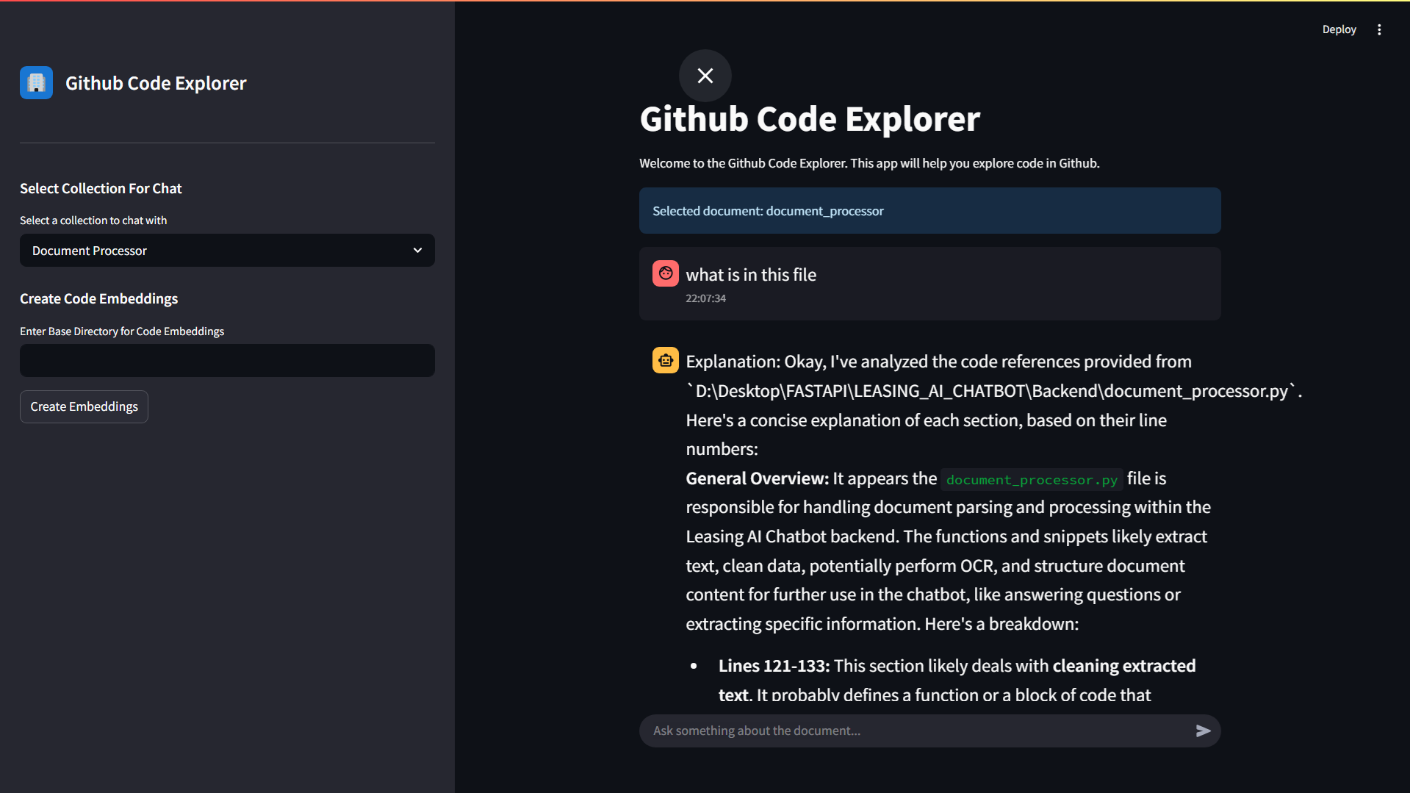
PROJECT INTERFACE

Slide 3
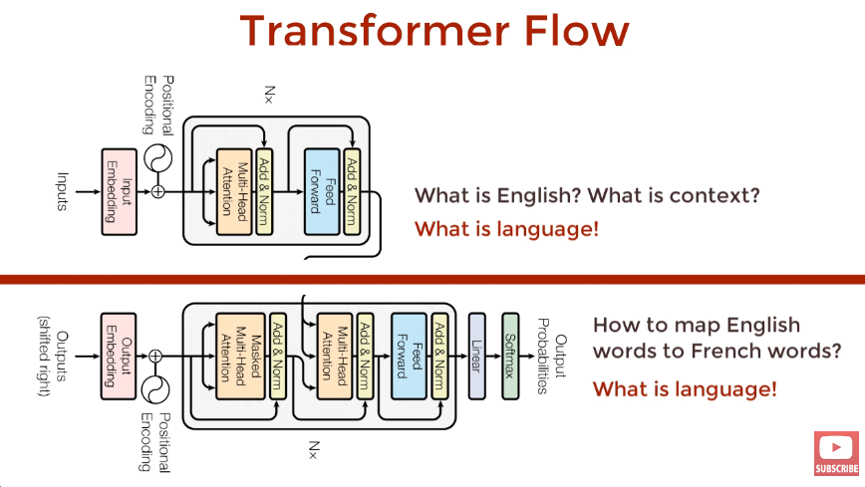
tRANSFORMER FLOW:

Slide 4
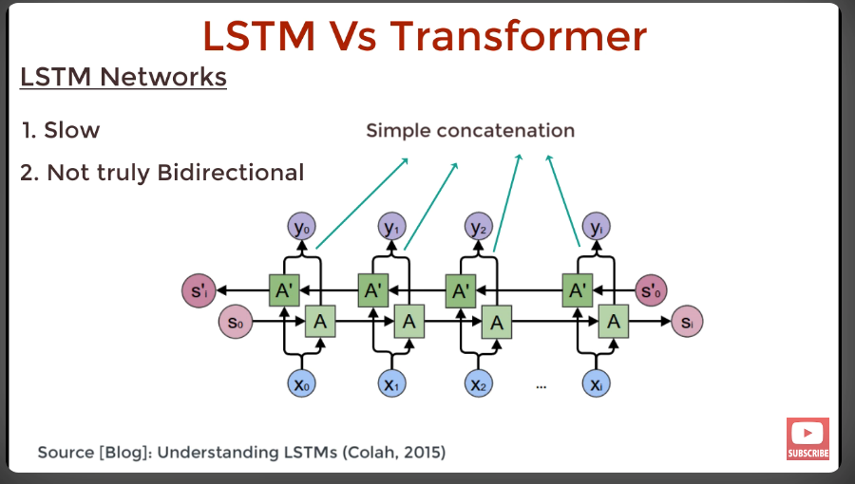
LSTM VS TRANSFORMER

Slide 5
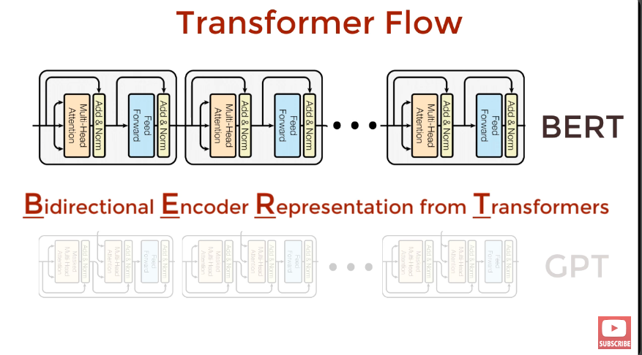
BERT USING TRANSFORMER

Slide 6
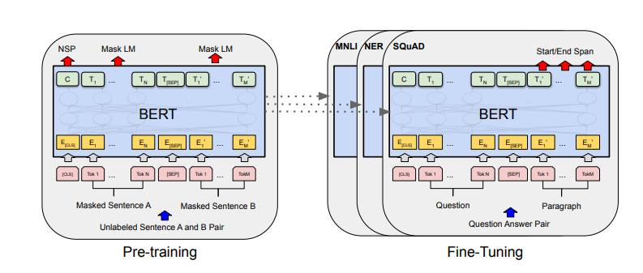
BERT FINETUNING

Slide 7
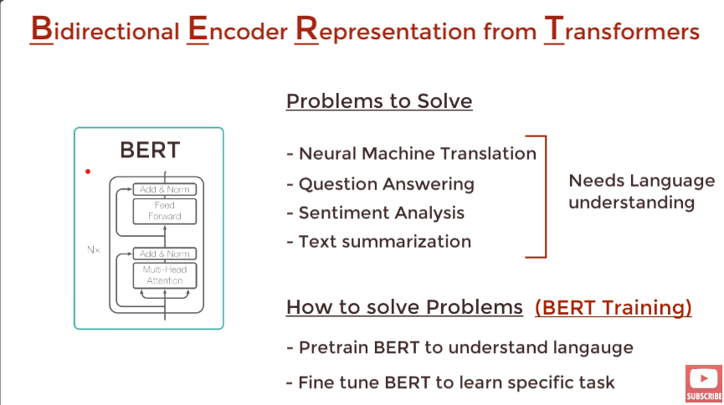
BERT TRAINING

Slide 8
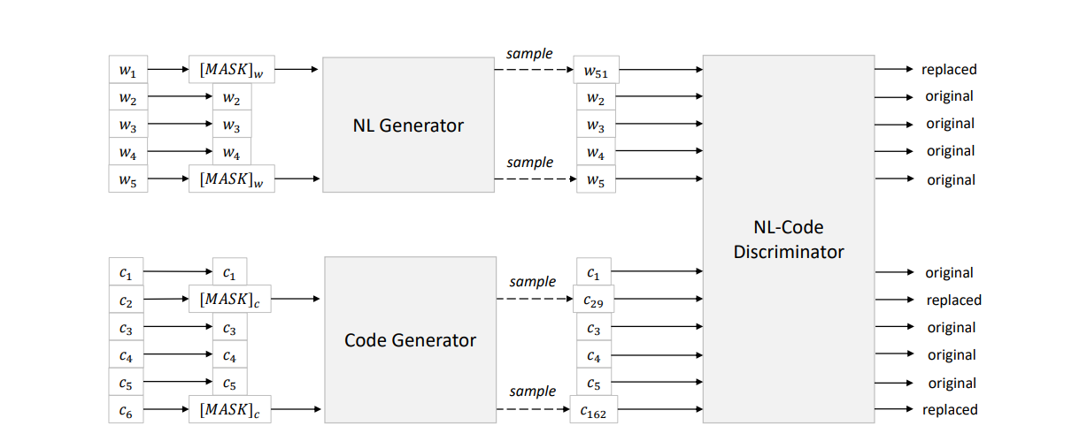
CODE BERT

Slide 9
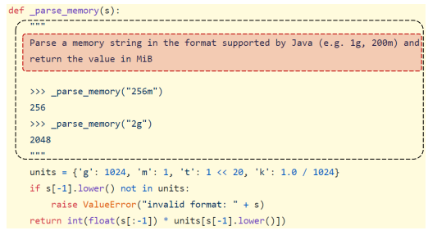
CODE BERT EXAMPLE

