Slide 1
Loops
What is meant by loops
Why we use loops
What types of loop are there in programming

Slide 2
What Is Loop
In computer programming, a loop is a sequence of instruction s that is continually repeated until a certain condition is reached. Typically, a certain process is done, such as getting an item of data and changing it, and then some condition is checked such as whether a counter has reached a prescribed number.

Slide 3
Usage of loop
To do a constant function under a given condition is the reason we use loop
We have different types of loop
If loop
For loop
While

Slide 4
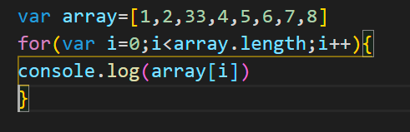
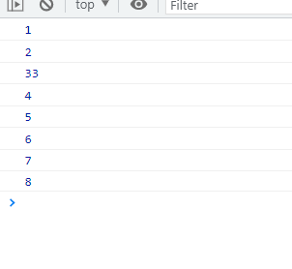
For Loop
The syntax of for loop is
For (initial condition ; condition of halting ; way of increment and decrement)
For example

Slide 5
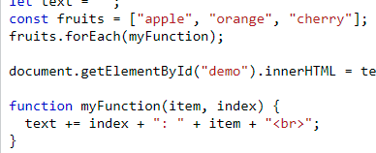
For Each Loop

Slide 6
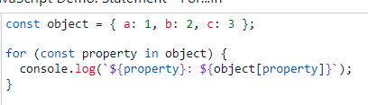

For-In Loop

Slide 7
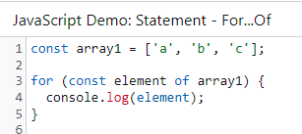
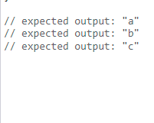
For Of Loop

Slide 8
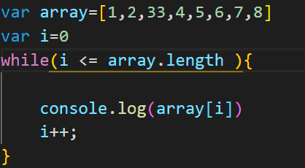
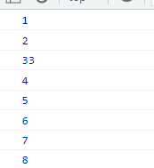
While Loop

Slide 9
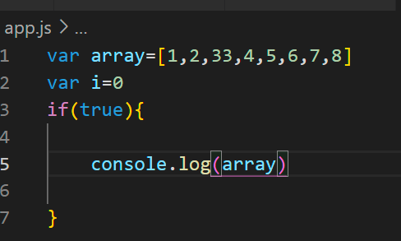
If Loop

Slide 10
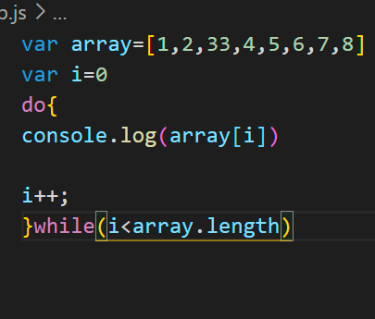
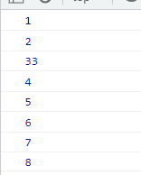
Do-While

Slide 11
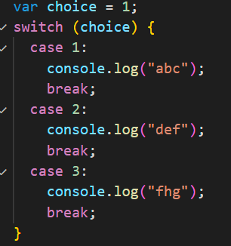

Switch Statements

Slide 12
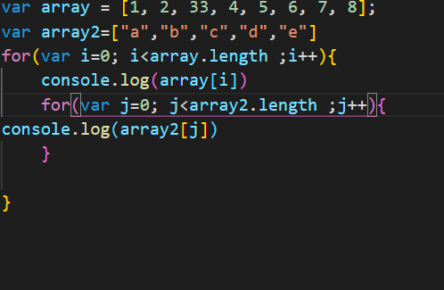

Nested Loops

Slide 13
Comparison operator
What are comparsion operator

Slide 14
Comparison operator
And ,or are the comparsion operator

