Slide 1
JAVASCRIPT

Slide 2
What Is JavaScript
JavaScript is a text-based programming language used both on the client-side and server-side that allows you to make web pages interactive. Where HTML and CSS are languages that give structure and style to web pages, JavaScript gives web pages interactive elements that engage a user.
In simple words JavaScript is act as the brain for the following webpage to make the UI of the webpage more interesting and pleasant

Slide 3
JavaScript History
December 4, 1995
Paradigm | Multi-paradigm: event-driven, functional, imperative, object-oriented programming
Designed by | Brendan Eich of Netscape initially; others have also contributed to the ECMAScript standard
First appeared | December 4, 1995

Slide 4
ECMAScript
ECMA stands for European Computer Manufacturers Association Script
ECMAScript is a Standard for scripting languages such as JavaScript, JScript, etc. It is a trademark scripting language specification. JavaScript is a language based on ECMAScript. A standard for scripting languages like JavaScript, JScript is ECMAScript
The fundamental /Core JavaScript is also known as Es5 (ECMAScript_5)
The Advance /JavaScript is called Es6 (ECMAScript_6)

Slide 5
JavaScript Introduction
JavaScript compiles code through interpreter
Language which also compiles code on interpreter are PHP, Ruby, Python
Interpreter. An interpreter translates code into machine code, instruction by instruction - the CPU executes each instruction before the interpreter moves on to translate the next instruction. Interpreted code will show an error as soon as it hits a problem, so it is easier to debug than compiled code.

Slide 6
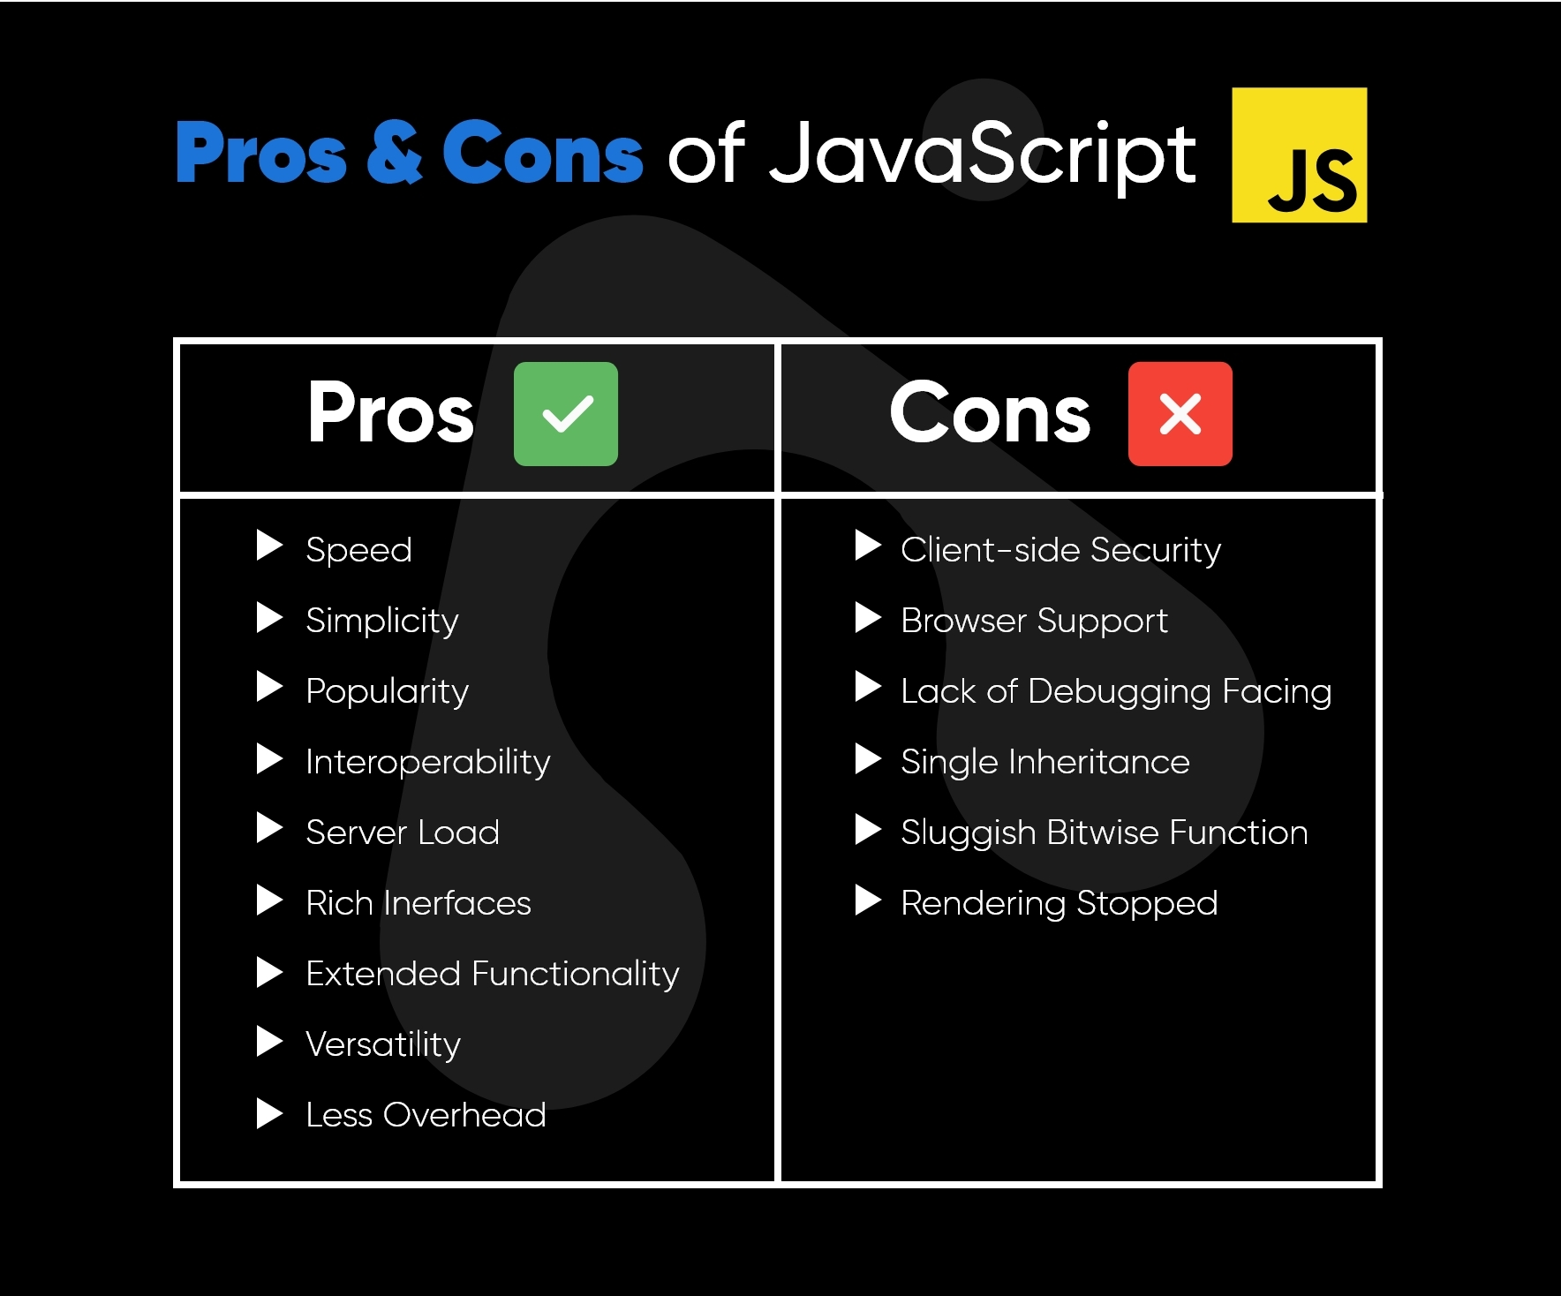
Java Script Advantages And Disadvantages

Slide 7
What Is Possible After Learning About JavaScript
Adding interactive behavior to web pages
Creating web and mobile apps
Building web servers and developing server applications
Game development
Desktop Applications
BlockChain

Slide 8
Current V8 Browser
A browser engine (also known as a layout engine or rendering engine) is a core software component of every major web browser. The primary job of a browser engine is to transform HTML documents and other resources of a web page into an interactive visual representation on a user's device.
V8 is an open-source JavaScript engine developed by the Chromium Project for Google Chrome and Chromium web browsers. The project’s creator is LarsBak. The first version of the V8 engine was released at the same time as the first version of Chrome: 2 September 2008

Slide 9
JavaScript-Based Libraries And Framework
React,Angular,vue js ,next.js for web development
Electorn js meteor.js ,proton native for desktop applications
Pixer.js,Babylon,phaser for game development
Solidity for blockchain

Slide 10
Placing The Script
We can put script in two ways
Internal
External
For adding js internally we can add Js extension file in the head or at the end of the body
We can also add the script externally by given the path in src tag in the script
<script src=“path to be given”></script>
Adding js externally is a better way to organize the code efficiently
We can also place th3 script file externally on the head tag or the after the body tag

Slide 11
Comments
JavaScript comments can be used to explain JavaScript code, and to make it more readable.
JavaScript comments can also be used to prevent execution, when testing alternative code.
Any text between /* and */ will be ignored by JavaScript
Single line comments start with //. Any text between // and the end of the line will be ignored by JavaScript (will not be executed).

Slide 12
Data Types In General
Primitive data structure is a kind of data structure that stores data of only one type. The non-primitive data structure is a type of data structure that can store data of more than one type. Examples of primitive data structures are integer, character, float.
Class, object, array, string, and interface are called non-primitive data types in general. These data types are not predefined in most programming languages.

Slide 13
Data Types In JavaScript
In programming, data types is an important concept.
To be able to operate on variables, it is important to know something about the type.
Without data types, a computer cannot safely solve this
For example:-
var x; // Now x is undefined
x= true; //Now x is Boolean
X=[3,6,4,59,2,12] // Now x is an array
x = 5; // Now x is a Number
x = “BMJ"; // Now x is a String

Slide 14
Scope
General meaning “the extent of the area or subject matter that something deals with or to which it is relevant."we widened the scope of our investigation“”
In programing in which manner the variable can be get accessed
Block scope( value cant get changed by other dependecy )
Global scope( vice versa)

Slide 15
Var Keyword
To declare integer we use (int) for character we declared (char) and for a single line statement we declared ( String )
In JavaScript we use var to declared any types of data type
It will dynamically detects the data whether its bits , integer , long , float , string or undefined/null

Slide 16


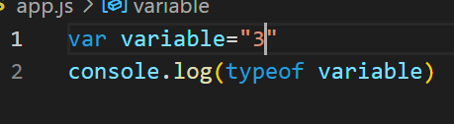

Auto-Detection Of Data Type In JavaScript

Slide 17
Alerts
The alert() method in JavaScript displays an alert box with a specified message and an OK button. It is often used to make sure that information comes through to the user. The alert box takes the focus away from the current window and forces the browser to read the message

Slide 18
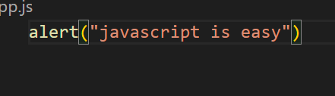
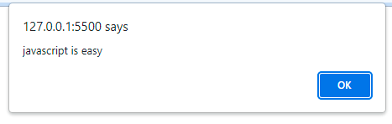
Alert

Slide 19
Variables
Why we use variable
Usage of variable
Rules to declared variable
What type of case we use in javascript(professional practice)

Slide 20
Variables
We use variable to store data entered by user or any specific data use in multiple places in the program so dynamically change the value of any specific will be much easier and accountable by the developer
variable usage is the reference of the actual allocated in the drive
No number at the starting , no special signs and no spaces between the variable
We use camel casing

Slide 21
Variable
What type of data can be stored in variable
How to use the variable data
How to declared and assigned the value in the variable

Slide 22

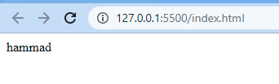
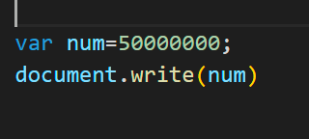
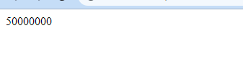
Variable
We can store integer ,float , boolean ,array ,string and null

Slide 23







The Legal And Illegal Variable Of Name

Slide 24

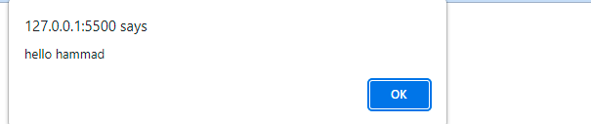
Concatenate
Concatenation means joining two strings together. ... Most programming languages have an operator or function that can be used to join two strings

Slide 25
Prompts
What is prompt
Why we use prompt
Any alternative of prompt

Slide 26
Prompts
JavaScript prompt() dialog box. The prompt() method in JavaScript is used to display a prompt box that prompts the user for the input
It is generally used to take the input from the user before entering the page. It can be written without using the window prefix
To get data from text fields is the alternative is the professional and pleasant way to extract data from the user

