Slide 1
Lecture 10
CS202 Fall 2013

Slide 2
Errors
Big Java's classification of errors:
  Syntax/Compiletime
    Incorrect Java, caught by IDE or compiler
int x == 0;
  Runtime / Logic
    Logical problems in the program
public static void main(String[] args){
int quotient = 0;
for(int counter = 10; counter >=0; counter--){
System.out.print("10 / " + counter + " = ");
quotient = 10/counter;
System.out.println (quotient);
}
}

Slide 3
Errors
Other books / programmers distinguish runtime errors from logic errors:
Runtime errors occur when an operation is impossible to carry out. Without additional handling, they cause the application to crash:
    Division by zero
    Read from a file that does not exist
    Integer.parseInt(1.2);

Slide 4
Errors
Logic errors cause incorrect results, not crashes
String[] options = {"Yes", "No"};
int buy = 0;
JOptionPane.showOptionDialog(null, "Place Order?", "Buy Dialog", JOptionPane.DEFAULT_OPTION, JOptionPane.PLAIN_MESSAGE, null, options, "Yes");
switch (buy) {
case 0:
buyProduct();
break;
case 1:
returnToShopping();
}

Slide 5
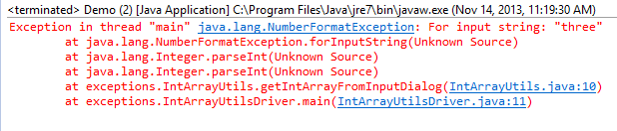
Stack Trace
A stack trace is a list of method calls and code line numbers, usually seen when an error occurs:
You should love a stack trace like a wise older sibling.
Note that you can tell what line of your code was executing when the error occurred, but you may have to read several lines of the trace to get to it.

Slide 6

Exceptions
Definitions of "exception:"
Wikipedia:
"An anomalous or exceptional event requiring special processing"
Liang Introduction To Java Programming, referring to Java exceptions specifically:
  "An object that represents an error or condition that prevents execution from proceeding normally."
In Java, an exception is an object!
Various kinds of Exceptions are defined in different Exception classes.
Exception classes have methods; the ones you are likely to use involve stack traces and error messages.
Exceptions are "raised" or "thrown" by code, either written by you or by the author of a class you are using.

Slide 7
Exceptions:
You can create your own exceptions to deal with the problems that are likely to arise in your programs.
Many exception types are built in to Java; you have already encountered many of these
This code will throw a StackOverflowException :
public class Demo {
int x;
public Demo(int oldX){
x = oldX + 1;
System.out.println(x);
Demo d = new Demo(x);
}
public static void main(String[] args) {
Demo demo = new Demo(1);
}
}
Other exceptions are programmer-defined.

Slide 8
Exceptions
Try/Catch:
Run an error-prone operation in try{}; if an exception occurs, deal with it in catch{}
Optional finally{} runs after the try code, whether or not there is an exception

Slide 9
Try…catch…finally
Try-Catch-Finally
try{
error-prone code
}
catch(TypeOfException nameForException){
what to do if this type of exception occurs
}
catch(OtherTypeOfException nameForException){
what to do if this type of exception occurs
}
Catch(Exception ex){
}
…
finally{
code to execute afterwards, whether or not an exception occurred
}

Slide 10
Throwing Exceptions
The exceptions we have seen so far are thrown by code you did not write
You can also check for exceptional conditions and throw exceptions, either standard ones or your own
See the textbook for syntax for creating your own exception types. Only do this when none of the standard ones seem correct.

Slide 11
Try-Catch-Finally
Consider this error-prone code:
public static void main(String[] args) {
Scanner input = new Scanner(System.in);
System.out.println("Enter two numbers:");
double num1 = input.nextDouble();
double num2 = input.nextDouble();
double result = num1 / num2;
System.out.println(num1 + "/" + num2 + "=" + result);
input.close();
}

Slide 12
Try-Catch-Finally
public class Demo {
public static double quotient(double num1, double num2){
if(num2 == 0) throw new ArithmeticException("Divisor cannot be zero");
return num1/num2;
}
public static void main(String[] args) {
Scanner input = new Scanner(System.in);
System.out.println("Enter two numbers:");
double num1= input.nextDouble();
double num2= input.nextDouble();
try{
double result = quotient(num1, num2);
System.out.println(num1 + "/" + num2 +"=" + result);
}
catch(ArithmeticException ex){
System.out.println(ex.getMessage());
}
finally{input.close();}
}
}

Slide 13
Checked Exceptions
The compiler will force you to handle certain kinds of exceptions; these are called Checked Exceptions.
Recall the file operations in week 10. Since file I/O is so error-prone, many file operations throw exceptions which you must catch in order to use the File, PrintWriter, etc. classes.

Slide 14
Recursion
This topic is often covered in CS202-level classes, but the new textbook covers it in chapter 13, just after the material for this course ends
Since we are still making the transition to the new book, you may take CS203 with an instructor who expects you to understand recursion. Recursion is also extremely important in CS312.
Recursion is not hard to understand in principle, but students often find coding it challenging
There is no time to cover it thoroughly here; this brief coverage is intended to give you a basic understanding of the principle.
There may be multiple-choice questions on quizzes or short-answer questions on the final about recursion, but you will not be required to write any recursive code in this course.

Slide 15
Recursion
Recursion is the technique of breaking down a problem into smaller instances of the same problem.
A recursive method is a method that directly or indirectly calls itself
  direct recursion: methodA calls methodA
  indirect recursion: methodA calls methodB and methodB calls methodA
Avoid infinite regression (and stack overflows) by providing a condition that causes termination of the recursion

Slide 16

King of Hearts’ Algorithm
  "Where shall I begin, please your majesty?" he asked.
  "Begin at the beginning," the King said gravely, "and go on till you come to the end; then stop. "

Slide 17
Recursive Algorithm
  Recursion usually involves doing the opposite of the King of Hearts’ method:
  doSomething()
  If you are finished, return(stop)
  Otherwise
    Solve part of the problem
    Run this algorithm

Slide 18
Recursion
For example, we can define the operation goHome() as:
  If you are at home, stop.
  Otherwise
    Take one step toward home.
    goHome()

Slide 19
Factorial: non-recursive
function factorial is:
input: integer n such that n >= 0
output: [n × (n-1) × (n-2) × … × 1]
Iterative algorithm
  create new variable called running_total with a value of 1
  begin loop
    if n is 0, exit loop
    set running_total to (running_total × n)
    decrement n
    repeat loop
  return running_total
  end

Slide 20
Recursive Factorial
You will see this algorithm again in future classes!
function factorial:
input: integer n such that n >= 0
output: [n × (n-1) × (n-2) × … × 1]
if n is 0, return 1
otherwise, return [ n × factorial(n-1) ]

Slide 21
Recursion
public class Demo {
public static int factorialRecursive(int intIn){
if(intIn ==0) return 1;
return intIn * factorialRecursive(intIn -1);
}
public static void main(String[] args) {
int num = Integer.parseInt(JOptionPane.showInputDialog(null, "Please "
+ "enter the number whose factorial you would like to compute"));
JOptionPane.showMessageDialog(null, "The factorial of " + num + " is " +
factorialRecursive(num));
}
}

Slide 22
Recursion
Function recurse()
If you are done with your program, stop
Otherwise, try to find the problem
Utter an obscenity
recurse()

Slide 23
Java Assertions
Note that Java Assertions as described in Big Java are different from the various types of JUnit Assertions.
Make sure you understand this material, but I am not going to cover it in the lecture.
Assertions that are false throw exceptions only if assertions are enabled in the JVM (since you would not want this in released code).

Slide 24
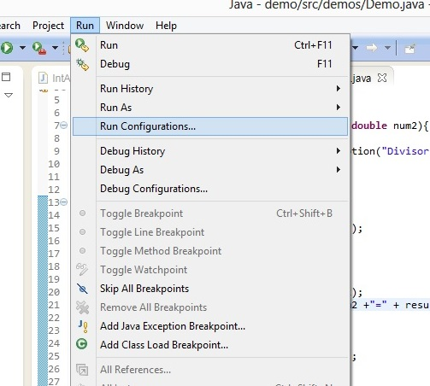
Java Assertions

Slide 25
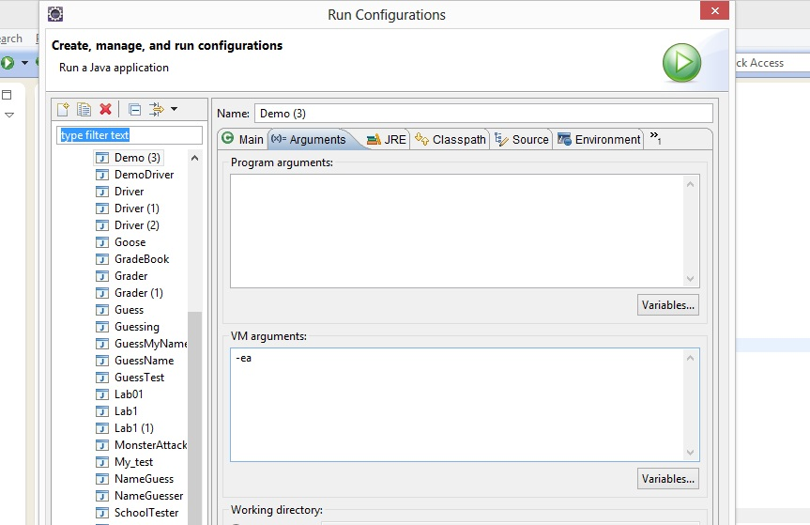
Java Assertions

Slide 26
GUIs
Other than JOptionPane methods, everything we have done so far has involved command-line input and output.
Practically all consumer-oriented software today uses Graphical User Interfaces (GUIs, pronounced "gooeys")
An attractive and easy to use UI makes a bigger impression on the typical consumer than elegant program logic or even performance does.
  Consumers buy sizzle, not steak.
  Bill Gates is the richest person in the world some years, but Richard Stallman can’t afford a razor
Java is heavily used in several types of GUI-based applications
  Web apps
  Android apps
  BluRay

Slide 27
GUIs
When you started taking CS classes, you probably expected to use GUI interfaces right away. There are several reasons we don’t do it that way
  Traditions in the field; most instructors and textbook authors started programming before GUIs were popular
  To the CS way of thinking, there is no point in having a great GUI if you don’t know how to program any functionality
  GUI design shades into graphic arts and psychology rather than CS and requires different skills

Slide 28
GUIs
GUIs are usually built using frameworks or toolkits that provide customizable GUI components.
You do not have to write the code to define what a dialog box or a radio button looks like. You will call methods of GUI classes that have already done this and send the arguments that define the specifics you want.
GUIs are introduced in Java using Swing, a library for desktop GUIs. Swing code is platform-independent, but your GUIs may look a little different from platform to platform.
The basic principles of GUIs are very similar in most other types of GUI programming you will encounter.
When you learn server-side web programming in CS320, or Android programming, you will build on this material.

Slide 29
GUIs
Swing apps are based on components that are placed inside frames.
  A component might be another frame, an image, a check box, button, etc. A frame is a component that is the outer container for the GUI. You can move the whole frame on the screen, resize it, etc.
  The usual frame used in Swing is the JFrame.
  Components, including JFrame, are created by instantiating objects of component classes.
  Many common Swing components are listed at http://www.oracle.com/technetwork/java/architecture-142923.html. This site also has a discussion of the general architecture and principles of Swing
  I'll use many components without introducing them first; the basic nature of the component is always obvious.
  You may eventually use GUI builder toolkits to put components together, but you have to understand how GUI programming works before you can take short cuts. Write all your GUI code in this class yourself, not with a GUI builder.

Slide 30
GUIs
Hello, World using Swing, adapted from
http://docs.oracle.com/javase/tutorial/uiswing/examples/start/HelloWorldSwingProject/src/start/HelloWorldSwing.java
  Instantiate a JFrame
  Instantiate a JLabel (label component that can hold text)
  Put the text “Hello World”.
  Add the JLabel to the frame
  Make the frame visible

Slide 31
GUIs
package guidemo;
import javax.swing.*;
public class HelloWorldSwing {
private static void createAndShowGUI() {
// Create and set up the window.
JFrame frame = new JFrame("HelloWorldSwing");
// Tell the application to close when the frame is closed
frame.setDefaultCloseOperation(JFrame.EXIT_ON_CLOSE);
// Add the "Hello World" label.
JLabel label = new JLabel("Hello, World");
frame.add(label);
// Tell the window to adjust to the size of its components
frame.pack();
// Display the window.
frame.setVisible(true);
}
public static void main(String[] args) {
createAndShowGUI();
}
}

Slide 32
Layout Managers
Java’s layout managers automatically map your user interface on all window systems so that GUIs can be platform-independent and display-independent.
The UI components are placed in containers. Each container has a layout manager to arrange the UI components within the container.
Layout managers are set in containers using the setLayout(LayoutManager) method in a container.
Several types of layout managers:
  FlowLayout
  GridLayout
  BorderLayout
  There are also several others
slides on Layout Managers are from Liang, Introduction To Java Programming

Slide 33
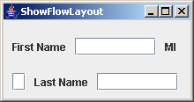
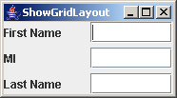
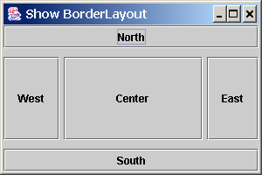
Layout Managers
FlowLayout
  Starts at a corner (top left by default
  but can be changed), add content to
  the end of the row, then start the next
  row, etc
GridLayout
  Orderly rows and columns:
BorderLayout:
  divides the container into five areas:
  East, South, West, North, and Center.
There are also several other LayoutManagers
For more information on LayoutManagers, check http://docs.oracle.com/javase/tutorial/uiswing/layout/visual.html

Slide 34
JPanel
JPanel is a container you can add to a frame and use to hold almost any kind of components.
Separating parts of your GUI into JPanels and then working with the JPanels allows more flexibility than just putting components directly into the JFrame.
I don’t have a lot to say about JPanel: I'm introducing it here because the next few demos use it

Slide 35
Layout Managers
// adapted from http://www.java2s.com/Code/Java/Swing-JFC/GridLayoutDemo.htm
package guidemo;
import java.awt.Color;
import java.awt.GridLayout;
import javax.swing.BorderFactory;
import javax.swing.JComponent;
import javax.swing.JFrame;
import javax.swing.JLabel;
import javax.swing.JPanel;
public class GridLayoutDemo {
private JComponent createComponent(String s) {
JLabel l = new JLabel(s);
l.setBorder(BorderFactory
.createMatteBorder(5, 5, 5, 5, Color.DARK_GRAY));
l.setHorizontalAlignment(JLabel.CENTER);
return l;
}
public static void main(String[] args){
GridLayoutDemo g = new GridLayoutDemo();
g.createGUI();
}

Slide 36
Layout Managers
public void createGUI() {
JFrame frame = new JFrame();
frame.setDefaultCloseOperation(JFrame.EXIT_ON_CLOSE);
// Constructor takes two arguments: rows, columns. Try setting one to zero.
JPanel p = new JPanel(new GridLayout(2, 2));
p.add(createComponent("Component 1"));
p.add(createComponent("Component 2"));
p.add(createComponent("Component 3"));
p.add(createComponent("Component 4"));
// p.add(createComponent("Component 5"));
// p.add(createComponent("Component 6"));
// p.add(createComponent("Component 7"));
frame.setContentPane(p);
//Display the window.
frame.pack();
frame.setVisible(true);
}
}

Slide 37
Listeners and Event Handlers
Our programs so far have asked for input at times directed by the code, then handled the input when given.
GUI programs must handle events that are user-directed and may occur at any time.
GUI actions raise Events. These are objects of subclasses of the class EventObject
Event Handlers specify which events the program will notice and what to do when they occur
In Java, these are called "Action Listeners"

Slide 38
// from Oracle documentation
package guidemo;
import java.awt.BorderLayout;
import java.awt.ComponentOrientation;
import java.awt.Container;
import java.awt.FlowLayout;
import java.awt.event.ActionEvent;
import java.awt.event.ActionListener;
import javax.swing.ButtonGroup;
import javax.swing.JButton;
import javax.swing.JFrame;
import javax.swing.JPanel;
import javax.swing.JRadioButton;
import javax.swing.UIManager;
import javax.swing.UnsupportedLookAndFeelException;
public class FlowLayoutDemo extends JFrame {
JRadioButton RtoLbutton;
JRadioButton LtoRbutton;
FlowLayout experimentLayout = new FlowLayout();
final String RtoL = "Right to left";
final String LtoR = "Left to right";
JButton applyButton = new JButton("Apply component orientation");

Slide 39
public FlowLayoutDemo(String name) {
super(name);
}
public void addComponentsToPane(final Container pane) {
final JPanel compsToExperiment = new JPanel();
compsToExperiment.setLayout(experimentLayout);
experimentLayout.setAlignment(FlowLayout.TRAILING);
JPanel controls = new JPanel();
controls.setLayout(new FlowLayout());
LtoRbutton = new JRadioButton(LtoR);
LtoRbutton.setActionCommand(LtoR);
LtoRbutton.setSelected(true);
RtoLbutton = new JRadioButton(RtoL);
RtoLbutton.setActionCommand(RtoL);
// Add buttons to the experiment layout
compsToExperiment.add(new JButton("Button 1"));
compsToExperiment.add(new JButton("Button 2"));
compsToExperiment.add(new JButton("Button 3"));
compsToExperiment.add(new JButton("Long-Named Button 4"));
compsToExperiment.add(new JButton("5"));
/*compsToExperiment.add(new JButton("lotsa text here"));
compsToExperiment.add(new JButton("'nothing to see here, move along, said the policeman' last "
+" Monday night as we were strolling along the Boulevard"));
compsToExperiment.add(new JButton("abcdefghijklmnopqrstuvwxyz"));
compsToExperiment.add(new JButton("'1 2 3 4 5 6 7 8 9 10 11 12 13 14 15 16 17 18 19 20 21 22 23 24 25 26 27 28 29 30")); */
// Left to right component orientation is selected by default
compsToExperiment
.setComponentOrientation(ComponentOrientation.LEFT_TO_RIGHT);

Slide 40
// Add controls to set up the component orientation in the experiment layout
final ButtonGroup group = new ButtonGroup();
group.add(LtoRbutton);
group.add(RtoLbutton);
controls.add(LtoRbutton);
controls.add(RtoLbutton);
controls.add(applyButton);
// Process the Apply component orientation button press
applyButton.addActionListener(new ActionListener() {
public void actionPerformed(ActionEvent e) {
String command = group.getSelection().getActionCommand();
// Check the selection
if (command.equals("Left to right")) {
compsToExperiment
.setComponentOrientation(ComponentOrientation.LEFT_TO_RIGHT);
} else {
compsToExperiment
.setComponentOrientation(ComponentOrientation.RIGHT_TO_LEFT);
}
// update the experiment layout
compsToExperiment.validate();
compsToExperiment.repaint();
}
});
pane.add(compsToExperiment, BorderLayout.CENTER);
pane.add(controls, BorderLayout.SOUTH);
}

Slide 41
private static void createAndShowGUI() {
// Create and set up the window.
FlowLayoutDemo frame = new FlowLayoutDemo("FlowLayoutDemo");
frame.setDefaultCloseOperation(JFrame.EXIT_ON_CLOSE);
// Set up the content pane.
frame.addComponentsToPane(frame.getContentPane());
// Display the window.
frame.pack();
frame.setVisible(true);
}
public static void main(String[] args) {
createAndShowGUI();
}
}

Slide 42
Anonymous Classes With GUIs
Add an ActionListener to the button The class is created right here in this method call. It has no name,
but it implements ActionListener
applyButton.addActionListener(new ActionListener() { ActionListener requires only an ActionPerformed method public void actionPerformed(ActionEvent e){ that takes the event as an argument
String command = group.getSelection().getActionCommand();
// Check the selection
if (command.equals("Left to right")) {
compsToExperiment.setComponentOrientation(
ComponentOrientation.LEFT_TO_RIGHT);
} else {
compsToExperiment.setComponentOrientation(
ComponentOrientation.RIGHT_TO_LEFT);
}
// update the experiment layout
compsToExperiment.validate();
compsToExperiment.repaint();
} end of the actionPerformed method of the anonymous class
}); semicolon is the end of the whole statement
close paren is the end of the argument list for addActionListener()
Curly brace is the end of the anonymous class

Slide 43
Celsius Converter: Version 1
// from http://www.java2s.com/Code/Java/Swing-JFC/CelsiusConvertertheuseofJButtonJTextFieldandJLabel.htm
package guidemo;
import java.awt.BorderLayout;
import java.awt.GridLayout;
import java.awt.event.ActionEvent;
import java.awt.event.ActionListener;
import javax.swing.BorderFactory;
import javax.swing.JButton;
import javax.swing.JFrame;
import javax.swing.JLabel;
import javax.swing.JPanel;
import javax.swing.JTextField;
import javax.swing.SwingConstants;
// This example demonstrates the use of JButton, JTextField and JLabel.
public class CelsiusConverter implements ActionListener {
JFrame converterFrame;
JPanel converterPanel;
JTextField tempCelsius;
JLabel celsiusLabel, fahrenheitLabel;
JButton convertTemp;
public CelsiusConverter() {
converterFrame = new JFrame("Convert Celsius to Fahrenheit");
converterPanel = new JPanel();
converterPanel.setLayout(new GridLayout(2, 2));
addComponents();

Slide 44
Celsius Converter: Version 1
converterFrame.getContentPane()
.add(converterPanel, BorderLayout.CENTER);
converterFrame.setDefaultCloseOperation(JFrame.EXIT_ON_CLOSE);
converterFrame.pack();
converterFrame.setVisible(true);
}
private void addComponents() {
tempCelsius = new JTextField(2);
celsiusLabel = new JLabel("Celsius", SwingConstants.LEFT);
convertTemp = new JButton("Convert...");
fahrenheitLabel = new JLabel("Fahrenheit", SwingConstants.LEFT);
convertTemp.addActionListener(this);
converterPanel.add(tempCelsius);
converterPanel.add(celsiusLabel);
converterPanel.add(convertTemp);
converterPanel.add(fahrenheitLabel);
celsiusLabel.setBorder(BorderFactory.createEmptyBorder(5, 5, 5, 5));
fahrenheitLabel.setBorder(BorderFactory.createEmptyBorder(5, 5, 5, 5));
}
// Implementation of ActionListener interface.
public void actionPerformed(ActionEvent event) {
int tempFahr = (int) ((Double.parseDouble(tempCelsius.getText())) * 1.8 + 32);
fahrenheitLabel.setText(tempFahr + " Fahrenheit");
}
public static void main(String[] args) {
CelsiusConverter converter = new CelsiusConverter();
}
}

Slide 45
Separate Application Logic From The GUI
The initial ActionListener examples showed simple responses coded in the ActionListeners. It is better to separate out any substantial processing into separate methods, in other classes, following the general principle of separation of concerns.
  We may want to reuse code to handle various different events.
  We may want to use the same event handling with an entirely different kind of GUI
  When we need to change the handling code, it is easier to work with if it is not mixed with Action Listeners and GUI code.
  It's hard to unit test GUIs, so get the code that might have subtle bugs away form the GUI.

Slide 46
Celsius Converter 2.0
Let's move the conversion calculation to this class:
package guidemo;
public class CelsiusConverter2 {
public double cToF(double c){
return c * 1.8 + 32;
}
}

Slide 47
Unit test CelsiusConverter2:
package test;
import static org.junit.Assert.assertEquals;
import guidemo.CelsiusConverter2;
import org.junit.Test;
public class CelsiusConverter2Tester {
@Test
public void testFreezing() {
CelsiusConverter2 converter = new CelsiusConverter2();
double freezingC = 0;
double freezingF = 32;
double freezingResult = converter.cToF(freezingC);
// assertEquals for two doubles takes a delta as the third argument!
assertEquals(freezingResult, freezingF, 0.1);
}
@Test
public void testBoiling() {
CelsiusConverter2 converter = new CelsiusConverter2();
double boilingC = 100;
double boilingF = 212;
double boilingResult = converter.cToF(boilingC);
// assertEquals for two doubles takes a delta as the third argument!
assertEquals(boilingResult, boilingF, 0.1);
}
@Test
public void testNegForty() {
CelsiusConverter2 converter = new CelsiusConverter2();
double negForty = -40;
double negFortyResult = converter.cToF(negForty);
// assertEquals for two doubles takes a delta as the third argument!
assertEquals(negFortyResult, negForty, 0.1);
}
}

Slide 48
CelsiusConverter2GUI
package guidemo;
import java.awt.BorderLayout;
import java.awt.GridLayout;
import java.awt.event.ActionEvent;
import java.awt.event.ActionListener;
import javax.swing.BorderFactory;
import javax.swing.JButton;
import javax.swing.JFrame;
import javax.swing.JLabel;
import javax.swing.JPanel;
import javax.swing.JTextField;
import javax.swing.SwingConstants;
public class CelsiusConverter2GUI implements ActionListener {
JFrame converterFrame;
JPanel converterPanel;
JTextField tempCelsius;
JLabel celsiusLabel, fahrenheitLabel;
JButton convertTemp;
CelsiusConverter2 converter = new CelsiusConverter2();
public CelsiusConverter2GUI() {
converterFrame = new JFrame("Convert Celsius to Fahrenheit");
converterPanel = new JPanel();
converterPanel.setLayout(new GridLayout(2, 2));
addComponents();
converterFrame.getContentPane()
.add(converterPanel, BorderLayout.CENTER);
converterFrame.setDefaultCloseOperation(JFrame.EXIT_ON_CLOSE);
converterFrame.pack();
converterFrame.setVisible(true);
}

Slide 49
CelsiusConverter2GUI
private void addComponents() {
tempCelsius = new JTextField(2);
celsiusLabel = new JLabel("Celsius", SwingConstants.LEFT);
convertTemp = new JButton("Convert...");
fahrenheitLabel = new JLabel("Fahrenheit", SwingConstants.LEFT);
convertTemp.addActionListener(this);
converterPanel.add(tempCelsius);
converterPanel.add(celsiusLabel);
converterPanel.add(convertTemp);
converterPanel.add(fahrenheitLabel);
celsiusLabel.setBorder(BorderFactory.createEmptyBorder(5, 5, 5, 5));
fahrenheitLabel.setBorder(BorderFactory.createEmptyBorder(5, 5, 5, 5));
}
public void actionPerformed(ActionEvent event) {
int tempFahr = (int) converter.cToF(Double.parseDouble(tempCelsius.getText()));
fahrenheitLabel.setText(tempFahr + " Fahrenheit");
}
public static void main(String[] args) {
CelsiusConverter2GUI converter = new CelsiusConverter2GUI();
}
}

