Slide 1
Lecture 12
CS 202 Fall 2013

Slide 2
Binary I/O
ObjectOutputStream and ObjectInputStream allow binary i/o of whole objects
Objects read from files must be cast correctly
Objects stored this way must be serializable, meaning they must implement the Serializable interface, which just identifies them as convertible to a binary stream. Serializable does not require any actual methods.
If the object contains references to other objects, all the classes must be serializable!

Slide 3
Binary I/O
Monster Tracker uses these classes:
GUI class
Monster
MonsterHerd, which is a collection of Monsters
MonsterPersister, which provides methods for binary i/o

Slide 4
Monster Tracker
package menudemo;
import java.io.Serializable;
public class Monster implements Serializable{
private String name;
private String hometown;
private String rampageBehavior;
public Monster(String nameIn, String hometownIn, String rampageBehaviorIn){
name = nameIn;
hometown = hometownIn;
rampageBehavior = rampageBehaviorIn;
}
public String getName() {
return name;
}
public void setName(String name) {
this.name = name;
}
public String getHometown() {
return hometown;
}

Slide 5
Monster Tracker
public String getHometown() {
return hometown;
}
public void setHometown(String hometown) {
this.hometown = hometown;
}
public String getRampageBehavior() {
return rampageBehavior;
}
public void setRampageBehavior(String rampageBehavior) {
this.rampageBehavior = rampageBehavior;
}
public String toString (){
return name + " from " + hometown + " likes to " + rampageBehavior;
}
}

Slide 6
Monster Tracker
package menudemo;
import java.io.File;
import java.io.Serializable;
import java.util.ArrayList;
import java.util.List;
public class MonsterHerd implements Serializable{
private List<Monster> monsters;
private MonsterHerdPersister persister;
public MonsterHerd(){
monsters = new ArrayList<Monster>();
persister = new MonsterHerdPersister();
}
public List<Monster> getMonsters() {
return monsters;
}
public void saveBinary(File fileOut){
persister.saveHerdToFile(fileOut, this);
}
public void populateFromFile(File fileIn){
monsters = persister.readHerdFromFile(fileIn).getMonsters();
}
public void addMonster(Monster m){monsters.add(m);}
public String toString(){
StringBuilder sb = new StringBuilder();
for(Monster m: monsters) sb.append(m + "\n");
return sb.toString();
}
}

Slide 7
Monster Tracker
package menudemo;
import java.io.BufferedInputStream;
import java.io.BufferedOutputStream;
import java.io.File;
import java.io.FileInputStream;
import java.io.FileOutputStream;
import java.io.ObjectInputStream;
import java.io.ObjectOutputStream;
import java.io.Serializable;
public class MonsterHerdPersister implements Serializable{
public void saveHerdToFile(File f, MonsterHerd mh) {
ObjectOutputStream out = null;
try {
out = new ObjectOutputStream(new BufferedOutputStream(
new FileOutputStream(f)));
out.writeObject(mh);
out.close();
} catch (Exception e) {
e.printStackTrace();
}
}
public MonsterHerd readHerdFromFile(File f) {
ObjectInputStream in = null;
MonsterHerd m = null;
try {
in = new ObjectInputStream(new BufferedInputStream(
new FileInputStream(f)));
m = (MonsterHerd) in.readObject();
in.close();
} catch (Exception e) {
e.printStackTrace();
}
return m;
}
}

Slide 8
Monster Tracker
package menudemo;
import java.awt.Dimension;
import java.awt.event.ActionEvent;
import java.awt.event.ActionListener;
import java.awt.event.KeyEvent;
import java.io.File;
import java.util.List;
import javax.swing.JFileChooser;
import javax.swing.JFrame;
import javax.swing.JMenu;
import javax.swing.JMenuBar;
import javax.swing.JMenuItem;
import javax.swing.JOptionPane;
import javax.swing.JPanel;
import javax.swing.JScrollPane;
import javax.swing.JTable;
public class MonsterGUI {
MonsterHerd herd;
JFrame frame = null;
JPanel panel;
JMenuBar menubar;
JScrollPane scrollPane;
JTable table;

Slide 9
Monster Tracker
public MonsterGUI() {
herd = new MonsterHerd();
initUI();
}
public final void initUI() {
frame = new JFrame();
panel = new JPanel();
table = setUpTable();
menubar = new JMenuBar();
JMenu file = new JMenu("File");
file.setMnemonic(KeyEvent.VK_F);
final JFileChooser fc = new JFileChooser();
// enums like KeyEvent evaluate to ints
createAndAddMenuItem(file, "Open", KeyEvent.VK_O, "Open File",
new ActionListener() {
public void actionPerformed(ActionEvent event) {
int retVal = fc.showOpenDialog(frame);
if (retVal == JFileChooser.APPROVE_OPTION) {
File selectedFile = fc.getSelectedFile();
herd.populateFromFile(selectedFile);
updateTable();
}
}
});

Slide 10
Monster Tracker
createAndAddMenuItem(file, "Add Monster", KeyEvent.VK_A, "Add Monster",
new ActionListener() {
public void actionPerformed(ActionEvent event) {
String name = JOptionPane.showInputDialog(frame, "please enter the monster's name");
String hometown = JOptionPane.showInputDialog(frame, "please enter the monster's hometown");
String rampage = JOptionPane
.showInputDialog(frame,
"what does the monster do when it goes on a rampage?");
Monster m = new Monster(name, hometown, rampage);
herd.addMonster(m);
updateTable();
}
});
createAndAddMenuItem(file, "Save", KeyEvent.VK_S, "Save File",
new ActionListener() {
public void actionPerformed(ActionEvent event) {
int retVal = fc.showOpenDialog(frame);
if (retVal == JFileChooser.APPROVE_OPTION) {
File selectedFile = fc.getSelectedFile();
herd.saveBinary(selectedFile);
}
}
});

Slide 11
Monster Tracker
createAndAddMenuItem(file, "Exit", KeyEvent.VK_E, "Exit application",
new ActionListener() {
public void actionPerformed(ActionEvent event) {
System.exit(0);
}
});
menubar.add(file);
frame.setJMenuBar(menubar);
frame.setTitle("Monsters");
frame.setSize(600, 200);
frame.setLocationRelativeTo(null);
frame.setDefaultCloseOperation(JFrame.EXIT_ON_CLOSE);
scrollPane = new JScrollPane(table);
panel.add(scrollPane);
frame.add(panel);
frame.setVisible(true);
}
private void createAndAddMenuItem(JMenu menu, String message, int mnemonic,
String tooltip, ActionListener a) {
JMenuItem menuItem = new JMenuItem(message);
menuItem.setMnemonic(mnemonic);
menuItem.setToolTipText(tooltip);
menuItem.addActionListener(a);
menu.add(menuItem);
}

Slide 12
Monster Tracker
private JTable setUpTable(){
String[] columnNames = { "Name", "Hometown", "Rampage Behavior"};
Object[][] data = listToArray(herd.getMonsters());
JTable newTable = new JTable(data, columnNames);
newTable.setPreferredScrollableViewportSize(new Dimension(500, 70));
newTable.setFillsViewportHeight(true);
newTable.setAutoCreateRowSorter(true);
newTable.doLayout();
return newTable;
}
private void updateTable() {
for (Monster m : herd.getMonsters())
System.out.println(m);
panel.removeAll();
table = setUpTable();
scrollPane = new JScrollPane(table);
panel.add(scrollPane);
panel.doLayout();
}
private Object[][] listToArray(List<Monster> list) {
Object[][] array = new Object[list.size()][3];
for (int counter = 0; counter < list.size(); counter++) {
array[counter][0] = list.get(counter).getName();
array[counter][1] = list.get(counter).getHometown();
array[counter][2] = list.get(counter).getRampageBehavior();
}
return array;
}
public static void main(String[] args) {
MonsterGUI ex = new MonsterGUI();
}
}

Slide 13
Images in Swing
BufferedImage reads and writes image files
ImageIcon displays an image. It was originally used to create icons but is typically used for all images.
ImageIcons are typically added to Jlabels which are then placed in the frame

Slide 14
// adapted from http://stackoverflow.com/questions/299495/java-swing-how-to-add-an-image-to-a-jpanel
// paste the image file directly to your project, not into src or any other folder within it
package menudemo;
import java.awt.BorderLayout;
import java.awt.image.BufferedImage;
import java.io.File;
import java.io.IOException;
import javax.imageio.ImageIO;
import javax.swing.ImageIcon;
import javax.swing.JFrame;
import javax.swing.JLabel;
import javax.swing.JPanel;
public class ImageDemo {
JFrame frame;
JPanel panel;
JLabel picLabel;
BufferedImage myPicture;
public ImageDemo() {
frame = new JFrame();
myPicture = null;
try {
File f = new File("godzilla.jpg");
myPicture = ImageIO.read(f);
ImageIcon i = new ImageIcon(myPicture);
picLabel = new JLabel(i);
} catch (IOException e) {
e.printStackTrace();
}
setUpFrame();
}
private void setUpFrame(){
frame = new JFrame("Show an image");
panel = new JPanel();
panel.add(picLabel);
frame.getContentPane().add(panel, BorderLayout.CENTER);
frame.setDefaultCloseOperation(JFrame.EXIT_ON_CLOSE);
frame.pack();
frame.setVisible(true);
}
public static void main(String[] args) {
ImageDemo i = new ImageDemo();
}
}

Slide 15
Javadoc
Javadoc is a tool that generates html documentation (similar to the reference pages at java.sun.com) from Javadoc comments in the code. In this tutorial we will go over how to write basic Javadoc comments and how to use features of Javadoc to generate html documentation.
Javadoc Comments
  Javadoc recognizes special comments /** .... */ which are highlighted blue by default in Eclipse (regular comments // and /* ... */ are highlighted green).
  Javadoc allows you to attach descriptions to classes, constructors, fields, interfaces and methods in the generated html documentation by placing Javadoc comments directly before their declaration statements.
  Here's an example using Javadoc comments to describe a class, a field and a constructor:
  /** Class Description of MyClass */ public class MyClass { /** Field Description of myIntField */ public int myIntField; /** Constructor Description of MyClass() */ public MyClass() { // Do something ... } }
Javadoc Tags
  Tags are keywords recognized by Javadoc which define the type of information that follows.
  Tags come after the description (separated by a new line).
  Here are some common pre-defined tags:
    @author [author name] - identifies author(s) of a class or interface.
    @version [version] - version info of a class or interface.
    @param [argument name] [argument description] - describes an argument of method or constructor.
    @return [description of return] - describes data returned by method (unnecessary for constructors and void methods).
    @exception [exception thrown] [exception description] - describes exception thrown by method.
    @throws [exception thrown] [exception description] - same as @exception.
  From http://www.mcs.csueastbay.edu/~billard/se/cs3340/ex7/javadoctutorial.html

Slide 16
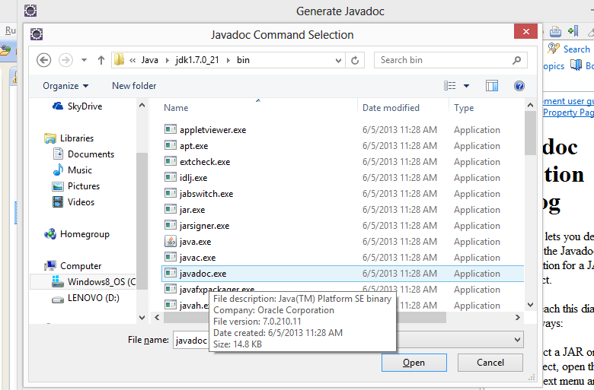
Javadoc
You can generate Javadoc in Eclipse with project/generate javadoc. Choose "Command" and find javadoc.exe, which will be in your jdk's bin directory:

Slide 17
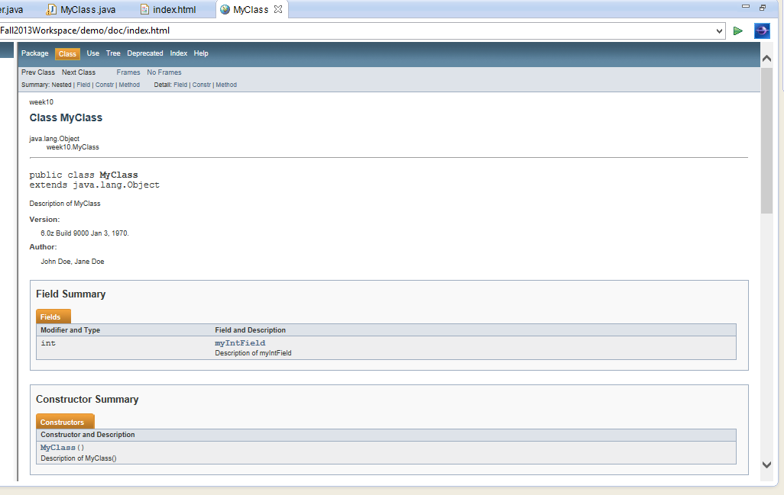
Javadoc
View Javadoc by finding it in Eclipse (you will need to refresh the project after generating it), right clicking on index.html and choosing Open With / Web Browser

Slide 18
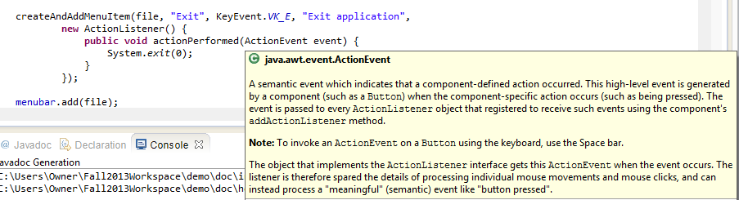
Javadoc
You can also view Javadoc by mouse hovering over code that uses an object of another class. This is very handy when you use classes written by other programmers.

Slide 19
View Declaration and View Call Hierarchy
To see the definition of a method in your code or an imported library which contains code, select code that calls the method, right click, and choose Open Declaration
To find all calls to a method, select the method name, right click, and choose "view call hierarchy"

Slide 20
Images
More sophisticated image demo, from
http://alvinalexander.com/java/jwarehouse/netbeans-src/usersguide/demosrc/examples/imageviewer/ImageFrame.java.shtml
The author of this demo used a GUI builder which left some annotations that are not relevant to us. I may not have deleted them all.

Slide 21
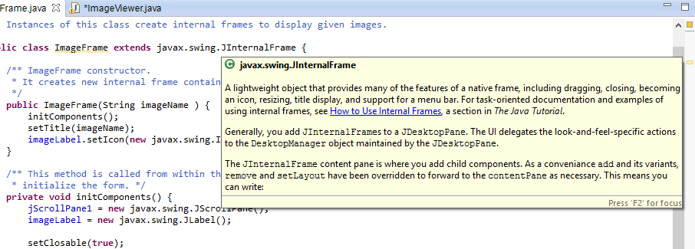
Images
This example uses several new (to use) components. Note that if you mouse-hover over a class name in code in Eclipse, you see a description of the class from the class' Javadoc.

Slide 22
Images
package week10;
/** This class is an entry point of the simple image viewer.
* It creates and shows the main application frame.
*/
public class ImageViewer extends javax.swing.JFrame {
/** Image Viewer constructor.
* It initializes all GUI components [menu bar, menu items, desktop pane, etc.].
*/
public ImageViewer() {
initComponents();
pack();
setBounds( 100, 100, 400, 400 );
}
private void initComponents() {
desktop = new javax.swing.JDesktopPane();
mainMenuBar = new javax.swing.JMenuBar();
fileMenu = new javax.swing.JMenu();
openMenuItem = new javax.swing.JMenuItem();
jSeparator1 = new javax.swing.JSeparator();
exitMenuItem = new javax.swing.JMenuItem();
setTitle("Image Viewer");
addWindowListener(new java.awt.event.WindowAdapter() {
public void windowClosing(java.awt.event.WindowEvent evt) {
exitForm(evt);
}
});

Slide 23
Images
getAccessibleContext().setAccessibleName("Image Viewer Frame");
getContentPane().add(desktop, java.awt.BorderLayout.CENTER);
desktop.getAccessibleContext().setAccessibleName("Image Desktop");
desktop.getAccessibleContext().setAccessibleDescription("Image desktop");
fileMenu.setMnemonic('f');
fileMenu.setText("File");
openMenuItem.setAccelerator(javax.swing.KeyStroke.getKeyStroke(java.awt.event.KeyEvent.VK_O, java.awt.event.InputEvent.CTRL_MASK));
openMenuItem.setMnemonic('o');
openMenuItem.setText("Open");
openMenuItem.addActionListener(new java.awt.event.ActionListener() {
public void actionPerformed(java.awt.event.ActionEvent evt) {
openMenuItemActionPerformed(evt);
}
});
fileMenu.add(openMenuItem);
openMenuItem.getAccessibleContext().setAccessibleName("Open Menu Item");
openMenuItem.getAccessibleContext().setAccessibleDescription("Open menu item.");
fileMenu.add(jSeparator1);
exitMenuItem.setMnemonic('x');
exitMenuItem.setText("Exit");
exitMenuItem.addActionListener(new java.awt.event.ActionListener() {
public void actionPerformed(java.awt.event.ActionEvent evt) {
exitMenuItemActionPerformed(evt);
}
});

Slide 24
Images
fileMenu.add(exitMenuItem);
exitMenuItem.getAccessibleContext().setAccessibleName("Exit Menu Item");
exitMenuItem.getAccessibleContext().setAccessibleDescription("Exit menu item.");
mainMenuBar.add(fileMenu);
fileMenu.getAccessibleContext().setAccessibleName("File Menu");
fileMenu.getAccessibleContext().setAccessibleDescription("File menu.");
setJMenuBar(mainMenuBar);
mainMenuBar.getAccessibleContext().setAccessibleName("Main Menu Bar");
mainMenuBar.getAccessibleContext().setAccessibleDescription("Main menu bar.");
}
/** This method is called when File -> Exit menu item is invoked.
* It closes the application.
* @param evt ActionEvent instance passed from actionPerformed event.
*/
private void exitMenuItemActionPerformed(java.awt.event.ActionEvent evt) {
System.exit( 0 );
}
/** This method is called when File -> Open menu item is invoked.
* It displays a dialog to choose the image file to be opened and displayed.
* @param evt ActionEvent instance passed from actionPerformed event.
*/

Slide 25
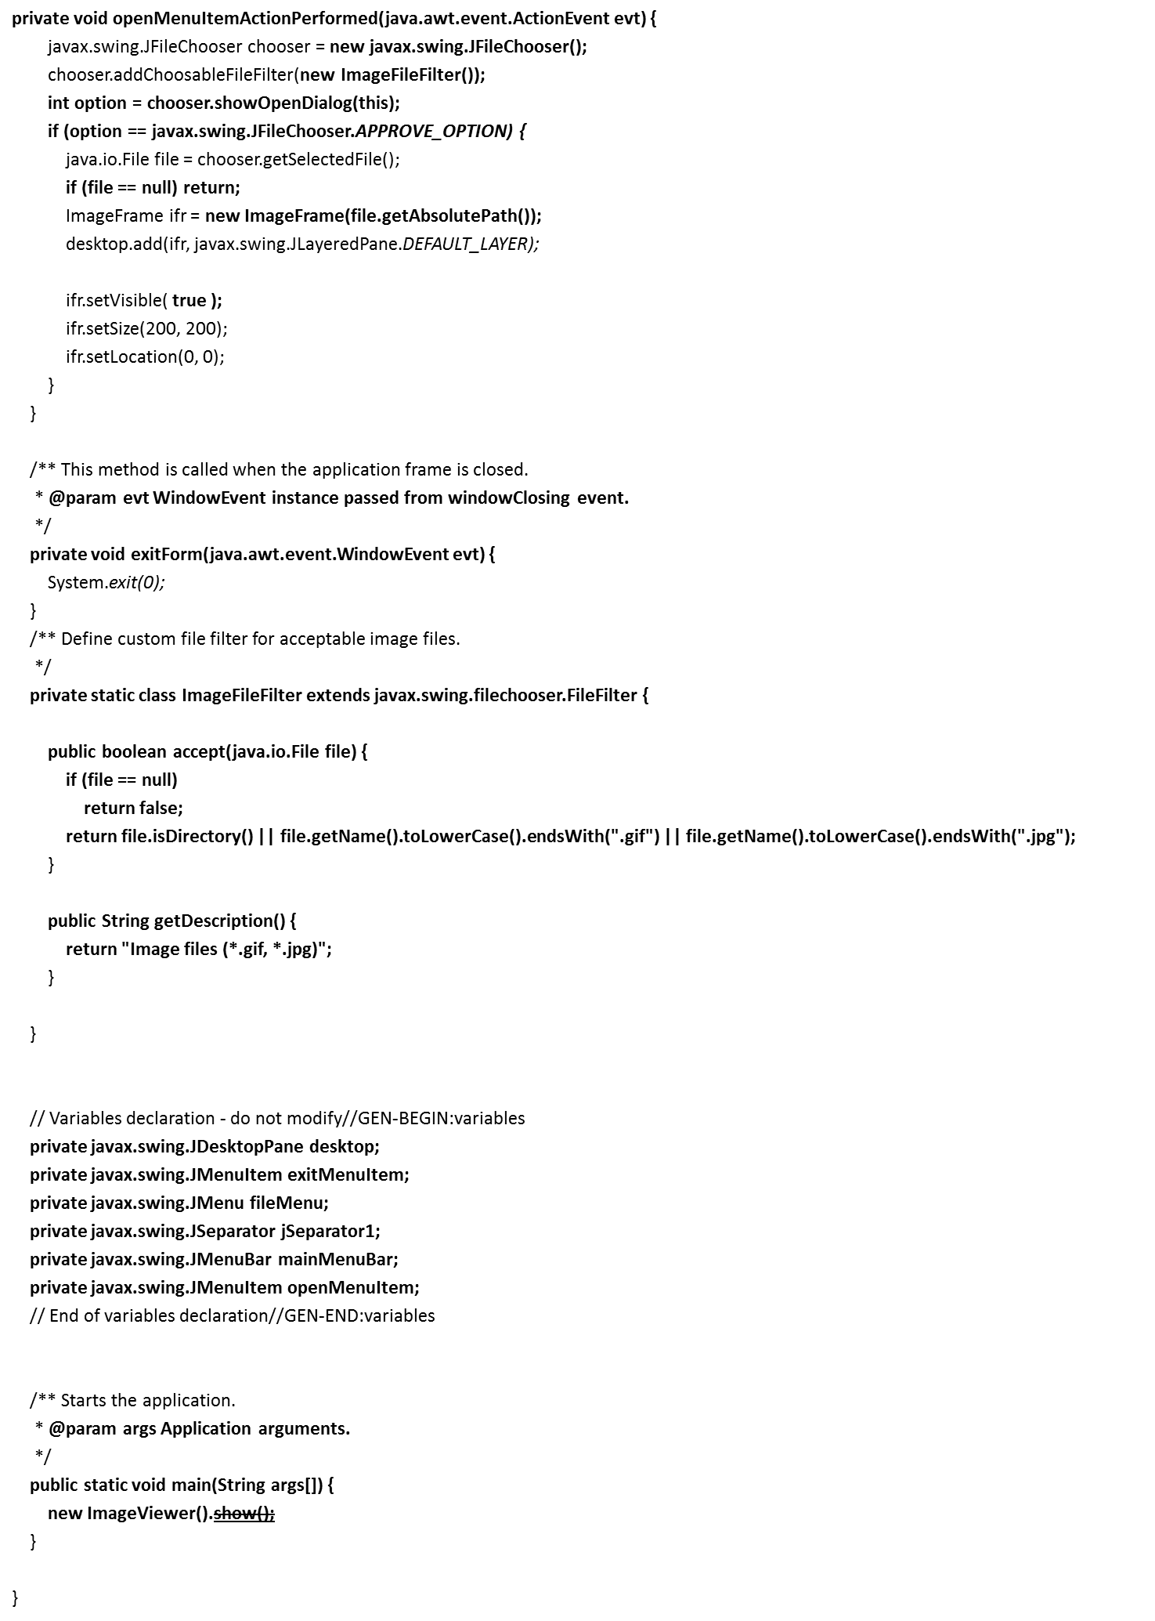
Images

Slide 26
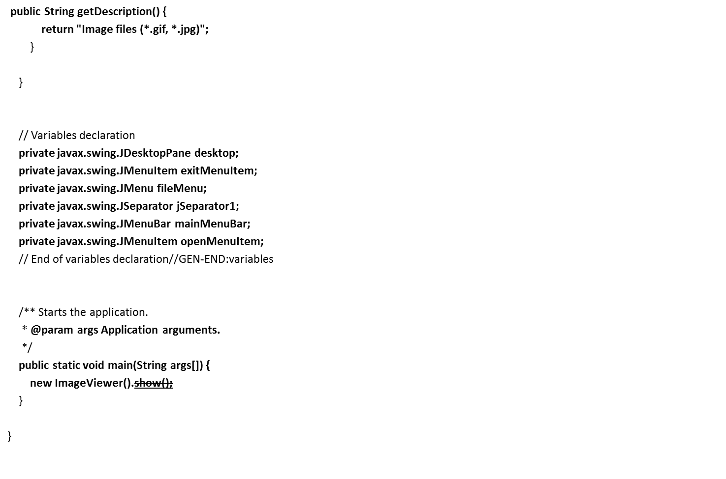
Images

Slide 27
package week10;
/** Instances of this class create internal frames to display given images.
*/
public class ImageFrame extends javax.swing.JInternalFrame {
/** ImageFrame constructor.
* It creates new internal frame containing the given image and displays it.
*/
public ImageFrame(String imageName ) {
initComponents();
setTitle(imageName);
imageLabel.setIcon(new javax.swing.ImageIcon(imageName) );
}
/** This method is called from within the constructor to
* initialize the form. */
private void initComponents() {
jScrollPane1 = new javax.swing.JScrollPane();
imageLabel = new javax.swing.JLabel();
setClosable(true);
setIconifiable(true);
setResizable(true);
getAccessibleContext().setAccessibleName("Image Internal Frame");
getAccessibleContext().setAccessibleDescription("Image internal frame.");
jScrollPane1.setViewportView(imageLabel);
imageLabel.getAccessibleContext().setAccessibleName("Image Label");
imageLabel.getAccessibleContext().setAccessibleDescription("Image label.");
getContentPane().add(jScrollPane1, java.awt.BorderLayout.CENTER);
}
// Variables declaration
private javax.swing.JLabel imageLabel;
private javax.swing.JScrollPane jScrollPane1;
}

Slide 28
Audio
Audio uses streams that are related to the stream types we have already used for binary file i/o
  in fact, we are just doing a specialized kind of binary file i/o
The next example will only work for .wav, but you can find open-source libraries that can handle mp3, etc.
AudioInputStream is just what it sounds like
Line: an audio feed
LineListener notifies your object when a Line's status changes
  So you can start or stop attempting to play the file when it starts or ends
Clip is an object that can load an audio file in advance rather than as the file loads for smooth performance
This example uses a hard-coded file name. Put a .wav in your project and change the filename. In a real app, of course, you would choose the file somehow, perhaps with a JFileChooser.

Slide 29
Audio
package week10;
import javax.sound.sampled.*;
import java.io.File;
import java.io.IOException;
import javax.sound.sampled.LineEvent.Type;
public class WavPlayer {
private void playClip(File clipFile) throws IOException,
UnsupportedAudioFileException, LineUnavailableException,
InterruptedException {
AudioListener listener = new AudioListener();
AudioInputStream audioInputStream = AudioSystem
.getAudioInputStream(clipFile);
try {
Clip clip = AudioSystem.getClip();
clip.addLineListener(listener);
clip.open(audioInputStream);
try {
clip.start();
listener.waitUntilDone();
} finally {
clip.close();
}
} finally {
audioInputStream.close();
}

Slide 30
Audio
}
public static void main(String[] args) {
WavPlayer a = new WavPlayer();
try {
a.playClip(new File("cangoos1.wav"));
} catch (Exception e) {
e.printStackTrace();
}
}
private class AudioListener implements LineListener {
private boolean done = false;
@Override
public synchronized void update(LineEvent event) {
Type eventType = event.getType();
if (eventType == Type.STOP || eventType == Type.CLOSE) {
done = true;
// notifyAll() tells all objects or threads that are waiting for the line to do something that its state has changed
notifyAll();
}
}
public synchronized void waitUntilDone() throws InterruptedException {
while (!done) {
wait();
}
}
}
}

Slide 31
Using Libraries
Java has a very strong culture of open-source software
Students, professors, programming hobbyists, and developers who choose to give back to the profession make many projects available for free
This allows you to use functionality you lack the expertise to code or don’t have time for
Quality control is nonexistent and malware is probably sometimes spread this way!
You will learn several other ways to get libraries and integrate them into your projects, but here is the simple way

Slide 32
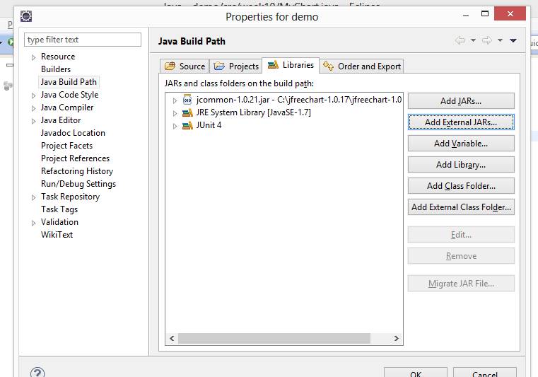
Using Libraries

Slide 33
Using Libraries
Find the website for the library you want and download it.
If you have the choice to get the bytecode alone or with the source included, get the source
You will usually need to unzip or untar the library. The result will include one or more .jar files, which are archives of class files. Often there is also documentation, tutorials, and other material as well.
Right click on the project name and choose "Build Path/Configure Build Path", then "Add External JARs", then find the Jar you need to add.
The library should now appear under "Referenced Libraries" in your project

Slide 34
Using Libraries
// http://www.vogella.com/articles/JFreeChart/article.html
package week10;
import javax.swing.JFrame;
import org.jfree.chart.ChartFactory;
import org.jfree.chart.ChartPanel;
import org.jfree.chart.JFreeChart;
import org.jfree.chart.plot.PiePlot3D;
import org.jfree.data.general.DefaultPieDataset;
import org.jfree.data.general.PieDataset;
import org.jfree.util.Rotation;
public class MyChart extends JFrame{
private static final long serialVersionUID = 1L;
public MyChart(String applicationTitle, String chartTitle) {
super(applicationTitle);
// This will create the dataset
PieDataset dataset = createDataset();
// based on the dataset we create the chart
JFreeChart chart = createChart(dataset, chartTitle);
// we put the chart into a panel
ChartPanel chartPanel = new ChartPanel(chart);
// default size
chartPanel.setPreferredSize(new java.awt.Dimension(500, 270));
// add it to our application
setContentPane(chartPanel);
}

Slide 35
Using Libraries
/** * Creates a sample dataset */
private PieDataset createDataset() {
DefaultPieDataset result = new DefaultPieDataset();
result.setValue("Mothra", 32);
result.setValue("Smog Monster", 24);
result.setValue("Bill Gates", 44);
return result;
}
/** * Creates a chart */
private JFreeChart createChart(PieDataset dataset, String title) {
JFreeChart chart = ChartFactory.createPieChart3D(title, // chart title
dataset, // data
true, // include legend
true,
false);
PiePlot3D plot = (PiePlot3D) chart.getPlot();
plot.setStartAngle(290);
plot.setDirection(Rotation.CLOCKWISE);
plot.setForegroundAlpha(0.5f);
return chart;
}
public static void main(String[] args) {
MyChart demo = new MyChart("Comparison", "Who do you expect Godzilla to fight next?");
demo.pack();
demo.setVisible(true);
}
}

Slide 36
Review Questions?

Slide 37
Evaluations

