Slide 1
CS 202: Introduction To Object-Oriented Programming
Lecture 2: Review of CS201
John Hurley
Fall 2013
Cal State LA

Slide 2
Memory
  RAM
    volatile = data is normally lost when power lost (reboot or power interruption)
    every location in memory has a numeric address
    all information is stored in bits
      a bit can be conceptualized as a switch that is either on or off
        values of single or multiple bits are represented as base 2 (binary) numbers
        can also be interpreted as true / false

Slide 3
Base 2
Decimal | Binary
0 | 0
1 | 1
2 | 10
3 | 11
4 | 100
5 | 101
6 | 110
Decimal | Binary
7 | 111
8 | 1000
9 | 1001
15 | 1111
16 | 10000

Slide 4

Hardware

Slide 5
Bytes
  1 byte = 8 bits
  2⁸ = 256, so the value of 1 byte ranges from
    00000000 to 11111111 binary = 0 to 255 decimal
  1 byte is usually the minimum amount of information that you can manipulate, but Java does maintain some low-level operations form C that allow programmers to work with individual bits.
  Terms like kilobyte and megabyte refer to quantities of bytes in units that are powers of 2 close to the decimal numbers implied in the names, 1K = 1024 bytes; 1meg = 1048576 bytes

Slide 6
Bytes
  Storage affects the possible values for a piece of data.
  Java uses 4 bytes = 32 bits to store the value of an integer
    The (complex) method for tracking the sign effectively uses one bit, so we are left with 31 bits.
    2³¹ = 2147483648
    a Java integer has possible values from -2147483648 to
    +2147483647
    2147483647 + 1 = garbage
    MEMORIZE THIS: “the minimum value for a Java integer is approximately negative 2 billion. The maximum value is approximately positive 2 billion.”

Slide 7



Software
Software
  The intangible instructions and data that are necessary for operating a computer
Program
A software application, or a collection of software applications, designed to perform a specific task
Algorithm
  A set of instructions that will solve a problem in a finite amount of time (Horstmann uses a different definition, but I like this one.)
A program normally implements one or more algorithms

Slide 8
Programming Languages
Computer executes machine code, also called machine language, which consists of instructions expressed as base 2 numbers
  Very few programmers can write machine language
Some programming is done in assembly language, a human-understandable set of mnemonic codes that corresponds closely to machine instructions for the CPU being used.
Over time, easier-to-use programming languages have evolved to allow greater programmer productivity

Slide 9
Programming Languages
Low level language: few machine instructions per line of programming-language code.
  a fancier way to put this: little abstraction from the machine operations
High level language: many machine instructions per line of code
  greater abstraction from machine operations
Because high-level languages do not directly manipulate machine operations, they can be standardized across different operating systems, and even across different hardware (that uses different sets of machine operations.)
Lower level languages often generate programs that run more efficiently (faster or with less memory use) than higher level languages
Higher level languages usually offer better programmer productivity

Slide 10
Expense
Resources are not free; in programming lingo, they are said to be expensive
Programmers’ time
CPU usage
Memory
Storage
Minimizing expense is a key part of programming
Use as little CPU capacity, memory, storage, etc. as possible
Use programmers’ time as productively as possible

Slide 11
Expense
Hardware has become much cheaper over time, but programmers in developed countries get paid about the same after inflation dollars as they did 45 years ago
Thus, programmers have become more expensive relative to hardware. The expense of paying us is a much larger part of the total expense of developing software than it was in the early years of the field.
This favors programming languages and techniques that make programmers more productive, rather than those that produce the most runtime efficiency

Slide 12
Java
Java 1995
  developed at Sun Microsystems
  simpler to use than C++ in many ways but gives up some of C’s low-level capabilities
  approximately tied with C++ as the most widely used programming language today
  Used in many web-based applications
  Widespread use in embedded systems (software that runs on computers included in appliances, cars, etc)
  Widely used for programming devices like video game consoles, BluRay players, smart phones, etc.
  Designed to allow identical code to produce the same results on many different platforms

Slide 13
Programming Language to Machine Instructions
Source code = instructions written in a programming language
Assembly language is translated to machine code using an assembler
High level languages are translated using interpreters and or compilers
  interpreter translates into machine language at runtime; no need to store extra files
  compiler translates into machine language ahead of time and stores the executable file: faster at runtime than in interpreter

Slide 14
Programming Language to Machine Instructions
Traditional BASIC and JavaScript (language used for writing programs that run in web browsers) use interpreters, as do many newer languages like Python.
C uses compilers
Java, like the Microsoft .NET languages, uses a two-step process that attempts to make the best of both
MEMORIZE THIS!
  Java is compiled before runtime to an intermediate language called Java bytecode
  The Java Virtual Machine interprets bytecode to machine language at runtime
  Each platform (operating system or hardware type) requires a different type of JVM, but all forms of JVM run the same bytecode
  Therefore, Java bytecode is analogous to an assembly language for the JVM

Slide 15
Pros and Cons of JVM
Main Advantage
  Java is highly platform-independent
    Write Once, Run Anywhere
      Usually easy to run the same Java code in Linux/UNIX/OSX/Windows/ Toaster/Antilock Brake System/Whatever
        reduces the amount of knowledge the programmer needs to have about the specific platform and the need to port programs to different platforms.
Main Drawbacks:
  JVM itself uses some system resources
  Adds complexity by introducing one extra step
  Java code often runs more slowly than compiled C++

Slide 16
Data Types
Every data item (variable, constant, or even literal, such as the integer 3 or the string “Godzilla”) has a specific data type.
Each type of data is stored with a specific amount of memory and treated differently by the JVM
Thus, you must think carefully about the type of every piece of data you use.

Slide 17
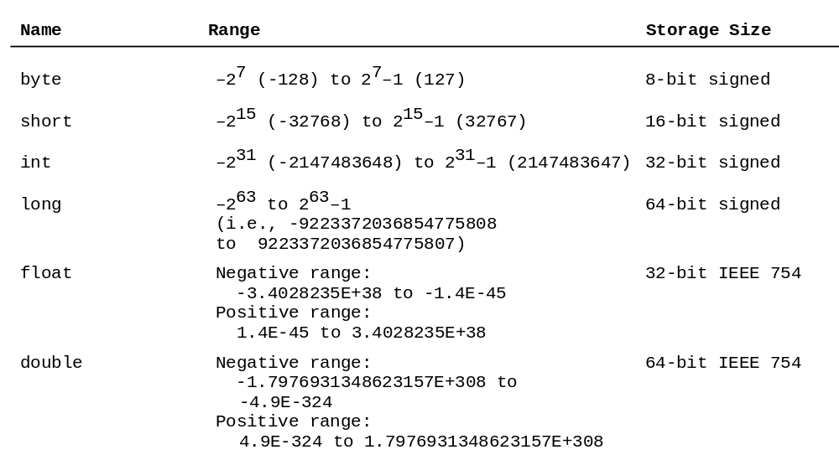
Numeric Data Types

Slide 18
Floating Point Types
Data types which can represent real numbers with arbitrary precision
“Floating point types” include float and double
Internal representation of floating points types includes an exponent, much as in scientific notation, but using powers of 2
These types store values with limited precision, essentially rounding to the closest value they can hold
double doesn’t just hold a larger range of values than float, it also provides greater precision
If you want to learn more about this, see
  https://en.wikipedia.org/wiki/Floating_point_type
Notes:
Don’t test floating point number for equality. Test to see whether they are within some tolerance of each other.

Slide 19
Math Operations and Data Type
What will the output from this code be?
  public class Mathematician{
  public static void main(String[] args){
  int total = 5;
  int divisor = 4;
  int result = total / divisor;
  System.out.println( total + "/" +divisor + " = " + result);
  }
  }

Slide 20
Math Operations and Data Type
What about this one?
  public class Mathematician{
  public static void main(String[] args){
  int total = 5;
  int divisor = 3;
  int result = total / divisor;
  System.out.println( total + "/" +divisor + " = " + result);
  }
  }

Slide 21
Math Operations and Data Type
This one still doesn’t work!
  public class Mathematician{
  public static void main(String[] args){
  int total = 5;
  int divisor = 4;
  double result = total / divisor;
  System.out.println( total + "/" +divisor + " = " + result);
  }
  }

Slide 22
Math Operations and Data Type
To get a floating point result from division, you must make at least one of the operands a floating point type:
  public class Mathematician{
  public static void main(String[] args){
  int total = 5;
  double divisor = 4;
  double result = total / divisor;
  System.out.println( total + "/" +divisor + " = " + result);
  }
  }

Slide 23
Casting
Casting converts data types
For primitive types, the syntax looks like this:
  int x = (int) 5.1;
Casting a floating point type to an integer truncates, doesn’t round!
  int x = (int) 1.6;
    sets x to 1, not 2!

Slide 24
Casting
Casting the value back to the original type does not restore lost data, so if you need the original value, go back to the original variable
public class Caster{
public static void main(String[] args){
double x = 1.6;
int y = (int) x;
System.out.println(x);
System.out.println(y);
System.out.println((double) y);
System.out.println(x);
}
}
outputs:
1.6
1
1.0
1.6

Slide 25
Equality with Floating Point Types
Due to the imprecision of floating point types, it is unwise to test floats and doubles with == operator
  import javax.swing.JOptionPane;
  public class GPAWrong{
  public static void main(String[] args){
  double grade = 4.0;
  do{
  JOptionPane.showMessageDialog(null, "grade = " + grade);
  // BAD CODE AHEAD!!!!
  if(grade == 4.0 || grade == 3.3 || grade == 3.0 || grade == 2.3) grade -= 0.3;
  else grade -= 0.4;
} while(grade > 2.0);
  }
  }

Slide 26
Equality with Floating Point Types
  Instead of testing to see whether two floating point values are equal, test to see whether they are within some tolerance using Math.abs:
  Math.abs(a-b) < tolerance
  In the example on the last slide, we can’t accurately test whether a grade value ends in .7, but we can test whether it is very close to 3.7.
  Use a test like the following:
    if ((Math.abs(grade - 3.7) < .02) || (Math.abs(grade - 2.7) < .02)) grade -= .4;

Slide 27
More Fun With Data Types
Boolean
Value that is either true or false
inequalities and tests in loop statements evaluate to boolean values
1 < 2 is true
  2 < 1 is false
  2 == 2 is true
This code:
int i = 2;
  System.out.println(i + " < " + 5 + "?" + (i < 5));
    prints “true”

Slide 28
More Fun With Data Types
char
  One character
  Set value using single quotes:
    char myChar = ‘A’;
  ‘A’ is not the same as ‘a’

Slide 29
More Fun With Data Types
String
Sequence of zero or more characters.
Note the capital S
    String is a class; we will learn what that means soon.
Set values using double quotes:
String myString = “Get your own String, This one is mine.”
“” is called a null String or empty String.

Slide 30
Constants
Suppose you are writing a program which can calculate the circumference of a circle, the area of a circle, and the volume of a cylinder.
You could type in a value of pi each time you will use it
    double circumference = 2 * 3.14 * radius;
    double area = 3.14 * radius * radius;
    double volume = 3.14 * radius * radius * height;
Better idea: define a constant and set its value once
  Less risk of errors or inconsistencies
  Clearer code; it’s easier to recognize the constant name than the value
  Easier to change values: suppose you need to user greater precision for pi for more accurate results. If you wrote out 3.14 repeatedly, you have to change it to 3.14159 (or whatever) in each case. This is, as a programming cliché goes, tedious and error-prone. If you instead declared a constant and initialized it with the value, you only need to change one line.

Slide 31
Naming Conventions
Java has well-established conventions for names:
Variable and method names: use camelcase
  Do not capitalize the name, but if it consists of several words, concatenate them, use lowercase for the first word, and capitalize the first letter of each subsequent word. For example, computeAreaInSquareCM()
Constants: capitalize all letters. Use underscores to connect words or just run words together. For example, PI or either MAX_VALUE or MAXVALUE. Opinion differs on whether underscores in names are a good idea.
Class names: capitalize the first letter of each word. For example Calculator or String.

Slide 32
Use meaningful names!
Always choose names that are meaningful and descriptive:
radius is a good variable name.
x is a poor variable name.
myInt is a poor variable name, even though you will often see names like this in generic examples.

Slide 33
Loops
  A loop performs a set of instructions repeatedly as long as some condition is met
    while (x != 0) {
      //statements
    }
    executes the statements repeatedly as long as the value of x is not equal to 0 when it is tested, which is at the beginning of each run through the loop.

Slide 34
For Loop
for(int i = 0; i <10; i++) {
System.out.println(i);
}
  Declares an integer variable named i
  i is a loop counter. It's a good idea to name it something like “counter” instead of something like “i”:
    for(int counter = 0; counter < numStudents; counter++){ }
  In this case the counter is initially set to 0; this is typical
  Tests whether the counter is less than 10
    If so, prints the value of the counter, then increments i by 1 and returns to the top of the loop
    If not, continues to whatever is after the loop
  the statements between the brackes are a block
    could contain any number of statements, all of which execute each time through the loop.

Slide 35
More on While Loops
A while loop will continue as long as the test is true.
    public class WhileDemo{
    public static void main(String[] args){
    int thisVar = 0;
    while(thisVar < 10)
    System.out.println(thisVar++);
    }
    }

Slide 36
Do While
Similar to while loop, but with test at the end, not the beginning; loop always runs at least once
In this example, the code inside the loop will never execute:
int x = 0;
while ( x > 0) {
… more code
}
In this one, the code inside the loop will execute at least once:
do{
  … more code
  } while ( x > 0);

Slide 37
Validation
Screen input for problems before using it
do… while loops are very handy for this
Example:
  int age;
  do{
    age = Integer.parseInt(JOptionPane.showInputDialog(null, "Please enter your age in years"));
    } while(age < 0 || age > 105);
    System.out.println(“You entered “ + age);

Slide 38
Nested Loops
  Consider a case in which, for each iteration of the outer loop, the inner loop executes the same number of times as the outer loop:
  public class NestedLoopDemo2{
  public static void main(String[] args){
  int count = 0;
  int max = 10;
  for(int a = 1; a <= max; a++){
  for(int b = 1; b <= max; b++){
  System.out.printf("\nvariable a: %d\t variable b: %d", a, b);
  count++;
  }
  }
  System.out.println("\ntotal number of prints: " + count);
  }
  }
  At the end of the method, count = max²

Slide 39
Nested Loops
  What about this one?
  public class NestedLoopDemo3{
  public static void main(String[] args){
  int count = 0;
  int max = 5;
  for(int a = 0; a < max; a++){
  for(int b = 0; b < a; b++){
  System.out.printf("\nvariable a: %d\t variable b: %d", a, b);
  count++;
  }
  }
  System.out.println("\ntotal number of prints: " + count);
  }
  }
  At the end of the method, count = 0+ 1 + 2 + … + (max – 1)

Slide 40
Branching
  Branching refers to control flow that may vary according to logical conditions.
  Like loops, branching is a key programming technique.
  CS201 teaches if/else if /or and switch statements. Most students find branching easier to understand than loops, so this review will be very light.

Slide 41
If / else shorthand
Syntax:
condition?value if condition is true:value if condition is false;
Example:
int firstInt = 5;
for(int secondInt = 0; secondInt <= 10; secondInt++){
System.out.println(firstInt + " " + (firstInt < secondInt?"is":"isn't") + " less than " + secondInt);
} // end for

Slide 42
Multiple Conditions
  AND: &&
    if(condition 1 && condition 2) {}
    example: if(a < b && b < 1) c = 1;
    example 2: if(a < b && a < 0) System.out.println(“a is negative and less than b”);
  OR: ||
    if(condition 1 || condition 2) {}
    example: if(a < b || b < 1) c = 1;
  Can string any number of conditions together, but be careful not to write code that is hard to understand

Slide 43
Multiple Conditions
  public class MultipleConditionsDemo{
  public static void main(String[] args){
  boolean trueCondition = true;
  boolean falseCondition = false;
  System.out.println("True is " + (trueCondition?"true":"false"));
  System.out.println("False is " + (falseCondition?"true":"false"));
  System.out.println("(True and False) is "+(trueCondition&& falseCondition?"true":"false"));
  System.out.println("(True or False) is "+(trueCondition||falseCondition?"true":"false"));
  } // end main()
  } // end class

Slide 44
Negations
NOT: !
!(a == b) is equivalent to (a != b)
Can also use with more complex conditions
  !((a == b) && (a == 1))
  !(a || b)
  !(a &&(b||c))

Slide 45
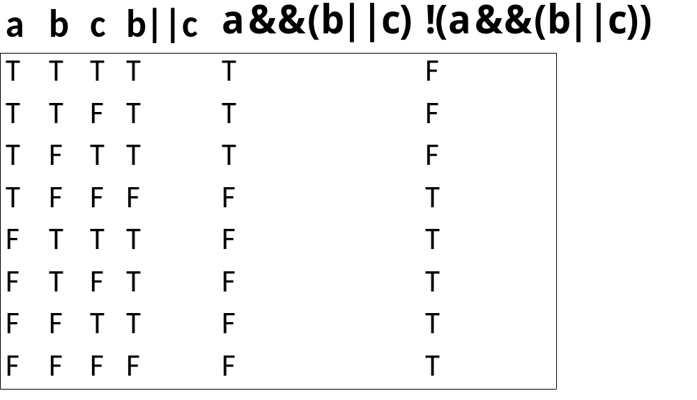
Negations

Slide 46
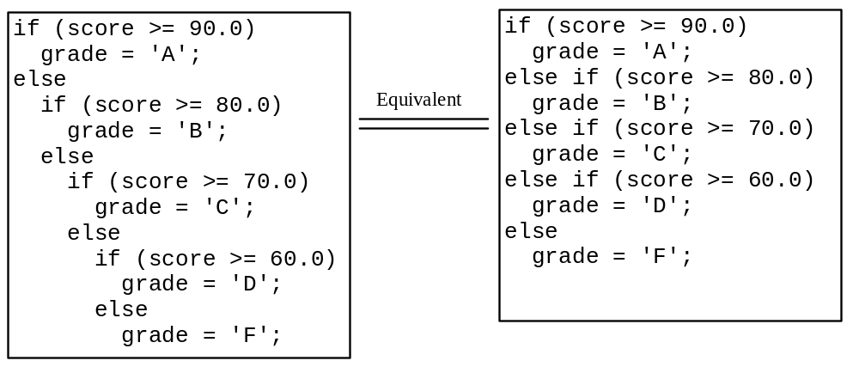
Multiple Alternative if Statements

Slide 47
switch Statement Rules
The keyword break is optional, but it should be used at the end of each case in order to terminate the remainder of the switch statement. If the break statement is not present, the next case statement will be executed.
switch (switch-expression) {
case value1: statement(s)1;
break;
case value2: statement(s)2;
break;
…
case valueN: statement(s)N;
break;
default: statement(s)-for-default;
}
The default case, which is optional, can be used to perform actions when none of the specified cases matches the switch-expression.
The case statements are executed in sequential order, but the order of the cases (including the default case) does not matter. However, it is good programming style to follow the logical sequence of the cases and place the default case at the end.

Slide 48
Switch
  import javax.swing.JOptionPane;
  public class SwitchDemo{
  public static void main(String[] args){
  char ageCat = 'y';
  while (ageCat != 'q'){
  String input = JOptionPane.showInputDialog(null, "Welcome to John's bar. Please enter your age category: \ny for under 21, m for 21-29, o for 30 and older. Enter q to quit.");
  ageCat = (char) input.charAt(0);
  switch(ageCat){
  case 'y':
  JOptionPane.showMessageDialog(null, "Enjoy your Shirley Temple, Junior");
  break;
  case 'm':
  JOptionPane.showMessageDialog(null, "You'd better stick to beer");
  break;
  case 'o':
  JOptionPane.showMessageDialog(null, "You probably need some whiskey");
  break;
  case 'q':
  break;
  default:
  JOptionPane.showMessageDialog(null, "Invalid input"); } // end switch
  } // end while
  } // end main()
  } // end class

Slide 49
Math Operations
  x = 1 is an assignment that sets x to the value 1
    To the computer, this means “go find the memory you set aside to keep track of x and replace the value there with 1”
  x == 1 is a test that is true if x is equal to 1, otherwise false.
    Usually used in a expression like
  if(x == 1)
  System.out.println(“x is equal to 1!”);

Slide 50
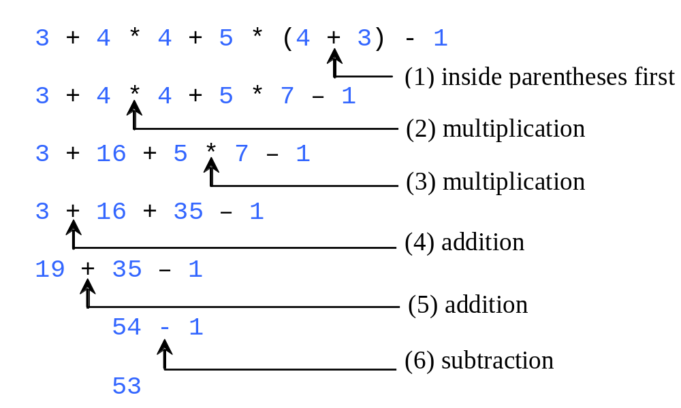
Operator Precedence

Slide 51
Operator Associativity
Binary operators are those that take two operands.
  Example: a - b
All binary operators except assignment operators are left-associative.
  a – b + c – d is equivalent to ((a – b) + c) – d
Assignment operators are right-associative. Therefore, the expression
  x = 10 * b;
means “find the value of b, multiply it by 10, and assign the resulting value to x.”

Slide 52
Math Operations
Modulo operator %
  find the remainder after division, discard the quotient
    10 % 1 = 0
    10 % 5 = 0
    10 % 4 = 2
    10 % 3 = 1

Slide 53
Math Operations
Modulo operations have many uses in programming. One is to create a sequence of unlimited length using a finite set of resources, by taking turns in round-robin fashion
Example of modulo logic:
  Stooge₀, Stooge₁, and Stooge₂ will share some number of slaps on the head. We can only slap one Stooge at a time.
  slap_{slapNum} goes to Stooge_{i}, where i = slapNum % 3
  int stoogeNum = slapNum % 3;

Slide 54
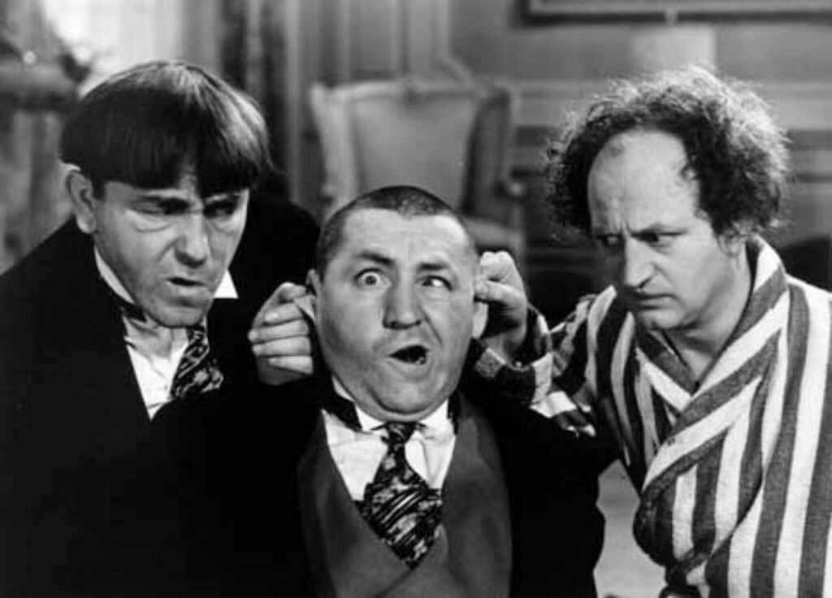
Math Operations
0
1
2

Slide 55
Modulo
public static void main(String[] args) {
int numberOfStooges = 3;
int currentStoogeNum = 0;
for (int slapNum = 0; slapNum < 100; slapNum++) {
currentStoogeNum = slapNum % numberOfStooges;
System.out.println("Slap # " + slapNum
+ " administered to Stooge # " + currentStoogeNum);
}
}

Slide 56
Shortcuts
Operator Example Equivalent
+= i += 8 i = i + 8
-= f -= 8.0 f = f - 8.0
*= i *= 8 i = i * 8
/= i /= 8 i = i / 8
%= i %= 8 i = i % 8

Slide 57
Increment and
Decrement Operators
Operator Name Description
++var preincrement The expression (++var) increments var by 1 and evaluates
to the new value in var after the increment.
var++ postincrement The expression (var++) evaluates to the original value
in var and increments var by 1.
--var predecrement The expression (--var) decrements var by 1 and evaluates
to the new value in var after the decrement.
var-- postdecrement The expression (var--) evaluates to the original value
in var and decrements var by 1.

Slide 58
Increment and
Decrement Operators
public class Increments{
public static void main(String[] args){
int num = 0;
System.out.println(num);
System.out.println(num++);
System.out.println(num);
System.out.println(++num);
System.out.println(num);
}
}
Outputs this sequence:
0
0
1
2
2

Slide 59
Increment and
Decrement Operators
public class Increments{
public static void main(String[] args){
for(int num = 0; num < 5; num++)
System.out.println(num);
}
}
outputs this sequence:
0
1
2
3
4

Slide 60
Increment and
Decrement Operators
public class Increments{
public static void main(String[] args){
for(int num = 0; num < 5; num++)
System.out.println(num++);
}
}
outputs this:
0
2
4

Slide 61
Character Codes
Computers store information as bits, not characters. There are several code systems that assign numeric values to characters. We usually use the decimal values, but the compiler converts these to binary.
ASCII
    developed in the early 1960s, when memory was much more expensive than it is now
    128 (2⁷) possible characters
    The first 33 are control characters, originally used to control teletypes
Unicode
    Used in Java
    Superset of ASCII
    65536 values
    First 128 are the same as ASCII
    Adds Greek, Arabic, etc. alphabets, many other characters.

Slide 62
Character Codes
  public class ASCIIUnicodeDemo{
  public static void main(String[] args){
  for(int charNum = 0; charNum < 128; charNum++){
  System.out.println("Character " + charNum + " is " + (char) charNum);
  }
  }
  }
  Why do we get a blank line in the output after char #10 and before char #11?

Slide 63
Escape Sequences
Some characters will cause confusion in output
  What will happen if we try to execute this:
    System.out.println(““Hi,Mom””);
Use escape characters for these cases

Slide 64
Escape Sequences
Description Escape Sequence
Backspace \b
Tab \t
Linefeed \n
Carriage return \r
  (think of a typewriter)
Backslash \\
Single Quote \'
Double Quote \"

Slide 65
Escape Sequences
public static void main(String[] args){
System.out.println("A\tB\n\tC D\\E \'Hi, Mom\' \"Hi, Mom\"");
System.out.println("She said \"They tried to make me go to rehab, but I said \"No, No, No!\"\"");
}

Slide 66
Imports
  We have already discussed javax.swing.JOptionPane methods to show input and message dialogs
  These required the following line at the top of the class:
    Import javax.swing.JOptionPane;
  If you omit this line and compile, you will get an error message like this:
    SwitchDemo.java: 7: cannot find symbol
    Symbol:variable JOptionPane

Slide 67
Imports
  Java classes are organized in packages
    Soon you will start using your own packages for multiple classes
  Javax.swing is a package of GUI-related classes that is included with all distributions of Java
  JOptionPane is a class within this package
  JOptionPane.showMessageDialog() and JOptionPane.showInputDialog are methods of the class

Slide 68
Imports
Including a package in your program adds a small cost, slowing down the compiler as it looks through the imported package
Thus, things like javax.swing are not included automatically; you must specify that you need them
You will eventually be importing your own packages, too.

Slide 69
Dialog Boxes
  The JOptionPane class provides pop-up I/O boxes of several kinds
Need to include this at the very top of your class:
import javax.swing.JOptionPane;
JOptionPane.showMessageDialog(message);
displays a dialog box containing the String message as text
This is a good opportunity to remind you that Java is rigorously case-sensitive. JoptionPane.ShowMessageDialog(), jOptionPane.showMessageDialog(), and JoptionPane.showMessagedialog() won't work

Slide 70
Dialog Boxes
  import javax.swing.JOptionPane;
  public class DialogBox{
  public static void main(String[] args){
  for(int i = 0; i < 4; i++) {
  JOptionPane.showMessageDialog(null, "This is number " + i);
  }
  }
  }

Slide 71
Dialog Boxes
JOptionPane.showInputDialog() shows a dialog box that can take input. The user input becomes the return value for showInputDialog() , and it is returned as a String:
  import javax.swing.JOptionPane;
  public class InputBox{
  public static void main(String[] args){
  String input = JOptionPane.showInputDialog(null, "Please enter some input ");
  JOptionPane.showMessageDialog(null, "You entered: \"" + input + "\"");
  String input2 = input.concat(" " + JOptionPane.showInputDialog(null, "Please enter some more input "));
  JOptionPane.showMessageDialog(null, "You entered: \"" + input2 + "\"");
  }
  }

Slide 72
Casting to Numeric Types
JOptionPane.showInputDialog returns a String. If you need some other data type, use a cast
Example:
int age = Integer.parseInt(
JOptionPane.showInputDialog(null, “Please enter your age in years”);
Cast to double: Double.parseDouble(doubleString);
Note the capitalization in the method names. Double and Integer are not quite the same as double and integer.
    You’ll understand this very soon…

Slide 73
Casting to Integer
import javax.swing.JOptionPane;
public class NumericCastDemo{
public static void main(String[] args){
int age = Integer.parseInt(JOptionPane.showInputDialog(null, "Please enter your age"));
if(age < 30)
JOptionPane.showMessageDialog(null, age + " is pretty young.");
else if(age > 100) JOptionPane.showMessageDialog(null, "really?");
else JOptionPane.showMessageDialog(null, "That's OK. Methuseleh lived to be " + (270 - age) +
" years older than you are now.");
} // end main()
} // end class

Slide 74
Casting to Double
import javax.swing.JOptionPane;
public class NumericCastDemo{
public static void main(String[] args){
double age = Double.parseDouble(JOptionPane.showInputDialog(null, "Please enter your age"));
if(age < 30)
JOptionPane.showMessageDialog(null, age + " is pretty young.");
else if(age > 100) JOptionPane.showMessageDialog(null, "really?");
else JOptionPane.showMessageDialog(null, "That's OK. Methuseleh lived to be " + (270 / age) +
" times as old as you are now.");
} // end main()
} // end class

Slide 75
Other JoptionPane methods
JOptionPane also contains many other I/O methods. Check Oracle's online documentation.
Some of the methods require many parameters whose purpose is not always obvious. Look for an example online
Pay careful attention to the return type.
Example: showOptionDialog allows the user to choose one of a set of options.
String[] choices = { "Cardassian", "Klingon", "Vulcan" };
int code = JOptionPane.showOptionDialog(null, "What language do you prefer?",
"Choose A Language", 0, JOptionPane.QUESTION_MESSAGE, null,
choices, "Klingon"
);
System.out.println(code);
  Run this code snippet and make different choices to see how the integer value it returns corresponds to the choices given. You will usually want to use a switch with the return value.

Slide 76
Command Line Input
The simplest command line input class is Scanner
import java.util.Scanner;
Scanner has a variety of methods to get input of different data types

Slide 77
Scanner Input Methods
  We describe methods using in this format:
    Class.method()
    If there are any parameters, their type goes inside the parentheses
  You have already seen
    System.out.println(String)
    JOptionPane.showMessageDialog(null, message)
  You will often replace the class name with the name of an instance of the class. You'll understand why very soon.
      Scanner input = new Scanner(System.in);
      … stuff deleted…
      name = input.next();
  In the example above, input is an instance of Scanner.
    We set up a Scanner and called it input

Slide 78
Scanner Input Methods
Scanner.next() reads the next parseable string
Scanner.nextLine() reads up to the next line break and puts the result in a String
Scanner.nextDouble() reads the next parseable string and tries to convert it to a Double:
double d = Scanner.nextDouble();
There are equivalent methods for nextInteger(), nextBoolean(), etc.

Slide 79
Scanner.next Example
import java.util.Scanner;
public class Demo {
public static void main(String[] args) {
Scanner input = new Scanner(System.in);
String name = null;
int candyCount = 0;
do {
System.out.println("Guess my name:");
name = input.next();
if (name.equals("Candyman"))
candyCount += 1;
} while (candyCount < 3);
System.out.println("You called the Candyman three times, fool! Now he will eat you!");
input.close();
}
}

Slide 80
Scanner.nextDouble Example
import java.util.Scanner;
public class Demo {
public static void main(String[] args) {
Scanner input = new Scanner(System.in);
double myDouble = 0.0;
System.out.print("Input a double:");
myDouble = input.nextDouble();
System.out.println("\nYou entered: " + myDouble);
input.close();
}
}

Slide 81
Validating Scanner Input
  Examples used so far crash when casts to numeric types fail. Try this one with input “two point five”:
import java.util.Scanner;
public class Demo {
public static void main(String[] args) {
Scanner input = new Scanner(System.in);
Double inpDouble;
do {
System.out.print("Input a double. Enter 0 to quit: ");
inpDouble = input.nextDouble();
System.out.println("\nYou entered: " + inpDouble);
} while (inpDouble != 0.0);
input.close();
}
}

Slide 82
Validating Scanner Input
Here is the simplest way to validate Scanner input for data type (that is, to make sure you get input that can be cast to double, integer, etc.)
Scanner has hasNext…() methods that see if there is a parseable token
  hasNextInt()
  hasNextDouble()
  hasNextBoolean()
Also need nextLine() to skip over bad input

Slide 83
Validating Scanner Input
Here is the simplest way to validate Scanner input for data type (that is, to make sure you get input that can be cast to double, integer, etc.)
Scanner has hasNext…() methods that see if there is a parseable token
  hasNextInt()
  hasNextDouble()
  hasNextBoolean()
Also need nextLine() to skip over bad input

Slide 84
Validating Scanner Input
  In order to get good output, we need to arrange things in a slightly more complex way:
import java.util.Scanner;
public class Demo {
public static void main(String[] args) {
Scanner sc = new Scanner(System.in);
System.out.print("Enter an integer: ");
while (!sc.hasNextInt()) {
sc.nextLine();
System.out.print("Enter an integer: ");
}
int inpInt = sc.nextInt();
System.out.println("You entered: " + inpInt);
sc.close();
}
}

Slide 85
Documentation From Oracle
When you need to remember the details of something like Scanner, look it up in Oracle’s excellent online documentation
Example: Google +Java +Scanner
Follow the link to http://docs.oracle.com/javase/1.5.0/docs/api/java/util/Scanner.html

Slide 86
Strings
A String consists of zero or more characters
String is a class that contains many methods used to manipulate String objects (think about this and you will start to understand classes and objects)
Create a String:
String newString = new String(stringLiteral);
Example: String message = new String("Welcome to Java");
Since strings are used frequently, Java provides a shorthand initializer for creating a string:
String message = "Welcome to Java";

Slide 87
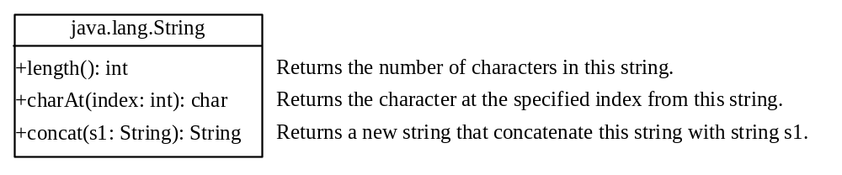
String Length, Characters, and Combining Strings

Slide 88
Finding String Length
Finding string length using the length() method:
message = "Welcome";
message.length() (returns 7)

Slide 89
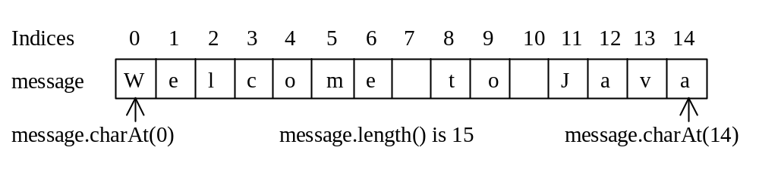
Retrieving Individual Characters in a String
Do not use message[0]
Use message.charAt(index)
Index starts from 0

Slide 90
Strings
public class StringDemo2{
public static void main(String[] args){
String s1 = new String("Welcome");
String s2 = " Shriners";
String s3 = s1.concat(s2);
System.out.println(s3);
String s4 = s1 + s2;
System.out.println(s3);
s1 = s1 + s2;
System.out.println(s3);
if(s1.startsWith("Wel")) System.out.println("\"" + s1 + "\"" + " starts with \"Wel!\"");
System.out.println("Length of \"" + s1 + "\" is " + s1.length());
System.out.println("In the string \"" + s1 + "\", the character at position 4 is " + s1.charAt(4));
}
}

Slide 91
String Concatenation
// Three strings are concatenated
String message = "Welcome " + "to " + "Java";
// String Supplement is concatenated with character B
String s1 = "Supplement" + 'B'; // s1 becomes SupplementB
To concatenate to existing String, create a new String and use concat():
  String myString = “Good”;
  String myOtherString = myString.concat(“ Morning”);

Slide 92
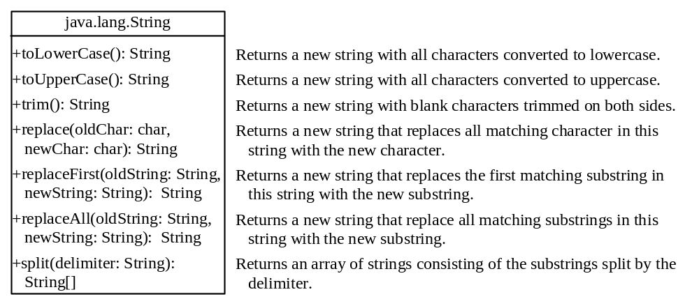
Converting, Replacing, and Splitting Strings

Slide 93
Examples
"Welcome".toLowerCase() returns a new string, welcome.
"Welcome".toUpperCase() returns a new string, WELCOME.
" Welcome ".trim() returns a new string, Welcome.
"Welcome".replace('e', 'A') returns a new string, WAlcomA.
"Welcome".replaceFirst("e", "AB") returns a new string, WABlcome.
"Welcome".replace("e", "AB") returns a new string, WABlcomAB.
"Welcome".replace("el", "AB") returns a new string, WABlcome.

Slide 94
Strings Are Immutable
A String object is immutable; its contents cannot be changed. Does the following code change the contents of the string?
String s = "Java";
s = "HTML";

Slide 95

animation
Trace Code
String s = "Java";
s = "HTML";

Slide 96
animation
Trace Code
String s = "Java";
s = "HTML";

Slide 97
Interned Strings
Since strings are immutable and are frequently used, to improve efficiency and save memory, the JVM uses a unique instance for string literals with the same character sequence. Such an instance is called interned. For example, the following statements:

Slide 98
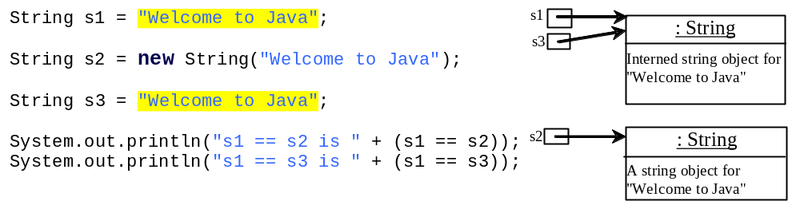

Examples
display
s1 == s2 is false
s1 == s3 is true
A new object is created if you use the new operator.
If you use the string initializer, no new object is created if the interned object is already created.
Notes:
Why doesn’t s1 == s2?
Because it’s testing to see whether they have the same memory address not if they have the same content.

Slide 99
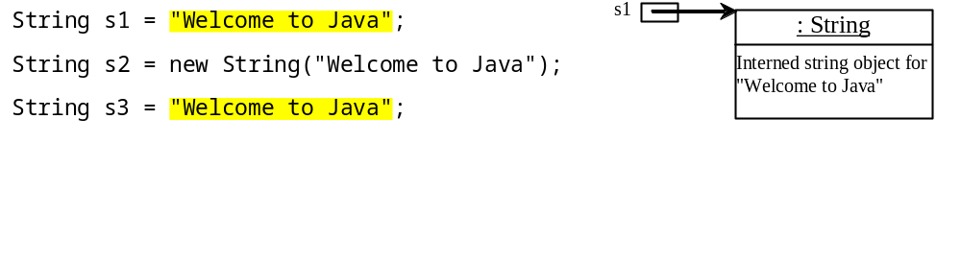
animation
Trace Code

Slide 100
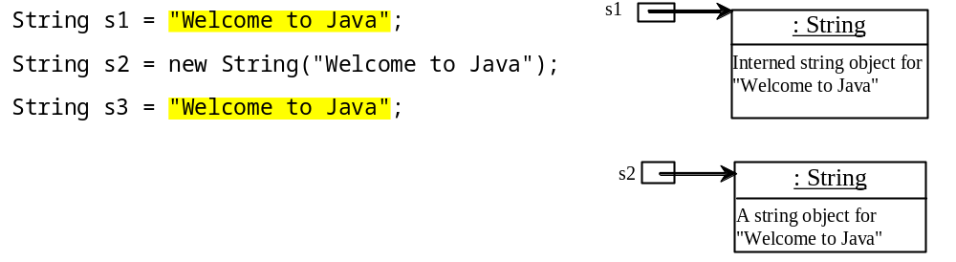
Trace Code

Slide 101
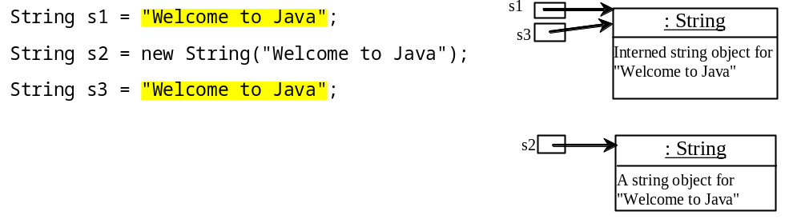
Trace Code

Slide 102
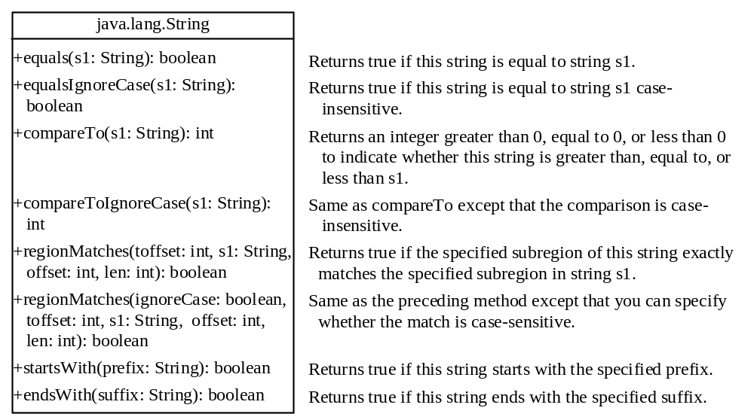
String Comparisons

Slide 103
String Comparisons
equals
String s1 = new String("Welcome“);
String s2 = "welcome";
if (s1.equals(s2)){
// s1 and s2 have the same contents
}
if (s1 == s2) {
// s1 and s2 have the same reference
}

Slide 104
String Comparisons, cont.
compareTo(Object object)
String s1 = new String("Welcome“);
String s2 = "welcome";
if (s1.compareTo(s2) > 0) {
// s1 is greater than s2
}
else if (s1.compareTo(s2) == 0) {
// s1 and s2 have the same contents
}
else
// s1 is less than s2

Slide 105
Pseudocode
Algorithms are often described with pseudocode
Pseudo means “almost” or “fake”
Pseudocode uses various constructs that are common to many programming languages
Pseudocode is a way to abstract algorithms from the details of particular programming languages
Pseudocode is only pseudostandardized. You will see many different notations.

Slide 106
Pseudocode
This is a pretty formal type of pseudocode:
function factorial is:
input: integer n such that n >= 0
output: [n × (n-1) × (n-2) × … × 1]
Iterative algorithm
  create new variable called running_total with a value of 1
  begin loop
    if n is 0, exit loop
    set running_total to (running_total × n)
    decrement n
    repeat loop
  return running_total
  end factorial
Notes:
Iterative means using loop.

Slide 107
Pseudocode
Here is a different pseudocode format:
procedure bizzbuzz
for i := 1 to 100 do
set print_number to true;
if i is divisible by 3 then print "Bizz";
set print_number to false;
if i is divisible by 5 then print "Buzz";
set print_number to false;
if print_number, print i;
print a newline;
end

Slide 108
Pseudocode
Here is yet another format, this one more abstract:
initialize passes to zero
initialize failures to zero
set minimum passing score to 70
set number of students to 10
for each student
get the student's exam result from input
if the student's score is greater than or equal to the passing score
add one to passes
else
add one to failures
print the number of passes
print the number of failures
if at least 70% of students passed
print "The university is succeeding! Raise tuition!"
else
print "The university needs more resources! Raise tuition!"

Slide 109
Methods
Here is some bad code:
public class UglyCode {
public static void main(String[] args){
int firstRadius = 2;
double firstCircumference = firstRadius * 2 * 3.1416;
System.out.printf("a circle with radius %d has circumference of %7.4f\n", firstRadius, firstCircumference);
int secondRadius = 6;
double secondCircumference = secondRadius * 2 * 3.14159;
System.out.printf("a circle with radius %d has circumference of %7f\n", secondRadius, secondCircumference);
int thirdRadius = 11;
double thirdCircumference = thirdCircumference = thirdRadius * 2 * 3.142;
System.out.printf("a circle with r = %d has circumference of %7.4f\n", thirdRadius, (thirdRadius * 2 * 3.142));
double fourthCircumference = 11 * 2 * 3.14;
System.out.printf(" circle with radius 11 has circumference of %7.4f\n", fourthCircumference);
}
}

Slide 110
What We Already Know
We can already spot some problems with the code above:
The second line of output shows 6 digits past the decimal point while the others show 4. Unless there is some reason to do otherwise, we should make this uniform.
The last two lines of output show different values for the circumference of a circle with radius 11.
We have several variables that are only used once each and represent the same kinds of values (radii and circumferences.)
Different lines of output have slightly different label text
This code is hard for humans to understand because it does the same thing repeatedly in inconsistent ways.

Slide 111
Modularity
As the state of the art of programming has progressed, we have found ways to make programs more modular
Modular = constructed from standardized components
Your house contains thousands of nails, but they were not each custom-machined. They are multiple copies of a few basic forms.
Ford was able to make Model Ts cheaply because, since they were all the same, they could be made cheaply on assembly lines from interchangeable parts
If you made a car from custom-machined parts, it would be expensive to make and hard to repair

Slide 112
Version 2.0
This is BASIC, but this technique was used in other languages ca. 1950s-1960s
10 LET P = 3.1416
20 LET r = 2
30 LET x = 50
40 GOTO 140
50 LET r = 6
60 LET x = 80
70 GOTO 140
80 LET r = 11
90 LET x = 110
100 GOTO 140
110 LET x = 130
120 GOTO 140
130 end
140 LET c = r * 2 * P
150 print "circumference of circle with radius "; r; " is "; c
160 GOTO x

Slide 113
Version 2.0
This version is more consistent and, if the calculation was more complex, it saves code.
However, it has some new problems:
  It is even harder to understand than the original
  x and r can be changed anywhere in the program, which creates a risk of hard-to-detect errors

Slide 114
Methods
Solution: design and use methods
Called subroutines, functions, or procedures in other programming languages
Separate some coherent piece of functionality into a separate unit of code and reuse as needed

Slide 115
Methods
Benefit of using methods: Modularity
Code a method once, use it as often as you need to
If the method is sufficiently modular, you can even copy it into another class when you need similar functionality
Make code easier to understand
Make it easier to change the code; only need to change the method once

Slide 116

Defining Methods
A method is a collection of statements that are grouped together to perform an operation.

Slide 117
Method Signature
Method signature is the combination of the method name and the parameter list.

Slide 118
Formal Parameters
The variables defined in the method header are known as formal parameters.

Slide 119
Actual Parameters
When a method is invoked, you pass a value to the parameter. This value is referred to as actual parameter or argument.

Slide 120
Return Value Type
A method may return a value. The returnValueType is the data type of the value the method returns. If the method does not return a value, the returnValueType is the keyword void. For example, the returnValueType in the main method is void.

Slide 121

Parameters and Return Values
Neither parameters nor a return value is required to meet the definition of a method
We might have any of the following combinations:
    No parameters, no return value
    Parameters but no return value
    Return value but no parameters
    Parameters and return value

Slide 122
Method Overloading
Scary term for a very simple concept
You can’t have two methods in the same class with the same name and same method signature
But you can have two methods with the same name and different signatures
This is a form of polymorphism.
  poly = many
  morph=shape, form, or change

Slide 123
public class Demo {
public static void main(String[] args) {
int x = 0;
x = getInt();
JOptionPane.showMessageDialog(null, "You chose " + x);
int min = 2;
int max = 10;
x = getInt(min, max);
JOptionPane.showMessageDialog(null, "You chose " + x);
}
public static int getInt() {
// get an integer from input
int x = Integer.parseInt(JOptionPane.showInputDialog(null,
"Please enter an integer"));
return x;
}
public static int getInt(int low, int high) {
// get an integer between min and max from input
int val;
do {
val = Integer.parseInt(JOptionPane.showInputDialog(null,
"Please enter an integer between " + low + " and " + high));
} while (val < low || val > high);
return val;
}
}

Slide 124
Scope
Variables and finals are visible at different places in your program depending on where you declare them
Scope determines where each variable/final is visible
Variables/finals are only visible in the block in which they are declared and blocks that are inside it
Variables or finals are *not* visible in blocks outside the one in which they are declared, even ones that enclose it
If a variable is declared in an outer block but has a value assigned to it in an inner block, it still has the new value when control returns to the outer block
This is convenient but can be a source of logic errors
The modifiers public, protected, and private control which values are visible outside the class; we will cover this later

Slide 125
Scope and Parameters
public static double calcCircumference(int r){
double circ = r * 2 * PI;
return circ;
}
r is available in this version of calcCircumference() because it is declared and given a value in the method signature

Slide 126
Scope and Methods
public class ScopeDemo{
static String classString = "This string is visible everywhere in this class";
public static void main(String[] args){
String mainString = "This string is visible only in the main method";
for(int counter = 0; counter < 1; counter++){
String loopString = "This string is visible only inside the loop";
System.out.println("main method output: \n" + classString + "\n" + mainString +"\n" + loopString);
}
otherMethod();
// trying to print loopString or otherMethodString here would cause an error because they are not in scope
// System.out.println(loopString);
// System.out.println(otherMethodString);
}
public static void otherMethod(){
String otherMethodString = "This string is visible only in otherMethod()";
System.out.println("\notherMethod output: \n" + classString + "\n" + otherMethodString);
// trying to print mainString or loopString here would cause an error because they are not in scope
// System.out.println(MainString);
// System.out.println(MainString);
}
}

Slide 127
Scope
public class ScopeDemo2{
static String classString = new String();
public static void main(String[] args){
String mainString = new String();
for(int counter = 0; counter < 1; counter++){
String loopString = new String();
System.out.println("loop output: \n" + classString + "\n" + mainString +"\n" + loopString);
}
otherMethod();
if(1+1 == 2){
classString = "class string";
mainString = "main string";
System.out.println("if output: \n" + classString + "\n" + mainString);
// printing or assigning a value to loopString here would cause an error
// loopString = "loopString";
}
System.out.println("output from main after end of if block:\n" + mainString);
otherMethod();
System.out.println("output from main after returning from otherMethod: \n" + classString);
}
public static void otherMethod(){
System.out.println("\notherMethod output: \n" + classString);
// using mainString here would cause an error because it is out of scope
classString = "new value of class string";
}

Slide 128
Scope and Parameters
public class Demo {
public static void main(String[] args) {
int num = 3;
int square = calcSquare(num);
System.out.println(num + " squared = " + square);
}
private static int calcSquare(int base){
int num = (int) Math.pow(base, 2);
return num;
}
}
num in main and num in calcSquare are two different variables that happen to have the same name.
This works because they are never both in scope at the same time.

Slide 129
Scope and Parameters
Consider this class:
public class MethodScopeDemo{
static int myInt;
public static void main(String[] args){
myInt = 1;
System.out.println(myInt);
otherMethod();
System.out.println(myInt);
}
public static void otherMethod(){
myInt = 2;
}
}
myInt is not passed as a parameter. It is in scope in otherMethod() because it is declared in the class but not inside any method.
What will the output be?

Slide 130
Scope and Hiding
So far, parameters have been passed by value. This means that we send a copy of the value.
The called method sets up a variable, assigns the parameter value to it, and, presumably, uses it.
Even if the parameter was a variable, its value in the calling method does not change
If you want to change the value of the variable in the calling method, you can return the correct data type from the called method and assign the return value to the variable:
x = getNewX(x);
It will get much more complicated soon!

Slide 131
Scope and Hiding
Even if you use the value of a class scope variable as a parameter and give the formal parameter in the called method the same name, Java will create a new variable with method scope that “hides” the class scope variable:
public class Demo{
static int x = 1;
public static void main(String[] args){
int y = otherMethod();
System.out.println("y = " + y);
System.out.println("x = " + x);
}
public static int otherMethod(){
int x = 2;
return x; // this x “hides” the global x
}
}
Output of the above is:
y = 2
x = 1

Slide 132
Data Structures
Memorize This!
A data structure is a systematic way to organize information in order to improve the efficiency of algorithms that will use the data

Slide 133
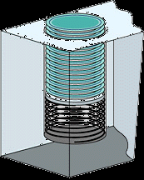
Stacks
A stack is a data structure in which the last value you add to the stack is the first one you use from it, as with a stack of plates in a cafeteria
Last In, First Out (LIFO)
Stacks have many uses in
programming, but the one that
concerns us here is that this is how
the JVM keeps track of method calls.
You will learn how to
implement stacks in CS203.

Slide 134



animation
Trace Call Stack
i is declared and initialized

Slide 135
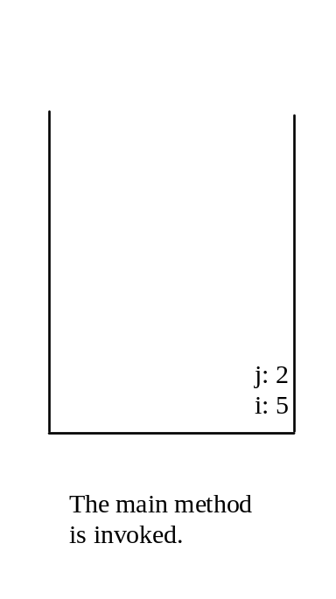
animation
Trace Call Stack
j is declared and initialized

Slide 136

animation
Trace Call Stack
Declare k

Slide 137
animation
Trace Call Stack
Invoke max(i, j)

Slide 138

animation
Trace Call Stack
pass the values of i and j to num1 and num2

Slide 139

animation
Trace Call Stack
pass the values of i and j to num1 and num2

Slide 140
animation
Trace Call Stack
(num1 > num2) is true

Slide 141

animation
Trace Call Stack
Assign num1 to result

Slide 142

animation
Trace Call Stack
Return result and assign it to k

Slide 143

animation
Trace Call Stack
Execute print statement

Slide 144
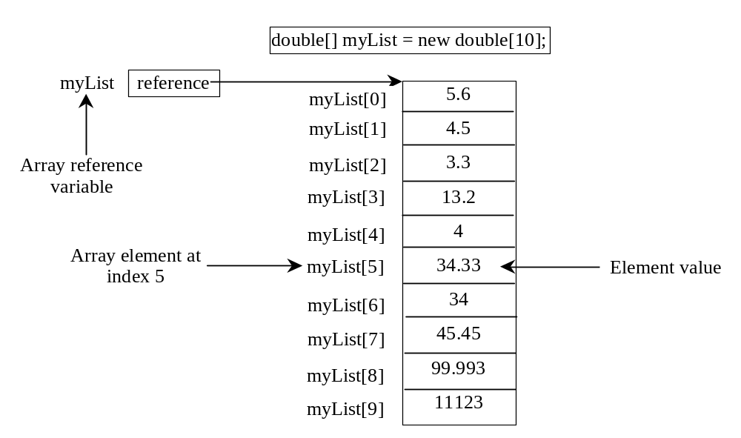
Arrays
An array is a data structure that represents a collection of items with the same data type

Slide 145
Array Indices
The array elements are accessed through a numeric index that is 0-based, i.e., ranges from 0 to array.length-1.
In the example in Figure 6.1, myList holds ten double values and the indices are from 0 to 9.
Each element in the array is represented using the following syntax, known as an indexed variable:
  arrayVar[index]
The indices are also called subscripts by analogy to subscripts used in math, even though we don't really write them that way.
Don't try to use an element at arrayVar[length]. That's one element past the end of the array!

Slide 146
Using Indexed Variables
After an array is created, an indexed variable can be used in the same way as a regular variable. For example, the following code adds the value in myList[0] and myList[1] to myList[2].
  myList[2] = myList[0] + myList[1];

Slide 147
Declaring Array Variables
datatype[] arrayRefVar;
Example:
double[] myList;
datatype arrayRefVar[]; // This style is allowed, but not preferred
Example:
double myList[];

Slide 148
Creating Arrays
arrayRefVar = new datatype[arraySize];
Example:
myList = new double[10];

Slide 149
Declaring and Creating
in One Step
datatype[] arrayRefVar = new
datatype[arraySize];
double[] myList = new double[10];
datatype arrayRefVar[] = new
datatype[arraySize];
double myList[] = new double[10];

Slide 150
The Length of an Array
Once an array is created, its size is fixed. It cannot be changed. You can find its size using
    arrayRefVar.length
For example,
    System.out.println(myArray.length);

Slide 151
Array Initializers
Declaring, creating, initializing in one step:
double[] myList = {1.9, 2.9, 3.4, 3.5};
This shorthand syntax must be in one statement.
This won’t work:
double[] myList;
myList = {1.9, 2.9, 3.4, 3.5};

Slide 152
Iterating Through Arrays
“Iterate”: to perform an action on each item in a set or on the results of each such prior action
Many array algorithms involve dealing with each item in the array one at a time. This is called iterating through the array.

Slide 153
Initializing arrays with input values
java.util.Scanner input = new java.util.Scanner(System.in);
System.out.print("Enter " + myList.length + " values: ");
for (int i = 0; i < myList.length; i++)
myList[i] = input.nextDouble();
Notes:
For each syntax: for(int i: myArray) System.out.println(i);

Slide 154
Printing arrays
for (int i = 0; i < myList.length; i++) {
System.out.print(myList[i] + " ");
}

Slide 155
Summing all elements
double total = 0;
for (int i = 0; i < myList.length; i++) {
total += myList[i];
}

Slide 156
Finding the largest element in an array
double max = myList[0];
for (int i = 1; i < myList.length; i++) {
if (myList[i] > max) max = myList[i];
}

Slide 157
Enhanced for Loop (for-each loop)
A “for-each” loop enables you to traverse the complete array sequentially without using an index variable. The general syntax is
for (elementType value: arrayRefVar) {
// Process the value
}
For example,
public static void main(String[] args) {
int[] myArray = { 1, 2, 3, 4, 5 };
for (int i : myArray)
System.out.println(i);
}
The term “for-each” originates in other programming languages in which this type of loop uses syntax like this: for each x in myArray...
You still have to use an index variable if you wish to traverse the array in a different order or change the elements in the array.

Slide 158
Pass Reference by Value
Java uses pass by value to pass arguments to a method; it passes a copy of the value. This is more complicated than it sounds.
If the value is a primitive data type (like int or double) the value of the variable itself is passed. Changing the value of the local parameter inside the method does not affect the value of the variable outside the method.
If the value is an object (such as a String or an array), the value passed is a reference to the memory location where an the object is stored. The new method thus knows where to find the original object.
  This saves memory because it is not necessary to copy all the data in the object
  Any changes to the object that occur inside the method body will affect the original object. This is sensibly called “passing by reference” in other languages, but in Java it is confusingly called “passing a reference by value”

Slide 159
Pass Reference by Value
In some other programming languages, you can choose whether to pass a parameter by value or by reference.
In Java, you do not get a choice. You must remember that primitive types are passed by value and objects are passed using “pass reference by value.”

Slide 160
Simple Example
public class Test {
public static void main(String[] args) {
int x = 1; // x represents an int value
int[] y = new int[10]; // y represents an array of int values
m(x, y); // Invoke m with arguments x and y
System.out.println("x is " + x);
System.out.println("y[0] is " + y[0]);
}
public static void m(int number, int[] numbers) {
number = 1001; // Assign a new value to number
numbers[0] = 5555; // Assign a new value to numbers[0]
}
}

Slide 161
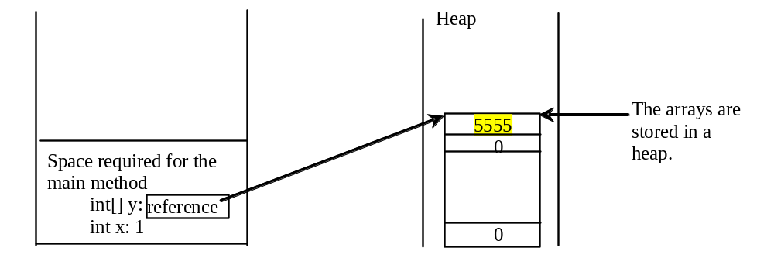
Heap
The JVM stores the array in an area of memory, called heap, which is used for dynamic memory allocation where blocks of memory are allocated and freed in an arbitrary order.
Notes:
MyClass.java
Javac MyClass.java
MyClass.class
Java MyClass

Slide 162
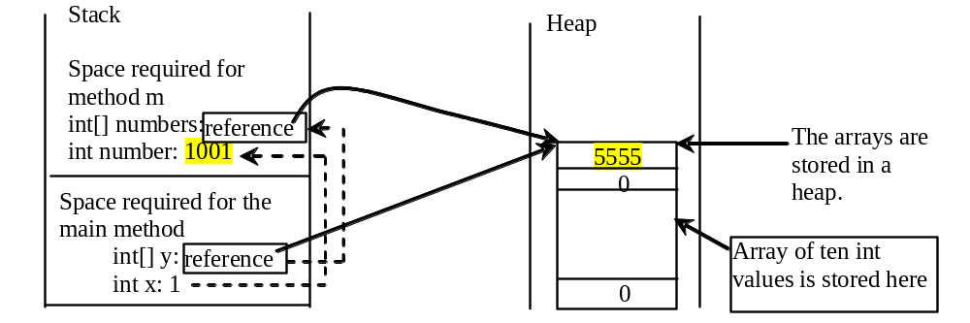
Call Stack
When invoking m(x, y), the values of x and y are passed to number and numbers. Since y contains the reference value to the array, numbers now contains the same reference value to the same array.

Slide 163
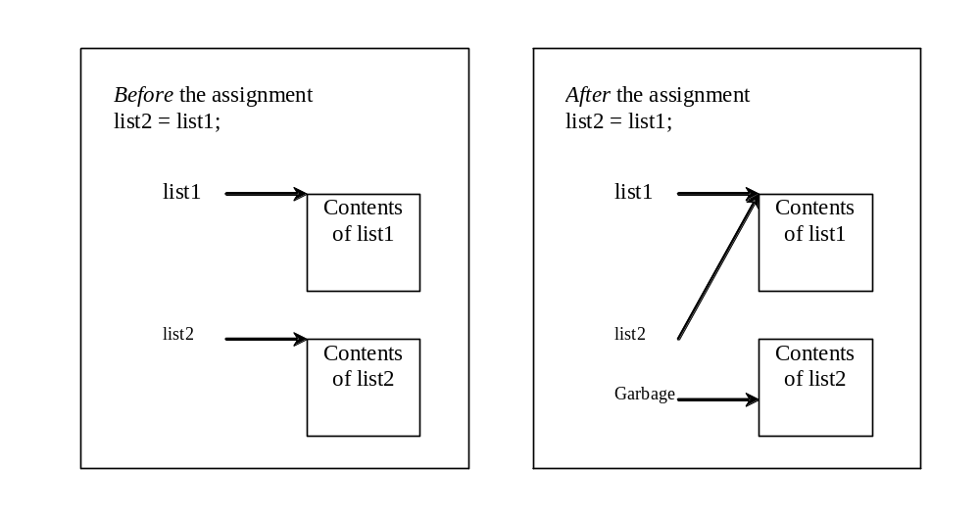
Copying Arrays
Often, in a program, you need to duplicate an array or a part of an array. In such cases you could attempt to use the assignment statement (=), as follows:
list2 = list1;
What happens when you change list1?

Slide 164
Copying Arrays
If you really need a new array will the same values, you must copy each value, typically using a loop:
int[] sourceArray = {2, 3, 1, 5, 10};
int[] targetArray = new int[sourceArray.length];
for (int i = 0; i < sourceArray.length; i++)
targetArray[i] = sourceArray[i];

Slide 165
The arraycopy Utility
arraycopy(sourceArray, src_pos, targetArray, tar_pos, length);
Example:
System.arraycopy(sourceArray, 0, targetArray, 0, sourceArray.length);

Slide 166
Copying Arrays: Caution!
public class ArrayCopyDemo{
public static void main(String[] args){
int[] numbers = {1,2,3,4,5,6,7,8,9,10};
System.out.println("\nNumbers:");
for(int n: numbers) System.out.println(n);
int[] numbers2 = numbers;
System.out.println("\nNumbers2:");
for(int n: numbers2) System.out.println(n);
int[] numbers3 = new int[10];
System.arraycopy(numbers, 0, numbers3, 0, numbers.length);
numbers[0] = 500;
System.out.println("\nNumbers after resetting [0]:");
for(int n: numbers) System.out.println(n);
System.out.println("\nNumbers2 after resetting numbers[0]:");
for(int n: numbers2) System.out.println(n);
System.out.println("\nNumbers3 after resetting numbers[0]:");
for(int n: numbers3) System.out.println(n);
}
}

Slide 167
Anonymous Arrays
public static void printArray(int[] array) {
for (int i = 0; i < array.length; i++) {
System.out.print(array[i] + " ");
}
}
Invoke the method
int[] list = {3, 1, 2, 6, 4, 2};
printArray(list);
Invoke the method
printArray(new int[]{3, 1, 2, 6, 4, 2});
Anonymous array

Slide 168
Anonymous Array
  The statement
    printArray(new int[]{3, 1, 2, 6, 4, 2});
  creates an array using the following syntax:
    new dataType[]{literal0, literal1, ..., literalk};
  There is no explicit reference variable for the array. Such array is called an anonymous array.

Slide 169
Returning an Array From A Method
A method can return a reference to an array.
Syntax for this looks much like the syntax for returning a single value:
    return myArray;

Slide 170
Returning an Array From A Method
public class ArrayReturn{
public static void main(String[] args){
int arraySize = 10;
int[] intArray = getIntArray(arraySize);
printArray(intArray);
}
public static int[] getIntArray(int size){
int[] retArray = new int[size];
for(int counter = 1; counter <= size; counter++){
retArray[counter-1]=counter;
}
return retArray;
}
public static void printArray(int[] arrayToPrint){
for(int i = 0; i < arrayToPrint.length; i++)
System.out.println("array[" + i + "] contains value " + arrayToPrint[i]);
}
}

Slide 171
Command Line Parameters
public class CommandLineParameters{
public static void main(String[] args){
for(String s: args) System.out.println(s);
}
}
Main() can get parameters from the command line
String[] args is an array of Strings, which can be populated from the command line
For(String s: args) iterates through all the Strings in the array
Try the code above by running
  java CommandLineParameters Godzilla is hungry

Slide 172
Two Dimensional Arrays
Java supports arrays of any number of dimensions
Just add an extra set of brackets and count:
int[][] twoD = new int[5][5];
Subscripts are treated as follows: first subscript is the # of rows, second is the # of columns
As with one-dimensional arrays, you will usually work with 2D arrays using loops; in this case the loops will be nested.
Always work with one row at a time, dealing with all the columns in the first row, then all the columns in the second row, etc. *Never* deal with a column one row at a time. You will learn the reason for this in CS440.

Slide 173
Two Dimensional Arrays
public class TwoDArrayDemo{
public static void main(String[] args){
int rows = 6;
int columns = 11;
int[][] twoD = new int[rows][columns];
for(int x = 0; x < twoD.length; x++){
for(int y = 0; y < twoD[x].length; y++){
twoD[x][y] = x * y;
}
}
for(int x = 0; x < twoD.length; x++){
System.out.println("\n");
for(int y = 0; y < twoD[x].length; y++){
System.out.print("\t" + twoD[x][y]);
}
}
}
}

Slide 174
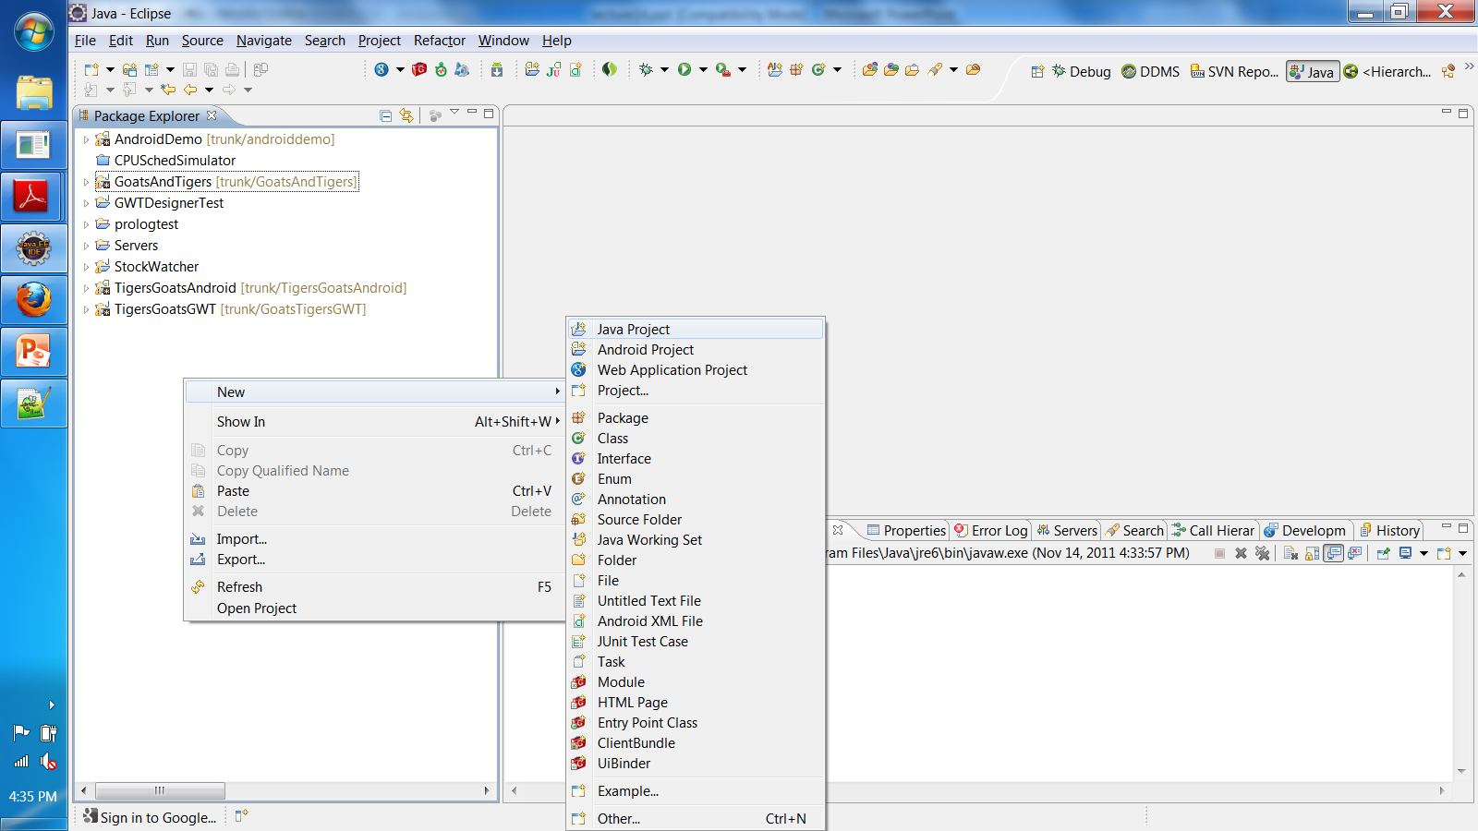
Eclipse: Create a Project

Slide 175
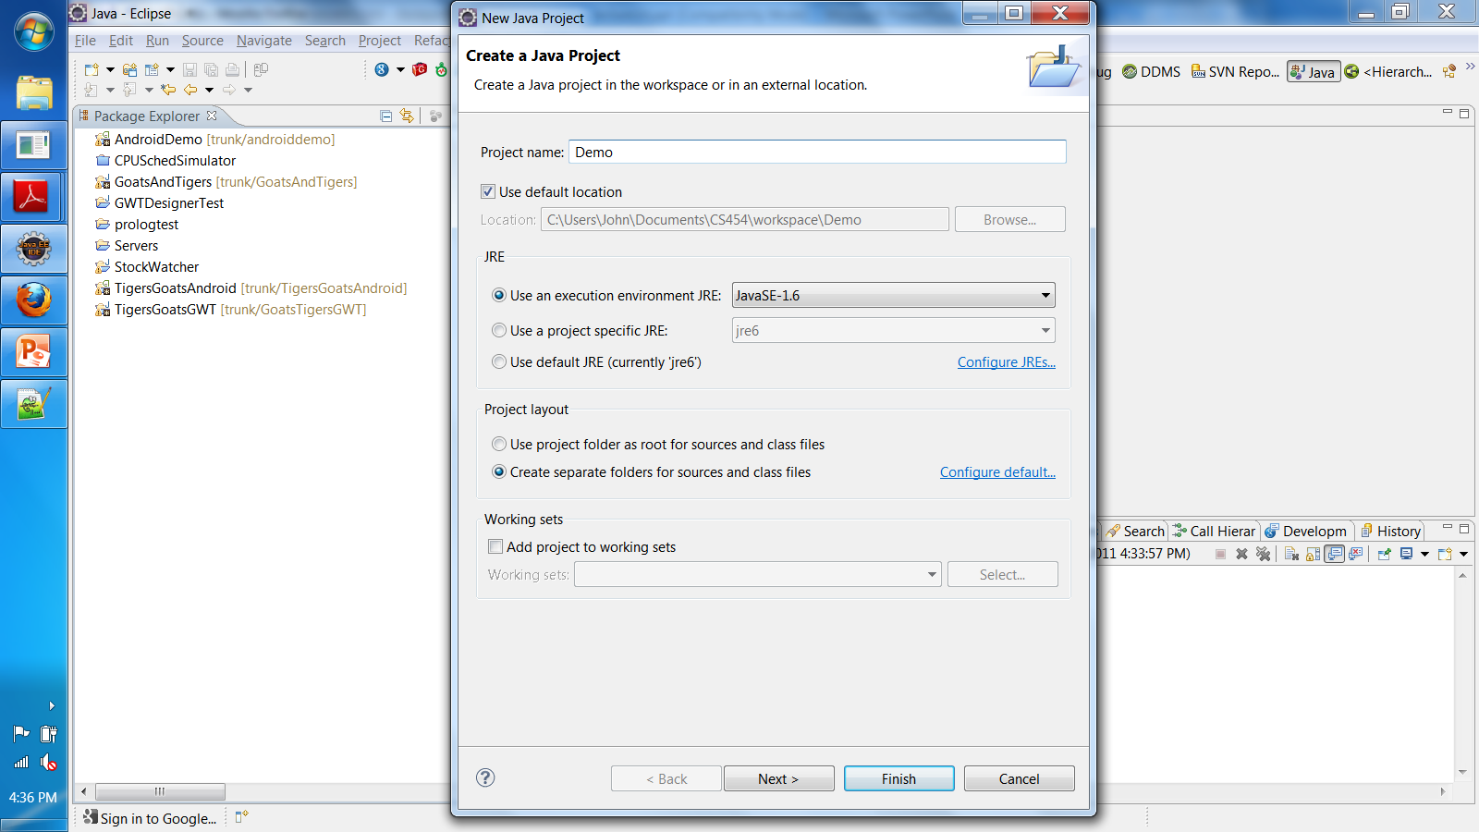

Slide 176
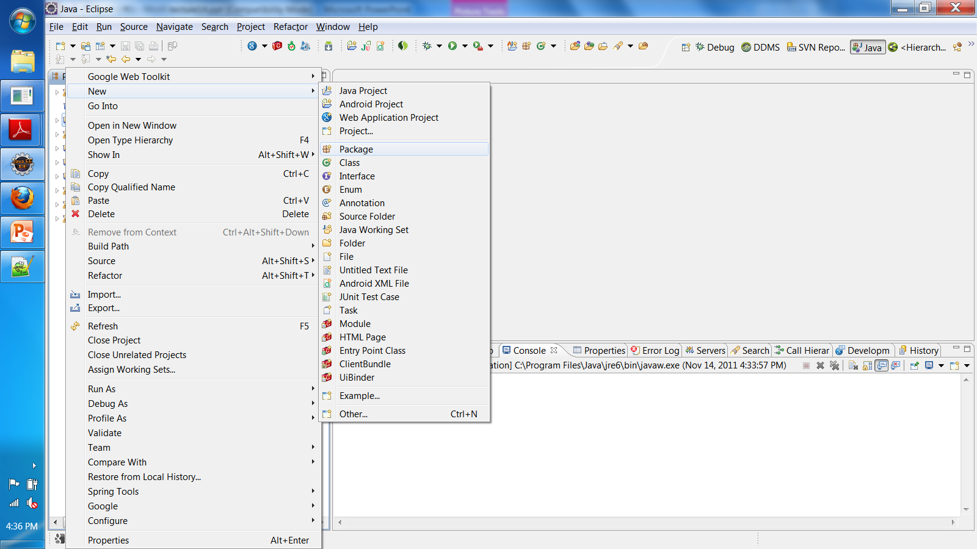
Add a Code Package

Slide 177
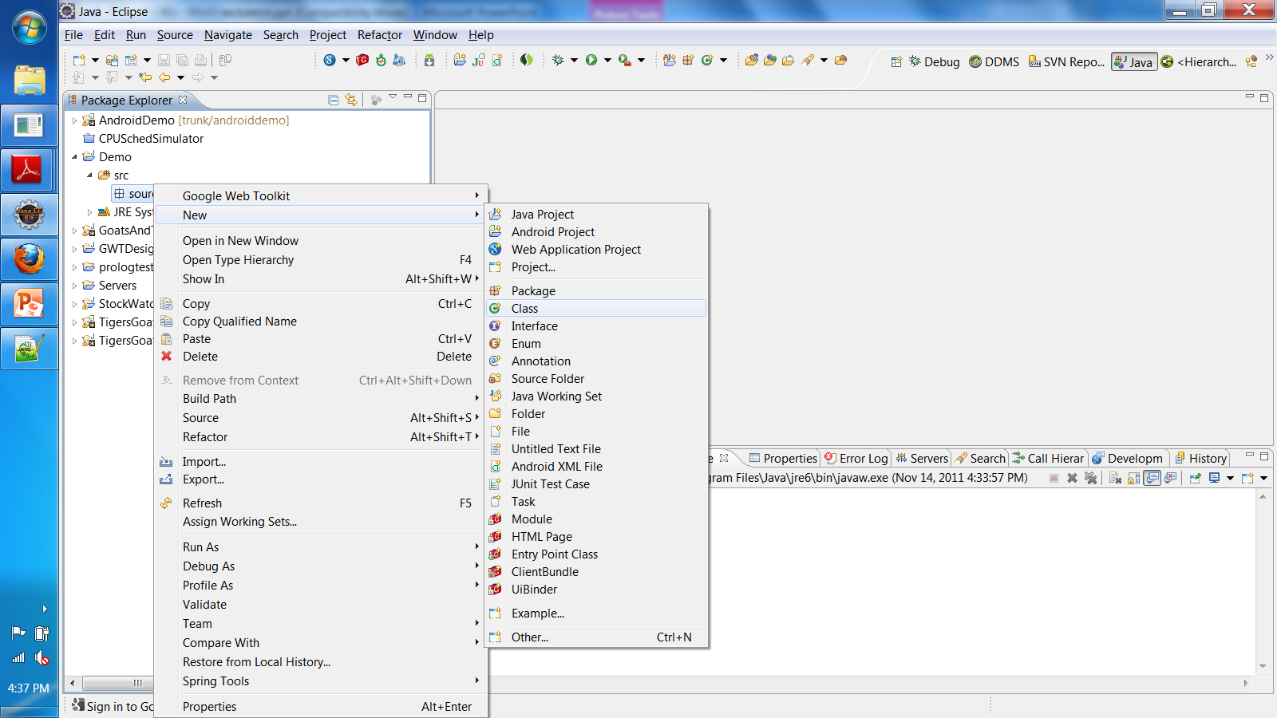
Add a class

Slide 178
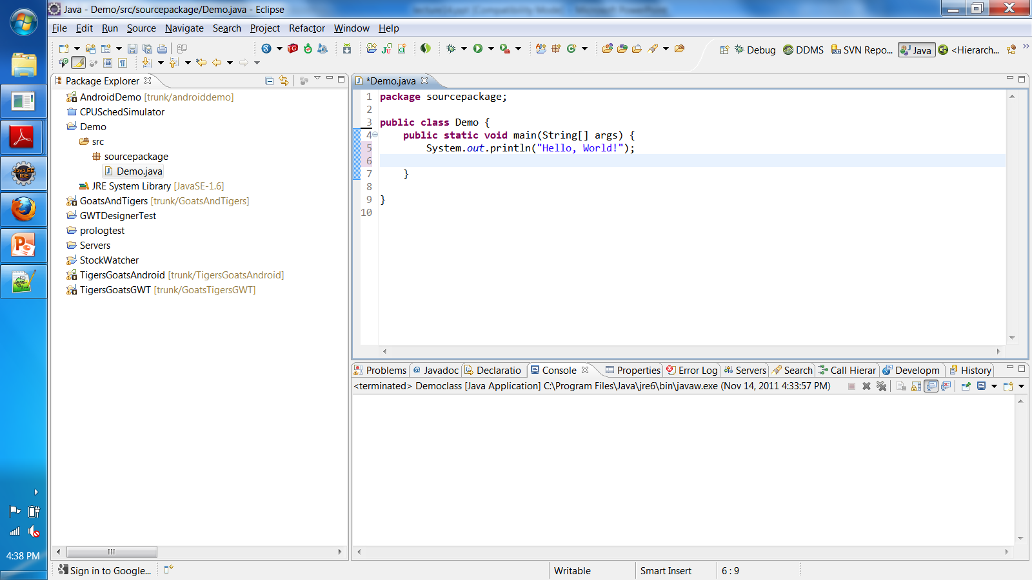
Write code in the class

Slide 179
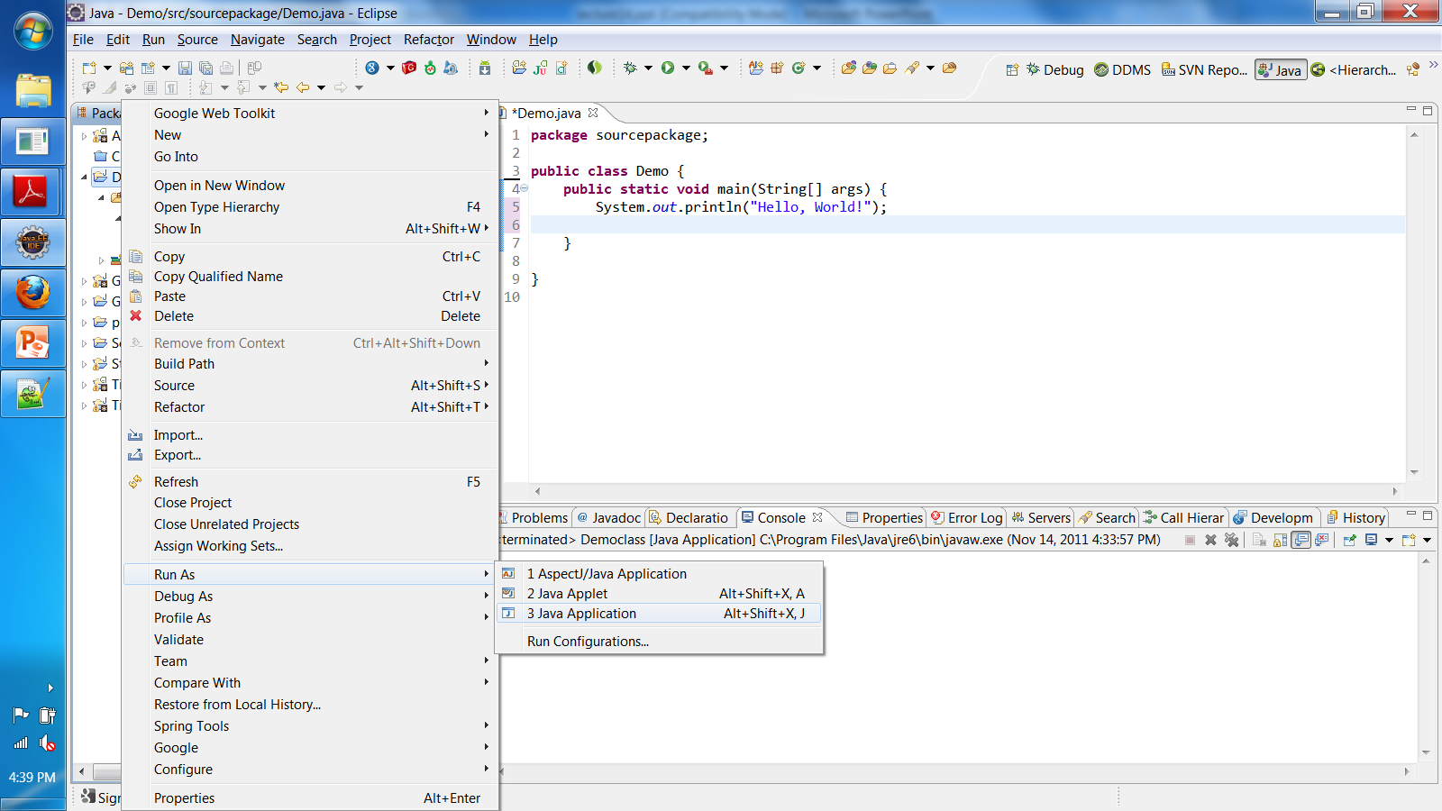
Run the project
At least one class must have a main()!

Slide 180
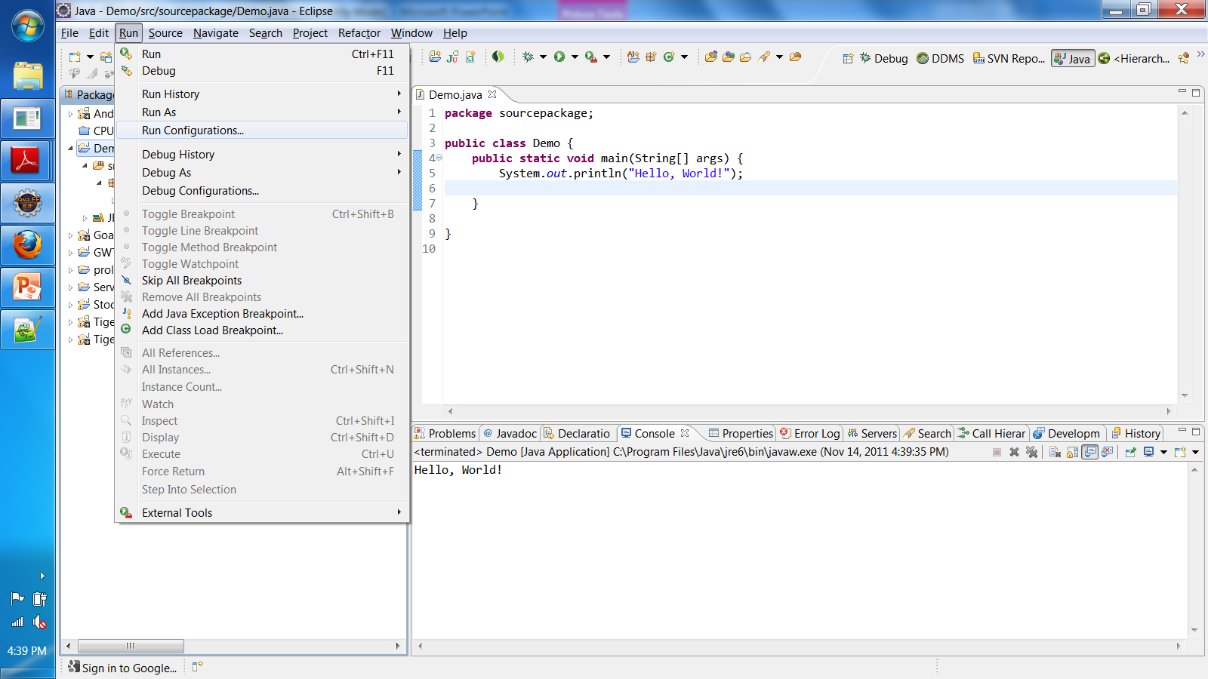

Slide 181
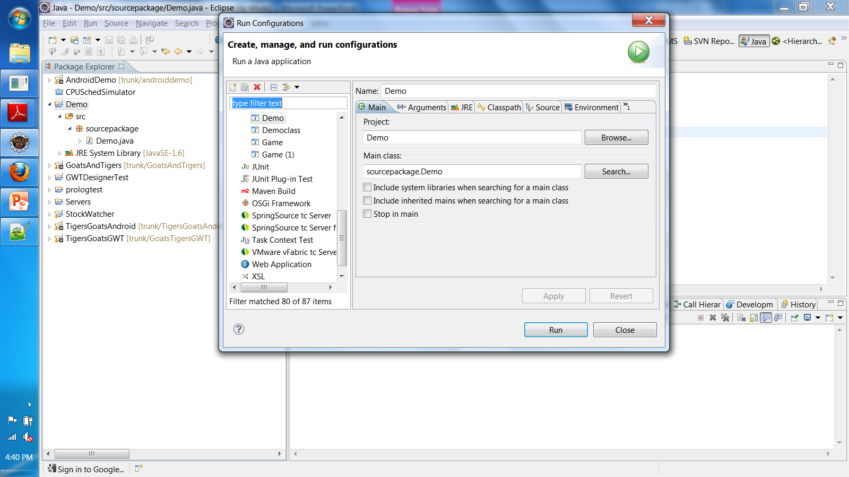
“Run Configurations” is critical

Slide 182
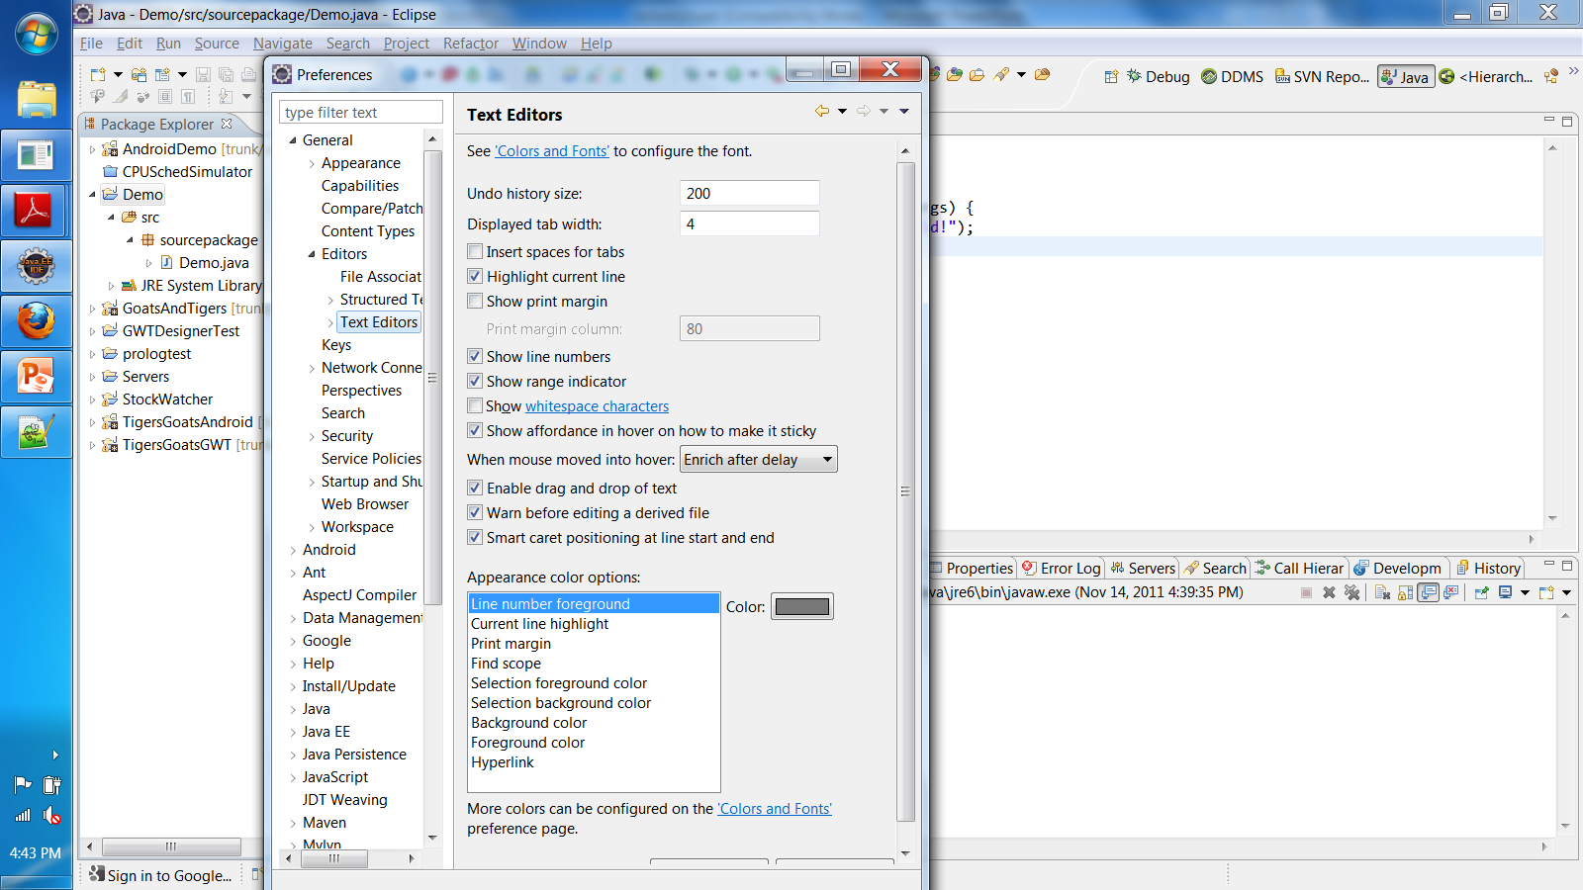
“Window/Preferences” contains many settings

