Slide 1
Lecture 4
StringBuilder
Constructors
File I/O
CS202
Fall 2013
John Hurley

Slide 2
StringBuilder
The StringBuilder class is a supplement, not an alternative, to the String class.
StringBuilder is more flexible than String. You can add, insert, or append new contents into a string buffer. StringBuilders are *not* immutable or interned.

Slide 3
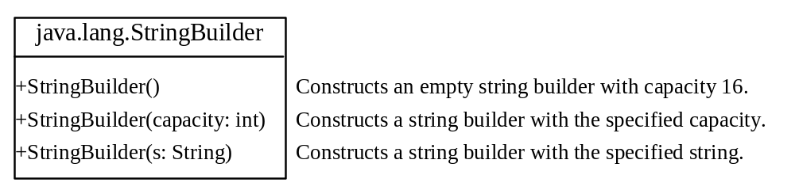
StringBuilder Constructors

Slide 4

Modifying Strings in the Builder

Slide 5

The toString, capacity, length, setLength, and charAt Methods

Slide 6
StringBuilder
public class StringBuilderDemo{
public static void main(String[] Args){
StringBuilder sb = new StringBuilder("Bakey");
System.out.println(sb);
sb.insert(4, "ry");
System.out.println(sb);
sb.deleteCharAt(5);
System.out.println(sb);
// this will not do what you expect!
sb.append(" " + sb.reverse());
System.out.println(sb);
sb.delete(sb.indexOf(" "), sb.length());
System.out.println(sb);
StringBuilder sb2 = new StringBuilder(sb);
sb.deleteCharAt(5);
sb2.reverse();
sb.append(sb2);
System.out.println(sb);
sb.insert(5," ");
System.out.println(sb);
sb.replace(0,0,"Y");
System.out.println(sb);
sb.deleteCharAt(1);
System.out.println(sb);
sb.reverse();
System.out.println(sb);
}
}

Slide 7
Constructors
Constructors are methods that populate data fields or do other work when an object is created
Every class has a default constructor that takes no parameters and doesn’t do anything
You can also write your own constructors
Method header looks like this:
public ClassName(parameters){}
A class may have more than one constructor (“constructor overloading”) as long as they take different arguments
By convention, if programmer-defined constructors are present, they are the first methods listed in a class.

Slide 8
Constructors
package demos;
public class Course {
private int courseNum;
private String instructorName;
public Course(int courseNum, String instructorName){
this.courseNum = courseNum;
this.instructorName = instructorName;
}
public int getCourseNum() {
return courseNum;
}
public void setCourseNum(int courseNum) {
this.courseNum = courseNum;
}
public String getInstructorName() {
return instructorName;
}
public void setInstructorName(String instructorName) {
this.instructorName = instructorName;
}
public String toString(){
return courseNum + "; Instructor: " + instructorName;
}
}

Slide 9
Constructors
package demos;
import java.util.ArrayList;
import java.util.List;
public class Department {
private String deptName;
private List<Course> courses;
public Department(String deptName){
courses = new ArrayList<Course>();
this.deptName = deptName;
}
public String getDeptName() {
return deptName;
}
public void setDeptName(String deptName) {
this.deptName = deptName;
}
public List<Course> getCourses() {
return courses;
}
public void addCourse(Course course) {
courses.add(course);
}
public void dropCourse(Course course) {
courses.remove(course);
}
public String toString(){
return deptName;
}
}

Slide 10
Constructors
package demos;
import java.util.ArrayList;
import java.util.List;
import javax.swing.JOptionPane;
public class CollegeDriver {
private static List<Department> departments = new ArrayList<Department>();
public static void main(String[] args) {
departments = new ArrayList<Department>();
String[] choices = { "Quit", "List Courses For A Department",
"Add A Course", "Add A Department" };
int choice;
do {
choice = JOptionPane.showOptionDialog(null, "Main Menu",
"Main Menu", 0, JOptionPane.QUESTION_MESSAGE, null,
choices, "null");
switch (choice) {
case 0:
break;
case 1:
if (!(departments.isEmpty()))
listDeptClasses();
break;
case 2:
if (!(departments.isEmpty()))
addCourse();
break;
case 3:
addDept();
break;
} // end switch
} while (choice != 0); // end do
}// end main

Slide 11
Constructors
private static Department getDeptNameFromInput() {
int choice = JOptionPane.showOptionDialog(null, "Choose A Department",
"Choose A Department", 0, JOptionPane.QUESTION_MESSAGE, null,
departments.toArray(), "null"); // the choices must be an array
return departments.get(choice);
}
private static void listDeptClasses() {
Department dept = getDeptNameFromInput();
if (departments.contains(dept)) {
List<Course> deptCourses = dept.getCourses();
StringBuilder sb = new StringBuilder(dept.getDeptName()
+ " offers the following courses:\n ");
if (deptCourses.isEmpty())
sb.append("None");
else
for (Course c : deptCourses)
sb.append(c + "\n"); // note that this will use the toString() method of Course
JOptionPane.showMessageDialog(null, sb);
} // end if
}
private static void addCourse() {
Department dept = getDeptNameFromInput();
if (departments.contains(dept)) {
int courseNum = Integer.parseInt(JOptionPane
.showInputDialog("Please enter the course number"));
String instructorName = JOptionPane
.showInputDialog("Please enter the name of the instructor in the new course");
dept.addCourse(new Course(courseNum, instructorName));
}// end if
}
private static void addDept() {
String deptName = JOptionPane
.showInputDialog("Please enter the name of the new department");
departments.add(new Department(deptName));
}
}

Slide 12
File I/O
Databases are the most efficient way to store large amounts of structured data, and accordingly, most live applications use databases for permanent data storage
In this case, though, we are mostly interested in the exceptions to this rule:
Applications whose purpose is to generate specially-formatted documents, like word processors and spreadsheets
Data that must be exchanged easily among many users who don’t have access to the same DB, e.g. info publicly available on the internet

Slide 13
The File Class
The File class provides an abstraction that deals with most of the machine-dependent complexities of files and path names in a machine-independent fashion.
  The filename is a string.
  The File class is a wrapper class for the file name and its directory path.

Slide 14
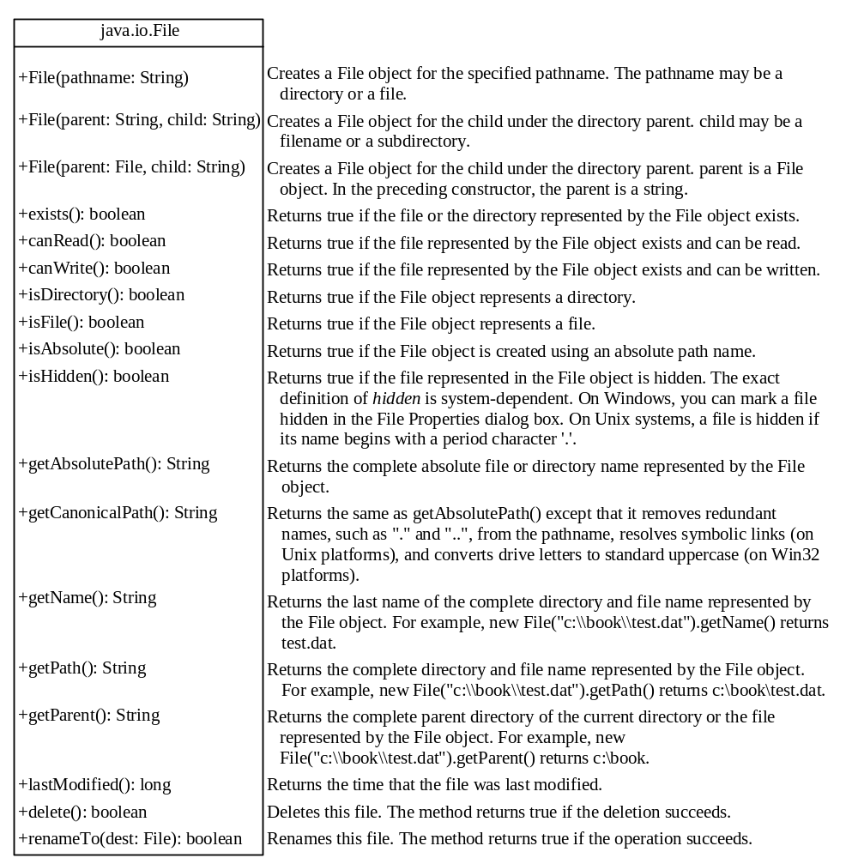
Obtaining file properties and manipulating files

Slide 15
File I/O
Two types of files used for I/O
Binary Files: to be covered in CS202
Text Files
  Data can be read from text files that are rigorously structured. Two common cases:
    XML (various forms of eXtensible Markup Language)
    CSV (Comma-Separated Values)

Slide 16
File I/O
Data is stored as text, but we need objects and/or primitive data types
Read in strings
Parse to the data types you need
Use logic to translate the parsed date into the parse that you need

Slide 17
XML Text File I/O
<bookcase>
  <shelf>
  <box>
  <item type="pencil" color="blue"/>
  <item type="pencil" color="red"/>
  <item type="pen" color="white"/>
      </box>
</shelf>
<shelf>
<book title = "System Programming With C and UNIX" author ="Hoover" />
</shelf>
</bookcase>

Slide 18
CSV Text File I/O
Date,Open,High,Low,Close,Volume,Adj Close
5/27/2011,1325.69,1334.62,1325.69,1331.1,3124560000,1331.1
5/26/2011,1320.64,1328.51,1314.41,1325.69,3259470000,1325.69
5/25/2011,1316.36,1325.86,1311.8,1320.47,4109670000,1320.47
5/24/2011,1317.7,1323.72,1313.87,1316.28,3846250000,1316.28
5/23/2011,1333.07,1333.07,1312.88,1317.37,3255580000,1317.37
5/20/2011,1342,1342,1330.67,1333.27,4066020000,1333.27

Slide 19
Text File I/O
Data is stored as text, but we need objects and/or primitive data types
Read in strings
Parse to the data types you need
Use logic to translate the parsed data to the data fields you need
    Labor-intensive and error prone, yet necessary where data must be widely available for different applications

Slide 20
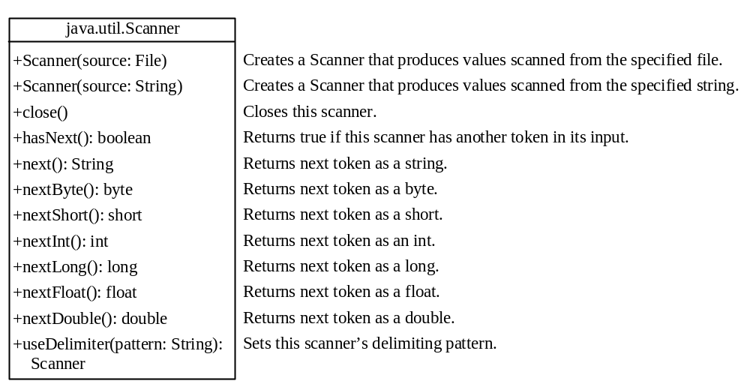
Reading Data Using Scanner

Slide 21

Writing Data Using PrintWriter

Slide 22
Writing Data Using PrintWriter
Get fields called CIN and grade from an object I and write them to a csv file using a PrintWriter
for (Student s: students){
writer.println(s.getCIN() + "," + s.getGrade());
}

Slide 23
BufferedWriter
A type of PrintWriter that writes data in chunks, rather than one character at a time
This uses system resources more efficiently

Slide 24
Exceptions
An exception is an event that occurs during the execution of a program and disrupts the normal flow of instructions.
Some operations are known to be error prone, so we use error-handling code to make programs more robust.
One way to do this is with try…catch syntax
Some operations, such as many file operations, are defined in Java to require exception handling code
Notes:
Reading from files is likely to cause errors

Slide 25
Throws/Catch
Declaring an exception type with the throws keyword in a method header throws the exception to the calling method, where it must be caught
You can also set custom circumstances for an exception using throw(), usually in an if block:
throw new NullPointerException( "This will be caught below" );

Slide 26
File Copy
import java.io.*;
import java.util.*;
public class CopyTextFile {
public static void main(String args[]) {
//... Get two file names from use.
System.out.println("Enter a filepath to copy from, and one to copy to.");
Scanner in = new Scanner(System.in);
//... Create File objects.
File inFile = new File(in.next()); // File to read from.
File outFile = new File(in.next()); // File to write to
//... Enclose in try..catch because of possible io exceptions.
try {
copyFile(inFile, outFile);
} catch (IOException e) {
System.err.println(e);
System.exit(1);
}
}
public static void copyFile(File fromFile, File toFile) throws IOException {
Scanner freader = new Scanner(fromFile);
BufferedWriter writer = new BufferedWriter(new FileWriter(toFile));
//... Loop as long as there are input lines.
String line = null;
while (freader.hasNextLine()) {
line = freader.nextLine();
writer.write(line);
writer.newLine();
}
//... Close reader and writer.
freader.close();
writer.close();
}
}

Slide 27
Parsing
Parse
Definitions From Wiktionary:
1. (linguistics) To resolve into its elements, as a sentence, pointing out the several parts of speech, and their relation to each other by government or agreement; to analyze and describe grammatically.
2. (computing) To split a file or other input into pieces of data that can be easily stored or manipulated.
Parsing input is a common problem in programming. In Object-Oriented Programming, parsing usually involves converting input into individual values which are then used to supply data for variables in objects.
This is the first way we will use file storage in our programs.

Slide 28
Parse a CSV file
  Consider this data, stored in a file in comma separated values format:
    Problem: write code that parses this data into an array of students, lists each student’s grade, finds the average grade, and prints it out.
    Note that each line of this file corresponds to a different human being, and that the two pieces of data we have about each person are separated by commas.
    Student,Grade
    Al,82
    Brian,98
    Carl,96
    Dennis,85
    Mike,62

Slide 29
Parse a CSV file
    public class Lect16Student{
    String name;
    double grade;
    public Lect16Student(String nameIn, double gradeIn){
    name = nameIn;
    grade = gradeIn;
    }
    public String getName(){
    return name;
    }
    public double getGrade(){
    return grade;
    }
    public String toString(){
    return(name + " recieved grade: " + grade);
    }
    }

Slide 30
Parse a CSV file
    import java.io.*;
    import java.util.*;
    public class CSVParse {
    Lect16Student[] students;
    int numRecords = 5;
    public static void main(String args[]) {
    CSVParse parser = new CSVParse();
    try{
    parser.readFile();
    }
    catch (Exception e){e.printStackTrace();}
    parser.showGrades();
    }
    public void showGrades(){
    for(Lect16Student s: students){
    System.out.println(s.toString());
    }
    showAverage();
    }
    public void showAverage(){
    double total = 0;
    for(Lect16Student stu: students) total+= stu.getGrade();
    System.out.println("Class Average: " + total / students.length);
    }

Slide 31
Parse a CSV file
    public void readFile() throws IOException {
    students = new Lect16Student[numRecords];
    try {
    System.out.println("Enter a filepath to read from ");
    Scanner in = new Scanner(System.in);
    File inFile = new File(in.next()); // File to read from.
    Scanner freader = new Scanner(inFile);
    freader.nextLine(); // skip the header
    // this would crash if the length of the array did not match the number of lines in the file.
    // next term you will learn to use lists, which are much more robust
    for(int counter =0; counter < students.length; counter++) {
    String line = freader.nextLine();
    String[] fields = line.split(",");
    String name = fields[0];
    double grade = Double.parseDouble(fields[1]);
    students[counter] = new Lect16Student(name, grade);
    }
    freader.close(); // Close to unlock.
    } catch (IOException e) {
    System.err.println(e);
    System.exit(1);
    }
    }
    }

Slide 32
Parse a CSV file
  This technique is not very robust, and it requires tedious coding to write and maintain
  Solutions:
  Use a third party parser
  2) Binary File I/O
    Java has built in methods to save entire objects to file and read them back into your application when needed
    Structure of object is maintained
    No need to do any parsing or mapping of data fields
    Probably not taught until CS 203, but very handy. It is worth reading about in the book

