Slide 1
Lecture 5
CS 202
Fall 2013

Slide 2
More on Static Methods and Data
Static data fields are controlled by the class, not the object.
Static fields will be the same for all instances of a class at any point during runtime

Slide 3
More on Static Methods and Data
public class Borg{
private String name;
private static int borgCount;
public Borg(String nameIn){
name = nameIn;
borgCount += 1;
}
public void stateName(){
System.out.println(name + " of " + borgCount);
}
public static void main(String[] args){
int max = 9;
borgCount = 0;
Borg[] borgs = new Borg[max];
for(int counter = 0; counter < max; counter++){
String name = String.valueOf(counter);
borgs[counter] = new Borg(name);
}
for(int counter = 0; counter < max; counter++){
borgs[counter].stateName();
}
}
}
Notes:
Don’t need a “borg” object to run

Slide 4
StringBuilder
The StringBuilder class is a supplement, not an alternative, to the String class.
StringBuilder is more flexible than String. You can add, insert, or append new contents into a string buffer. StringBuilders are *not* immutable or interned.

Slide 5
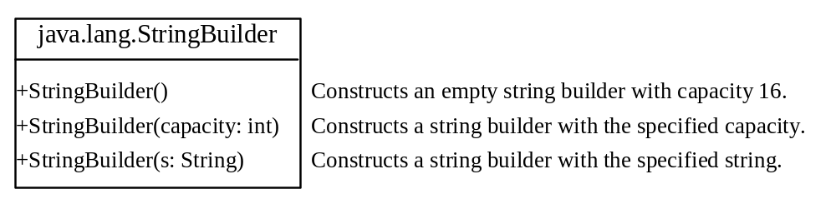
StringBuilder Constructors

Slide 6

Modifying Strings in the Builder

Slide 7

The toString, capacity, length, setLength, and charAt Methods

Slide 8
StringBuilder
public class StringBuilderDemo{
public static void main(String[] Args){
StringBuilder sb = new StringBuilder("Bakey");
System.out.println(sb);
sb.insert(4, "ry");
System.out.println(sb);
sb.deleteCharAt(5);
System.out.println(sb);
// this will not do what you expect!
sb.append(" " + sb.reverse());
System.out.println(sb);
sb.delete(sb.indexOf(" "), sb.length());
System.out.println(sb);
StringBuilder sb2 = new StringBuilder(sb);
sb.deleteCharAt(5);
sb2.reverse();
sb.append(sb2);
System.out.println(sb);
sb.insert(5," ");
System.out.println(sb);
sb.replace(0,0,"Y");
System.out.println(sb);
sb.deleteCharAt(1);
System.out.println(sb);
sb.reverse();
System.out.println(sb);
}
}

Slide 9
Constructors
Constructors are methods that populate data fields or do other work when an object is created
Every class has a default constructor that takes no parameters and doesn’t do anything but create an object
You can also write your own constructors
Method header looks like this:
public ClassName(parameters){}
A class may have more than one constructor (“constructor overloading”) as long as they take different arguments
By convention, if programmer-defined constructors are present, they are the first methods listed in a class.

Slide 10
Constructors
package demos;
public class Course {
private int courseNum;
private String instructorName;
public Course(int courseNum, String instructorName){
this.courseNum = courseNum;
this.instructorName = instructorName;
}
public int getCourseNum() {
return courseNum;
}
public void setCourseNum(int courseNum) {
this.courseNum = courseNum;
}
public String getInstructorName() {
return instructorName;
}
public void setInstructorName(String instructorName) {
this.instructorName = instructorName;
}
public String toString(){
return courseNum + "; Instructor: " + instructorName;
}
}

Slide 11
Constructors
package demos;
import java.util.ArrayList;
import java.util.List;
public class Department {
private String deptName;
private List<Course> courses;
public Department(String deptName){
courses = new ArrayList<Course>();
this.deptName = deptName;
}
public String getDeptName() {
return deptName;
}
public void setDeptName(String deptName) {
this.deptName = deptName;
}
public List<Course> getCourses() {
return courses;
}
public void addCourse(Course course) {
courses.add(course);
}
public void dropCourse(Course course) {
courses.remove(course);
}
public String toString(){
return deptName;
}
}

Slide 12

Constructors
package demos;
import java.util.ArrayList;
import java.util.List;
import javax.swing.JOptionPane;
public class CollegeDriver {
private static List<Department> departments = new ArrayList<Department>();
public static void main(String[] args) {
departments = new ArrayList<Department>();
String[] choices = { "Quit", "List Courses For A Department",
"Add A Course", "Add A Department" };
int choice;
do {
choice = JOptionPane.showOptionDialog(null, "Main Menu",
"Main Menu", 0, JOptionPane.QUESTION_MESSAGE, null,
choices, "null");
switch (choice) {
case 0:
break;
case 1:
if (!(departments.isEmpty()))
listDeptClasses();
break;
case 2:
if (!(departments.isEmpty()))
addCourse();
break;
case 3:
addDept();
break;
} // end switch
} while (choice != 0); // end do
}// end main

Slide 13
Constructors
private static Department getDeptNameFromInput() {
int choice = JOptionPane.showOptionDialog(null, "Choose A Department",
"Choose A Department", 0, JOptionPane.QUESTION_MESSAGE, null,
departments.toArray(), "null"); // the choices must be an array
return departments.get(choice);
}
private static void listDeptClasses() {
Department dept = getDeptNameFromInput();
if (departments.contains(dept)) {
List<Course> deptCourses = dept.getCourses();
StringBuilder sb = new StringBuilder(dept.getDeptName()
+ " offers the following courses:\n ");
if (deptCourses.isEmpty())
sb.append("None");
else
for (Course c : deptCourses)
sb.append(c + "\n"); // note that this will use the toString() method of Course
JOptionPane.showMessageDialog(null, sb);
} // end if
}
private static void addCourse() {
Department dept = getDeptNameFromInput();
if (departments.contains(dept)) {
int courseNum = Integer.parseInt(JOptionPane
.showInputDialog("Please enter the course number"));
String instructorName = JOptionPane
.showInputDialog("Please enter the name of the instructor in the new course");
dept.addCourse(new Course(courseNum, instructorName));
}// end if
}
private static void addDept() {
String deptName = JOptionPane
.showInputDialog("Please enter the name of the new department");
departments.add(new Department(deptName));
}
}

Slide 14

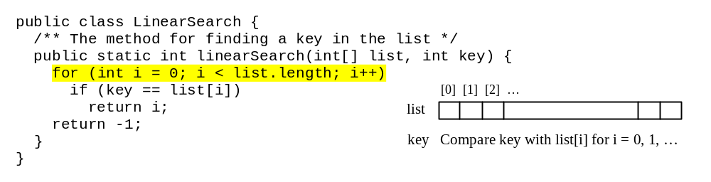
Searching Arrays and Lists
Searching is the process of looking for a specific element in an array; for example, discovering whether a certain score is included in a list of scores.
Searching is a common task in programming. There are many algorithms and data structures devoted to searching. In this section, two commonly used approaches are discussed, linear search and binary search.

Slide 15
Linear Search
The linear search approach compares the key element, key, sequentially with each element in an array or list. The method continues to do so until the key matches an element in the list or the list is exhausted without a match being found.
If a match is made, the linear search returns the index of the element that matches the key. If no match is found, the search returns -1.

Slide 16
Linear Search Animation
animation
Key
List
3
6 | 4 | 1 | 9 | 7 | 3 | 2 | 8
3
6 | 4 | 1 | 9 | 7 | 3 | 2 | 8
3
6 | 4 | 1 | 9 | 7 | 3 | 2 | 8
3
6 | 4 | 1 | 9 | 7 | 3 | 2 | 8
3
6 | 4 | 1 | 9 | 7 | 3 | 2 | 8
3
6 | 4 | 1 | 9 | 7 | 3 | 2 | 8

Slide 17
From Idea to Solution
/** The method for finding a key in the list */
public static int linearSearch(int[] list, int key) {
for (int i = 0; i < list.length; i++)
if (key == list[i])
return i;
return -1;
}
Trace the method
int[] list = {1, 4, 4, 2, 5, -3, 6, 2};
int i = linearSearch(list, 4); // returns 1
int j = linearSearch(list, -4); // returns -1
int k = linearSearch(list, -3); // returns 5

Slide 18
Binary Search
For binary search to work, the elements in the array must already be ordered. Without loss of generality, assume that the array is in ascending order.
  e.g., 2 4 7 10 11 45 50 59 60 66 69 70 79
The binary search first compares the key with the element in the middle of the array.
Notes:
Linear works fine on any array or list.
Binary doesn’t. It must already be ordered.

Slide 19
Binary Search, cont.
Consider the following three cases:
If the key is less than the middle element, you only need to search the key in the first half of the array.
If the key is equal to the middle element, the search ends with a match.
If the key is greater than the middle element, you only need to search the key in the second half of the array.

Slide 20
Binary Search
animation
Key
List
8
1 | 2 | 3 | 4 | 6 | 7 | 8 | 9
8
1 | 2 | 3 | 4 | 6 | 7 | 8 | 9
8
1 | 2 | 3 | 4 | 6 | 7 | 8 | 9

Slide 21
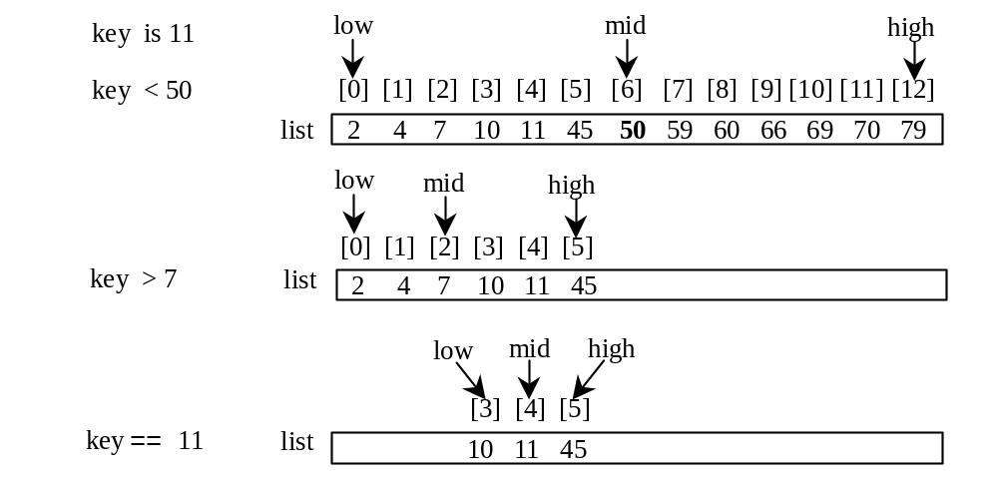
Binary Search, cont.

Slide 22
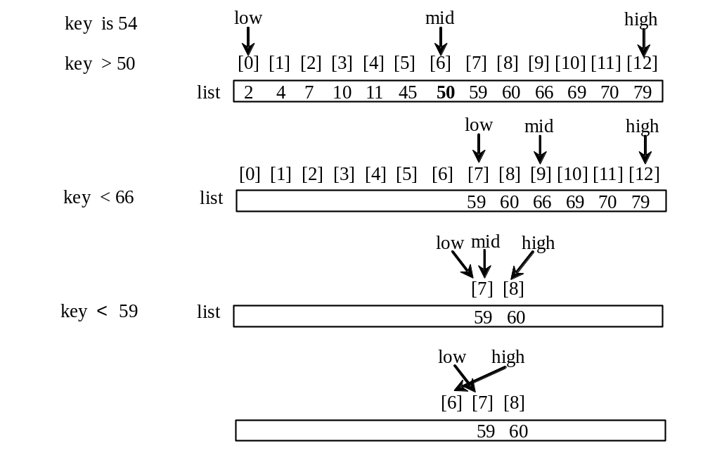
Binary Search, cont.

Slide 23
Binary Search, cont.
The binarySearch method returns the index of the element in the list that matches the search key if it is contained in the list. Otherwise, it returns
-insertion point - 1.
The insertion point is the point at which the key would be inserted into the list.

Slide 24
From Idea to Soluton
/** Use binary search to find the key in the list */
public static int binarySearch(int[] list, int key) {
int low = 0;
int high = list.length - 1;
while (high >= low) {
int mid = (low + high) / 2;
if (key < list[mid])
high = mid - 1;
else if (key == list[mid])
return mid;
else
low = mid + 1;
}
return -1 - low;
}
Notes:
Integer division in java

Slide 25
The Arrays.binarySearch Method
Since binary search is frequently used in programming, Java provides several overloaded binarySearch methods for searching a key in an array of int, double, char, short, long, and float in the java.util.Arrays class. For example, the following code searches the keys in an array of numbers and an array of characters.
  int[] list = {2, 4, 7, 10, 11, 45, 50, 59, 60, 66, 69, 70, 79};
  System.out.println("Index is " +
  java.util.Arrays.binarySearch(list, 11));
  char[] chars = {'a', 'c', 'g', 'x', 'y', 'z'};
  System.out.println("Index is " +
  java.util.Arrays.binarySearch(chars, 't'));
For the binarySearch method to work, the array must be pre-sorted in increasing order.
Return is 4
Return is –4 (insertion point is 3, so return is -3-1)

Slide 26
Sorting Arrays
Sorting, like searching, is a common task in computer programming. Many different algorithms have been developed for sorting. This section introduces two simple, intuitive sorting algorithms: bubble sort and insertion sort.

Slide 27
Bubble Sort
Bubble sort is neither the most efficient sort nor the easiest to code; we discuss it first because it is the easiest to understand
Check each adjacent pair of items and swap them if out of order; continue until you have made one complete pass through the array with no swaps.

Slide 28
Bubble Sort Pseudocode
procedure bubbleSort( A : list of sortable items )
repeat
  swapped = false
  for i = 1 to length(A) - 1 inclusive do:
  /* if this pair is out of order */
  if A[i-1] > A[i] then
  /* swap them and remember something changed */
      swap( A[i-1], A[i] )
    swapped = true
    end if
    end for
  until not swapped // until we have made one pass with no swaps
  end procedure
Notes:
Swap (int a, int y){
int z = y;
x = y;
y = z;
}

Slide 29
Insertion Sort
Insertion Sort removes elements one at a time from the input data, inserting them into the correct positions in the already-sorted list, until no input elements remain.
The resulting array after k iterations has the property that the first k + 1 entries are sorted. In each iteration the first remaining entry of the input is removed, inserted into the result at the correct position, thus extending the result:
https://www.princeton.edu/~achaney/tmve/wiki100k/docs/Insertion_sort.html

Slide 30


Insertion Sort
At each iteration,
Becomes
with each element greater than x copied to the right as it is compared against x.
https://www.princeton.edu/~achaney/tmve/wiki100k/docs/Insertion_sort.html

Slide 31
Insertion Sort
animation
int[] myList = {2, 9, 5, 4, 8, 1, 6}; // Unsorted
2 | 9 | 5 | 4 | 8 | 1 | 6
2 | 9 | 5 | 4 | 8 | 1 | 6
2 | 5 | 9 | 4 | 8 | 1 | 6
2 | 4 | 5 | 9 | 8 | 1 | 6
2 | 4 | 5 | 8 | 9 | 1 | 6
1 | 2 | 4 | 5 | 8 | 9 | 6
1 | 2 | 4 | 5 | 6 | 8 | 9

Slide 32
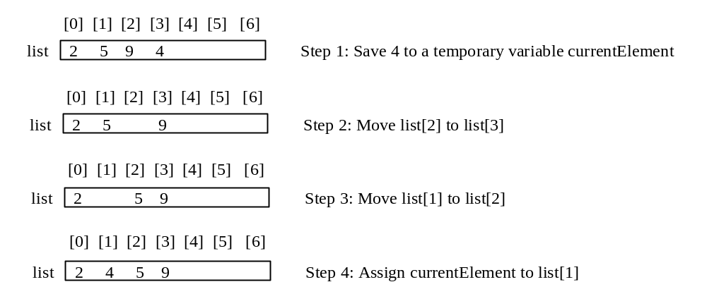
How to Insert?
The insertion sort algorithm sorts a list of values by repeatedly inserting an unsorted element into a sorted sublist until the whole list is sorted.

Slide 33
Insertion Sort Pseudocode
1. for j ←1 to length(A)-1
  2. key ← A[ j ]
  3. > A[ j ] is added in the sorted sequence A[1, .. j-1]
  4. i ← j - 1
  5. while i >= 0 and A [ i ] > key
    6. A[ i +1 ] ← A[ i ]
    7. i ← i -1
  8. A [i +1] ← key

Slide 34
The Arrays.sort Method
Since sorting is frequently used in programming, Java provides several overloaded sort methods for sorting an array of int, double, char, short, long, and float in the java.util.Arrays class. For example, the following code sorts an array of numbers and an array of characters.
  double[] numbers = {6.0, 4.4, 1.9, 2.9, 3.4, 3.5};
  java.util.Arrays.sort(numbers);
  char[] chars = {'a', 'A', '4', 'F', 'D', 'P'};
  java.util.Arrays.sort(chars);
  The sort algorithm used depends on the parameter type

