Slide 1
Lecture 7
CS 202
Fall 2013

Slide 2
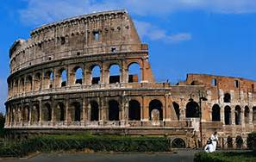
More On Inheritance
Concrete means particular or tangible, not abstract.
  Originally meant solidified or hardened. The building material was named because it has this quality
The classes in the previous examples were concrete classes, ones that can be instantiated

Slide 3
More On Inheritance
Classes may be abstract
  An abstract class cannot be instantiated, but it can have subclasses that are concrete.
Abstract classes may contain data fields that will be common to all subclasses

Slide 4

More On Inheritance
Abstract classes may define concrete methods, but they may also declare abstract methods
  An abstract method isn't defined (written) in the class, but must be defined in a subclass
    Subclasses that are also abstract can define the method or ignore it, leaving it to be defined in their own subclasses.
    A concrete class may inherit or override
    concrete method definitions from its
    superclass(es)
    A concrete class must define any methods
    which are abstract in its superclass hierarchy
Notes:
Object is not an abstract class

Slide 5
More On Inheritance
Syntax for abstract method:
access modifier abstract return type name();
For example:
protected abstract void accelerate(double speedIncrement);
Syntax to implement a method that is abstract in the superclass:
  Just add @Override notation above the method code:
      @Override
      protected void accelerate(double speedIncrement){
      speedInKmPerHr+=speedIncrement;
      }
Notes:
The word “abstract” tells you it is an abstract.

Slide 6
More On Inheritance
Use an abstract class when you expect to create subclasses that will implement some methods identically but other methods in different ways.
If you don’t need any data fields and don’t need to define any methods, use an interface (next week!) instead.
Implementation of multiple subclasses of the same class is another form of polymorhphism.

Slide 7
More On Inheritance
package vehicles;
public class Direction {
private double bearing, angleToGround;
public Direction(){}
public Direction(double bearingIn, double angleIn){
bearing = bearingIn;
angleToGround = angleIn;
}
public void setDirection(double bearingIn, double angleIn){
bearing = bearingIn;
angleToGround = angleIn;
}
public String toString(){
return "Bearing: " + bearing + ": Angle: " + angleToGround;
}
}

Slide 8
More On Inheritance
package vehicles;
public abstract class Vehicle {
protected double weightInKg;
protected double speedInKmPerHr;
protected Direction direction;
protected String color;
public String getColor(){return color;}
protected abstract void accelerate(double speedIncrement);
protected abstract void register();
protected abstract void steer(double bearing, double angle);
}
Notes:
Top SuperClass

Slide 9
More On Inheritance
package vehicles;
public abstract class MotorVehicle extends Vehicle {
protected double engineDisplacementInCc;
protected String fuelType;
protected String manufacturer;
public void register() {
System.out.println("Registered " + manufacturer + " vehicle with DMV");
}
}
Notes:
Abstract class with concrete method.

Slide 10
More On Inheritance
package vehicles;
public class Car extends MotorVehicle {
public Car(String manufacturerIn, double weightInKgIn, double displacementIn, String fuelTypeIn){
manufacturer=manufacturerIn;
weightInKg = weightInKgIn;
engineDisplacementInCc = displacementIn;
fuelType = fuelTypeIn;
speedInKmPerHr = 0;
direction = new Direction();
}
@Override
protected void steer(double bearing, double angle) {
// replace the following with code to steer a car
direction = new Direction(bearing, angle);
}
@Override
protected void accelerate(double speedIncrement) {
// replace the following with code to accelerate like a car
speedInKmPerHr += speedIncrement;
}
public String toString() {
return manufacturer + " car with a " + engineDisplacementInCc + " cc " + fuelType + " engine weighs " + weightInKg + " kg and is going " + speedInKmPerHr +" KPH " + direction.toString();
}
}
Notes:
Subclass of MotorVehicle

Slide 11
More On Inheritance
package vehicles;
public class Motorcycle extends MotorVehicle {
public Motorcycle(String manufacturerIn, double weightInKgIn, double displacementIn, String fuelTypeIn){
manufacturer=manufacturerIn;
weightInKg = weightInKgIn;
engineDisplacementInCc = displacementIn;
fuelType = fuelTypeIn;
speedInKmPerHr = 0;
direction = new Direction();
}
public Motorcycle(String manufacturerIn, double weightInKgIn, double displacementIn){
manufacturer=manufacturerIn;
weightInKg = weightInKgIn;
engineDisplacementInCc = displacementIn;
fuelType = "gasoline";
speedInKmPerHr = 0;
direction = new Direction();
}
@Override
protected void accelerate(double speedIncrement) {
// replace the following with code to accelerate like a motorcycle
speedInKmPerHr += speedIncrement;
}
@Override
protected void steer(double bearing, double angle) {
// replace the following with code to steer a motorcycle
direction=new Direction(bearing, angle);
}
public String toString() {
return manufacturer + " motorcycle with a " + engineDisplacementInCc + " cc " + fuelType + " engine weighs " + weightInKg + " kg and is going " + speedInKmPerHr +" KPH " + direction.toString();
}
}

Slide 12
More On Inheritance
package vehicles;
public abstract class Spacecraft extends Vehicle {
// this class could have a hierarchy of abstract and concrete classes under it
}

Slide 13
More On Inheritance
package vehicles;
public class Driver {
public static void main(String[] args) {
Vehicle shredder = new Car("Mazda", 1000, 1900, "gasoline");
System.out.println(shredder);
shredder.register();
shredder.accelerate(20);
shredder.steer(270, 0);
System.out.println(shredder);
System.out.println();
Vehicle hindenburg = new Motorcycle("BMW", 230, 594, "gasoline");
hindenburg.steer(70, 0);
hindenburg.accelerate(90);
System.out.println(hindenburg);
System.out.println();
Vehicle porky = new Motorcycle("Harley-Davidson", 400, 1200);
porky.accelerate(150);
porky.steer(180, 45);
System.out.println(porky);
}
}
Notes:
“shredder” is a variable of type “vehicle”

Slide 14
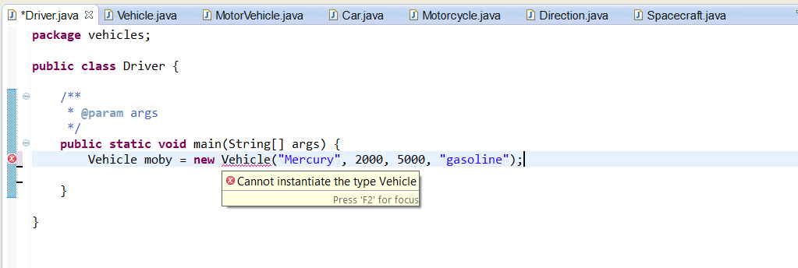
More On Inheritance
You can't instantiate an abstract class:

Slide 15
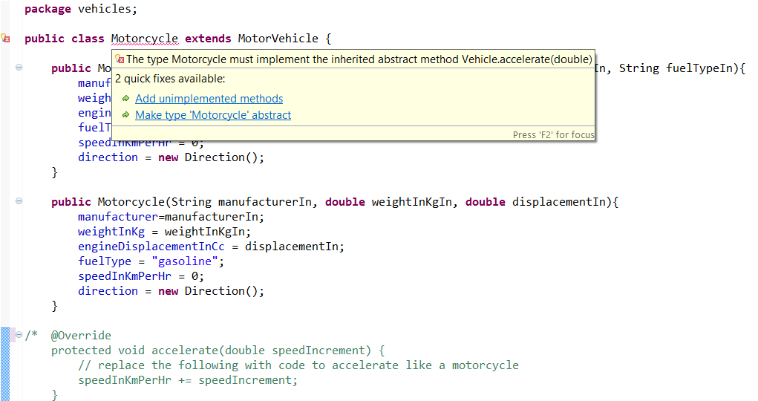
More On Inheritance
A concrete class have a definition for each inherited method. If the method was abstract in the last superclass, it must be defined in the new class:

Slide 16
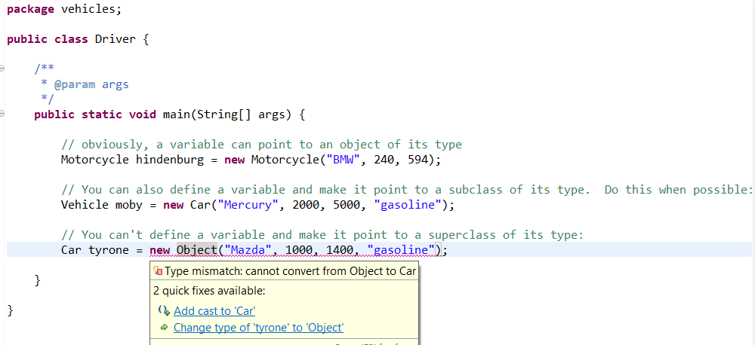
More On Inheritance
Usually a bad idea

Slide 17
More On Inheritance
You can use a reference variable to get access to public methods of the variable's type and supertypes. Using methods of subtypes of the variable's type requires a cast and is usually a bad idea. This is true even though you instantiate an object of the subclass and make the variable reference it.
public class Motorcycle extends MotorVehicle {
private boolean sidecarPresent;
… stuff omitted
public void installSidecar(){
// this is a method of motorcycle. Its superclasses don't know about it
sidecarPresent = true;
}
…

Slide 18
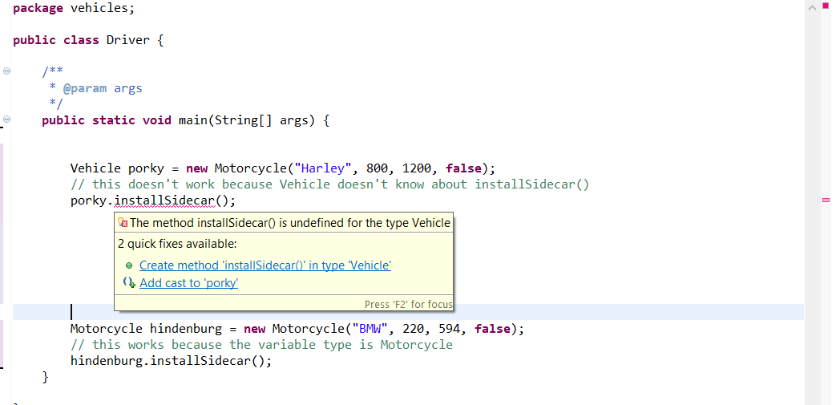
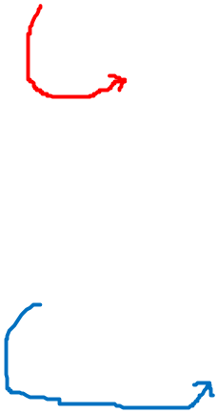
More On Inheritance
These are both dicy ideas!

Slide 19
More On Inheritance
Our hierarchy of abstraction is getting complicated:
  An object has actual data values. It is less abstract than the class of which it is an instance
  A concrete class doesn’t have data values (except constants), so it is more abstract than an object. However, all of its methods are defined, whether they were inherited from the superclass(es) or are written in the method itself, so it is less abstract than any superclass(es) it might have
  We may have concrete superclasses, which are more abstract than their subclasses
  Abstract classes are, as the name suggests, more abstract than concrete classes. They usually have methods that must be defined in their subclasses. Even if they don’t, they can never be instantiated; only their subclasses can. For these reasons, they are more abstract than concrete classes.
  We may have a hierarchy of abstract superclasses.
  Every class is a subclass of Object

Slide 20
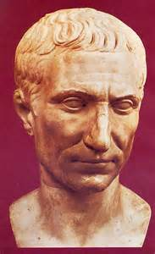
Write and Test Your Code Incrementally
Just as computers can only do simple tasks, humans can only think one simple thought at a time
You can’t solve a complicated problem all at once. Instead, break it down into many simple problems and solve them one at a time.
"divide et impera"

Slide 21


Write and Test Your Code Incrementally
Rule of thumb: you should be able to explain in one or two sentences how any method you write works. If you can’t, break it down into two or more methods.
"Don’t invest in anything you can’t explain
on the back of a cocktail napkin."
"When you believe in things that you
don't understand, then you suffer."

Slide 22
Write and Test Your Work Incrementally
We are writing a program in which a store tracks a group of salespeople. We need to be able to list the salespeople by name and year-to-date sales
The store is modeled by an object of class Store
The staff is modeled by an array list of objects of class Salesperson
Store must have a name, an array list of Salesperson objects, ways to get data for these fields, a toString(), and a method to list all the salespeople, using data from the objects.
Salesperson must have a lastname, a firstname, an id number, a double for year to date sales, some getters and setters, and a toString() method. It should probably have a constructor that takes the names as parameters.

Slide 23
Write and Test Your Work Incrementally
Two approaches:
  Top-Down: write the high-level class (Store) first
    Store has a dependency: it needs Salesperson to work correctly. If we write it first, we must “stub out” some of the methods or write simulations, then fill in the details later.
    This approach is analytical; it takes things apart
  Bottom-Up: write the low-level class (Salesperson) first, then write Store.
    Salesperson doesn’t depend on anything else, so we can write everything we know it needs all at once, although we will inevitably later realize we need to add more.
    This approach is synthetic; it puts things together. However, we still have to analyze the problem down to its basic elements first.
Both have strengths and weaknesses
  Bottom-up is simpler, but top-down matches the way we typically think out the project initially.
Either way, try to write the smallest unit of code that you can test. Get it working before you proceed any farther. Repeat until you are done!

Slide 24
Top-Down: Write Store First
package store;
import java.util.ArrayList;
import java.util.List;
public class Store {
private String name;
private List<Salesperson> staff;
// we must stub out the Salesperson class for this to work, but it doesn’t need anything beyond a class signature and one set of curly braces.
public Store(){
staff = new ArrayList<Salesperson>();
}
public void setName(String nameIn) {
name = nameIn;
}
public void hireStaffPerson() {
// We can't make this work until Salesperson is working, so we just write a stub
System.out.println("hireStaffPerson not implemented yet");
}
public void fireStaffPerson(){
//See note above
}
public String toString() {
return name;
}
public String listStaff() {
// can't make this work until after we get Salesperson working
return "listStaff not implemented yet";
}
}

Slide 25
Top-Down: Write Store First
package store;
public class StoreDriver {
public static void main(String[] args) {
Store store = new Store();
store.setName("Viking Furniture");
store.hireStaffPerson();
System.out.println(store.toString());
System.out.println(store.listStaff());
}
}

Slide 26
Test Your Work Incrementally
Let’t test it:
Output:
hireStaffPerson not implemented yet
Viking Furniture
listStaff not implemented yet
So far, Store is working as intended. Next, we implement Salesperson, the update the methods in Store to use actual Salesperson data.

Slide 27
Bottom-Up: Write Salesperson First
package store;
public class Salesperson {
private String lastName;
private String firstName;
private int id;
private double ytdSales;
public Salesperson(String lastIn, String firstIn){
lastName = lastIn;
firstName = firstIn;
ytdsales = 0;
}
public String toString() {
return lastName + ", " + firstName + ": id# " + id + "YTD Sales: "
+ ytdSales;
}
public String getLastname() {
return lastName;
}
public void setLastname(String lastName) {
this.lastName = lastName;
}
public String getFirstName() {
return firstName;
}
public void setFirstName(String firstName) {
this.firstName = firstName;
}
public int getId() {
return id;
}
public void setId(int id) {
this.id = id;
}
public double getYtdSales() {
return ytdSales;
}
public void setYtdSales(double ytdSales) {
this.ytdSales = ytdSales;
}
}
Notes:
public String getName(){
return lastName + “, “ + firstName + “YTD Sales: “ + ytdSales;
}

Slide 28
Bottom-Up: Write Salesperson First
package store;
public class StoreDriver {
public static void main(String[] args) {
String testFirstName = "Ted";
String testLastName = "Cruz";
Salesperson p = new Salesperson(testLastName, testFirstName);
if (p.getYtdSales() != 0)
System.out.println("Sales error");
double testSaleAmount = 179.99;
p.recordSale(testSaleAmount);
String testName = testLastName + ", " + testFirstName;
if (!(p.getName().equals(testName)))
System.out.println("name error");
if (p.getYtdSales() != (0+testSaleAmount))
System.out.println("Sales error");
System.out.println(p.toString());
}
}

Slide 29
Bottom-Up: Write Salesperson First
Once Salesperson is working correctly, then proceed to write Store

Slide 30
Simulators
Imagine you need data to test software that will be used to process real-world measurements, like the ages of college students
Sometimes you might want linearly-distributed data, but Gaussian distributions are often more realistic

Slide 31
package simulator;
import java.util.Arrays;
public class Grader {
private double average;
private double std;
private int classSize;
private double[] grades;
private final double MINGRADE = 0;
private final double MAXGRADE = 100;
public enum GradingType {LINEAR, GAUSSIAN};
public Grader(double avgIn, double stdIn, int classSizeIn) {
average = avgIn;
std = stdIn;
classSize = classSizeIn;
}
public static void main(String[] args) {
Grader grd = new Grader(75d, 10d, 20);
grd.grade(GradingType.LINEAR);
grd.grade(GradingType.GAUSSIAN);
}
private void grade(GradingType type) {
Simulator sim = new Simulator();
if (type == GradingType.LINEAR)
grades = sim.getLinearData(classSize, MAXGRADE);
if (type == GradingType.GAUSSIAN)
grades = sim.getGaussianData(average, std, classSize, MINGRADE, MAXGRADE);
System.out.println("\nData using distribution type: " + type + "\n");
for (int i = 0; i < grades.length; i++) {
System.out.print("Student #" + i + " received a grade of ");
System.out.printf("%3.1f\n", grades[i]);
}
Arrays.sort(grades);
System.out.println("Here are the sorted values from the simulator:");
for (double d : grades)
System.out.printf("%3.1f\n",d);
}
}

Slide 32
package simulator;
import java.util.Random;
public class Simulator {
private static double[] nums;
public double[] getGaussianData(double mean, double std, int count, double min, double max) {
Random r = new Random();
nums = new double[count];
double randDoub;
for (int counter = 0; counter < nums.length; counter++){
randDoub = r.nextGaussian() * std + mean;
// it's pretty hard to set absolute limits for the values in a rigorous way, so here is a hacky way.
if(randDoub > max) randDoub = max;
if(randDoub < min) randDoub = min;
nums[counter] = randDoub;
}
return nums;
}
public double[] getLinearData(int count, double max) {
Random r = new Random();
nums = new double[count];
double randDoub;
for (int counter = 0; counter < nums.length; counter++){
randDoub = r.nextDouble() * max;
nums[counter] = randDoub;
}
return nums;
}
}

Slide 33
Separate Things That Are Likely To Change Independently
Grader is domain-specific (only useful for a narrow type of problem, in this case grading schoolwork)
Simulator, on the other hand, does not contain anything that shows it is from an application that simulates graded. It could be used to generate test data for a very wide variety of problems
This is an example of an important principle in software engineering. Separate the general from the specific, and separate things you can probably reuse from things you can't. If two things are likely to change independently of each other, don’t combine them.
  "When all you have is a hammer, everything looks like a nail" – folk proverb
  "If I had a hammer, I'd hammer in the morning, I'd hammer in the evening, all over this land. I'd hammer out danger; I'd hammer out a warning; I'd hammer out love between my brothers and my sisters, all over this land." –Pete Seeger

