Slide 1
Lecture 8
CS 202
Fall 2013

Slide 2
Review of Abstract Classes
Abstract classes
  can not be instantiated but can have concrete subclasses
  can have concrete methods
  can have abstract methods
  can also have instance variables

Slide 3
Types and Data Structure Parameters
Arrays and Lists (and also other data structures you will study in CS 203) can be parameterized with abstract classes.
An array or list whose type is a class can hold objects of any concrete class that extends the class.

Slide 4
Types and Data Structure Parameters
package vehicles;
public class ShrinerMobile extends Car {
public ShrinerMobile(double weightInKgIn,
double displacementIn, String fuelTypeIn) {
super("Shriners' Lodge #1", weightInKgIn, displacementIn, "gasoline");
}
public String toString() {
return "Shrinermobile with a " + engineDisplacementInCc + " cc gasoline engine weighs " + weightInKg + " kg and is going " + speedInKmPerHr +" KPH " + direction.toString();
}
}

Slide 5
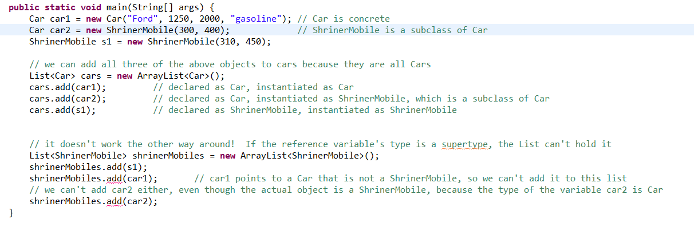
Types and Data Structure Parameters

Slide 6
Breaking Down At The Interfaces
Software is said to "break down at the interfaces."
  You can write a class that does a good job of modeling a savings account
  Somebody else will do a good job writing a class that models a bank
  The hard part is making them work together

Slide 7
Need For Interfaces
Inheritance is very powerful and can be used well where
  subclasses will have many similarities and a few differences
  Subclasses can be grouped hierarchically
    MotorVehicle Vs. Spacecraft
  Subclasses will all have very similar data fields
But
  class hierarchies can be confusing
  since methods might be defined at any point in the hierarchy, they can be hard to change without creating unanticipated consequences

Slide 8
Need For Interfaces
Interfaces meet some of the same needs in a different and simpler way
Interfaces provide another way to use polymorphism.
  If you are programming a furnace, you need a heatAir() method. However, the internal workings of the method will differ depending on whether you are programming a gas furnace or an oil one.
Interfaces contain method declarations and may contain constants
  No method definitions
  No variables
Interfaces can’t declare private or protected methods, just public ones (that's why they're called that!)
Notes:
Never code a method in an interface

Slide 9
Interface Syntax
Syntax for defining an interface:
  Access modifier interface name{
  static final declarations
  method declarations
  }
  For example:
public interface Vehicle {
public static final double KMTOMILES = .609;
public void accelerate(double speedIncrementInKmPH);
public double getSpeedInKmPH();
public void steer(Direction d);
}
Notes:
Cant declare a variable but you can declare a static final constant

Slide 10
Need For Interfaces
Classes implement interfaces. This is declared in the class header:
  public class MyClass implements MyInterface {
  Eg
  public class Car implements Vehicle {
The distinction between interface and implementation is very important in OOP.
A class can implement any number of interfaces
Notes:
Implementation I the code that is going to be used from the methods created in the previous slide

Slide 11
Implementing Interfaces
A class that implements an interface must implement the methods declared in the interface
Thus, if a class implements a particular interface, we know that we can call certain methods on object of the class. We don’t care that the methods may work differently for different implementations of the interface.
Here's another way to make the last point. Different classes that implement the interface may use methods whose internal workings are completely different, as long as they have the signature defined in the interface

Slide 12
Implementing Interfaces
Implementations of classes required by an interface need the @Override annotation:
@Override
public void setLocation(String location){
this.location = location;
}

Slide 13
Not Breaking Down At The Interfaces
Other objects that deal with objects of your class should only have to know the public interface, not the internal workings of your class
  Reduce what other programmers need to learn (or you need to remember) in order to use your classes
  Minimize problems at interfaces
  You can change the internal workings of your class without any problems if the interface stays the same.

Slide 14
Not Breaking Down At The Interfaces
Consider a WeatherReport class and a WeatherBalloon class.
  A WeatherReport should be able to get the barometric pressure from a WeatherBalloon by just calling an accessor method. It shouldn’t be dependent on the particular way WeatherBalloon determines what the pressure is.
    WeatherReport's programmer doesn’t need to learn how the measurement is made
    WeatherBalloon's programmer can change the method for determining pressure without affecting WeatherReport at all.
  Compare this to a computer storing data in permanent storage. I should be able to swap out my hard drive and controller for an SSD drive and controller without affecting the CPU, operating system, etc.

Slide 15
Not Breaking Down At The Interfaces
Consider an application that monitors monster attacks. We need to track both various species of monsters, like zombies, and unique monsters, like Godzilla and the Jersey Devil (https://en.wikipedia.org/wiki/Jersey_devil). We also need to be able to track new types of monsters we don’t even know about yet.
Although there are many types of monsters, all monsters can do these things:
  tell us their names
  change locations
  tell us their origin stories
  rampage

Slide 16
List Parameterized by an Interface
List<Monster> monsters = new ArrayList<Monster>();
Monster ebenezer = new Zombie("New Orleans");
Monster godzilla = new UniqueMonster("Godzilla", "radioactive breath of fire", "Tokyo",
"ancient sea monster awakened from millennia of sleep by radioactive fallout after "
+ "World War II");
// if the type in the list or array is an interface, we can add objects of any class that implements the interface
monsters.add(ebenezer); // ebenezer is a Zombie
monsters.add(godzilla); // godzilla is a UniqueMonster

Slide 17
Monster Interface
package monsters;
public interface Monster {
public void setName(String name);
public String getName();
public void setLocation(String location);
public void rampage();
public String getOriginStory();
}

Slide 18
package monsters;
public class Zombie implements Monster{
private static int zombieCount; // since zombieCount is static, we will get the same zombieCount from any Zombie
private String name;
private String location;
public Zombie(String location){
this.name = "Zombie # " + String.valueOf(zombieCount);
zombieCount++;
this.location=location;
}
@Override
public void setName(String name) {
this.name = name;
}
@Override
public String getName() {
return name;
}
@Override
public void rampage() {
System.out.println(name + " joins a herd of zombies who attack citizens of " + location + " and eat their brains");
}
@Override
public String getOriginStory() {
return "former human being who was raised from the dead by a magical spell spread by the bite of "
+ "other zombies.";
}
@Override
public void setLocation(String location) {
this.location = location;
}
}

Slide 19
package monsters;
public class UniqueMonster implements Monster{
private String name;
private String weapon;
private String location;
private String originStory;
public UniqueMonster(String name, String weapon, String location,
String originStory) {
this.name = name;
this.weapon = weapon;
this.location = location;
this.originStory = originStory;
}
@Override
public void setName(String name) {
this.name = name;
}
@Override
public void setLocation(String location){
this.location = location;
}
@Override
public void rampage() {
System.out.println(name + " destroys " + location + " with " + weapon);
}
@Override
public String getOriginStory() {
return originStory;
}
@Override
public String getName() {
return name;
}
}

Slide 20
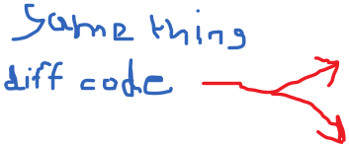

package monsters;
import java.util.ArrayList;
import java.util.List;
public class MonsterAttackDriver {
public static void main(String[] args) {
List<Monster> monsters = new ArrayList<Monster>();
Monster m1 = new UniqueMonster("Godzilla", "radioactive breath of fire", "Tokyo",
"ancient sea monster awakened from millennia of sleep by radioactive fallout after World War II");
monsters.add(m1);
// here is a more concise way to create and object and add it to the list
monsters.add(new UniqueMonster("Jersey Devil", "claws", "Princeton", "giant "
+ "batlike creature born to a cursed farmer in the 1700s"));
Monster m = new Zombie("New Orleans");
monsters.add(m);
for (int counter = 0; counter < 3; counter++) {
m = new Zombie("London"); // reuse the Monster variable from a few lines back
monsters.add(m);
}
for (Monster z : monsters) {
System.out.println(z.getName() + " is a(n) " + z.getOriginStory());
z.rampage();
System.out.println();
}
}
}

Slide 21
clone() and Cloneable
Cloneable is an interface that requires that implementing classes have clone() methods.
clone() methods return deep copies of objects, so a variable that refers to a clone points to a separate object, not the one that was cloned
Object contains a protected clone() method which you need to call from your own clone methods, but Object.clone() will not copy objects to which your instance variables point.
  If these are mutable, your clone() method must also copy them. If you fail to do this, your variables will point to the same objects the original object variables pointed to. This can lead to strange results.

Slide 22
clone() and Cloneable
package monsters;
public class Crypt {
private String location;
public Crypt(String location) {
this.location = location;
}
public void setLocation(String location) {
this.location = location;
}
public String getLocation() {
return location;
}
public String toString(){
return "a mysterious crypt in " + location;
}
}

Slide 23
clone() and Cloneable
package monsters;
public class Vampire implements Monster, Cloneable {
private String name;
private Crypt crypt;
public Vampire(String name, String location) {
this.name = name;
crypt = new Crypt(location);
}
@Override
public void setName(String name) {
this.name = name;
}
@Override
public String getName() {
return name;
}
@Override
public void setLocation(String location) {
crypt.setLocation(location);// TODO Auto-generated method stub
}
@Override
public String getOriginStory() {
return "undead creature which lives by sucking the blood of living humans";
}

Slide 24
clone() and Cloneable
@Override
public void rampage() {
StringBuilder sb = new StringBuilder(name
+ " arises from " + crypt.toString() + " and ");
if (crypt.getLocation() == "Transylvania")
sb.append("sucks people's blood all night, then returns to a coffin to hide from sunlight");
else if (crypt.getLocation() == "Burbank")
sb.append("takes over the entire television industry");
else {
System.out.println("wreaks unknown havoc in fresh Vampire territory");
return;
}
System.out.println(sb);
}
@Override
public Object clone() {
Vampire newV;
try {
/* Object clone() returns an Object. It will be a Vampire, but in order to get to anything specific to Vampires, we need
to cast it to a Vampire and use a Vampire reference variable */
newV = (Vampire) super.clone();
//newV.crypt= new Crypt(crypt.getLocation());
} catch (CloneNotSupportedException e) {
e.printStackTrace();
return null;
}
return newV;
}
}

Slide 25
package monsters;
public class MonsterAttackDriver {
public static void main(String[] args) {
// traps with faulty clone() methods
Vampire v1 = new Vampire("Dracula", "Transylvania");
Vampire v2 = v1;
// the Object version of toString is the one that shows the memory
// location. v1 and v2 point to the same Vampire in memory
System.out.println("v1: " + (Object) v1 + " v2: " + (Object) v2);
// clone() returns an Object, but it will be a Vampire. To use methods
// that are not inherited from Object, we need to cast.
Vampire v3 = (Vampire) v1.clone();
// v1 and v3 are two different Vampires with all the same data values
System.out.println("v1: " + (Object) v1 + " " + "v3: " + (Object) v3);
System.out.println();
v1.rampage();
v3.rampage();
System.out.println();
// Since Strings are interned, when we change v3's name, we are creating
// a new String and making v3's name variable refer to the new one
v3.setName("Timmy");
v1.rampage();
v3.rampage();
System.out.println();
v3.setLocation("Burbank");
// crypt, the variable, is a reference variable of type Crypt. We didn't
// write any code to reset v1's home, but watch what happens
v1.rampage();
v3.rampage();
// we just changed the value to which both v1's and v3's crypt variables
// refer
System.out.println();
}
}

Slide 26
Corrected clone()
@Override
public Object clone() {
Vampire newV;
try {
/* Object clone() returns an Object. It will be a Vampire, but in order to get to anything specific to Vampires, we need
to cast it to a Vampire and use a Vampire reference variable */
newV = (Vampire) super.clone();
newV.crypt= new Crypt(crypt.getLocation());
} catch (CloneNotSupportedException e) {
e.printStackTrace();
return null;
}
return newV;
}

Slide 27
Driver Code For Corrected clone()
package monsters;
public class MonsterAttackDriver {
public static void main(String[] args) {
Vampire v1 = new Vampire("Dracula", "Transylvania");
// clone() returns an Object, but it will be a Vampire. To use methods that are not inherited from Object, we need to cast.
Vampire v2 = (Vampire) v1.clone();
v2.setName("Timmy");
v2.setLocation("Burbank");
v1.rampage();
v2.rampage();
}
}

Slide 28
Inner and Anonymous Classes
Be sure you understand the material in the book on inner classes and anonymous classes.
  There may be a question on the midterm that requires you to know how to write an inner class
  Study the syntax for creating inner classes within methods as well as within the parent class but outside any method.
Whether to use non-anonymous inner classes is a matter of individual preference
  They make it obvious that the inner class is intended to be used with the main class, but
  They clutter up your code
If you use them at all, only do it when
  The inner class is very simple, and
  You are sure it will only be used with the parent class

Slide 29
Inner and Anonymous Classes
Anonymous inner classes, which almost always implement interfaces, are very common in GUI programming and client-server apps (that's nearly everything these days!) When we cover GUIs, you will need to understand anonymous classes.

Slide 30

Code To The Interface, Not The Implementation
Use variables of the most abstract type available
Use interface methods rather than methods that are unique to particular concrete classes whenever possible
Coding to particular implementations, as opposed to interfaces, exposes you to the risk that your code will break when some other implementation changes. This is *very* dangerous because you may not even know when the other classes change.
Coding to the interface also makes your code more modular. If you rely on well-defined interfaces, you can more easily swap out parts of your code later or determine which implementations of an interface at runtime.

Slide 31
Code To The Interface, Not The Implementation
Use variables of the most abstract type available
Use interface methods rather than methods that are unique to particular concrete classes whenever possible
Coding to particular implementations, as opposed to interfaces, exposes you to the risk that your code will break when some other implementation changes. This is *very* dangerous because you may not even know when the other classes change.
Coding to the interface also makes your code more modular. If you rely on well-defined interfaces, you can more easily swap out parts of your code later or determine which implementations of an interface at runtime.

Slide 32
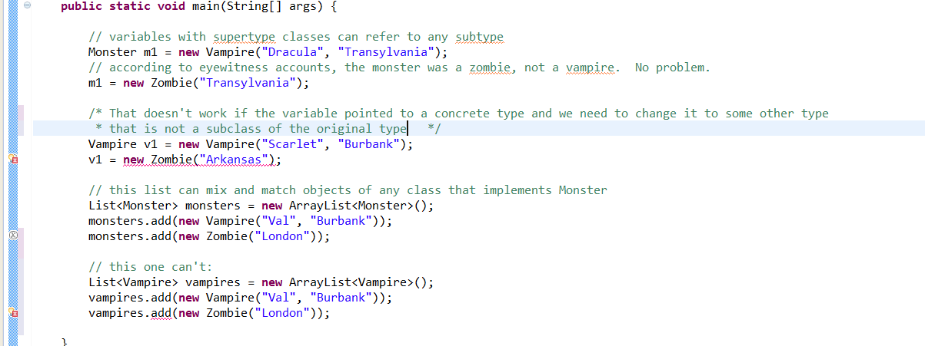
Code To Interface, Not Implementation

