Slide 1
Lecture 9
CS 202
Fall 2013

Slide 2
One-Off Implementations
Java interfaces are usually used for cases in which many classes must implement partially or fully identical public interfaces
Some developers even write interfaces for classes when there will be only one implementation
  Separate interface from implementation even when there is only one implementation
  Interface is easier to understand because it is described in a stand-alone file
  You, or some other programmer, are less likely to introduce bugs by carelessly changing the interface later.

Slide 3
One-Off Implementations
package calculator;
public interface Calculator {
public double add(double op1, double op2);
public double subtract(double op1, double op2);
public double multiply(double op1, double op2);
public double divide(double op1, double op2);
}

Slide 4
One-Off Implementations
package calculator;
public class CalculatorImpl implements Calculator{
@Override
public double add(double op1, double op2) {
return op1 + op2;
}
@Override
public double subtract(double op1, double op2) {
return op1 - op2;
}
// other methods omitted
}

Slide 5

Testing
Debugging is twice as hard as writing the code in the first place. Therefore, if you write the code as cleverly as possible, you are, by definition, not smart enough to debug it.
--Brian Kernighan

Slide 6
Testing
Finding and correcting errors is the most time-consuming part of programming
Testing and debugging always takes much more time than the first pass at writing code
You can make this process easier if you are systematic about testing. Test early and often, and test the smallest increments of code that you can in order to isolate errors.
  This is one more reason to break your code down into many simple methods instead of a few complicated ones.

Slide 7
Testing
Professional software development organizations have full-time testers whose job is to find the faults in your code
  They will always find some, but the better your code is when they get it, the longer you will keep your job
The earlier errors are caught, the easier it is to correct them and the fewer person-hours are expended on testing and debugging.
The first line of testing is done by the programmers themselves.

Slide 8
Testing
First step towards unit testing: besides providing plenty of output that you can check, test various conditions that should be true or false.
package monsters;
public class MonsterAttackDriver {
public static void main(String[] args) {
Monster dracula;
String dName = "Dracula", dNewName = "Bob", dHome = "Transylvania";
dracula = new Vampire(dName, dHome);
if(dracula.getName() != dName) System.out.println("Name error");
dracula.setName(dNewName);
if(dracula.getName() != dNewName) System.out.println("Name error");
if(dracula.getOriginStory() == null) System.out.println("Origin story error");
// etc. Test all public methods
}
}

Slide 9
Unit Testing
We have used driver and tester classes to test our classes
We have also written test methods that look for likely errors
Unit testing is a systematic way to test parts of your applications
Test for every likely error you can think of
Each test asserts that some condition is true or false; the assertions will fail if particular errors occur

Slide 10
Unit Testing
Run all the tests periodically to find errors caused by later code breaking things that worked before or by implementation changes in one part of a system
  This is the simplest instance of the concept of regression testing.
    Regression means "going back". Regression testing "goes back" to test code again to see if it still works correctly.

Slide 11
JUnit
Eclipse includes a unit testing framework called JUnit
A test case is a class that contains one or more tests, usually all testing the same target class.
Create one or more separate packages in each project for test cases.
Tests use assertions of various kinds
  assertNull(Object o), assertNotNull(Object o)
  assertEquals(Object o, Object p), assertFalse(boolean), assertTrue(boolean)
  Many others listed here: https://github.com/junit-team/junit/wiki/Assertions
A test succeeds if the assertion(s) are true when the test is run and fails if one or more are false
The object of a test is to assert something that will be true if the class is working correctly but false if some plausible error occurs

Slide 12
JUnit
Let's start by writing unit tests for the Vampire class, which implements the Monster interface, and for the Crypt class, which is used by Vampire.
Test Crypt first, because it can work without Vampire, but Vampire will not work if Crypt is broken

Slide 13
Monster
package monsters;
public interface Monster {
public void setName(String name);
public String getName();
public void setLocation(String location);
public String getLocation();
public void rampage();
public String getOriginStory();
}
getLocation() is new in this version of Monster

Slide 14
Crypt
package monsters;
public class Crypt {
private String location;
public Crypt(String location) {
this.location = location;
}
public void setLocation(String location) {
this.location = location;
}
public String getLocation() {
return location;
}
public String toString(){
return "a mysterious crypt in " + location;
}
}

Slide 15
Vampire
package monsters;
public class Vampire implements Monster, Cloneable {
private String name;
private Crypt crypt;
public Vampire(String name, String location) {
this.name = name;
crypt = new Crypt(location);
}
@Override
public void setName(String name) {
this.name = name;
}
@Override
public String getName() {
return name;
}
@Override
public void setLocation(String location) {
crypt.setLocation(location);// TODO Auto-generated method stub
}
@Override
public String getLocation(){
return crypt.getLocation();
}

Slide 16
@Override
public String getOriginStory() {
return "undead creature which lives by sucking the blood of living humans";
}
@Override
public void rampage() {
StringBuilder sb = new StringBuilder(name
+ " arises from " + crypt.toString() + " and ");
if (crypt.getLocation() == "Transylvania")
sb.append("sucks people's blood all night, then returns to a coffin to hide from sunlight");
else if (crypt.getLocation() == "Burbank")
sb.append("takes over the entire television industry");
else {
System.out.println("wreaks unknown havoc in fresh Vampire territory");
return;
}
System.out.println(sb);
}
@Override
public Object clone() {
Vampire newV;
try {
/* Object clone() returns an Object. It will be a Vampire, but in order to get to anything specific to Vampires, we need
to cast it to a Vampire and use a Vampire reference variable */
newV = (Vampire) super.clone();
newV.crypt= new Crypt(crypt.getLocation());
} catch (CloneNotSupportedException e) {
e.printStackTrace();
return null;
}
return newV;
}
}

Slide 17
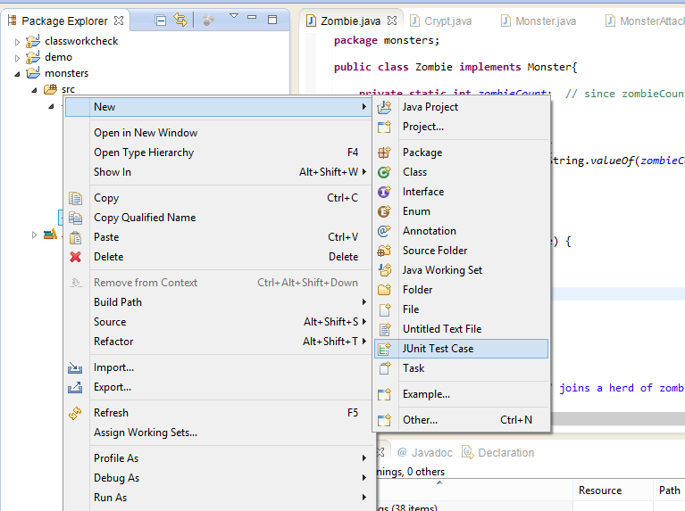
Unit Testing

Slide 18
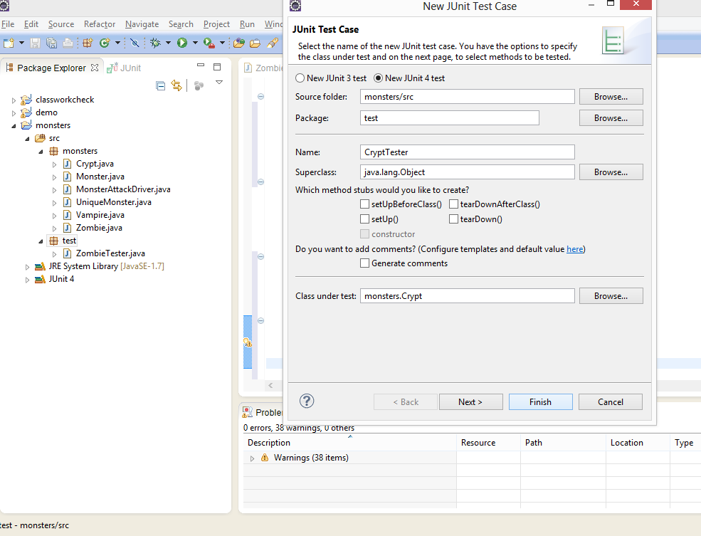
Unit Testing

Slide 19
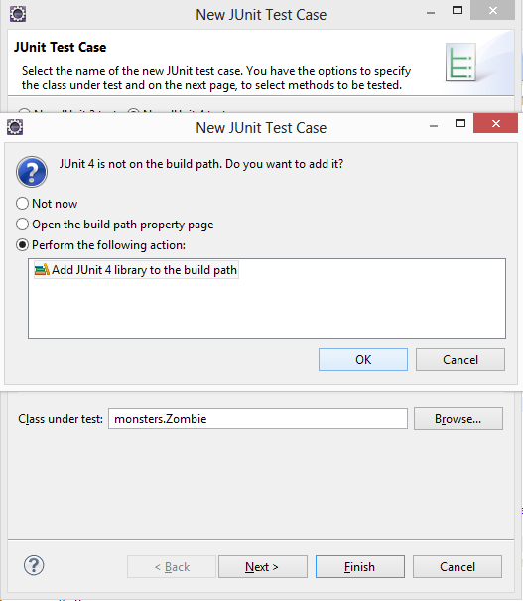
Unit Testing

Slide 20
Unit Testing
JUnit tests are identified with the annotation
@Test:
@Test
public void testToString(){
String location = "Transylvania";
Crypt c = new Crypt(location);
assertNotNull(c.toString());
}

Slide 21
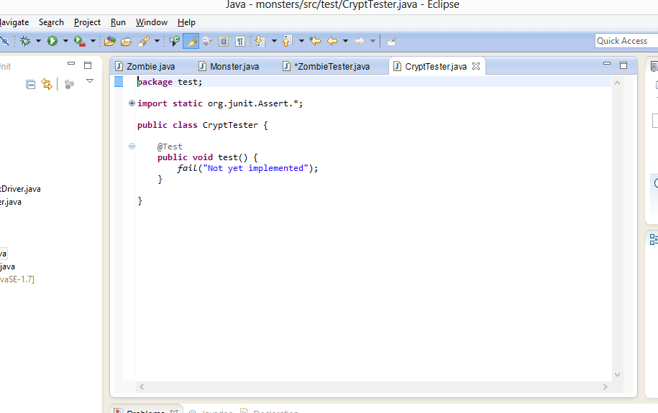
JUnit
JUnit starts us off with a test that is directed to fail:

Slide 22
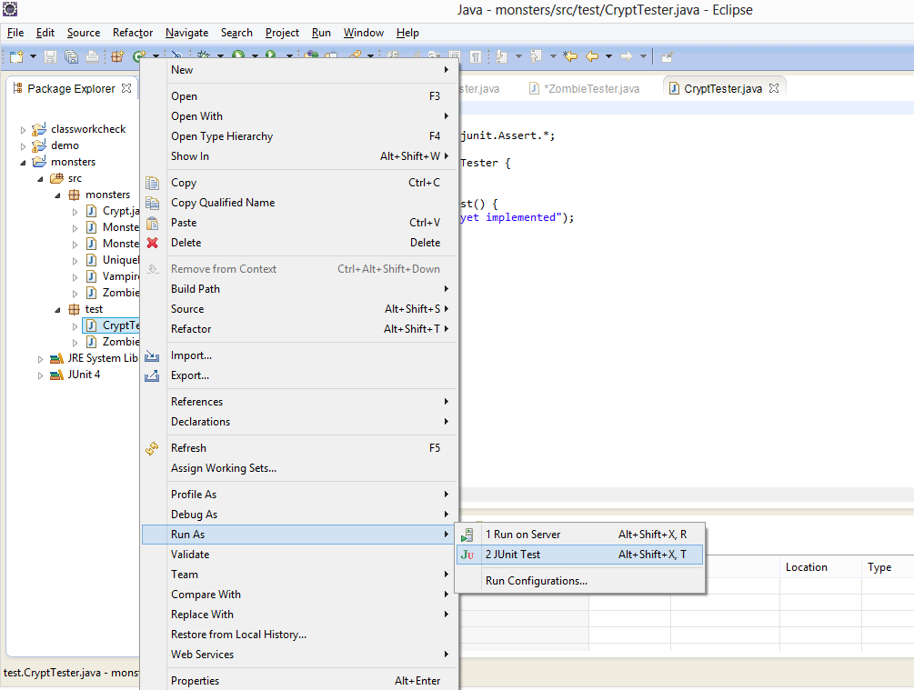
JUnit

Slide 23
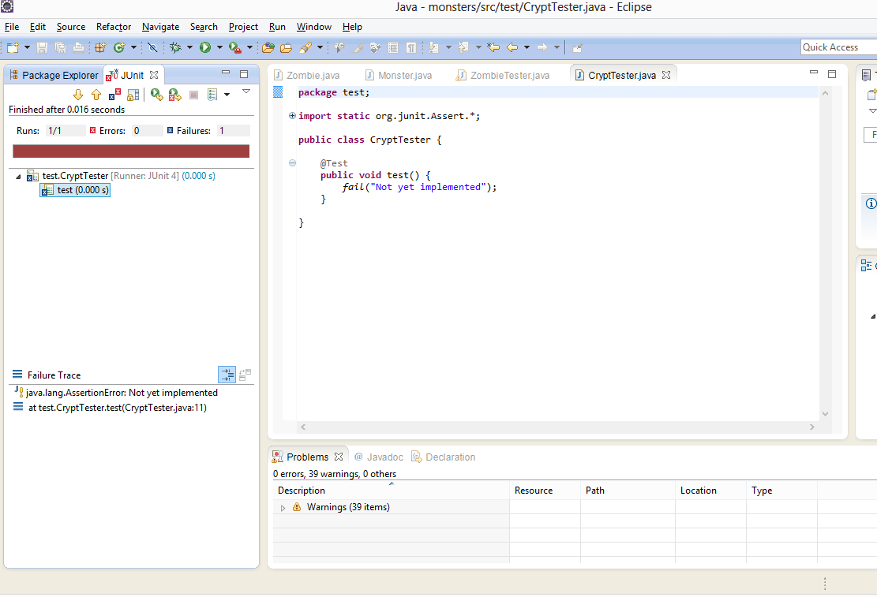
Test Failure

Slide 24
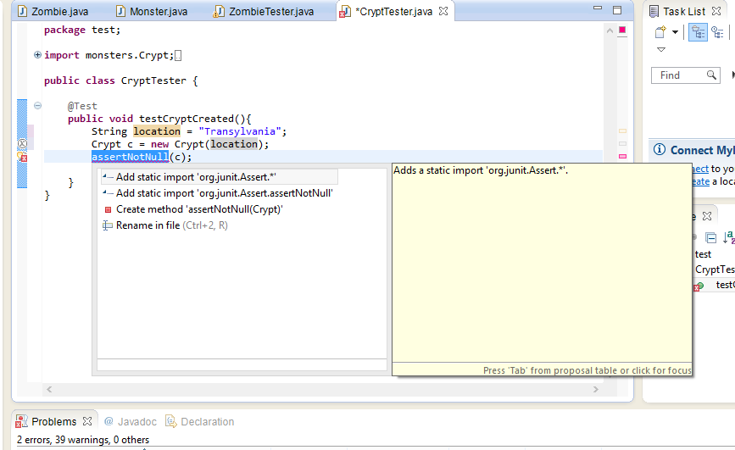
Unit Testing
JUnit Assertions require imports
JUnit Assertions require imports

Slide 25
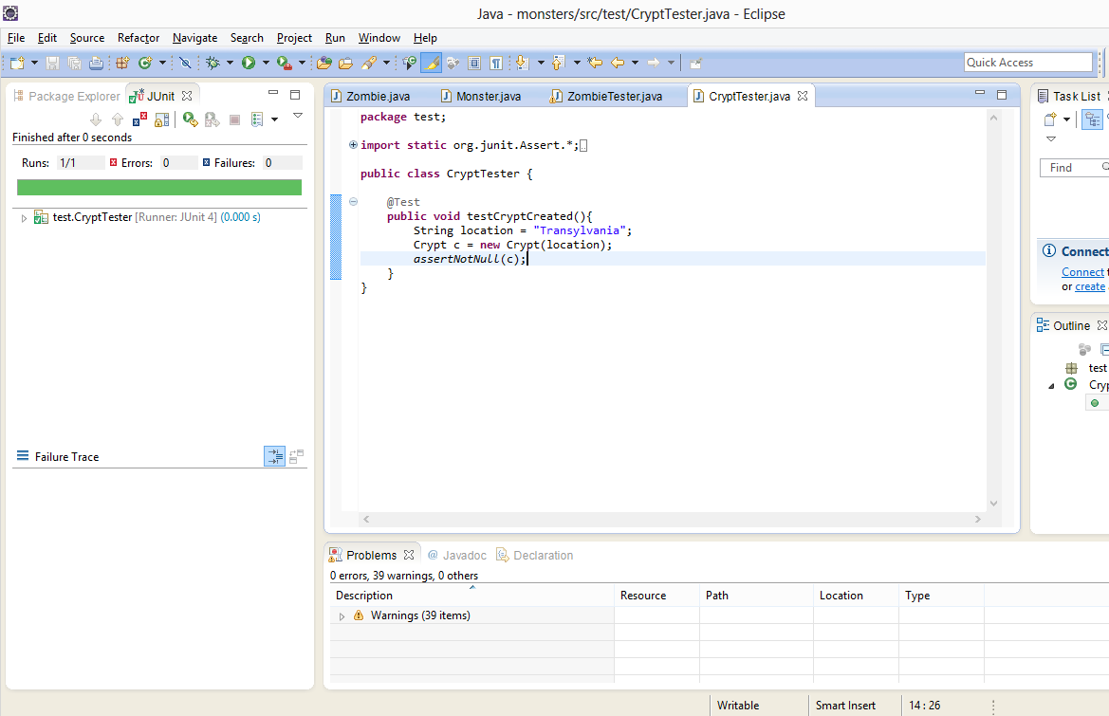
Test Success

Slide 26
Unit Testing
Write assertions that will fail if likely errors occur
Keep the tests simple. Most tests have only one assertion each. This way, you can find problems quickly.
Systematically exercise the whole interface
  In this case, "interface" means the public interface of the class being tested. That may be defined partially or completely by a Java interface, an abstract class, or a concrete superclass, or it may be unique to the class.
  Unit testing is not usually used for private methods; if these are wrong, any errors should come to light through the public interface
It is possible to instantiate objects and use them in multiple tests, but it is usually better to start from scratch for each test
  Tests should not have dependencies on each other, which would cause tests to break if other tests are changed

Slide 27
Unit Testing
package test;
import static org.junit.Assert.*;
import monsters.Crypt;
import org.junit.Test;
public class CryptTester {
@Test
public void testCryptCreated(){
String location = "Transylvania";
Crypt c = new Crypt(location);
assertNotNull(c);
}
@Test
public void testCryptLocation(){
String location = "Transylvania";
Crypt c = new Crypt(location);
assertEquals(c.getLocation(), location); // careful; this tests ==, not .equals() c
}
@Test
public void testSetCryptLocation(){
String firstLocation = "Transylvania";
Crypt c = new Crypt(firstLocation);
String secondLocation = "Wisborg";
c.setLocation(secondLocation);
assertEquals(c.getLocation(), secondLocation);
}
@Test
public void testToString(){
String location = "Transylvania";
Crypt c = new Crypt(location);
assertNotNull(c.toString());
}
}

Slide 28
VampireTester
Vampire has a Crypt (remember, this is composition).
  There is no public method in Vampire that returns the Crypt, so we can’t directly test that it is correctly creating the crypt.
  This is white box testing, though, and we do know that Vampire.getLocation() gets the location from Crypt.getLocation()
  @Test
  public void testLocation() {
  String name = "Orlok";
  String location = "Transylvania";
  Vampire v = new Vampire(name, location);
  assertEquals(v.getLocation(), location);
  }

Slide 29
VampireTester
Here are some tests of Vampire.clone()
  @Test
  public void testCloneIsNewVampire(){
  String name = "Orlok";
  String location = "Transylvania";
  Vampire v1 = new Vampire(name, location);
  Vampire v2 = (Vampire) v1.clone(); //clone() returns an object, but it is a Vampire
  assertNotSame(v1, v2);
  }
  @Test
  public void testCloneName(){
  String name = "Orlok";
  String location = "Transylvania";
  Vampire v1 = new Vampire(name, location);
  Vampire v2 = (Vampire) v1.clone(); //clone() returns an object, but it is a Vampire
  assertTrue(v1.getName().equals(v2.getName()));
  }
  @Test
  public void testCloneLocation(){
  String name = "Orlok";
  String location = "Transylvania";
  Vampire v1 = new Vampire(name, location);
  Vampire v2 = (Vampire) v1.clone(); //clone() returns an object, but it is a Vampire
  assertTrue(v1.getLocation().equals(v2.getLocation()));
  }
  @Test
  public void testCloneChangeLocation(){
  String name = "Orlok";
  String location = "Transylvania";
  Vampire v1 = new Vampire(name, location);
  Vampire v2 = (Vampire) v1.clone();
  v2.setLocation("Burbank");
  assertFalse(v1.getLocation().equals(v2.getLocation()));
  }

Slide 30
VampireTester
To refactor code is to change the implementation
When refactoring a class, don't change the public interface unless you can do a major reorganization of the whole application
  Refactoring should be completely invisible from outside the class, so that
    other code does not have to change and
    other programmers don’t have to learn the internal workings of your code
  Changing the interface inherently means other code must change
Let's refactor Crypt.

Slide 31
VampireTester
Refactor Crypt without introducing any errors:
public String toString(){
return "a very, very mysterious crypt in " + location;
}
All test results remain the same
Notes:
Changes implementation not the entire interface.

Slide 32
VampireTester
Refactor Crypt and introduce a bug:
public void setLocation(String location) {
  location = location;
}
Both CryptTester and VampireTester contain tests that will now fail

Slide 33
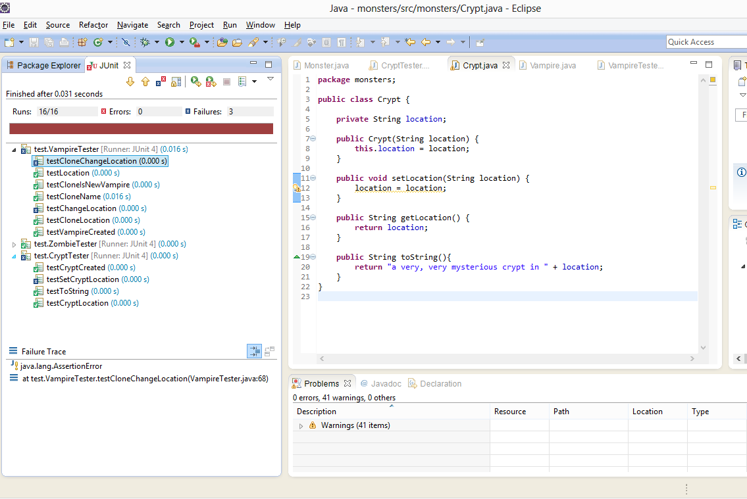
VampireTester

Slide 34
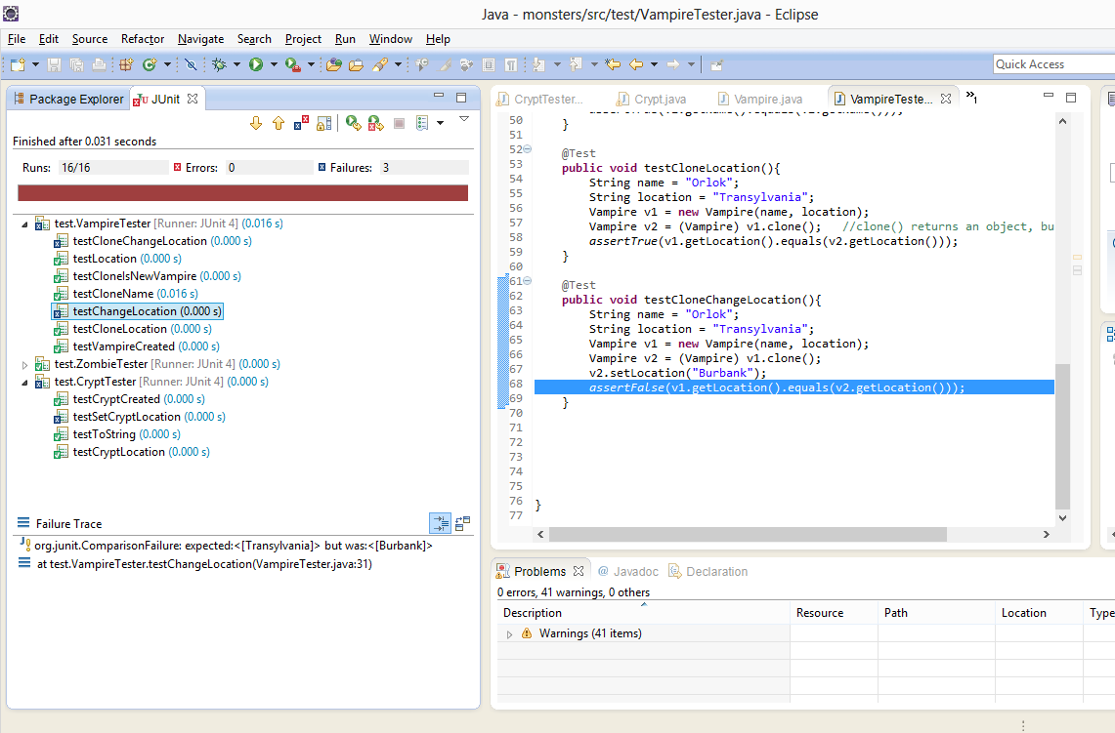
VampireTester
Click on *each* line in the JUnit output indicating a failed test

Slide 35
Skip A Test
When we notice that the errors in Vampire all involve Crypt location, it is a tip off to look closely at Crypt rather than Vampire.
The failing test in CryptTester uses Crypt.setLocation() and Crypt.getLocation(), further isolating the problem
Find the problem, fix it, and run the tests again.

Slide 36
Skip A Test
If you find multiple problems and want to deal with them separately, you can skip a test this way:
@Ignore
@Test
public void testSetCryptLocation(){
String firstLocation = "Transylvania";
Crypt c = new Crypt(firstLocation);
String secondLocation = "Wisborg";
c.setLocation(secondLocation);
assertEquals(c.getLocation(), secondLocation);
}
You may need to use <ctrl><shift>o to import the @Ignore
I strongly recommend you don’t leave failing tests aside. Instead, fix all known problems before coding anything else. If the code you are testing is incorrect, it may cause hard-to-find errors elsewhere.

Slide 37
Test-Driven Development
Some developers use unit testing as a planning tool by writing the tests before the classes themselves. The class is correct when it passes all the tests (meets the contract)
Tests can also serve as a form of documentation; they show how the classes are intended to be used
  Written documentation is always out of date, but if you change the code in response to new requirements without changing the tests, you'll find out immediately and have to fix it!
TDD is popular with agile developers, who emphasize quick development and frequent incremental releases, not formal planning
  In e-commerce, social media, etc., developers would always lag behind customer demands ("be late to the market") if they wrote detailed documents and didn’t release anything until the "final" product was ready.
  This doesn’t work for everything; you wouldn't write an antilock braking system or a Mars lander this way

Slide 38
Unit Testing
import org.junit.runner.RunWith; import org.junit.runners.Suite; @RunWith(Suite.class) @Suite.SuiteClasses({ TestFeatureLogin.class, TestFeatureLogout.class, TestFeatureNavigate.class, TestFeatureUpdate.class }) public class FeatureTestSuite { // the class remains empty, // used only as a holder for the above annotations }

Slide 39
Unit Testing
JUnit has many more advanced capabilities. As your applications become more complex, periodically look at https://github.com/junit-team/junit/wiki

