Slide 1
Information Retrieval Systems
Models, Architectures
Instructor: Dr. Khaldoon Syed Khurshid
Presented by: Safiullah [2021-CS-120]
Yaqoob [2021-CS-118]
M. Umair [2021-CS-144]
Ahmad Raza[2021-CS-161]
Department of Computer Science University of Engineering and Technology Lahore

Slide 2
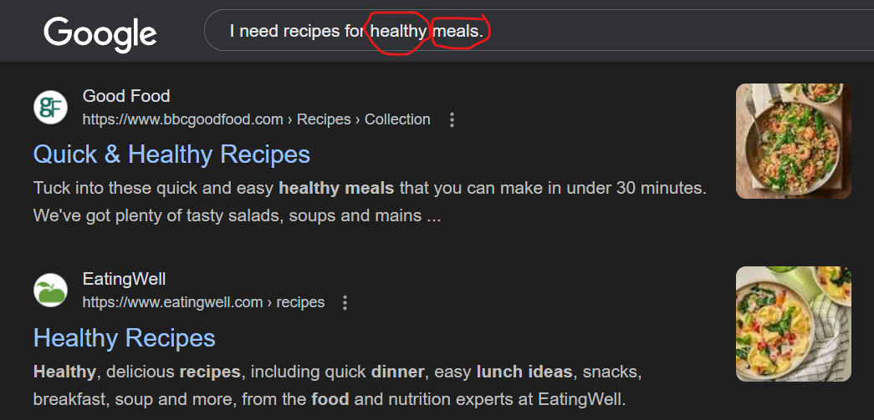
Introduction
Information Retrieval (IR) is the process of finding relevant information from large collections of data.

Slide 3

Goal Definition
Problem:
We live in a world flooded with information, but finding the right information quickly and accurately remains a challenge.
Goal:
To create systems that:
Retrieve relevant data from large datasets.
Understand user intent beyond simple keywords.
Deliver results efficiently and effectively.
Impact:
Making information accessible and meaningful for real-world applications like search engines, e-commerce, and knowledge systems.

Slide 4
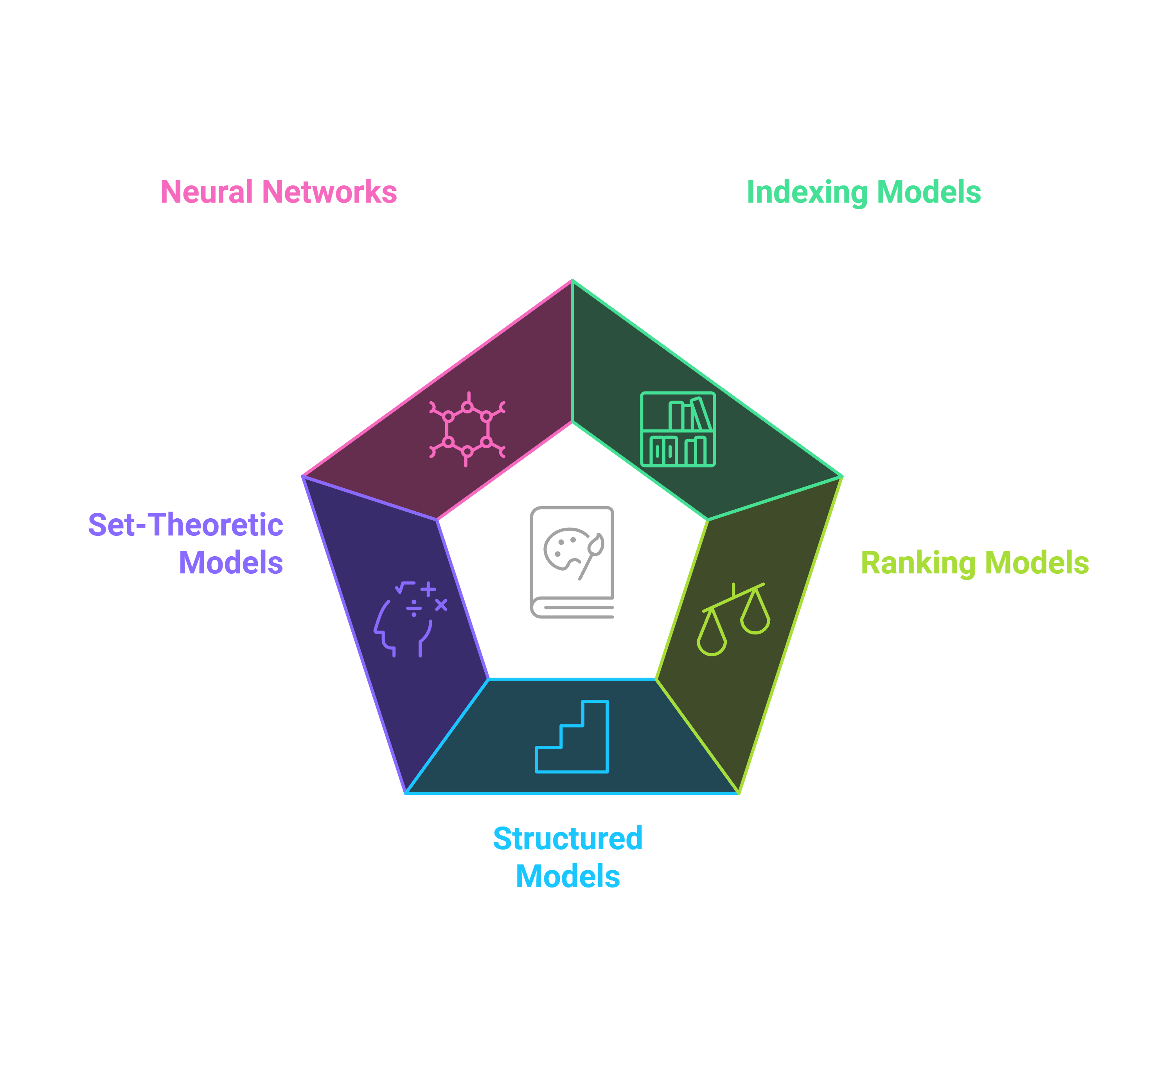
The Journey
"We started with simple indexing and progressed to advanced probabilistic models like Inference and Belief Networks.“

Slide 5
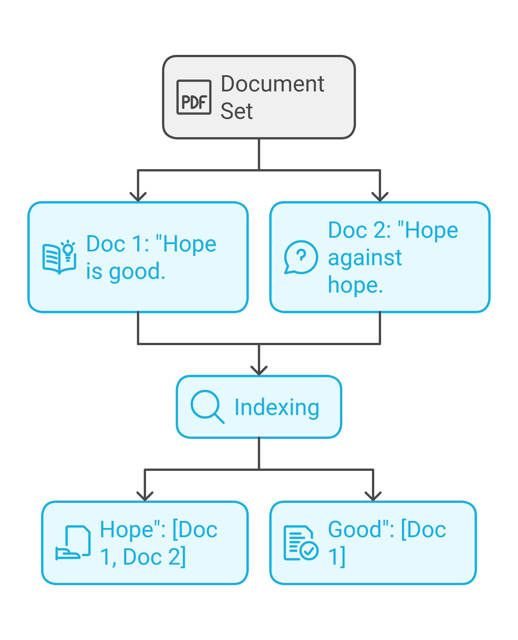
Indexing (1)
Key Concept:
Indexing is organizing words to make document searching efficient.
Example:
Document Set:
Doc 1: "Hope is good.“
Doc 2: "Hope against hope.“
Index:
"Hope": [Doc 1, Doc 2].
"Good": [Doc 1].

Slide 6
Document Ranking (2)
Objective: Rank documents by relevance.
Techniques Covered:
Keyword Matching.
Term Frequency (TF): Measures how often a term appears in a document. Higher frequency = more relevance within the document.
Inverse Document Frequency (IDF): Reduces the importance of common terms across multiple documents (e.g., "the," "is"), focusing on unique terms.
Imagine two documents as arrows pointing in space. Cosine similarity measures how close these arrows are to each other, based on the angle between them. Smaller angle = higher similarity, meaning the documents are more alike.
Example:
Query: "Healthy food.“
Doc 1: "Healthy snacks." (Score: High)
Doc 2: "Food recipes." (Score: Medium)

Slide 7
Advanced Retrieval Models (3)
Models Introduced:
Probabilistic (Binary Independence Model)
Non-Overlapped List Model
Proximal Nodes Model.
Example:
Query: "Machine Learning.“
Probabilistic: Score documents based on keyword probability.
Non-Overlapped List: Combine documents from related topics (e.g., "AI" and "Big Data").
Proximal Nodes: Identifies concepts closely connected to "Machine Learning" such as "Deep Learning," "Neural Networks," and "Data Science."

Slide 8
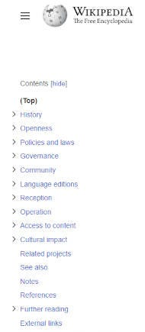
Structured Navigation (4)
Approach:
Guided Browsing and Hypertext Models.
Analogy:
"Navigating a library using sections and hyperlinks.“
Example:
Guided Browsing: Educational website hierarchy.
Hypertext: Wikipedia-style linked articles.

Slide 9
Set-Theoretic Models (5)
Models Explored:
Boolean Extended, Fuzzy Sets
Generalized Vectors, Latent Semantic Indexing
Example:
Query: "Best laptops under $1000.“
Boolean Extended: ("Laptop" AND "Best") AND ("Under $1000" OR "Affordable")
Fuzzy Sets: Partial match (e.g., laptops $900-$1200).
Generalized Vectors: Affordable laptops with top-notch performance.
LSI: Match semantically related documents (e.g., "affordable laptops").

Slide 10
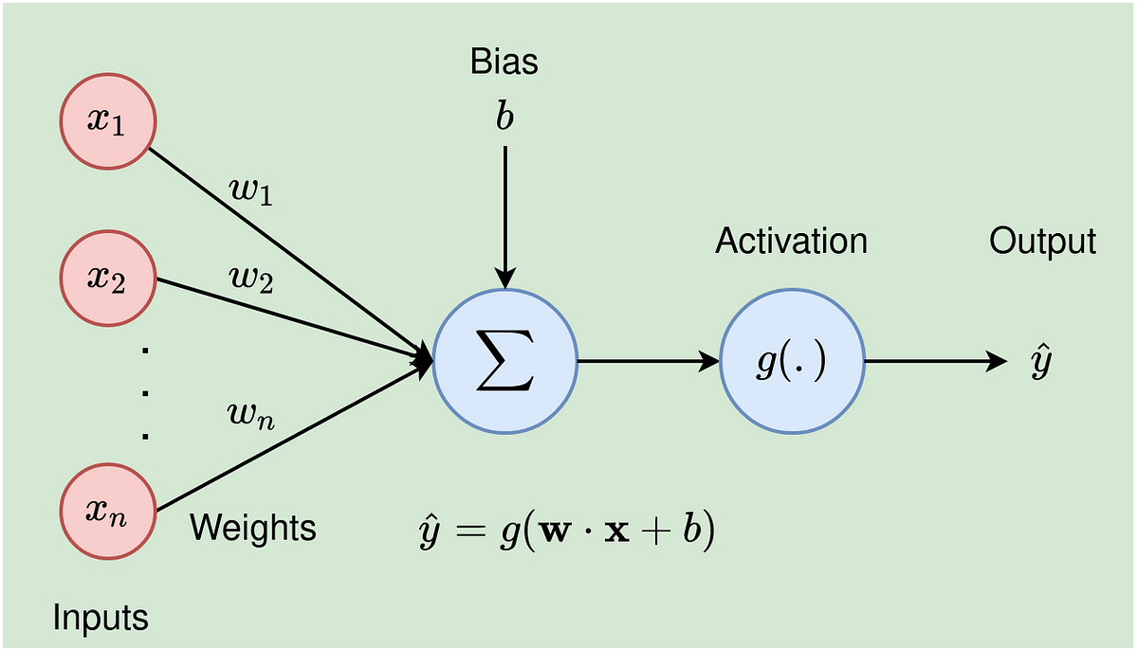
Neural Networks (6)
Shift to Machine Learning: Neural Networks for ranking.
Analogy: Neural Networks "learn relationships between words.“
Example:
Query: "Benefits of exercise.“
NN learns:
"Exercise" → "Fitness.“
"Benefits" → "Advantages.“
Outputs documents on "yoga" and "healthy living."

Slide 11
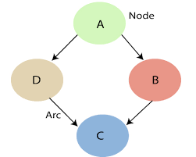
Probabilistic Models (7)
Models Introduced:
Inference: Using probabilities to make decisions.
Belief Networks: Graphical representation of relationships between variables.
Example:
Query: "Best camera phones.“
Belief Network Factors:
Node 1: Camera Specs.
Node 2: User Reviews.
Node 3: Price Range.
Output: Predict probability of relevance.

Slide 12
The Journey Recap
Progression:
Start: Simple Indexing (Assignment 1).
End: Probabilistic Models (Assignment 7).
What We Learned:
IR has evolved from keyword matching to advanced semantic understanding.

Slide 13
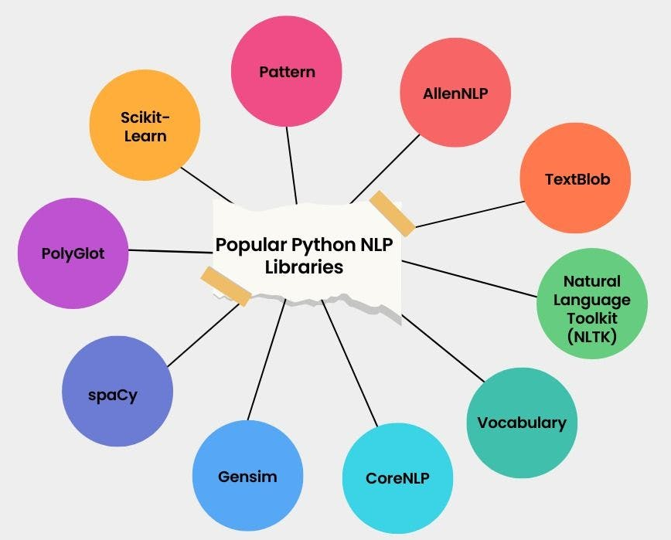
Challenges and Opportunities
Challenges Faced:
No Advanced Libraries: For each model, we have to use no modern libraries like NLTK etc.
Tokenization: Have to make our own tokenizer functions.
Complexities in Neural Network tuning.
Probabilistic model assumptions.
Future Directions:
Integration with deep learning models like BERT.
Improving inference models with real-world data.

Slide 14
Thank You
Suggestions and Questions are welcomed!

