Slide 1

Cloud Computing
Introduction to Cloud Computing and the world of DevOps

Slide 2

Umais Siddiqui
Instructor and Senior Software Engineer

Slide 3
LeCture
Introduction to DevOps
Introduction to Cloud Computing
Discuss the tools we will be using for this course
Ensure everyone can access to those tools
3

Slide 4
What is ClouD Computing?
Cloud Computing
Cloud computing is the delivery of on-demand computing resources over the internet, allowing organizations to access and utilize shared computing infrastructure, services, and applications.

Slide 5
Cloud Services
IAAS
Provides virtualized compute resources such as virtual machines, storage, and networks
SAAS
SaaS delivers applications over the internet on a subscription basis, eliminating the need for organizations to install and maintain software locally
PAAS
PaaS provides a complete development and deployment environment in the cloud, allowing organizations to build, test, and deploy applications without the complexity of managing underlying infrastructure.

Slide 6
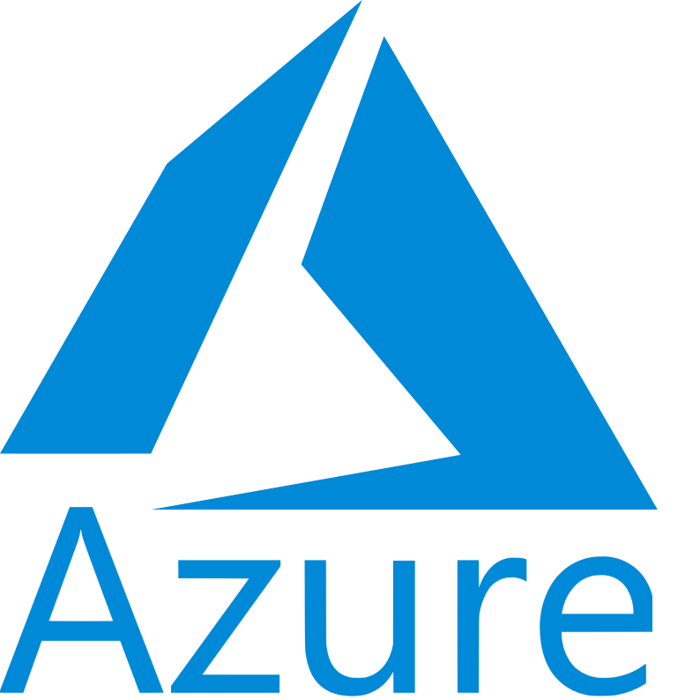
Azure IAAS
Virtual Machines
Network like VNET, Domains
Network IP Addresses
Azure AD Accounts
Azure Storage
Azure SAAS
Office365
Dynamics 365
Azure Dev Ops
Azure PAAS
Azure App Service
Azure Functions
Azure SQL Database
Cosmos DB

Slide 7

IAAS
Virtual Machines
Network
IAM
IP Addresses etc.
SAAS
Amazon Workspaced
Amazon Chime
PAAS
AWS Elastic Beanstalk
AWS Lambda
AWS App Runner
AWS Batch
AWS AppSync
AWS Amplify
AWS STEP Functions
AWS RDS/Aurora/DynamoDb

Slide 8
AWS VS AZURE
Launched 2006 | Launched 2010
Longer Market Presence | Significant Growth
Wide Global Presence | Rapidly expanding

Slide 9
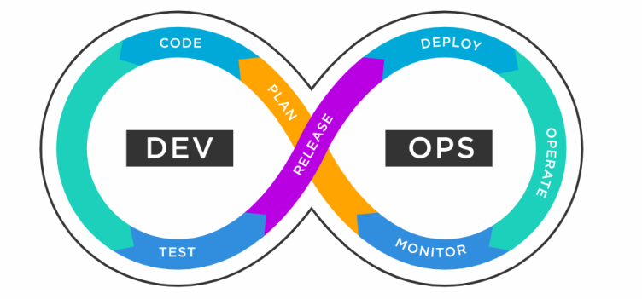
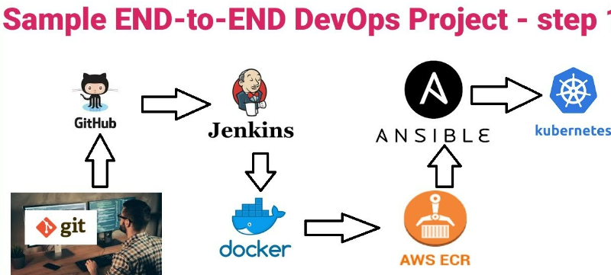
What is DEVOPS?
DEVOPS
DevOps is a set of practices that combines software development (Dev) and IT operations (Ops) in order to increase the speed and quality of software delivery. It involves collaboration between development and operations teams to automate and streamline the entire software delivery process, from code development to testing, deployment, and monitoring.

Slide 10
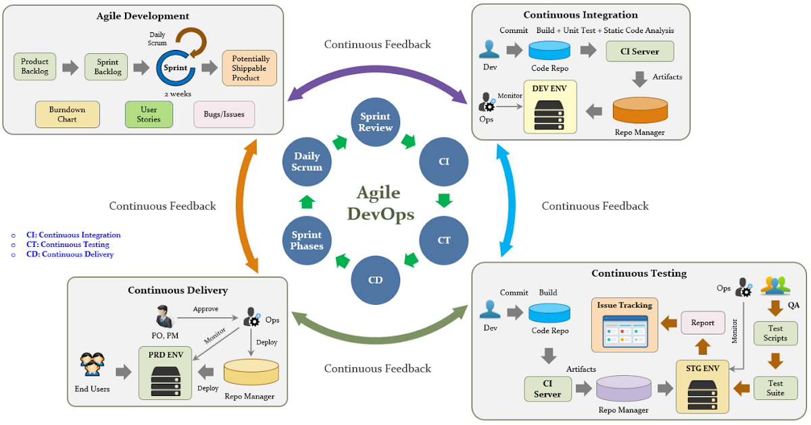

Slide 11
What is a PIPELINE?
Pipelines
Steps and tasks that are performed sequentially
CI Pipelines
Begins with Integrating Code into a Shared repository
Building , Testing and Code Validation
CD Pipelines
Packaging code and delivering to the destination

Slide 12
How are PIPELINES Defines
YAML
Pipelines are defined by a language called YAML
It stands for Aint Markup Language
Why use YAML?
It is a subset of JSON and very lightweight and human readable.
It is now a Industry standard and most tools use it
Tools that use YAML
Azure Devops
Github Actions

Slide 13
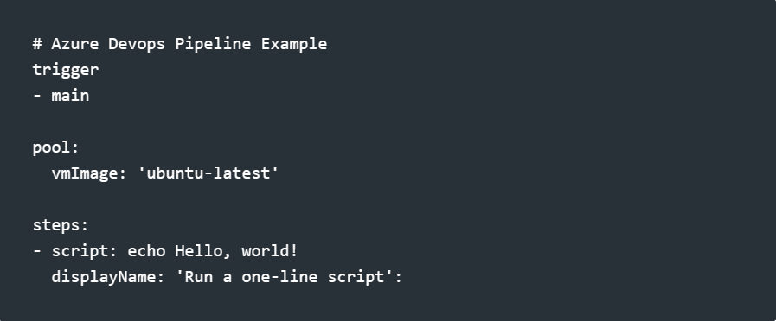
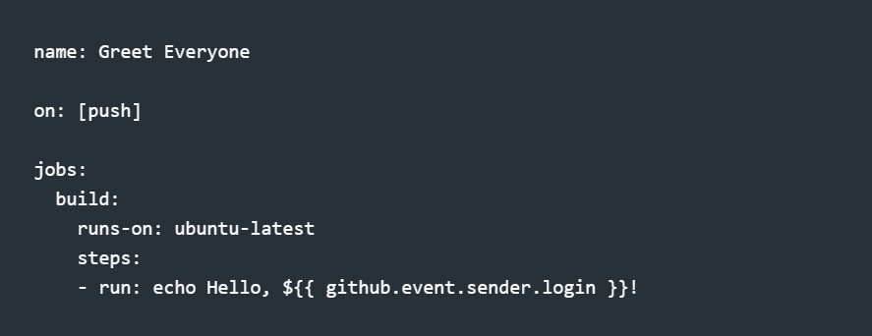
Example CODE

Slide 14
What is a Source Code Repository?
Source Code Repo
A shared centralized place where developers can collaborate on coding
Examples
TFS, Github, bit bucket, Azure Dev Ops , SVN etc

Slide 15
Github Overview
Github
Github is a popular source code repository
Has a CLI
url is https://github.com
Create a new account
Everyone should have an account here.
Download the Github CLI
Create new Repository and add people
I will create repository
Demonstrate how to create and add people to the repository.

Slide 16
Important Links
Downloads
Download .NET 6.0 (Linux, macOS, and Windows) (microsoft.com)
Git - Downloads (git-scm.com)
Download Visual Studio Code - Mac, Linux, Windows
Accounts
GitHub
https://portal.azure.com/
https://dev.azure.com/
Learning Resources
https://azure.microsoft.com/en-us/services/devops/

Slide 17
HANDS ON LAB

