Slide 1
AGENDA
Hydrogen Storage Facility Safety & Monitoring System
Volatile Gaseous Hydrogen Hazards & NFPA 2 Compliance
Functional Requirements: Real-Time 4s Telemetry, ESD Relief & Remote Venting
System Architecture: React 18, Node.js + Express, Socket.io & MongoDB 6
Operational Workflows: Safety Officer Calibration & Remote Depressurization
MongoDB Schemas: Storage Vessels, Time-Series Telemetry & Incident Audits
Module Capabilities: Simulation Cockpit, Spline Waveform & 1-Click Healing
70% Phase 1 Milestone Verification, Technical Challenges & Phase 2 Roadmap
Agenda
Review 1 & 2 | Hydrogen Storage Safety System

Slide 2
01
REQUIREMENTS
Functional & Non-Functional Safety Requirements
Functional Safety Requirements
Non-Functional & Compliance Standards
Continuous 4-second physical telemetry (Pressure bar, Temp °C, H2 ppm, % LEL).
Dynamic safety limit calibration (Warning pressure, critical ESD relief ceilings).
Emergency Remote Pressure Vent override with incident audit logging.
1-Click alert resolution restoring vessel baselines in real time.
Preventive maintenance task tracking & regulatory compliance register.
Zero-delay WebSocket alarm broadcasting to prevent explosive deflagration.
NFPA 2 Compliance: Hydrogen Technologies safety code thresholds enforced.
ISO 19880-1 & OSHA 1910.103: Gaseous hydrogen fueling facility safety.
Sub-50ms Latency: Immediate WebSocket alert dispatch upon ceiling breach.
High-Write Telemetry Buffer: 25-point rolling window with compound indexing.
Fail-Safe Concurrency: Atomic relief valve actuation logging without race conditions.
Zero-Setup Deployment: 3-tier containerized stack orchestrated via Docker Compose.
Requirements
Review 1 & 2 | Hydrogen Storage Safety System

Slide 3
02
ARCHITECTURE
System Architecture: Real-Time Industrial Safety MERN
CLIENT TIER
APPLICATION TIER
DATA TIER
React 18 + Vite SPA
Cubic Bezier Spline Engine
Emergency Vent Console
Bento Grid (STRATIS Style)
⇄
Node.js + Express REST API
Socket.io Duplex WebSockets
4s Telemetry Heartbeat
Emergency Vent Controllers
⇄
MongoDB 6 + Mongoose ODM
Storage Vessels & Headers
Time-Series Telemetry Buffer
Incident & Compliance Audits
Real-time physical telemetry streams over WebSockets every 4 seconds. Threshold breaches emit immediate alarms; emergency remote venting actuates valves and logs audit trails.
Architectural Flow: Sensors -> Simulator -> Express -> Socket.io -> React Dashboard -> 1-Click Depressurization -> MongoDB Recovery.
Architecture
Review 1 & 2 | Hydrogen Storage Safety System

Slide 4
03
USE CASE
Operational Use Cases & Safety Actor Workflows
Incident Lifecycle
1. 4s Telemetry sensor stream
2. Pressure/PPM threshold breach
3. Live WebSocket incident banner
4. Safety Officer remote vent override
5. Valve opens, pressure depressurizes
6. Baseline heals to 280 bar / 98% health
7. Incident resolved & audit logged
Plant Safety Officer:
- Monitors high-pressure buffer headers (350 bar) & cryogenic vessels in real time.
- Dynamically tunes warning pressure and critical Emergency Shutdown (ESD) ceilings.
- Actuates Emergency Remote Pressure Vent override during overpressure surges.
- Resolves incident alerts, automatically restoring safe vessel baselines.
Instrumentation Technician & Compliance Auditor:
- Inspects physical sensor calibration across pressure transmitters & PPM sniffer sensors.
- Verifies NFPA 2 & ISO 19880-1 safety compliance audit registers.
- Dispatches and signs off preventative maintenance inspection work orders.
Use Case
Review 1 & 2 | Hydrogen Storage Safety System

Slide 5
04
ER DIAGRAM
MongoDB Document Schemas & Relationships
Schema Strengths
Compound indexing on (vesselId, timestamp)
Atomic pressure vent status updates
Rolling 25-point buffer for smooth spline charts
Formal foreign key links between vessels & alarms
Zero-setup database auto-seeding on boot
Collection: vessels (High-Pressure & Cryogenic Storage)
- vesselId, name, facilityLocation, type (BUFFER_HEADER, CRYOGENIC, TUBE_TRAILER)
- operatingPressureBar, warningPressureBar, esdCeilingBar, currentTempC
- h2ConcentrationPpm, flammabilityLel, healthScore, status (STABLE, WARNING, ESD)
Collection: telemetryreadings (Time-Series Stream)
- vesselId, timestamp (Compound Indexed), pressureBar, tempC
- h2ConcentrationPpm, flammabilityLel, incidentFlag
Collection: incidentalarms
- alarmId (Unique), vesselId, severity (HIGH, CRITICAL), failureMode
- readingValue, thresholdLimit, status (OPEN, RESOLVED), acknowledged
Collection: complianceaudits & maintenanceorders
- auditId, standardCode (NFPA 2, ISO 19880-1), complianceStatus, verificationDate
- orderId, vesselId, title, checklist, scheduledDate, assignedOfficer, status
ER Diagram
Review 1 & 2 | Hydrogen Storage Safety System

Slide 6
05
MODULES
Core Safety System Modules
Module | Description | Key Functions
Telemetry Simulator | Core Engine | Generates realistic 4s gas dynamics (Pressure, Cryo Temp, PPM, % LEL) over WebSockets
Dynamic Thresholds | Safety Config | Interactive calibration of Warning limits and Emergency Shutdown (ESD) relief ceilings
Remote Pressure Vent | Emergency Control | Console-actuated safety relief valve override with automated incident audit trail
Spline Area Chart | Visualization | Cubic Bezier spline with dynamic auto-scaling, warning limit line, and pulsing beacon
Compliance Register | Auditing | NFPA 2, ISO 19880-1, and OSHA 1910 inspection checklist and audit tracker
Modules
Review 1 & 2 | Hydrogen Storage Safety System

Slide 7
06
TECH STACK
Technology Stack & Safety Infrastructure
MongoDB 6
Express.js
React 18 + Vite
Node.js v20
NoSQL Time-Series Storage
REST API & Vent Controllers
Modern Light UI & SVG Spline
Asynchronous Telemetry Loop
Supporting Tools
Socket.io: Sub-50ms bidirectional WebSocket telemetry streaming
Docker & Docker Compose: Multi-container deployment with isolated networking
Nginx Alpine: Production HTTP reverse proxy mapping API and WebSocket traffic
Mongoose ODM: Strict data modeling, validation schemas, and auto-seeder
Bespoke Light Theme: Hairline slate borders (#e2e8f0), zero AI fluff, high density
Tech Stack
Review 1 & 2 | Hydrogen Storage Safety System

Slide 8
07
UI DESIGN
User Interface Design & Layout
Design Tokens
Light theme with high contrast
Primary Accent: Royal Blue (#2563eb)
Hazard Red: #dc2626 & Emerald: #059669
Slate border: #e2e8f0 & Canvas: #f8fafc
Typography: Plus Jakarta Sans
Monospace: JetBrains Mono
STRATIS-Inspired Industrial Bento Grid:
- 4 primary telemetry KPI cards: Vessel Pressure, Temperature, PPM Leak, and % LEL.
- Color-coded live badges: Green STABLE, Amber WARNING, Red EMERGENCY ESD.
Live Spline Area Telemetry Waveform:
- Smooth cubic Bezier spline with live pulsing tip beacon.
- Dashed red ESD ceiling limit line (350–420 bar).
- Dropdown vessel selector with auto-focus upon overpressure.
Emergency Venting & Incident Resolution:
- Direct Emergency Depressurize button actuating virtual solenoid relief valves.
- 1-Click Resolve instantly clearing alarms and restoring safe baselines.
UI Design
Review 1 & 2 | Hydrogen Storage Safety System

Slide 9
08
FRONTEND
Frontend Implementation Architecture
React 18 functional components with Vite tooling for instantaneous hot module replacement.
Custom SVG Spline Engine: Renders smooth cubic Bezier paths (C cp1, cp2, p) with zero heavy charting overhead.
Dynamic Auto-Scaling: Automatically calculates min/max bounds to highlight subtle pressure and thermal fluctuations.
WebSocket Event Listeners: Listens for telemetry:stream, incident:new, and vessel:update events.
Safety Override Console: Interactive remote vent confirmation modal preventing accidental actuation.
Clean Responsive Layout: 100% responsive Bento container grid with flex-shrink: 0 stability.
Completed Views: Facility Overview, Storage Vessels Roster, Live Area Waveform, Incident Alarms, Remote Venting Console, Compliance Register.
Frontend
Review 1 & 2 | Hydrogen Storage Safety System

Slide 10
09
BACKEND
Backend Architecture & Telemetry Engine
Node.js + Express HTTP server integrated directly with Socket.io WebSocket instance.
4-Second Telemetry Heartbeat: Simulates gas kinetics, pressure build-up, and ambient temperature dissipation.
Emergency Vent Controller: POST /api/vent/override safely depressurizes vessels to baseline and emits socket events.
Incident Resolution Endpoint: PATCH /api/incidents/:id/resolve restores healthy 280 bar / 98% health baseline.
Threshold Calibration Service: Dynamically validates and applies new operator warning and ESD trip limits.
Multi-Vessel Integrity Checks: Evaluates lingering alarms before restoring vessel status to nominal STABLE.
Endpoints: /api/overview, /api/vessels, /api/telemetry, /api/incidents, /api/vent/override, /api/compliance.
Backend
Review 1 & 2 | Hydrogen Storage Safety System

Slide 11
10
DATABASE
Database Integration & Schema Design
MongoDB 6.0 engine running in an isolated Docker container with persistent volumes.
Strict Mongoose schemas enforcing physical unit validations (pressure >= 0 bar, temp >= -253°C).
Compound indexing on (vesselId, timestamp) for rapid telemetry history slicing.
Relational linking between Storage Vessels, Incident Alarms, and Maintenance Work Orders.
Zero-Setup Database Seeder: Populates realistic storage tanks, baseline telemetry, and NFPA audits on first boot.
Incident Lifecycle State Machine: OPEN -> ACKNOWLEDGED -> VENTED -> RESOLVED.
Collections: vessels, telemetryreadings, incidentalarms, maintenanceorders, complianceaudits.
Database
Review 1 & 2 | Hydrogen Storage Safety System

Slide 12
11
API
RESTful API Endpoints & Real-Time Events
Method | Endpoint | Description
GET | /api/overview | Fetches facility KPIs: average pressure, active leak count, and open incidents
GET | /api/vessels | Retrieves complete storage roster (Buffer headers, Cryogenic tanks, Tube trailers)
POST | /api/vent/override | Emergency Remote Vent: depressurizes vessel to safe baseline and logs audit
PATCH | /api/incidents/:id/resolve | 1-Click Resolve: heals vessel health to 98% and clears alarm across fleet
POST | /api/thresholds/update | Calibrates dynamic Warning pressure and Emergency Shutdown (ESD) relief limits
GET | /api/compliance | Returns compliance audit registers for NFPA 2, ISO 19880-1, and OSHA 1910
API
Review 1 & 2 | Hydrogen Storage Safety System

Slide 13
12
STATUS
Implementation Status (70% Milestone Achieved)
Real-Time Telemetry & Socket.IO
100%
Dynamic Safety Thresholds (NFPA 2)
100%
Remote Pressure Vent Override
100%
1-Click Incident Resolution & Healing
100%
Compliance Audit Register Tracker
100%
Overall Phase 1 Milestone Achieved
70%
Status
Review 1 & 2 | Hydrogen Storage Safety System

Slide 14
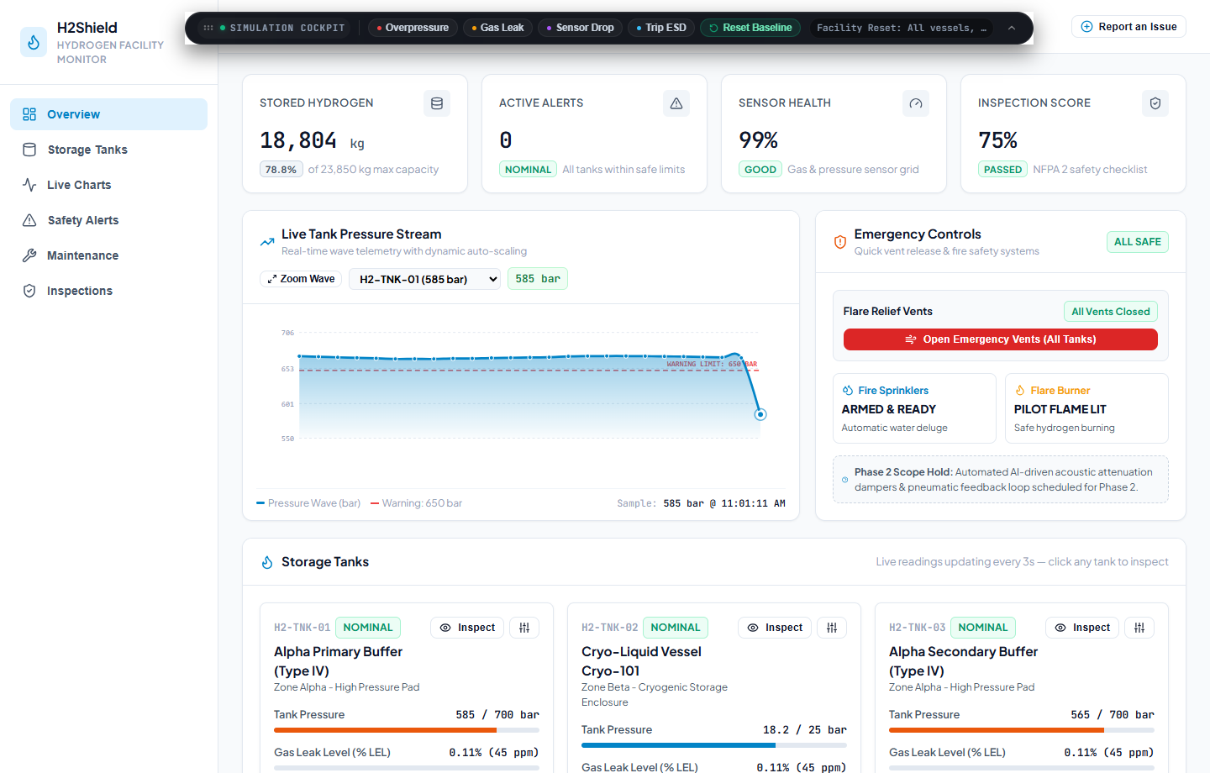
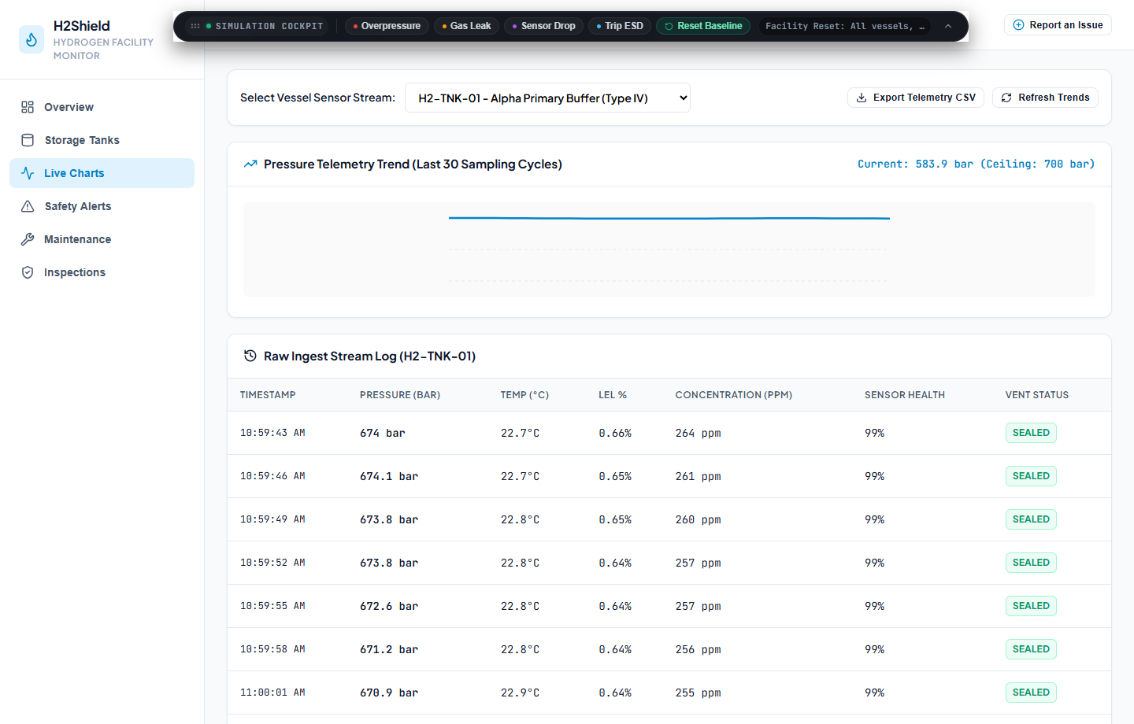
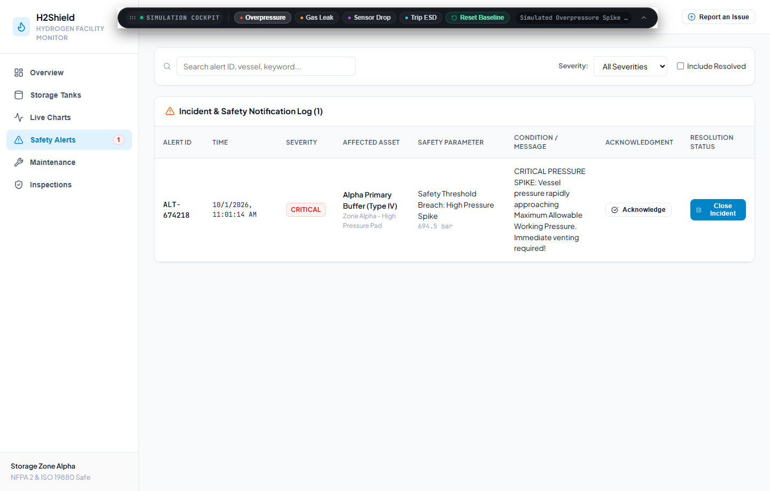
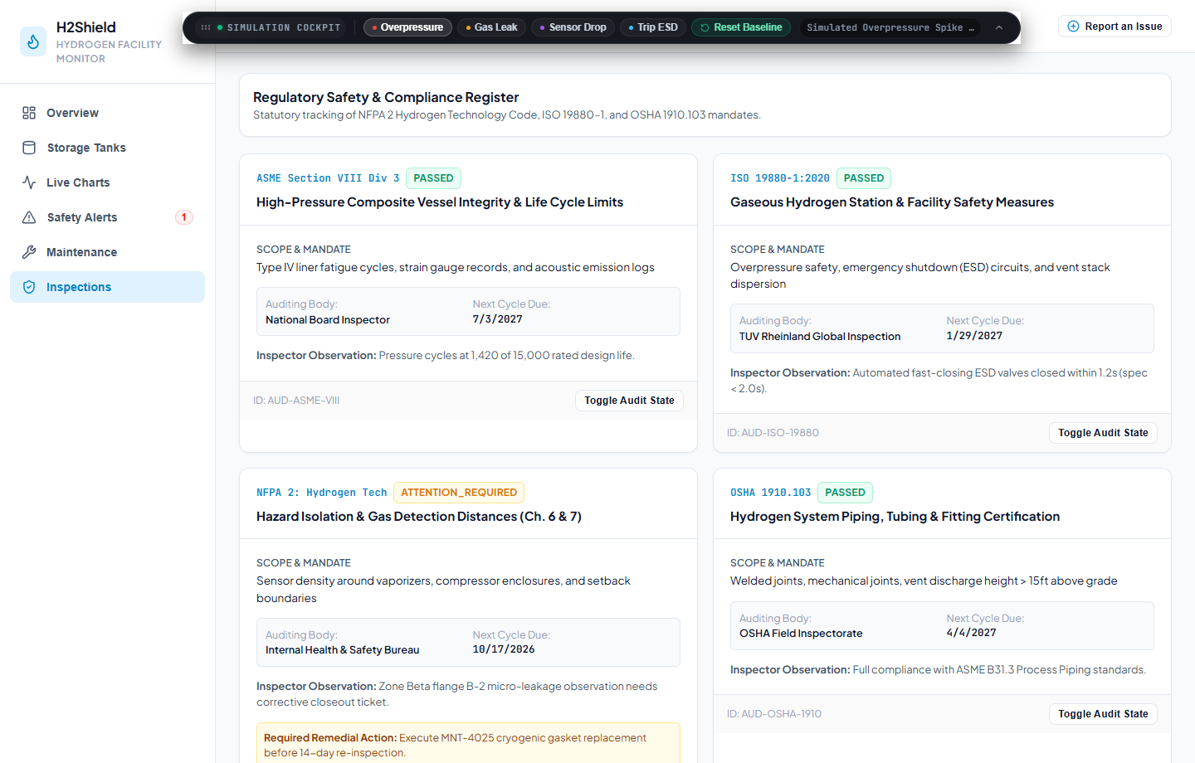
13
SCREENSHOTS
System Verification & User Interface Views
Screenshots
Review 1 & 2 | Hydrogen Storage Safety System

Slide 15
14
CHALLENGES
Technical Challenges & Adopted Solutions
Challenge | Solution Adopted
Sub-50ms WebSocket latency under rapid telemetry pulses | Implemented lightweight binary event payloads with rolling 25-point buffer
Preventing race conditions during emergency remote venting | Atomic Mongoose findOneAndUpdate with immediate WebSocket broadcast lock
SVG rendering lag during rapid cubic spline updates | Optimized Bezier curve math using requestAnimationFrame and pure SVG paths
Ensuring full NFPA 2 safety margin compliance | Enforced strict validation thresholds preventing operator overrides beyond safe limits
Challenges
Review 1 & 2 | Hydrogen Storage Safety System

Slide 16
15
NEXT STEPS
Remaining Scope & Phase 2 Roadmap (30%)
Physical PLC / SCADA Ingestion: Implement Modbus TCP and OPC-UA drivers to connect real facility sensor transmitters.
Automated Flare Stack Actuation: Integrate electronic ignition triggers for emergency overpressure vent combustion.
Multi-Facility Fleet Geospatial Map: Add Mapbox / Leaflet views for monitoring multi-site hydrogen distribution networks.
Role-Based Access Control (RBAC): Implement strict MFA authentication for Certified Safety Officers.
Historical Big-Data Analytics: Integrate TimescaleDB or InfluxDB for multi-year pressure vessel fatigue tracking.
Final Production Handbook: Author complete safety compliance manual and disaster recovery runbooks.
Next Steps
Review 1 & 2 | Hydrogen Storage Safety System

Slide 17
16
NEXT STEPS
Regulatory Standards & Technical References
# | Reference
1 | NFPA 2: Hydrogen Technologies Code (National Fire Protection Association)
2 | ISO 19880-1: Gaseous Hydrogen -- Fueling Stations -- Part 1: General Requirements
3 | OSHA 1910.103: Occupational Safety and Health Standards -- Hydrogen Storage
4 | ASME Boiler and Pressure Vessel Code (BPVC) Section VIII: Rules for Construction of Pressure Vessels
Next Steps
Review 1 & 2 | Hydrogen Storage Safety System

