Slide 1
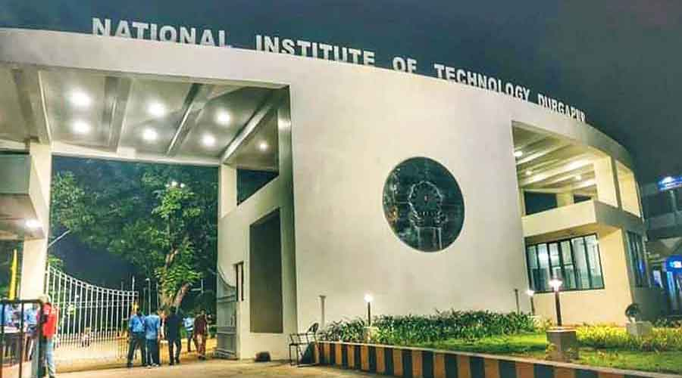
Accelerating LLM on FPGA: A Vitis HLS Approach
Name of the Presenter: Umakant Mukhiya
Roll No of the Presenter: 22CS4121
Guide/Supervisor: Prof. N.D. Jana
December, 2023
Department of Computer Science and Engineering
Notes:
NOTE:
To change the image on this slide, select the picture and delete it. Then click the Pictures icon in the placeholder to insert your own image.

Slide 2
Problem Definition / Objective of the work
To design and implement efficient and scalable FPGA architectures for LLMs.
To optimize the FPGA resource utilization, memory bandwidth, and power consumption for LLMs .
To compare the FPGA-based LLMs with other hardware platforms, such as GPUs and CPUs, in terms of cost, power, and usability.

Slide 3
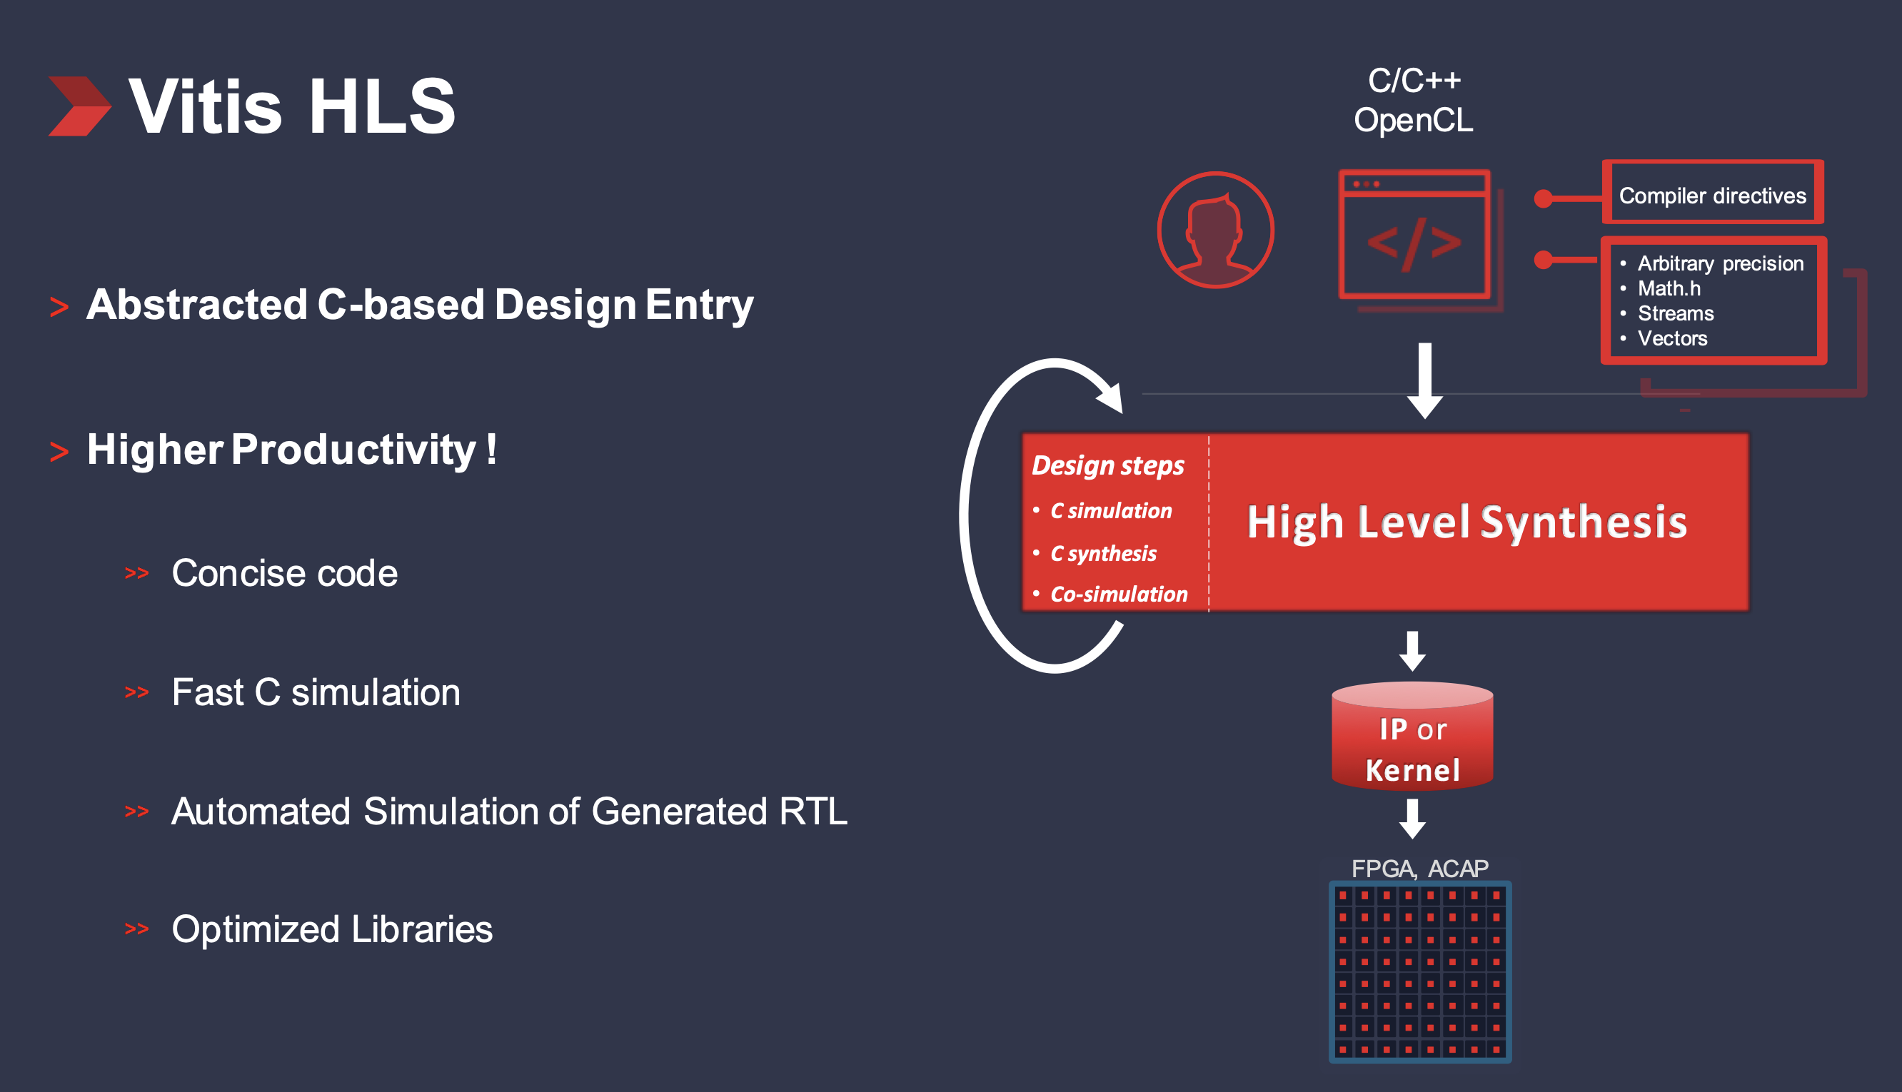
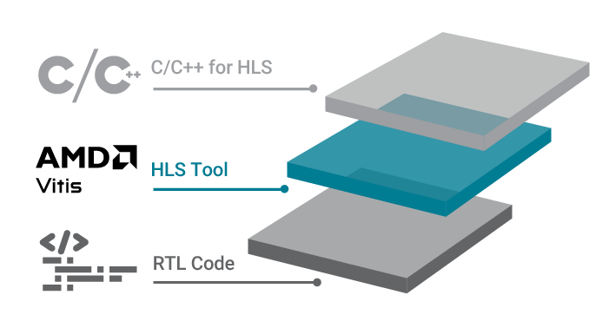
Vitis HLS

Slide 4
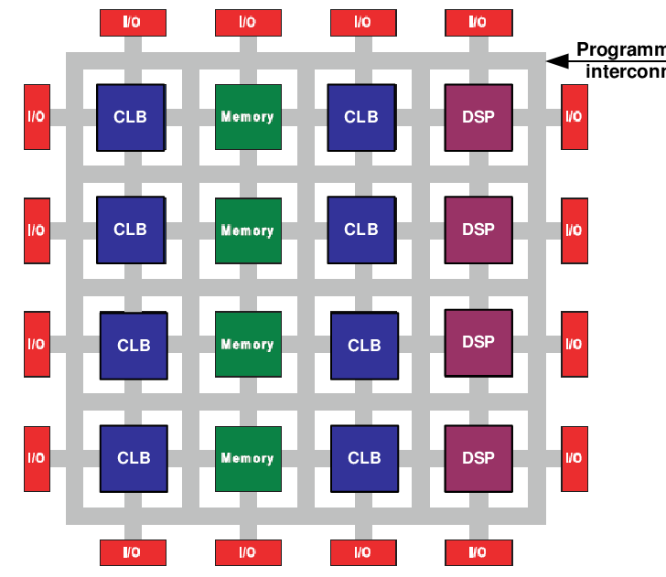
FPGA(Field-Programmable Gate Array)
In simple terms, an FPGA is a type of integrated circuit (a piece of electronic hardware) that can be reprogrammed by users or designers even after it has been manufactured and deployed.
Field-Programmable: You can program (configure) the FPGA after it has been manufactured. Unlike traditional integrated circuits (ICs) that have a fixed function, FPGAs are flexible and can be customized for various applications.
Gate Array: Refers to a grid of logic gates and other configurable components. The logic gates are the building blocks of digital circuits and can be configured to perform different functions based on the user's requirements.
In essence, an FPGA is like a blank canvas of digital logic that you can paint with your own design.

Slide 5
Contribution of your work: Algorithm/Methodology
Engaged in effective communication with team members to share insights and propose solutions for collective success.
Developed and optimized algorithms for implementing the functionality of Language Model (LLM) components, including LayerNorm, MLP, and Decoder layer.
Successfully implemented LayerNorm, MLP on FPGA using Vitis High-Level Synthesis (HLS).
Executed thorough testing to validate the functionality and performance of the FPGA implementation, achieving optimal results.
Played a key role in optimizing the performance of the implemented components, resulting in improved speed and efficiency.
Adapted quickly to evolving project requirements and Demonstrated a commitment to continuous learning by staying abreast of the latest developments in FPGA technology.

Slide 6
Outcome of the work
The utilization of HLS significantly expedited the development process compared to traditional RTL methods, resulting in a faster time-to-market for the implemented features.
Through meticulous optimization using Vitis HLS methodologies, the compute time for key modules such as LayerNorm and MLP was significantly improved.
The adoption of Pipelining, Dataflow, and parallelism in the HLS tool methodology played a pivotal role in achieving remarkable reductions in computation time, thereby enhancing the overall efficiency of the implemented components.
The FPGA implementation not only delivered superior performance but also showcased optimized resource utilization.
This outcome not only validates the decision to adopt HLS but also sets a precedent for future projects aiming to achieve accelerated development without compromising performance.

Slide 7
References and Documentations
Vitis HLS User Guide This is the comprehensive user guide that covers various aspects of using Vitis HLS, from installation to design methodologies.
Vitis HLS Examples. Xilinx provides a set of tutorials on GitHub that can help you get started with Vitis HLS.
Xilinx Community Forums. Xilinx forums are a valuable resource where you can find answers to specific questions, share your experiences, and interact with the community.
Adaptive Computing Developer. Xilinx has a YouTube playlist that covers various aspects of Vitis HLS, including introductory videos and more in-depth tutorials.
Xilinx Developer Program.

Slide 8
Conclusion:
In the course of this project, the successful implementation of Language Model functionalities using Vitis High-Level Synthesis (HLS) on FPGA has yielded significant advancements in both development efficiency and computational performance.
This accomplishment lays the groundwork for future projects, encouraging the broader adoption of HLS for complex algorithmic implementations.

