Slide 1
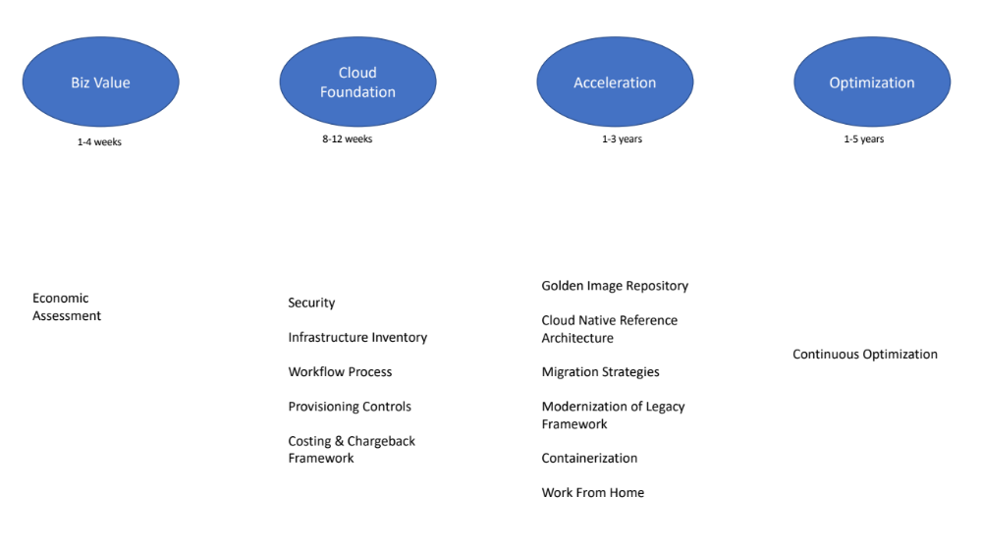
Biz Value
Cloud Foundation
Acceleration
Optimization
1-4 weeks
8-12 weeks
1-3 years
1-5 years
Help me with Best Practices, Standards
Empower & Review Project Architecture
Monitoring and Optimization
Should I embark ?
Security
Infrastructure Inventory
Workflow Process
Provisioning Controls
Costing & Chargeback
Framework
Golden Image Repository
Cloud Native Reference Architecture
Migration Strategies
Modernization of Legacy Framework
Containerization
Work From Home
Continuous Optimization
Economic Assessment
Big Consulting Firms
All Offshore companies

Slide 2
Biz Value
Cloud Foundation
Acceleration
Optimization
1-4 weeks
8-12 weeks
1-3 years
1-5 years
Security
Infrastructure Inventory
Workflow Process
Provisioning Controls
Costing & Chargeback
Framework
Economic Assessment
Help me with Best Practices, Standards
Reference Architecture & Empower Project Teams
Load Balancing and Optimization
Should I embark
Accenture, EY,
McKinsey
Infosys, TCS etc
Infosys, TCS etc

