Slide 1



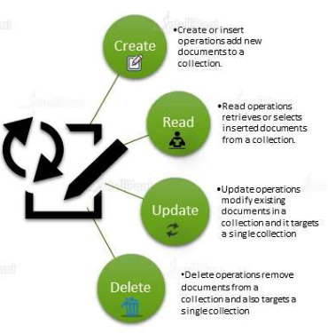
db.collection.insert()
db.collection.find().pretty()
db.collection.insertMany()
db.collection.find()
db.collection.find().limit(2)
db.collection.updateOne()
db.collection.updateMany()
db.collection.replaceOne()
db.collection.deleteOne()

Slide 2

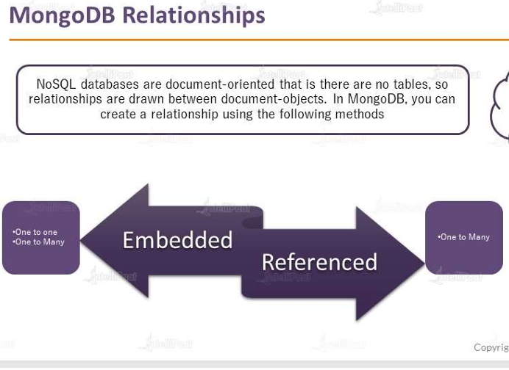


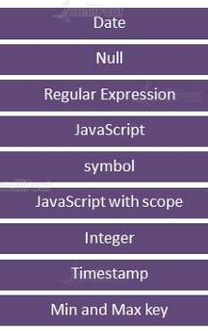

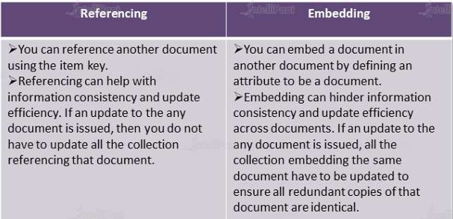


Slide 3
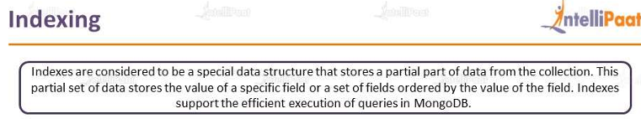

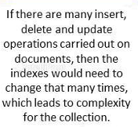

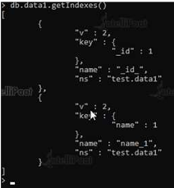
Module 3

Slide 4
Types of indexes
Single field Indexes
Compound Indexes
Multi key indexes
Geospatial Indexes
Text Indexes
Hashed Indexes

