Slide 1
3. Recursive CTEs (The Power Feature)
One of the biggest reasons to use CTEs in SSMS is recursion. This is used to query hierarchical data, like an organizational chart (Manager
Employee) or a folder structure.
A recursive CTE has two parts joined by a UNION ALL:
Anchor Member: The starting point (e.g., the CEO).
Recursive Member: The part that references the CTE itself to find the next level.
Example: Getting an Org Chart Level
In MSSQL (Microsoft SQL Server), a Common Table Expression (CTE) is a temporary result set that you can reference within a SELECT, INSERT, UPDATE, or DELETE statement.
Think of it as a temporary view that exists only for the duration of a single query. It makes complex queries much easier to read and maintain compared to nested subqueries
1. Basic Syntax
A CTE always begins with the WITH keyword
WITH OrgChart AS (
-- Anchor: Start with the top manager
SELECT EmployeeID, Name, ManagerID, 1 AS Level
FROM Employees
WHERE ManagerID IS NULL
UNION ALL
-- Recursive: Join the table back to the CTE
SELECT E.EmployeeID, E.Name, E.ManagerID, OC.Level + 1
FROM Employees E
INNER JOIN OrgChart OC ON E.ManagerID = OC.EmployeeID
)
SELECT * FROM OrgChart ORDER BY Level;
WITH CTE_Name (OptionalColumnAlias) AS (
-- This is the "Define" part
SELECT Column1, Column2
FROM YourTable
WHERE Condition = 1
)
-- This is the "Execute" part
SELECT * FROM CTE_Name;
2. Practical Example: Improving Readability
Imagine you want to find all employees who earn more than the average salary. Using a subquery can get messy; a CTE keeps it clean.
WITH AverageSalaryCTE AS (
SELECT AVG(Salary) AS AvgSalary
FROM Employees
)
SELECT E.EmployeeName, E.Salary
FROM Employees E, AverageSalaryCTE A
WHERE E.Salary > A.AvgSalary;

Slide 2
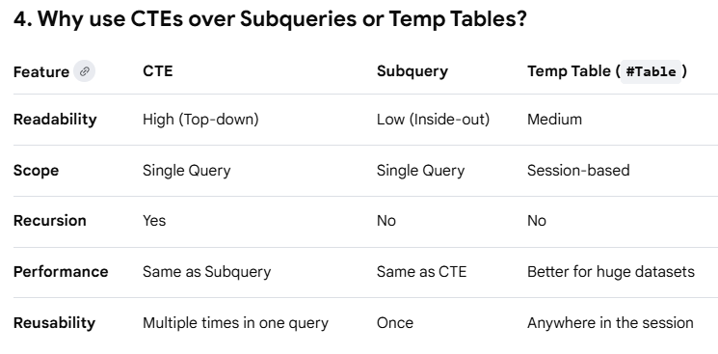
Pro-Tips for SSMS Users
The Semicolon Rule: If the statement before your CTE doesn't end with a semicolon, the CTE might throw an error. Many developers start their CTEs with one just in case: ;WITH MyCTE AS (...).
Debugging: You can't run a CTE by itself. To debug in SSMS, you must highlight both the WITH block and the final SELECT statement before hitting Execute (F5).
Multiple CTEs: You can define multiple CTEs in one go by separating them with a comma: WITH CTE1 AS (...), CTE2 AS (...) SELECT....

Slide 3
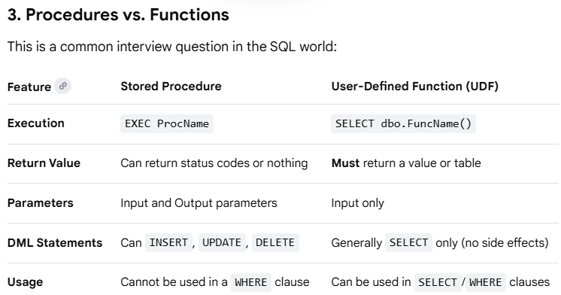
In MSSQL, a Stored Procedure is a prepared piece of SQL code that you save in your database so the code can be reused over and over again. Think of it as a function for your database.
1. Basic Syntax
You define them using CREATE PROCEDURE (or PROC) and execute them with EXEC.
-- Create the procedure
CREATE PROCEDURE GetEmployeeSales
@EmployeeID INT -- This is a parameter
AS
BEGIN
SELECT *
FROM Sales
WHERE SellerID = @EmployeeID;
END;
-- Run it
EXEC GetEmployeeSales @EmployeeID = 5;
4. Advanced Features
Output Parameters: Use the OUTPUT keyword to pass a value back to the caller without a result set.
Error Handling: Use BEGIN TRY...END TRY and BEGIN CATCH...END CATCH blocks to handle exceptions gracefully inside the DB.
Default Values: You can set @Param INT = 0 to make a parameter optional.
Resources for Mastering Procedures
Official Docs: The Microsoft SQL Server Procedure Guide covers everything from creation to encryption.
Tutorials: SQLServerTutorial.net offers a great step-by-step breakdown for beginners.
Practice: Try the LeetCode "Rank Scores" problem and attempt to wrap your logic in a procedure in SSMS
2. Key Advantages
Performance: SQL Server compiles the plan once and reuses it, which is faster than sending raw text queries repeatedly.
Security: You can give a user permission to execute a procedure without giving them access to the underlying tables (this prevents direct data tampering).
Reduced Traffic: Instead of sending a 500-line query over the network, you just send EXEC MyProc.
Maintenance: If logic changes, you update the procedure in one place instead of updating every application that calls it.

Slide 4
CREATE PROCEDURE dbo.usp_UpdateEmployeeSalary
@EmployeeID INT,
@NewSalary DECIMAL(18, 2),
@UpdatedBy VARCHAR(50)
AS
BEGIN
-- 1. Prevents extra result sets from interfering with SELECT statements
SET NOCOUNT ON;
BEGIN TRY
-- 2. Start the transaction
BEGIN TRANSACTION;
-- 3. Perform the Data Manipulation (DML)
UPDATE Employees
SET Salary = @NewSalary,
LastModifiedBy = @UpdatedBy,
LastModifiedDate = GETDATE()
WHERE EmployeeID = @EmployeeID;
-- 4. Log the change to an audit table
INSERT INTO SalaryAudit (EmployeeID, ChangedBy, ChangeDate)
VALUES (@EmployeeID, @UpdatedBy, GETDATE());
-- 5. If everything is fine, save changes permanently
COMMIT TRANSACTION;
PRINT 'Transaction Committed Successfully';
END TRY
BEGIN CATCH
-- 6. If an error occurs, undo all changes since BEGIN TRANSACTION
IF @@TRANCOUNT > 0
ROLLBACK TRANSACTION;
-- 7. Raise the error details for the application to see
DECLARE @ErrorMessage NVARCHAR(4000) = ERROR_MESSAGE();
DECLARE @ErrorSeverity INT = ERROR_SEVERITY();
DECLARE @ErrorState INT = ERROR_STATE();
RAISERROR (@ErrorMessage, @ErrorSeverity, @ErrorState);
END CATCH
END;
GO
Why this structure is "Production Grade":
SET NOCOUNT ON: Improves performance by stopping SQL Server from sending "done-in-proc" messages (e.g., "1 row affected") to the client after every statement.
BEGIN TRANSACTION: Ensures that if the UPDATE works but the INSERT into the audit table fails, the salary change is rolled back. Your data stays consistent.
@@TRANCOUNT: A system function that checks if an active transaction exists before attempting a ROLLBACK, preventing secondary errors.
RAISERROR: Passes the internal SQL error back to your application (C#, Python, etc.) so your frontend knows exactly what went wrong.
How to test it in SSMS:
-- Execution EXEC dbo.usp_UpdateEmployeeSalary
@EmployeeID = 101,
@NewSalary = 75000.00,
@UpdatedBy = 'AdminUser';

Slide 5
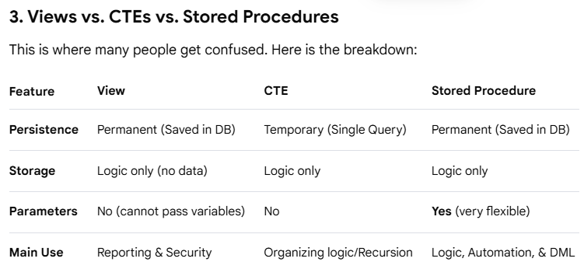
In MSSQL, a View is essentially a virtual table. It doesn't store data itself; instead, it stores a SELECT query. When you query the view, SQL Server runs the underlying query and shows you the results as if they were coming from a real table.
2. Why use Views?
Security (Data Masking): You can give a user access to a view that excludes sensitive columns (like SocialSecurityNumber or Salary) instead of giving them access to the base table.
Simplicity: If you have a query with 5 joins that you run every day, you can save it as a view and just run SELECT * FROM MyView.
Consistency: It ensures everyone is using the same logic (e.g., the same definition of an "Active Customer").
Renaming Columns: You can use a view to give cryptic table columns more user-friendly names without changing the actual database schema.
4. Advanced: Indexed Views (Materialized Views)
While standard views don't store data, MSSQL allows you to create Indexed Views.
When you create a "Unique Clustered Index" on a view, the result set is actually persisted to disk.
Benefit: Huge performance boost for massive aggregations (e.g., summing millions of rows).
Trade-off: It slows down updates/inserts to the base tables because the index must be updated too.
1. Basic Syntax
Creating a view is straightforward. You wrap your query in a CREATE VIEW statement.
CREATE VIEW v_ActiveEmployeeProjectDetails AS
SELECT
E.EmployeeName,
P.ProjectName,
D.DepartmentName
FROM Employees E
JOIN Projects P ON E.ProjectID = P.ProjectID
JOIN Departments D ON E.DeptID = D.DeptID
WHERE E.IsActive = 1;
-- To use it:
SELECT * FROM v_ActiveEmployeeProjectDetails WHERE DepartmentName = 'Engineering';
5. Limitations to Remember
No Parameters: You cannot pass a variable into a view (use a Table-Valued Function for that).
Ordering: You generally cannot use ORDER BY inside a view unless you also use TOP.
Performance: A view is only as fast as the query inside it. If the query is slow, the view will be slow.

Slide 6
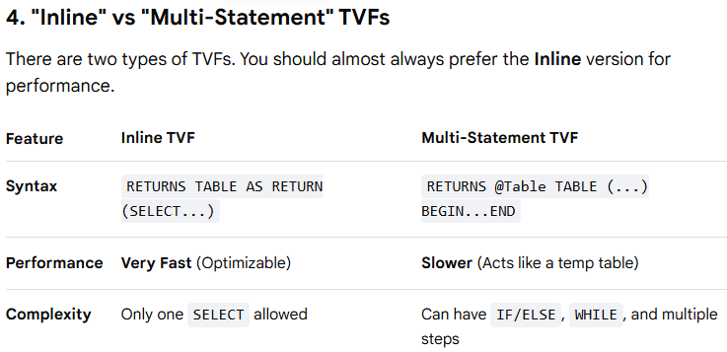
2. How to Use It
The beauty of a TVF is that you can use it in the FROM clause and even JOIN it to other tables, which you cannot do with a Stored Procedure.
In SQL Server, when you wish a View could take a parameter (like a specific Date or DepartmentID), you use an Inline Table-Valued Function (iTVF).
It looks like a function, but it acts like a view that you can "plug" values into.
-- Use it like a table
SELECT * FROM dbo.ufn_GetEmployeesByDept('Engineering');
-- Join it to another table
SELECT Proj.ProjectName, DeptStaff.*
FROM Projects Proj
CROSS APPLY dbo.ufn_GetEmployeesByDept('Engineering') AS DeptStaff
WHERE Proj.ProjectStatus = 'Active';
1. Basic Syntax
Unlike a Stored Procedure, an Inline TVF must return a table and consists of a single SELECT statement.
CREATE FUNCTION dbo.ufn_GetEmployeesByDept
(
@DeptName NVARCHAR(50) -- The parameter
)
RETURNS TABLE
AS
RETURN
(
SELECT
EmployeeID,
EmployeeName,
JobTitle
FROM Employees E
JOIN Departments D ON E.DeptID = D.DeptID
WHERE D.DepartmentName = @DeptName
);
GO
3. Why use an iTVF instead of a View or Proc?
Over a View: Views are static. If you want to filter a View, you have to filter the entire result set. An iTVF allows the database to optimize the query using your parameter from the very start.
Over a Stored Procedure: You can't use a Stored Procedure inside a JOIN or a WHERE clause. You can with an iTVF.
Performance: Inline TVFs are highly efficient because SQL Server treats them like a macro—it expands the code into the main query, allowing the optimizer to create a single, efficient execution plan.
Summary of "The Big Four"
To keep your SSMS tools straight:
View: A saved, static query.
CTE: A temporary, "one-time-use" view inside a query.
Stored Procedure: A script for "actions" (logic, updates, security).
Table-Valued Function: A "view with parameters" that returns data.

Slide 7
SSMS Architect Challenge:
The Scenario
You are managing a database for a global retail chain. You need to handle three specific tasks:
Task A: You need to generate a monthly report that shows every transaction, but you must hide the customer’s credit card numbers and home addresses for privacy reasons.
Task B: You need a way for the mobile app to pass a specific StoreID and StartDate to the database and get back a list of sales for just that store and timeframe. You want to be able to JOIN this result with a Product table later.
Task C: Every night at midnight, you need to run a script that calculates daily totals, inserts them into a Summary table, and then sends an email notification if any totals are suspiciously low.
Task A (View): Perfect. Views are the industry standard for security masking. By pointing the report to a View instead of the base table, you ensure users never even see the sensitive columns.
Task B (iTVF): Exactly. Because you mentioned the need to JOIN the result to another table, a Stored Procedure would have been a headache. The iTVF makes the logic "composable."
Task C (Stored Procedure): Correct. Since this involves logic (calculating), DML (inserting into a summary table), and an action (sending an email), a Stored Procedure is the only tool for the job.
The Scenario
You are managing a database for a global retail chain. You need to handle three specific tasks:
Task A: You need to generate a monthly report that shows every transaction, but you must hide the customer’s credit card numbers and home addresses for privacy reasons.
Task B: You need a way for the mobile app to pass a specific StoreID and StartDate to the database and get back a list of sales for just that store and timeframe. You want to be able to JOIN this result with a Product table later.
Task C: Every night at midnight, you need to run a script that calculates daily totals, inserts them into a Summary table, and then sends an email notification if any totals are suspiciously low.
One Final "Boss Level" Detail
In Task C, since it runs at midnight, you would typically use the SQL Server Agent in SSMS to schedule that Stored Procedure to run automatically.
The Question
Which tool is the best fit for each task?
View
CTE
Stored Procedure
Table-Valued Function (iTVF)

Slide 8
A Trigger is a special type of stored procedure that "fires" (executes automatically) when a specific event occurs in the database. Think of it as a security guard or an automated auditor watching your tables 24/7
CREATE TRIGGER trg_ProductPriceAudit
ON Products
AFTER UPDATE
AS
BEGIN
SET NOCOUNT ON;
-- Check if the Price column was actually changed
IF UPDATE(Price)
BEGIN
INSERT INTO PriceHistory (ProductID, OldPrice, NewPrice, ChangeDate)
SELECT
d.ProductID,
d.Price, -- Value from 'deleted' (old)
i.Price, -- Value from 'inserted' (new)
GETDATE()
FROM deleted d
JOIN inserted i ON d.ProductID = i.ProductID;
END
END;
1. The Three Main Events
Triggers usually react to DML (Data Manipulation Language) actions:
INSERT: When new rows are added.
UPDATE: When existing rows are changed.
DELETE: When rows are removed.
2. The "Magic" Tables: inserted and deleted
This is the most important concept in MSSQL triggers. When a trigger fires, SQL Server creates two temporary, memory-resident tables:
inserted Table: Holds the new versions of the rows (exists for INSERT and UPDATE).
deleted Table: Holds the old versions of the rows (exists for DELETE and UPDATE).
3. Basic Syntax Example (Audit Log)
Imagine you want to track whenever someone changes a product price.
5. The Dark Side (Warnings)
Triggers are powerful but can be dangerous if overused:
Hidden Logic: Developers often forget triggers exist because they happen "behind the scenes." This makes debugging difficult.
Performance: Triggers run as part of the same transaction. If your trigger is slow, the user's UPDATE statement will also be slow.
Complexity: A trigger on Table A might update Table B, which has its own trigger to update Table C. This is called Nested Triggers and can lead to infinite loops.
Best Practice Tools
Documentation: Check the Microsoft Trigger Guide for strict syntax rules.
Management: In SSMS, you can find triggers for a specific table under:
Databases -> [YourDB] -> Tables -> [YourTable] -> Triggers.
4. "AFTER" vs. "INSTEAD OF" Triggers
AFTER Trigger (Most Common): Fires after SQL Server completes the action (the data is already changed). Great for logging and synchronization.
INSTEAD OF Trigger: Fires instead of the action. If you try to delete a row, the trigger runs and the delete doesn't happen unless you manually code it inside the trigger. Great for complex views or enforcing strict business rules.

Slide 9
Implementing a "No-Delete Fridays" rule is the perfect use case for an INSTEAD OF trigger. Since this trigger runs before the actual deletion happens, we can intercept the attempt and cancel it with a friendly (or stern) warning.
The "No-Delete Fridays" Trigger
Why this is different from an AFTER trigger:
The Interception: In an AFTER trigger, the row is already gone by the time the code runs; you would have to ROLLBACK to get it back. In an INSTEAD OF trigger, the row hasn't been touched yet.
The Manual Action: If the condition (it's not Friday) is met, you are responsible for executing the DELETE statement inside the ELSE block. If you forget that line, the table will never allow deletes, even on Mondays! Learn more about INSTEAD OF logic on Microsoft Learn.
CREATE TRIGGER trg_PreventDeleteFriday
ON Employees
INSTEAD OF DELETE
AS
BEGIN
SET NOCOUNT ON;
-- Check if today is Friday (Friday is typically 6 in SQL Server, depending on DATEFIRST)
-- Using DATEPART and weekday name for clarity
IF DATENAME(weekday, GETDATE()) = 'Friday'
BEGIN
RAISERROR ('Deletion is prohibited on Fridays to prevent weekend deployment disasters.', 16, 1);
-- Note: We do NOT perform a DELETE here, so the rows stay safe.
END
ELSE
BEGIN
-- If it's not Friday, we must manually perform the delete
-- because this trigger REPLACED the original delete action.
DELETE FROM Employees
WHERE EmployeeID IN (SELECT EmployeeID FROM deleted);
PRINT 'Deletion successful.';
END
END;
GO
Pro-Tip: Disabling Triggers
If you have an emergency and must delete something on a Friday, you don't have to delete the trigger. You can temporarily disable it in SSMS:
DISABLE TRIGGER trg_PreventDeleteFriday ON Employees;
-- Perform your emergency delete
DELETE FROM Employees WHERE EmployeeID = 999;
ENABLE TRIGGER trg_PreventDeleteFriday ON Employees;

Slide 10
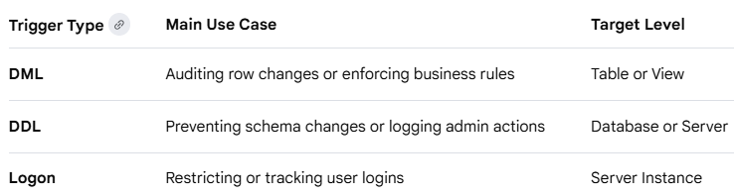
In MSSQL, triggers are classified into three main categories based on the type of event that fires them.
1. DML Triggers (Data Manipulation Language)
These are the most common and fire when data inside a table or view is modified.
Events: INSERT, UPDATE, or DELETE.
Sub-Types:
  AFTER Triggers: Execute after the data modification is completed.
  INSTEAD OF Triggers: Execute in place of the standard action, allowing you to bypass or redirect the modification.
2. DDL Triggers (Data Definition Language)
These fire in response to changes in the database structure rather than the data itself.
Events: CREATE, ALTER, or DROP statements (e.g., dropping a table or altering a procedure).
Scope: Can be scoped to the entire Server or just a specific Database.
3. Logon Triggers
These are specialized triggers that fire when a user's session is established.
Purpose: Used for security, auditing connections, or restricting access based on the number of concurrent users or time of day
1. DML Trigger (Data Manipulation)
This template tracks changes to a specific table. It uses the inserted and deleted tables to log who changed what.
CREATE TRIGGER dbo.trg_AuditEmployeeSalary
ON dbo.Employees
AFTER UPDATE
AS
BEGIN
SET NOCOUNT ON;
-- Only log if the Salary column was actually updated
IF UPDATE(Salary)
BEGIN
INSERT INTO SalaryAudit (EmployeeID, OldSalary, NewSalary, ChangedBy, ChangeDate)
SELECT
d.EmployeeID,
d.Salary, -- Old value from deleted table
i.Salary, -- New value from inserted table
SUSER_SNAME(),
GETDATE()
FROM deleted d
INNER JOIN inserted i ON d.EmployeeID = i.EmployeeID;
END
END;

Slide 11
2. DDL Trigger (Data Definition)
This template prevents users from dropping tables in your database. DDL triggers use EVENTDATA() to capture details about the structural change.
3. Logon Trigger
Logon triggers are created at the Server level (not the database level). This template limits a specific login to only one active session at a time.
CREATE TRIGGER trg_LimitUserSessions
ON ALL SERVER
FOR LOGON
AS
BEGIN
-- Check if the current login is the one we want to restrict
IF ORIGINAL_LOGIN() = 'TestAccount'
AND (SELECT COUNT(*) FROM sys.dm_exec_sessions
WHERE is_user_process = 1
AND original_login_name = 'TestAccount') > 1
BEGIN
-- Rollback prevents the session from being established
ROLLBACK;
END
END;
CREATE TRIGGER trg_PreventTableDrop
ON DATABASE
FOR DROP_TABLE
AS
BEGIN
SET NOCOUNT ON;
DECLARE @EventData XML = EVENTDATA();
DECLARE @ObjectName NVARCHAR(255) = @EventData.value('(/EVENT_INSTANCE/ObjectName)[1]', 'NVARCHAR(255)');
PRINT 'Attempt to drop table ' + @ObjectName + ' was blocked for security reasons.';
-- Rollback cancels the DROP command entirely
ROLLBACK;
END;
Crucial Tips for SSMS
Location: DML triggers are found under the specific table in Object Explorer. DDL triggers are under Programmability -> Database Triggers. Logon triggers are under Server Objects -> Triggers.
Testing: Always test your triggers on a development database first. A buggy Logon Trigger can accidentally lock everyone (including the admin) out of the entire server.

Slide 12
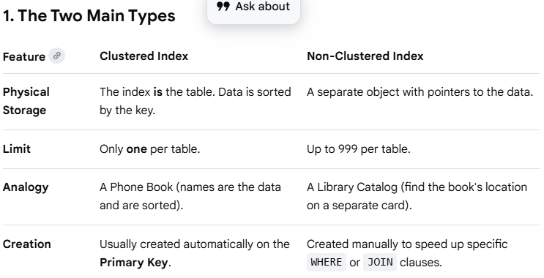
An Index is a physical structure in SQL Server that speeds up data retrieval. Think of it exactly like the index at the back of a textbook: instead of scanning every single page (a Table Scan) to find a topic, you look up the keyword in the index and jump straight to the correct page number (an Index Seek)
-- 1. Create a standard Non-Clustered Index
CREATE INDEX IX_Employees_LastName
ON Employees (LastName);
-- 2. Create a Unique Index (prevents duplicate values)
CREATE UNIQUE INDEX UIX_Employees_Email
ON Employees (Email);
-- 3. Create a Covering Index (Includes extra columns so SQL doesn't have to go back to the table)
CREATE INDEX IX_Orders_Date_Included
ON Orders (OrderDate)
INCLUDE (TotalAmount, CustomerID);
4. Pro-Tips for SSMS Users
The Execution Plan: Press Ctrl + M in SSMS before running a query. If you see a Table Scan or Clustered Index Scan on a large table, you likely need a better index.
Missing Index Suggestions: SQL Server is helpful! If you look at the Execution Plan, it will often show green text at the top saying "Missing Index (Impact 85%)". You can right-click that text to generate the CREATE INDEX script immediately.
Fragmentation: Over time, as data is deleted and moved, indexes become "fragmented" (messy). Use the ALTER INDEX REBUILD command to clean them up and restore performance
3. When to Use (and When to Avoid)
✅ Use them on:
  Columns used frequently in JOIN statements (Foreign Keys).
  Columns used in WHERE filters (e.g., Status = 'Active').
  Columns used in ORDER BY or GROUP BY.
❌ Avoid them on:
  Small tables (scanning the whole thing is faster than reading an index).
  Columns with "Low Cardinality" (e.g., a Gender column with only 2 values).
  Tables with massive INSERT/UPDATE volume (every index makes writes slower because the index must be updated too).
Resources
Deep Dive: The Microsoft Index Design Guide is the "bible" for understanding B-Trees and performance.
Visual Learning: Use Brent Ozar's SQL Server training to understand how to pick the right columns for your index.

