Slide 1
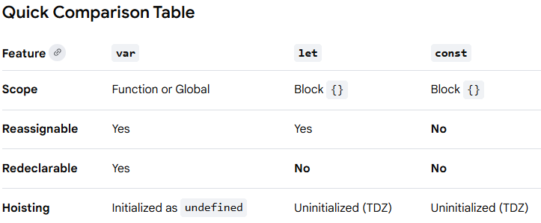
In modern JavaScript, the choice between var, let, and const depends on how you want to handle scoping, reassignment, and hoisting
Key Differences
const (Constant)
Default choice for modern development.
It creates an immutable binding, meaning you cannot reassign the variable to a new value once set.
Note: While you can't reassign the variable itself, you can still mutate the properties of an object or array declared with const.
let
Used for variables that need to change later (e.g., counters in a loop).
It is block-scoped, meaning it only exists within the curly braces {} where it was defined (like inside an if statement or a for loop).
var
The original keyword, now mostly considered obsolete.
It is function-scoped, which can lead to bugs because it "leaks" out of blocks like if or for.
It is hoisted and initialized as undefined, allowing it to be accessed before the actual line of code where it is declared (though this is usually poor practice).
Summary Recommendation
Use const by default.
Use let only if you know the value will be reassigned.
Avoid var in modern production code to prevent scoping issues.

Slide 2
To see how these keywords really differ, look at how they handle asynchronous code (like setTimeout) inside a loop. This is a classic interview question and a common source of bugs.
1. The var Trap (Shared Scope)
Because var is function-scoped, the loop shares a single variable i across every iteration. By the time the setTimeout actually runs (after 100ms), the loop has already finished, and the shared i is now 3.
javascript
for (var i = 0; i < 3; i++) { setTimeout(() => { console.log("var:", i); }, 100); } // Output after 100ms: // var: 3 // var: 3 // var: 3
Use code with caution.
2. The let Solution (New Scope per Iteration)
When you use let, JavaScript creates a new, fresh variable i for every single loop iteration. Each setTimeout "remembers" the specific value of i from its own iteration.
javascript
for (let i = 0; i < 3; i++) { setTimeout(() => { console.log("let:", i); }, 100); } // Output after 100ms: // let: 0 // let: 1 // let: 2
Use code with caution.
3. The const Error (Immutable)
Using const in a traditional for loop will cause an immediate TypeError. This is because the loop needs to increment i (which is a reassignment), and const forbids this.
javascript
for (const i = 0; i < 3; i++) { // ❌ TypeError: Assignment to constant variable. }
Use code with caution.
Pro Tip: You can use const in a for...of or for...in loop because a new constant is created for each item, rather than reassigning the same one.

Slide 3
Scenario 1: The "Shopping Cart" Problem
Question: You are building a checkout page. You have a totalPrice that increases as items are added, and a TAX_RATE that never changes. Which keywords do you use?
Answer:
Use let for totalPrice because its value must be reassigned every time an item is added.
Use const for TAX_RATE because it is a fixed configuration value that should not be accidentally overwritten
Scenario 5: Modern Best Practices
Question: You are starting a new React or Node.js project. What is the community-accepted "rule of thumb" for choosing between these three?
Answer:
Use const for everything by default.
If you find you must reassign the value, change it to let.
Never use var in modern development.
Scenario 2: The "API Response" Object
Question: If you fetch user data and store it in a const user = {}, can you still update user.name = "Alice"? Why or why not?
Answer: Yes. const creates an immutable binding, not an immutable value. You cannot reassign the variable user to a new object, but you can mutate the properties of the existing object.
Scenario 3: The "Accidental Global" Bug
Question: You have a function with a loop inside it. Using var i inside that loop, you notice i is still accessible after the loop finishes. How do you fix this and why does it happen?
Answer:
Fix: Change var i to let i.
Reason: var is function-scoped, so it "leaks" outside of the for block but stays inside the function. let is block-scoped, so it exists only inside the loop's curly braces {} and is deleted immediately after.
Scenario 4: The "Temporal Dead Zone" (TDZ)
Question: What happens if you try to console.log(x) before you declare let x = 5? How does this differ from var x = 5?
Answer:
With let, you get a ReferenceError because the variable is in the Temporal Dead Zone (TDZ).
With var, you get undefined because var is hoisted and initialized with undefined at the start of the script

Slide 4
Question 1: The Scoping Test
What will be logged to the console here?
javascript
{ var a = "Apple"; let b = "Banana"; } console.log(a); console.log(b);
Use code with caution.
Answer:
a logs "Apple" because var ignores the curly braces (it’s not a function).
b throws a ReferenceError because let is block-scoped and died inside the {}.
Question 2: The Object Mutation
Will this code throw an error?
javascript
const laptop = { brand: "Dell" }; laptop.brand = "Apple"; console.log(laptop.brand);
Use code with caution.
Answer:
No error. It logs "Apple".
Why? You didn't reassign the variable laptop itself; you only mutated a property inside the object. const only stops you from doing laptop = { brand: "HP" }.
Question 3: The Hoisting Race
What is the result of this execution?
javascript
console.log(x); var x = 10; console.log(y); let y = 20;
Use code with caution.
Answer:
console.log(x) logs undefined (it's hoisted but not assigned).
console.log(y) throws a ReferenceError because let is in the Temporal Dead Zone until the code actually hits the declaration.
Question 4: The Redefinition
Which of these will work without crashing?
javascript
// Case A var name = "John"; var name = "Pete"; // Case B let age = 25; let age = 30;
Use code with caution.
Answer:
Case A works fine. var allows redeclaration, which is actually a major source of bugs.
Case B crashes. let (and const) will throw a SyntaxError if you try to declare the same name in the same scope.

Slide 5
there are eight data types in JavaScript. Seven of them are called “primitive”, because their values contain only a single thing (be it a string or a number or whatever).
let user = new Object(); // "object constructor" syntax
let user = {}; // "object literal" syntax
let user = { // an object
name: "John", // by key "name" store value "John"
age: 30 // by key "age" store value 30
};
// get property values of the object:
alert( user.name ); // John
alert( user.age ); // 30
delete user.age;
let user = { name: "John", age: 30, }
That is called a “trailing” or “hanging” comma. Makes it easier to add/remove/move around properties, because all lines become alike.

