Slide 1
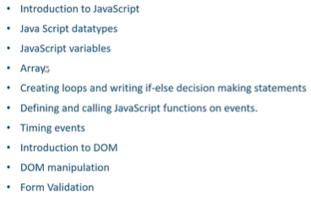

Slide 2
Introduction to JavaScript
JS is a cross platform. Object oriented scripting language used to make webpages interactive.
When a JavaScript is placed inside a webpage, the browser loads the page and built-in interpreter reads the JS code and execute
JS is case sensitive and dynamic typing, loosely typed. i.e. variable data types are not declared
JS is used in Webpages for
-- validating data
-- Putting dynamic content into an HTMl page
-- To make then interactive
Client-side scripting language Server-side scripting language
Inline scripting
External scripting
Alert(“Hi”)

