Slide 1
Mastering Core Java requires a blend of deep conceptual understanding and consistent hands-on practice. Here are key tips to guide your journey:
1. Solidify the Fundamentals
Before jumping into complex frameworks, ensure you have a "rock-solid" foundation in the basics:
Syntax & Control Flow: Be comfortable with variables, data types, loops (for, while), and conditional logic (if-else, switch).
OOPS Pillars: Master the four pillars of Object-Oriented Programming—Encapsulation, Inheritance, Polymorphism, and Abstraction.
Collections Framework: Deeply understand the Java Collections Framework, specifically when to use ArrayList vs. LinkedList, and how HashMap and HashSet work internally.
2. Practice "Active Learning"
Don't just watch tutorials; you must write code to retain it.
Build Real Projects: Move from basic console apps (like a calculator or to-do list) to medium-sized projects that solve real-world problems.
Solve Coding Challenges: Use platforms like LeetCode, HackerRank, and Exercism to improve your algorithmic thinking.
Read Others' Code: Explore open-source projects on GitHub to see how professionals structure their code and handle complexity.
3. Deep Dive into Advanced Core Concepts
To truly stand out, master these "expert-level" core topics:
Memory Management: Learn how the JVM (Java Virtual Machine) works, including the Heap, Stack, and Garbage Collection processes.
Concurrency: Master multithreading using the ExecutorService and CompletableFuture to build high-performance applications.
Java 8+ Features: Become proficient with modern Java features like Lambda expressions, the Streams API, and Records.
4. Use the Right Tools
IDE Proficiency: Get comfortable with an industry-standard IDE like IntelliJ IDEA or Eclipse. Learn their debugging tools to step through your code line by line.
Build Systems: Learn Maven or Gradle to manage dependencies and automate your build process.
5. Recommended Resources
Books:
Head First Java
(for beginners) and
Effective Java
by Joshua Bloch (for best practices).
Official Docs: Regularly consult the
Official Oracle Java Documentation
for the most accurate and up-to-date information.

Slide 2
Tips for Mastering Core Java
Understand OOP deeply - Practice creating real-world objects with proper relationships
Master Collections - Know when to use List, Set, Map, Queue
Exception Handling - Create meaningful custom exceptions
File I/O - Practice reading/writing different file formats
Date/Time API - Handle dates correctly in real applications
Validation - Always validate user input
Separation of Concerns - Keep UI, business logic, and data separate
Code Organization - Use packages to organize your code
Documentation - Write meaningful comments and JavaDoc
Testing - Test edge cases thoroughly

Slide 3
In Java, Collections refer to a unified framework (java.util package) designed to store, manage, and manipulate groups of objects. Unlike arrays, collections are dynamic and can grow or shrink in size automatically.
Core Interfaces and Their Roles
The framework is built on a hierarchy of interfaces that define the behavior for different types of data structures:
List: An ordered collection that allows duplicate elements. You can access items by their index.
Set: A collection that does not allow duplicate elements. It is primarily used to ensure uniqueness.
Queue: Designed for holding elements prior to processing, typically following First-In-First-Out (FIFO).
Deque: A double-ended queue that supports adding or removing elements from both ends.
Map: Stores data in key-value pairs. While technically not extending the Collection interface, it is a core part of the framework.
Common Implementation Classes
Essential Utility Methods
The Collections Utility Class provides static methods for common operations:
sort(List): Sorts the list in ascending order.
reverse(List): Reverses the order of elements.
binarySearch(List, key): Efficiently finds an element in a sorted list.
synchronizedCollection(c): Returns a thread-safe version of a collection.
Important Constraints
No Primitives: Collections can only store objects. To store int or double, Java uses wrapper classes like Integer or Double.
Generics: Using <Type> (e.g., ArrayList<String>) provides type safety, catching errors at compile-time instead of runtime.

Slide 4
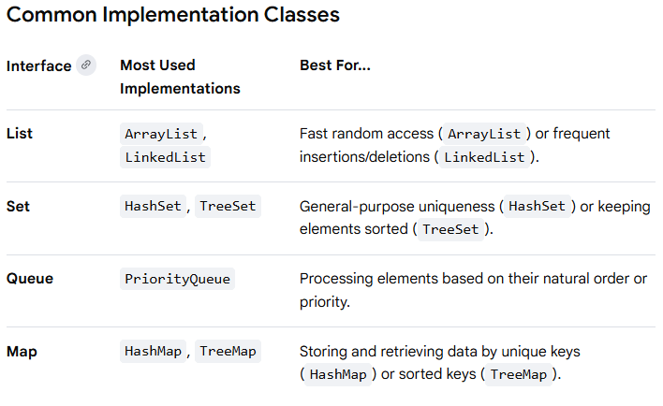

Slide 5
1. ArrayList (Dynamic List)
Use an ArrayList when you need an ordered collection that can grow as you add elements.
import java.util.ArrayList;
import java.util.Collections;
public class ListExample {
public static void main(String[] args) {
// Create an ArrayList of Strings
ArrayList<String> fruits = new ArrayList<>();
// Add elements
fruits.add("Apple");
fruits.add("Banana");
fruits.add("Cherry");
// Access by index
System.out.println("First fruit: " + fruits.get(0)); // Apple
// Sort the list using the Collections utility
Collections.sort(fruits);
// Iterate through the list
for (String fruit : fruits) {
System.out.println("Fruit: " + fruit);
}
}
}

Slide 6
2. HashMap (Key-Value Pairs)
Use a HashMap to store data in pairs, like a dictionary where you look up a "value" using a unique "key".
import java.util.HashMap;
import java.util.Map;
public class MapExample {
public static void main(String[] args) {
// Create a HashMap: Key is String (Name), Value is Integer (Age)
HashMap<String, Integer> userAges = new HashMap<>();
// Add pairs
userAges.put("Alice", 25);
userAges.put("Bob", 30);
userAges.put("Charlie", 35);
// Retrieve a value by its key
int bobAge = userAges.get("Bob");
System.out.println("Bob's age: " + bobAge);
// Check if a key exists
if (userAges.containsKey("Alice")) {
System.out.println("Alice is in the system.");
}
// Iterate over entries
for (Map.Entry<String, Integer> entry : userAges.entrySet()) {
System.out.println(entry.getKey() + " is " + entry.getValue() + " years old.");
}
}
}

Slide 7
Summary of Key Methods
add(element): Appends an item to a List or Set.
put(key, value): Adds a pair to a Map.
get(index/key): Retrieves an item from a List (by index) or Map (by key).
remove(index/key): Deletes an item from the collection.
size(): Returns the total number of elements.

